Slide 1

The Big Bang: Fact or Fiction?
Einstein’s lost manuscript
A tribute to Brendan McCann
Cormac O’Raifeartaigh FRAS
SETU Maths-Physics Seminar Series 2025

Slide 2
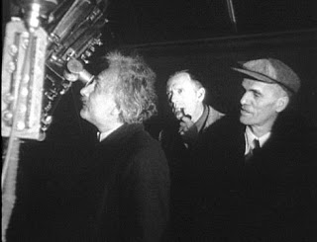
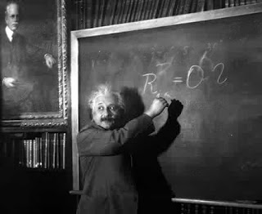
Einstein’s lost manuscript
An unpublished work
Written in early 1931
A ‘steady-state’ model of the universe
Expanding universe of constant density
Anticipates controversial theory (Hoyle)
Fatal flaw
Quickly abandoned
Embraced evolving models
Friedman-Einstein model (1931)
Einstein-de Sitter model (1932)
Einstein in California (1931)

Slide 3
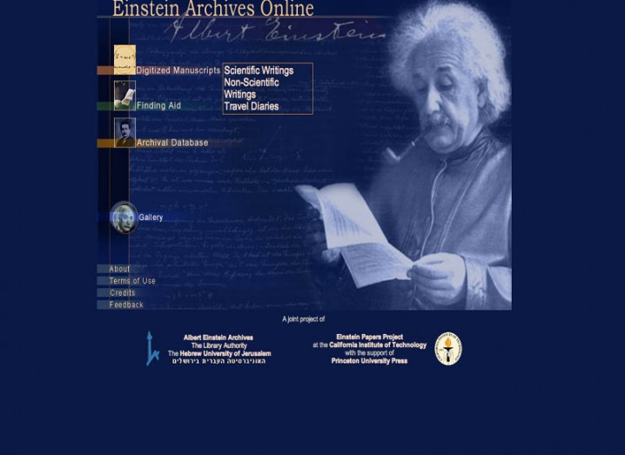
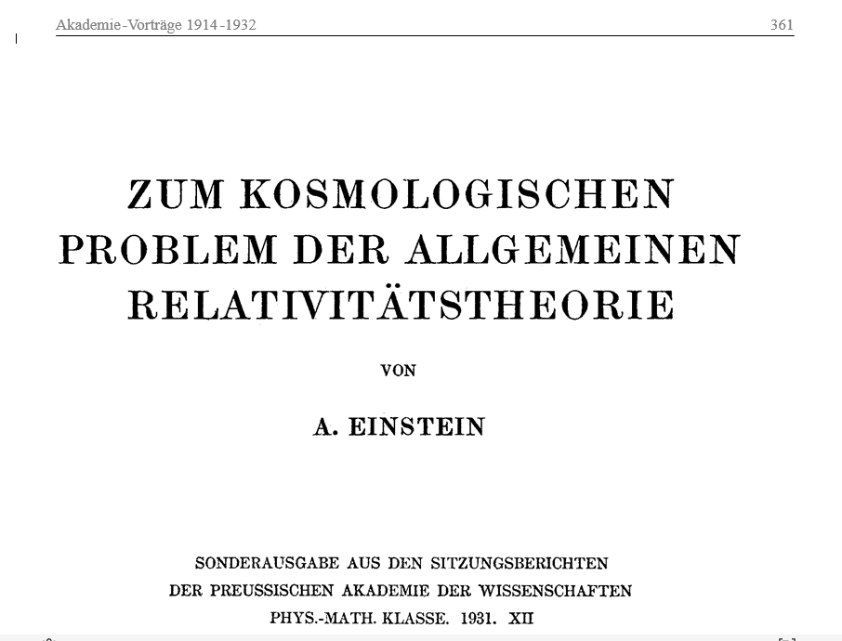
How was it found?
Albert Einstein Archive
Online archive of handwritten manuscripts
Manuscript misfiled
Misfiled as Einstein’s 1931 model of the cosmos
Hidden in plain sight
COR and BMC
Study and translation of Einstein’s 1931 model
Some anomalies in calculations
BMC: Work from original manuscript?
A lucky discovery!
Archive MS something quite different – ss model

Slide 4
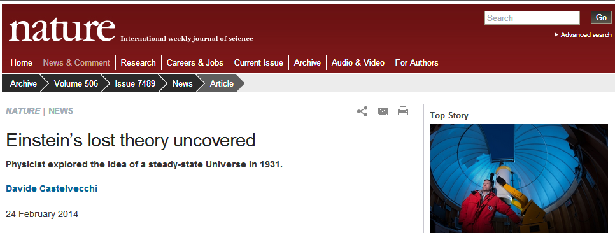
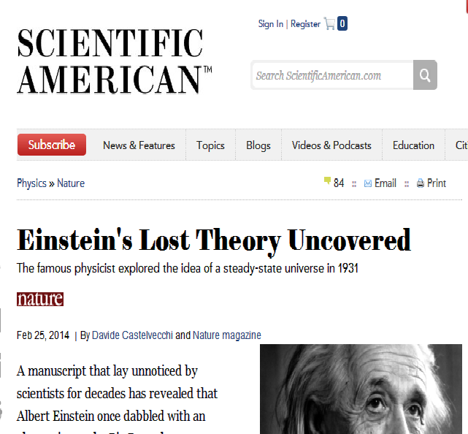
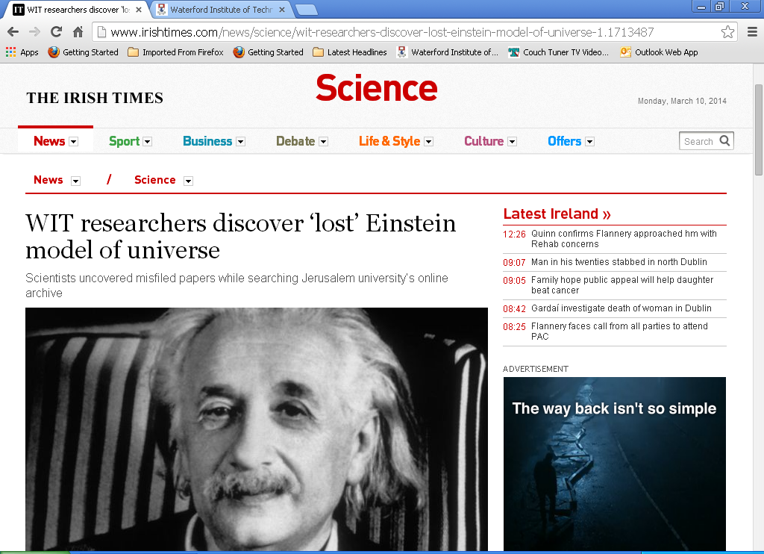
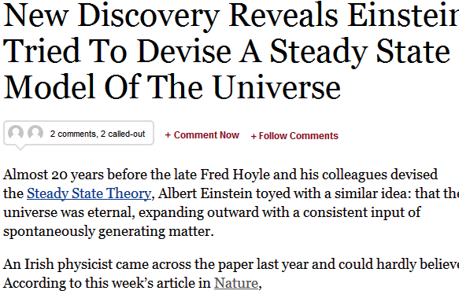
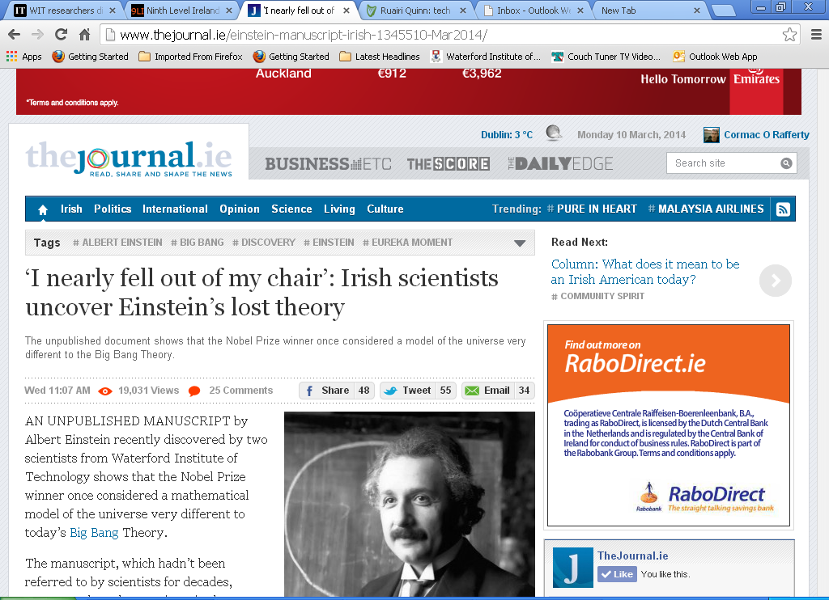

Slide 5


Scientific context
Hubble’s law (1929)
Linear relation between redshift and distance
Crisis for cosmology
What is causing the galaxies to move?
Expansion of space?
Predicted by general relativity
Friedman-Lemaitre models
Friedman’s expanding universe (1922)
Lemaitre’s expanding universe (1927)

Slide 6
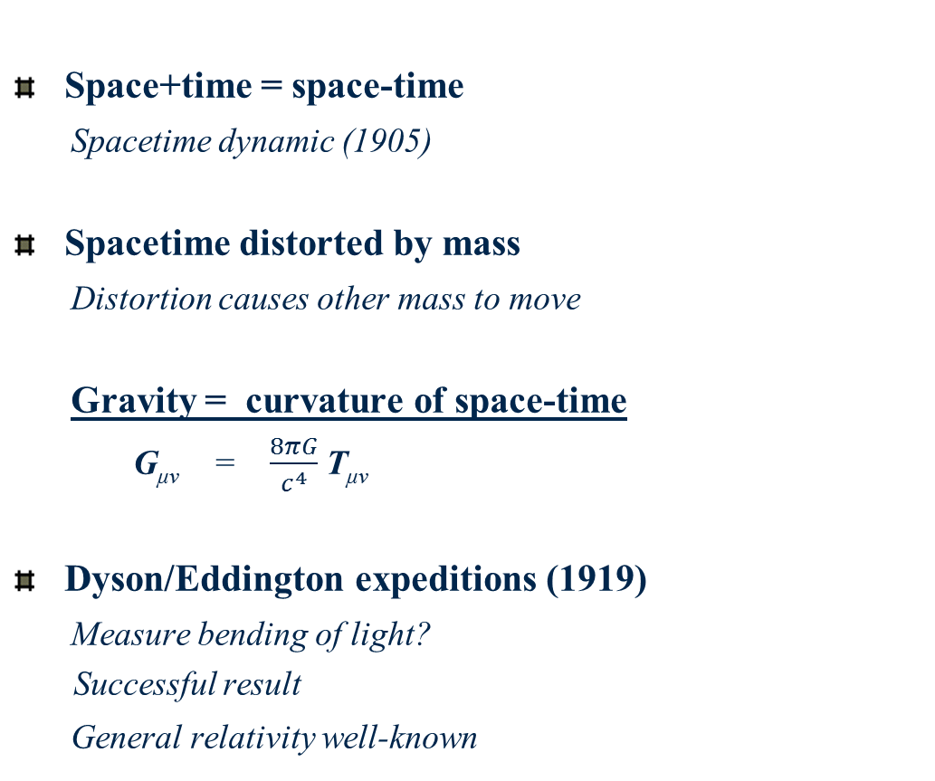

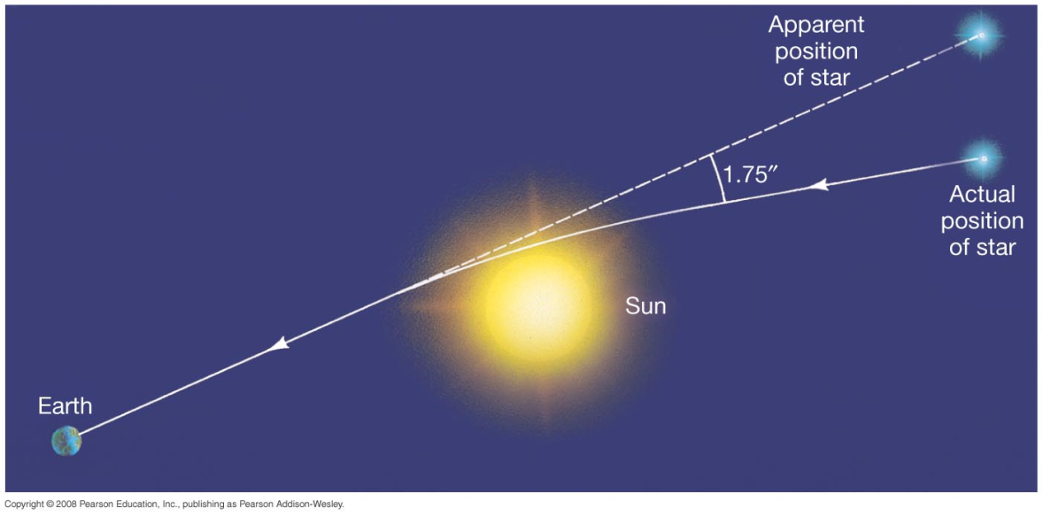
Introduction to general relativity
(1915)
Albert Einstein

Slide 7


Relativity and the universe
Einstein model (1917)
Assume static universe
Add cosmic constant term to give static solution
Closed curvature, finite radius
G_{μν} + λg_{μν} = T_{μν}
De Sitter (1917)
Empty universe
Apparently static (co-ordinate system)
Prediction of redshifts

Slide 8


Friedman models of the cosmos
Allow time-varying solutions to the field equations
Expanding, contracting universes
Geometry, evolution depends on matter content
Positive curvature (1922)
Hyperbolic curvature (1924)
Mathematical models (Zf. Ph.)
To be decided by astronomy
Ignored by community
Disliked by Einstein
Correction and retraction
Alexander Friedman 1888 -1925

Slide 9


Lemaître’s universe (1927)
Time-varying solutions to the field equations
Expanding universe?
Redshifts of galaxies = expansion of space?
Rate of expansion from mean distances and redshifts
H = 585 km/s/Mpc (1927)
Rejected by Einstein
“Votre physique est abominable”
Ditto for Friedman
No beginning: indefinite age
Starts from Einstein universe at t = - ∞
Fr Georges Lemaître

Slide 10
The paradigm shift
Hubble’s law (1929)
Linear relation between redshift and distance
RAS meeting (1930)
Einstein/de Sitter models don’t fit data
New model required
Hubble’s law = cosmic expansion?
If redshifts are velocities (Zwicky)
If effect is non-local
Letter from Lemaître
Recalls his 1927 model
Eddington, de Sitter impressed
Cosmic expansion?

Slide 11




The expanding, evolving universe (1930 -32)
Eddington (1930, 31)
On the instability of the Einstein universe
Expansion caused by condensation?
The Eddington-Lemaître model
de Sitter (1930, 31)
Further remarks on the expanding universe
Expanding universes of every flavour
Tolman (1930, 31)
On the behaviour of non-static models
Expansion caused by annihilation of matter ?
Einstein (1931, 32)
Friedman-Einstein model λ = 0, k = 1
Einstein-deSitter model λ = 0, k =0
Evolving models

Slide 12
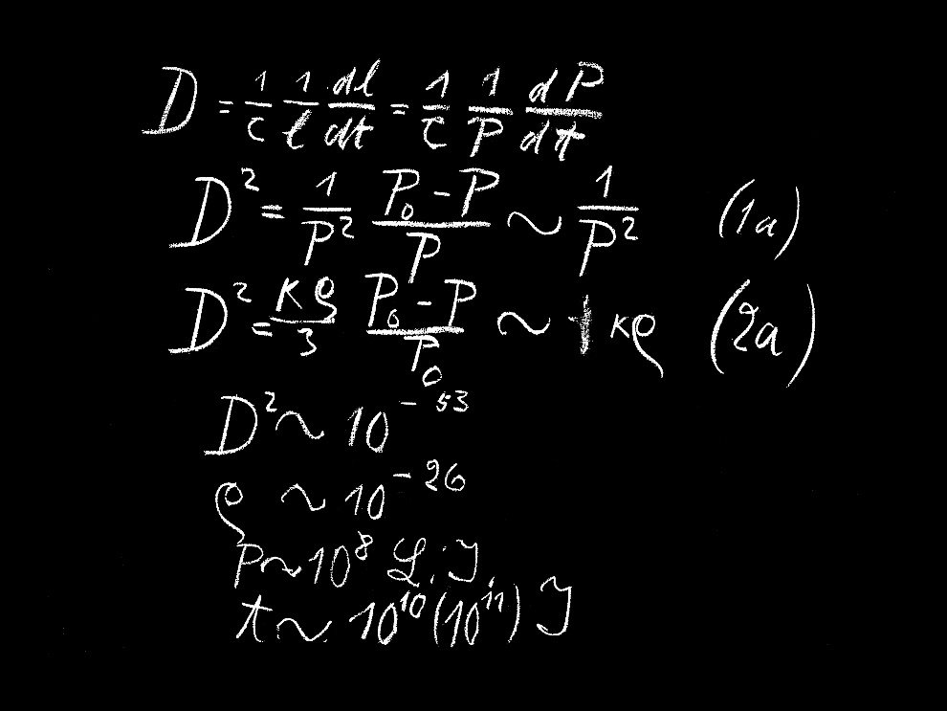
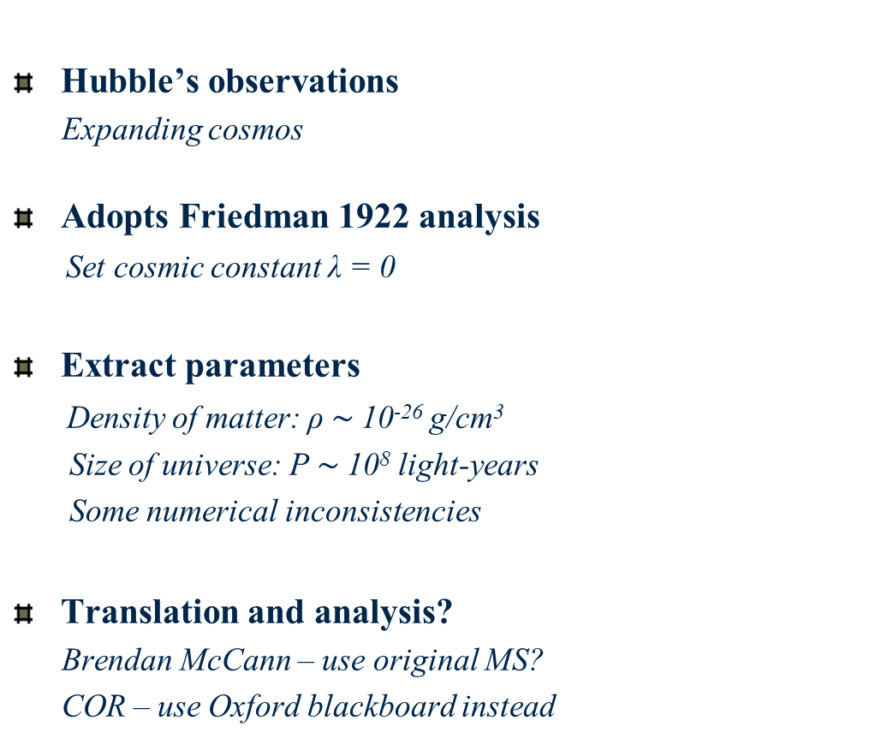
Einstein’s 1931 model (F-E)
Hubble’s observations
Expanding cosmos
Adopts Friedman 1922 analysis
Set cosmic constant λ = 0
Extract parameters
Density of matter: ρ $\sim$10⁻²⁶ g/cm³
Size of universe: P $\sim$10⁸ light-years
Some numerical inconsistencies
Translation and analysis?
Brendan McCann – use original MS?
COR – use Oxford blackboard instead
Friedman-Einstein universe

Slide 14
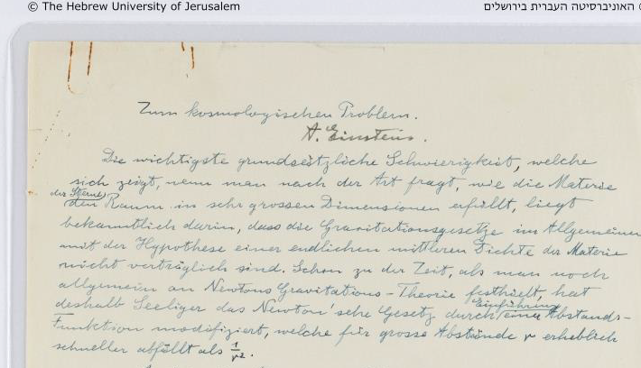

Surprise: Einstein’s steady-state model
Filed as draft of 1931 F-E model
Similar title, opening
Cites Hubble’s law
Cosmic expansion?
Cites evolving models (Tolman)
Discusses age problem
Proposes alternative solution
Constant density
Determines the expansion

Slide 15
Einstein’s steady-state model: key quotes
Transl. BMC
New solution
“In what follows, I wish to draw attention to a solution to equation (1) that can account for Hubbel’s facts, and in which the density is constant over time”
Matter creation
“If one considers a physically bounded volume, particles of matter will be
continually leaving it. For the density to remain constant, new particles of matter
must be continually formed within that volume from space “
Dark energy
“The conservation law is preserved in that, by setting the λ-term, space itself is not empty of energy; its validity is well known to be guaranteed by equations (1).”

Slide 16


Why was the model not published?
Model fails
De Sitter metric
No creation term in GFE
Null solution masked by error
Error in Christoffel coefficient
9/4 instead of -3/4
Einstein’s crossroads
Realised problem on revision
Declined to alter GFE
Switched to evolving models
Less contrived and set λ = 0
Werner Nahm
Simon Mitton

Slide 17

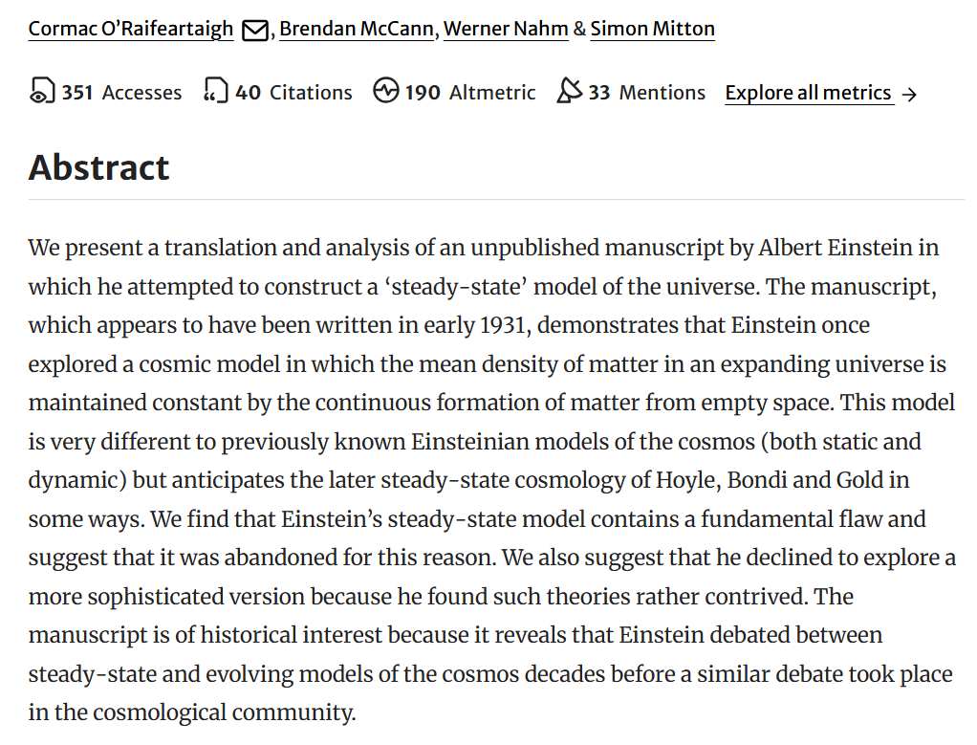

Slide 18

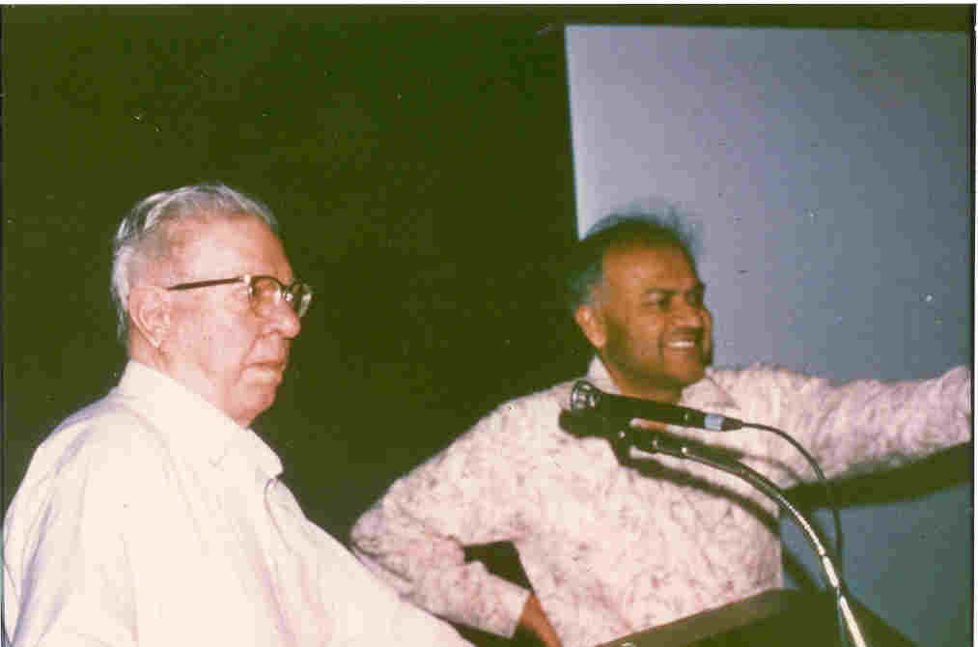
The steady-state universe (1948)
Expanding but unchanging universe
Hoyle, Bondi and Gold (1948)
No beginning, no age paradox
No assumptions about physics of early epochs
Continuous creation of matter
Very little matter required
Replace λ with creation term (Hoyle)
Conservation of energy violated
Improved version (1962)
Bondi, Gold and Hoyle
G_{μν} + C_{μν} = k T_{μν}
G_{μν} + λg_{μν} = k T (C_{μ}+ C_{ν)}
Hoyle and Narlikar (1962)

Slide 19


A bitter debate (1950-1965)
Steady-State or Big Bang universe?
Unchanging or evolving universe?
Study most distant galaxies
Compare with local galaxies
Galaxy distribution over time?
Radio-astronomy (Ryle)
Cambridge 3C Survey: evolving universe
Developments in optical astronomy
Timescale of expansion (Baade)

Slide 20


Cosmic microwave background (1965)
Radio receivers (AT&T)
Large, sensitive horn
Ubiquitous radio signal
From every direction
Low frequency (microwave)
Low temperature (3K)
Echo of big bang
Evidence of expansion
Penzias and Wilson
BB model goes mainstream

Slide 21
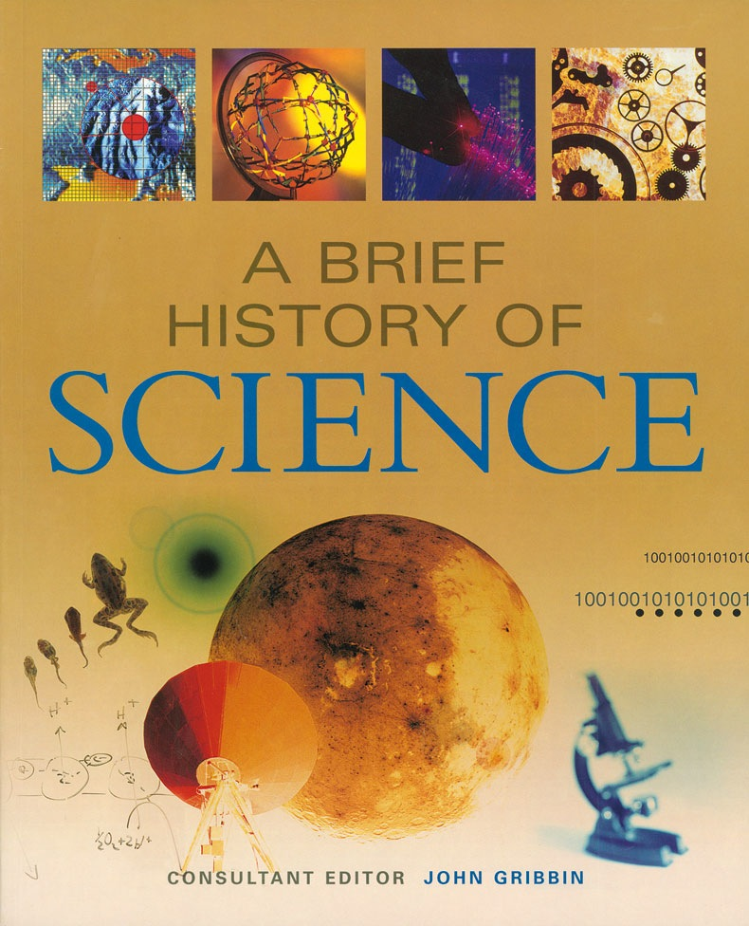
Why is Einstein’s steady-state model interesting?
Unsuccessful theories important
Understanding the development of successful theories
‘Whig’ histories avoided
A puzzle explained
Steady-state solutions not considered before 1948?
Obvious possibility
Insight into Einstein’s cosmology
Discards model rather than add new term to GFE
Occam’s razor approach
Some aspects of model still relevant
Dark energy, inflation

Slide 22

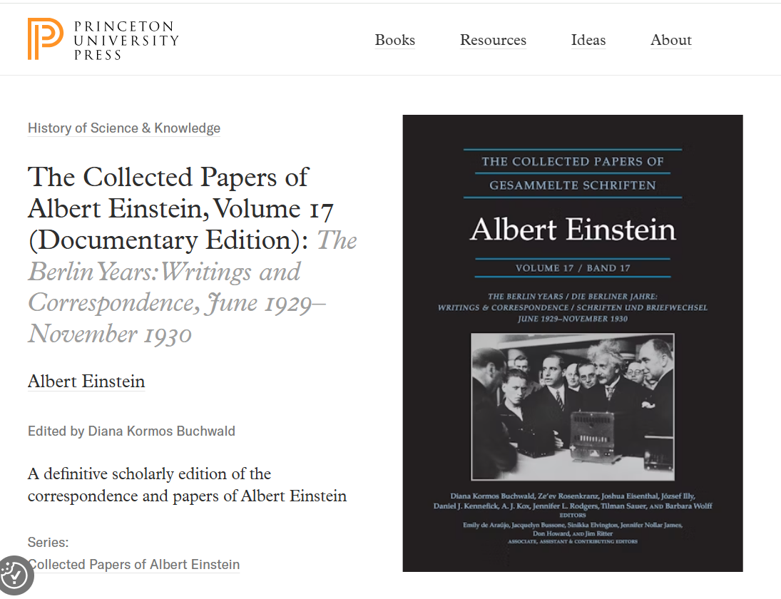
The best tribute: both translations to be used in CPAE (18)

Slide 24
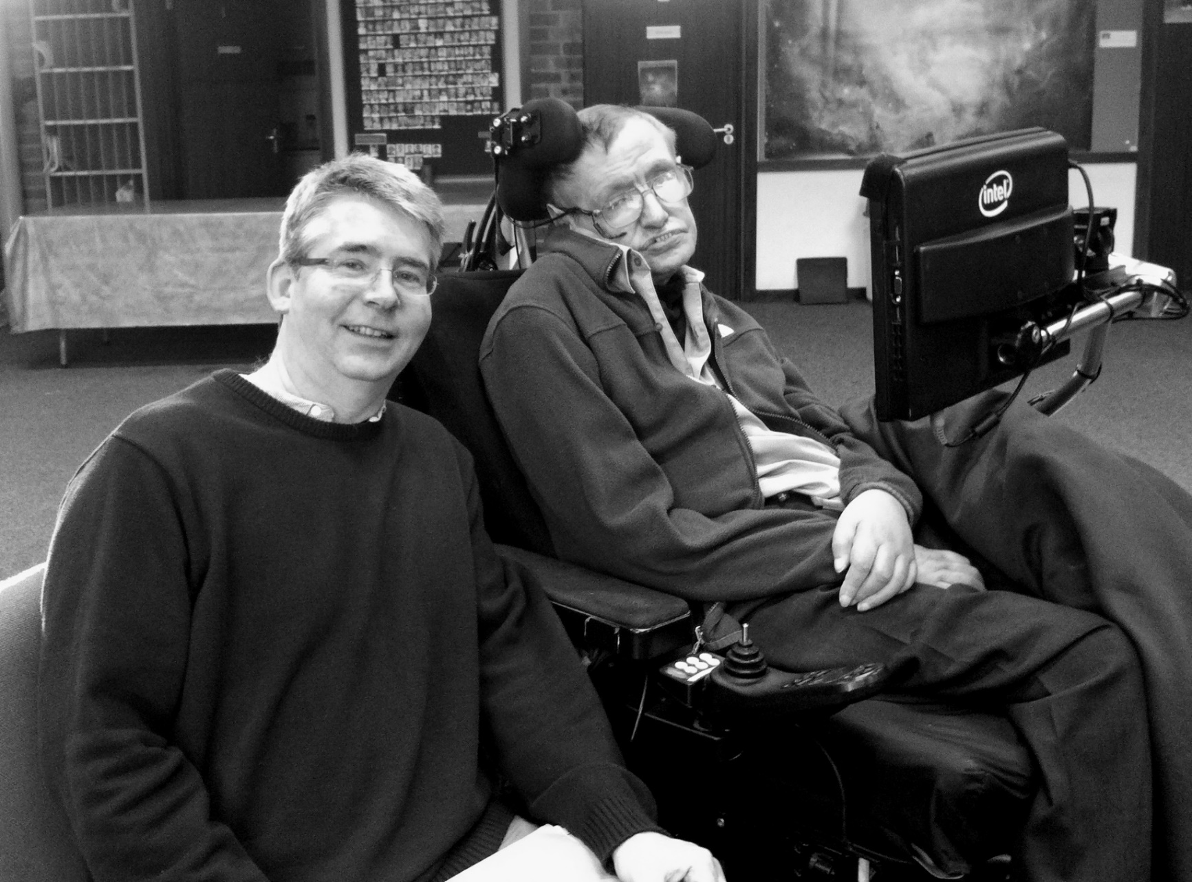
Worst moment
I knew…
your father

Slide 25
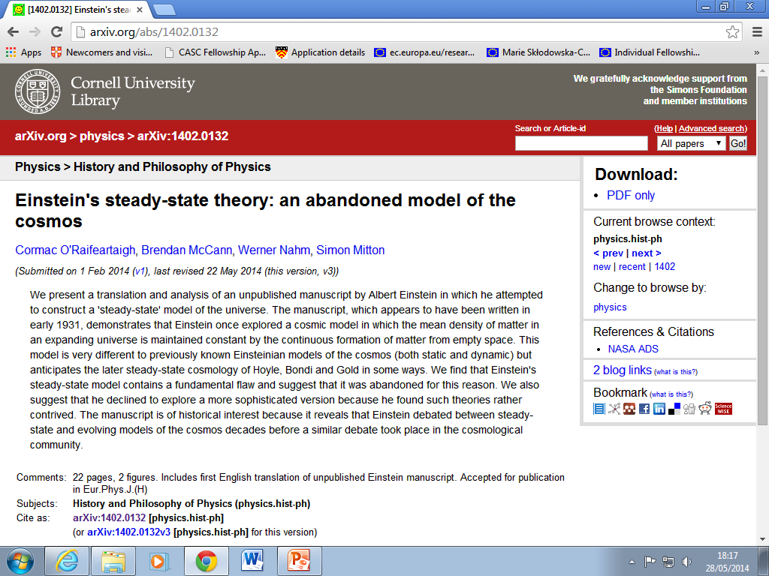

Slide 26

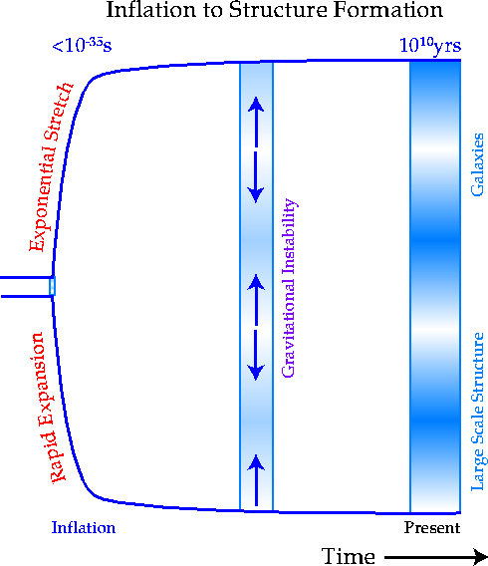
Einstein’s steady-state model and cosmology today
Dark energy (1998)
Accelerated expansion (observation)
Positive cosmological constant
Einstein’s dark energy
“The conservation law is preserved in that, by setting the λ-term, space itself is not empty of energy; its validity is well known to be guaranteed by equations (1).”
Cosmic inflation
Inflationary models use de Sitter metric
Used in all steady-state models
Flat curvature, constant rate of matter creation
Different time-frame!

Slide 27

Einstein-deSitter model (1932)
Remove curvature
Not known (Occam’s razor)
Adopt Friedmann analysis
Time-varying universe with λ = 0, k =0
Critical universe
Calculate critical density
10⁻²⁸ g/cm³ : agrees with astrophysics
Well-known model
Despite age problem

Slide 28
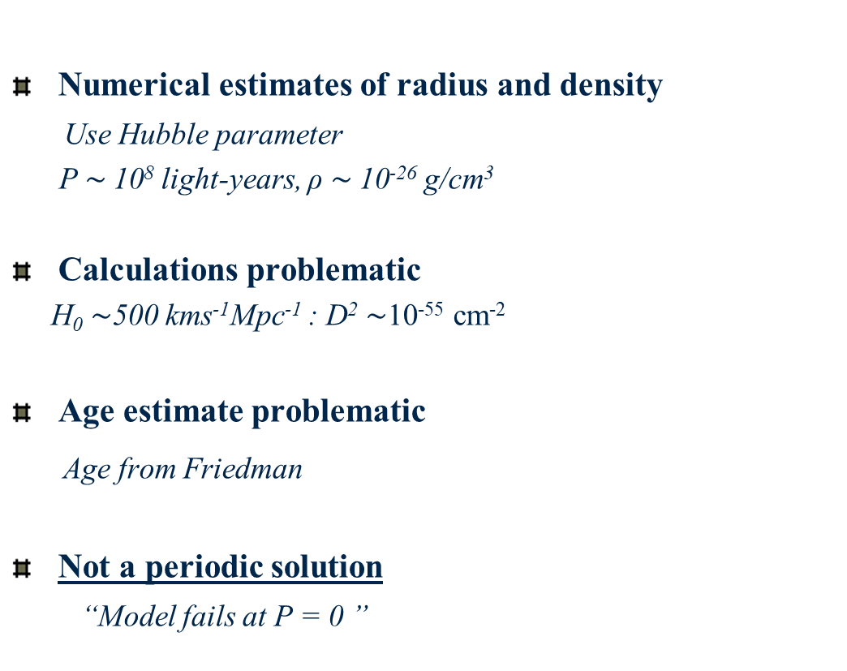
Einstein’s 1931 model (F-E)
Numerical estimates of radius and density
Use Hubble parameter
P $\sim$10⁸ light-years, ρ $\sim$10⁻²⁶ g/cm³
Calculations problematic
H₀ $\sim$500 kms⁻¹Mpc⁻¹ : D² $\sim$10⁻⁵⁵ cm⁻²
Age estimate problematic
Age from Friedman
Not a periodic solution
“Model fails at P = 0 ”
Oxford lecture (May 1931)

