Slide 1

The Big Bang: Fact or Fiction?
100 years of Lemaître’s cosmology
Cormac O’Raifeartaigh FRAS
5th International Conference on the Hitory of Physics Coimbra, May 2025

Slide 2
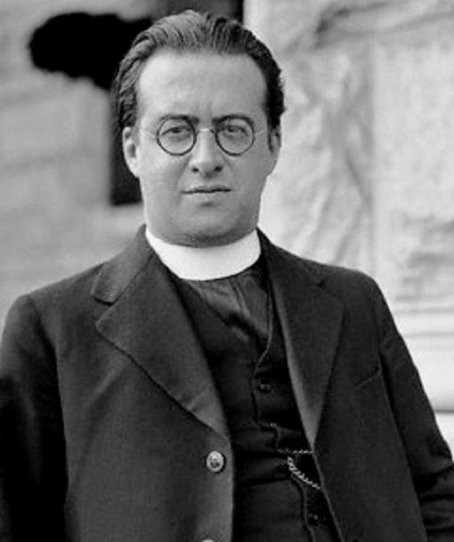
Three major contributions
The primeval atom (1931)
Early version of big bang model
The expanding universe (1927)
Showed GR predicted a cosmos of expanding radius
Note on de Sitter’s universe (1925)
Resolved a famous debate
Georges Lemaître
1894-1966
Later two works better-known but built on the first

Slide 3

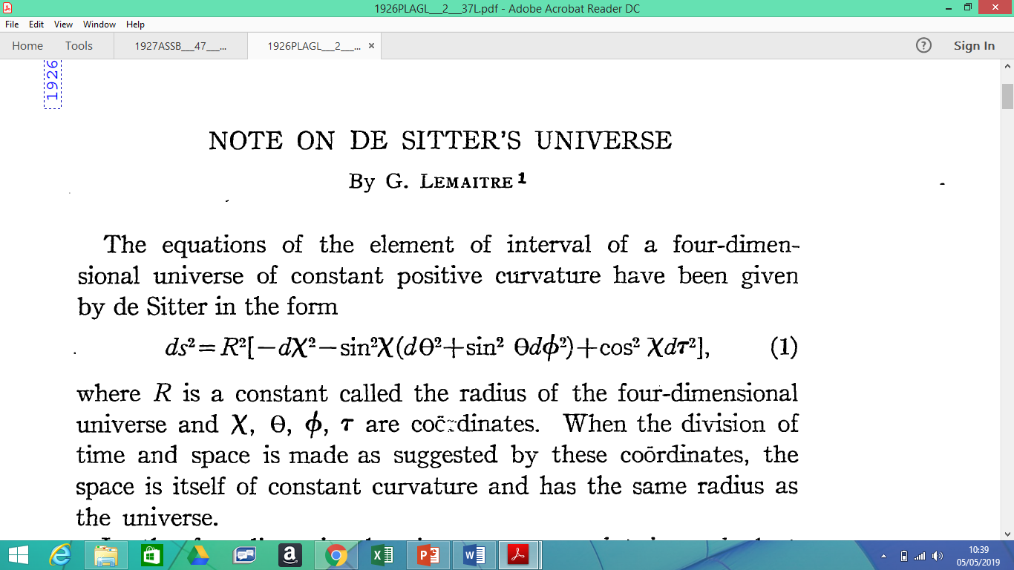
Biographical context
Early career
Engineering → physics (1918)
Talent in general relativity
RA at Cambridge (1923)
Astronomy and cosmology (Eddington)
RA at Cambridge MA (1924-5)
Astronomy at Harvard Observatory (Shapley)
PhD (GR) at MIT (Heymans)
1894-1966
Early-career researcher of the front rank

Slide 4
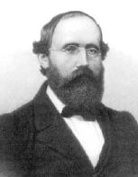

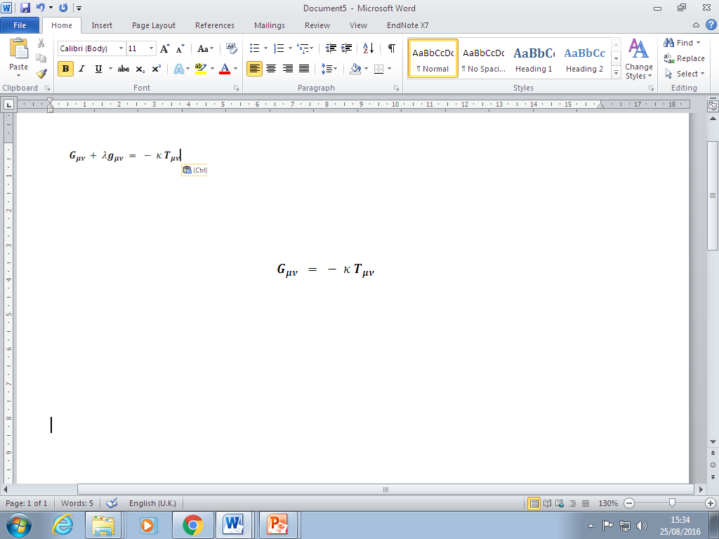


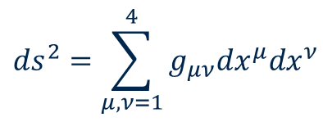
Scientific context:
The general theory of relativity (1915)
The geometry of space-time is determined by
the density and flow of mass-energy
$${ds}^{2}=\sum_{μ,ν=1}^{4}{g_{μν}{dx}^{μ}{dx}^{ν}}$$
Gravity = curvature of space-time

Slide 5

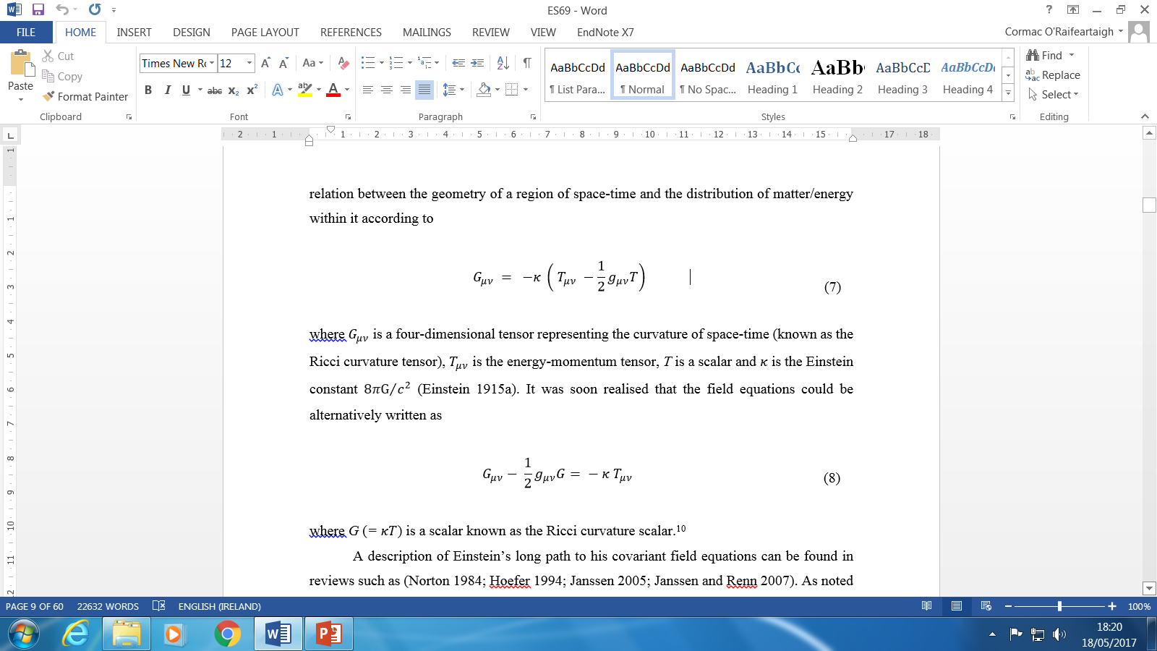
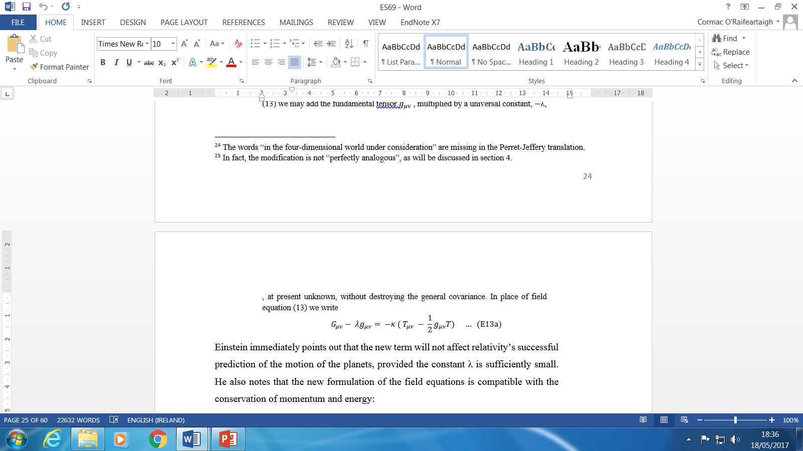
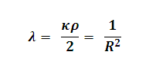
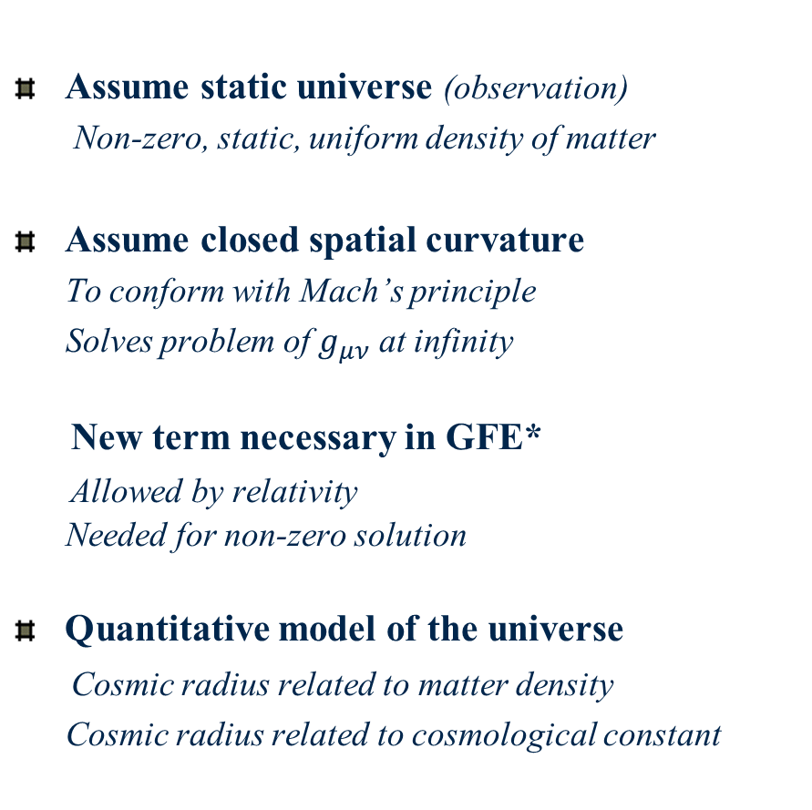
Applying GR to the cosmos :
The Einstein World (1917)
Assume static universe (observation)
Non-zero, static, uniform density of matter
Assume closed spatial curvature
To conform with Mach’s principle
Solves problem of $g_{μν}$ at infinity
New term necessary in GFE*
Allowed by relativity
Needed for non-zero solution
Quantitative model of the universe
Cosmic radius related to matter density
Cosmic radius related to cosmological constant

Slide 6

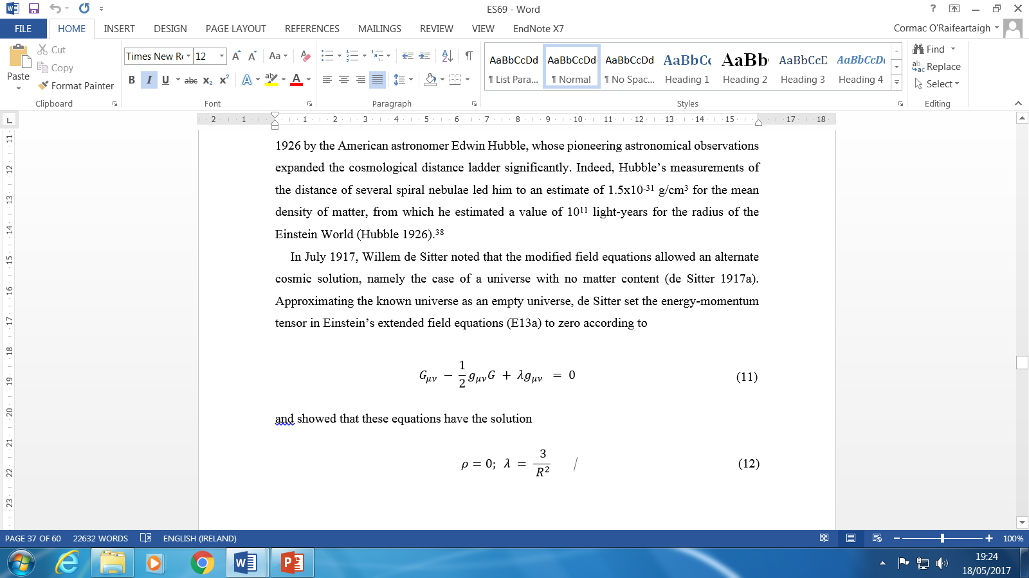

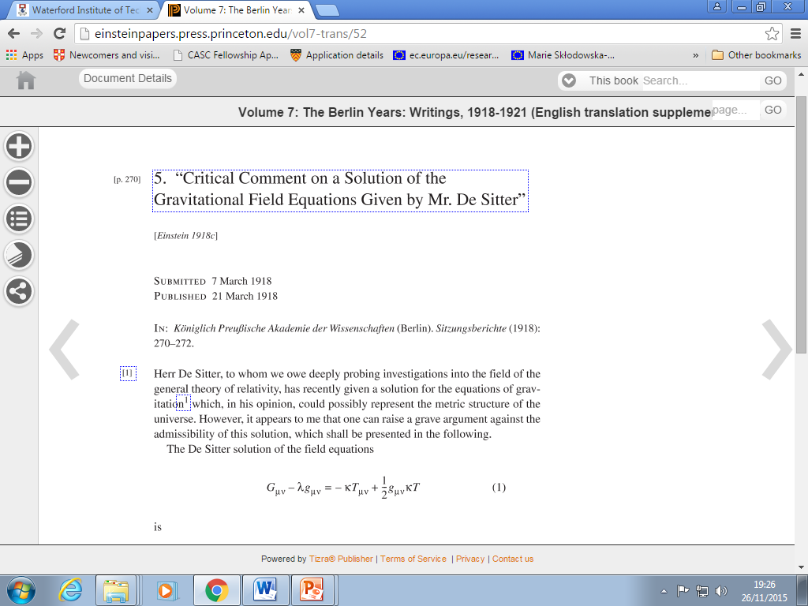
The de Sitter universe
Alternate cosmic solution
A universe empty of matter (1917)
Curvature of spacetime determined by cosmic constant
Einstein’s reaction
Unrealistic; conflict with Mach’s principle
Mathematically unsound? Singularity?
The Einstein-deSitter-Weyl-Klein debate
Static or non-static - a matter of co-ordinates?
Interest from astronomers
Prediction of redshifts
Willem de Sitter

Slide 7
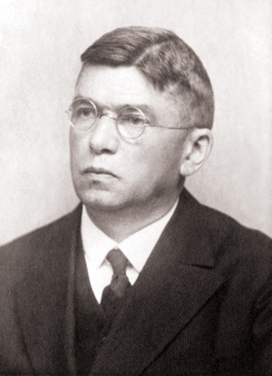
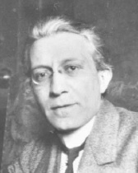
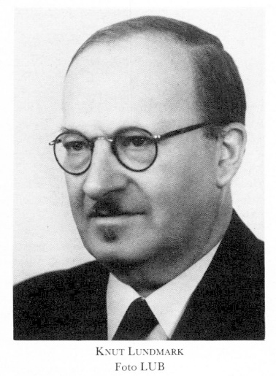
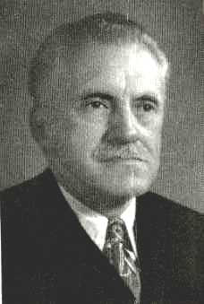
De Sitter effect and astronomy
Karl Wirtz (1922,24)
Redshifts of nebulae increasing with distance?
Dispersal effect? v = 2200 – 1200 log (Dm)
Ludwik Silberstein (1924)
Relation between redshifts, distance, curvature
Δλ/λ = +/- r/R (global clusters)
Knut Lundmark (1924,25)
Velocity against distance; clusters, nebulae
Gustav Strömberg (1925)
Vel/dist relation for globular clusters, nebulae?

Slide 8
Lemaître’s breakthrough (1925)
de Sitter line element has a spatial centre
Rewrite de Sitter line element as
Homogeneous in space
Starts from time t = 0
R increasing over time
No spatial curvature
Georges Lemaître
De Sitter solution is an expanding universe
Chimes with astronomical measurements

Slide 9

Lemaître’s universe (1927)
New solution: between Einstein and de Sitter models
Matter-filled U of increasing radius
Redshifts of galaxies = spatial expansion?
Rate of expansion from ave. distance and redshift
H = 585 km/s/Mpc
Rejected by Einstein
An idea whose time had not yet come

Slide 10


The paradigm shift: Hubble’s law
RAS meeting (January 1930)
Einstein, de Sitter models cannot account for Hubble’s law
Should alternative cosmologies be considered?
Reaction from Georges Lemaître
Letter to Eddington
Reminder of Lemaître (1927)
Accepted by Eddington
Lemaître paper shared and cited
Republished in English in MNRAS (1931)

Slide 11
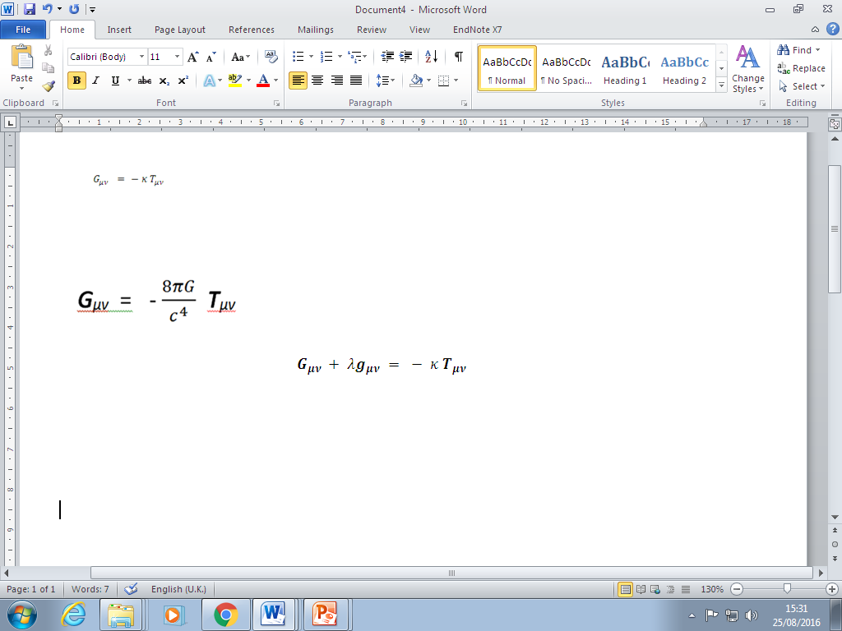
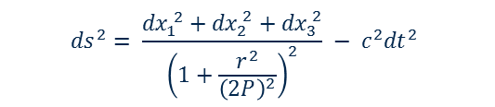
The Einstein World
Assume stasis
No evidence to the contrary
Einstein’s model of the Static Universe
Assume closed spatial curvature
To conform with Mach’s principle
Banish the boundaries!
The price
New term needed in field equations
The cosmological constant *
Quantitative model of the universe
Radius related to matter density
Radius related to cosmic constant
$${ds}^{2}= \frac{{dx}_{1}^{ 2}+{dx}_{2}^{ 2}+{dx}_{3}^{ 2}}{{\left(1+\frac{r^{2}}{{\left(2P\right)}^{2}}\right)}^{2}} − c^{2}{dt}^{2}$$

Slide 12
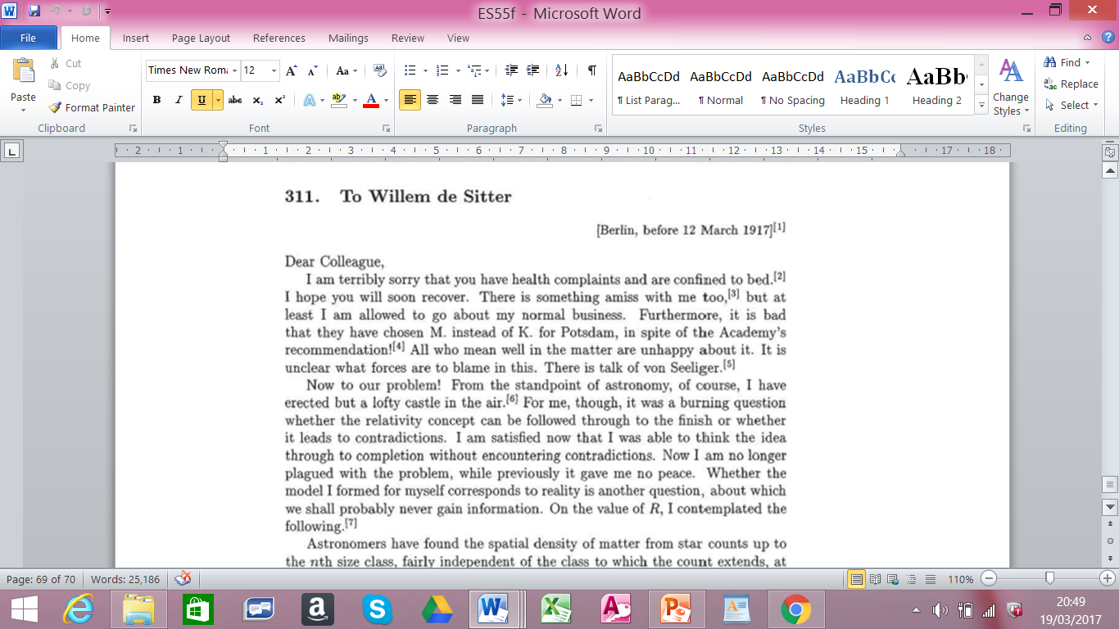
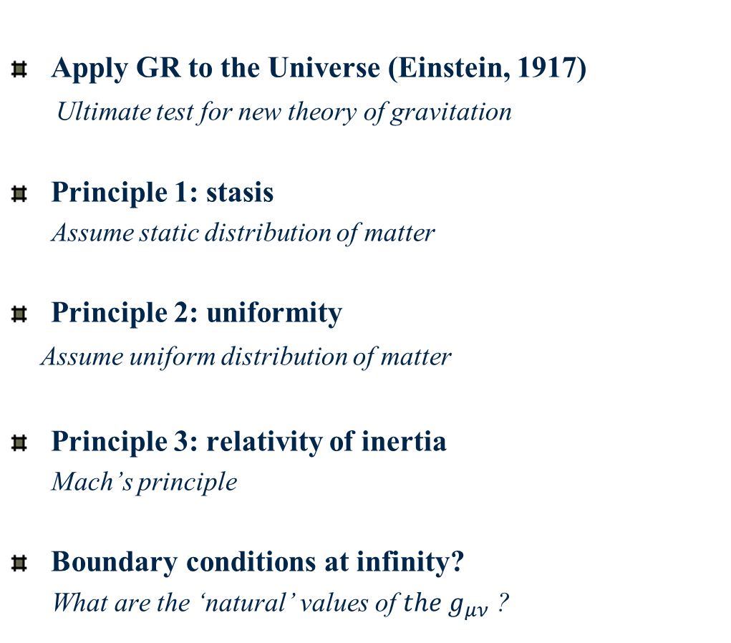
Applying GR to the universe
Apply GR to the Universe (Einstein, 1917)
Ultimate test for new theory of gravitation
Principle 1: stasis
Assume static distribution of matter
Principle 2: uniformity
Assume uniform distribution of matter
Principle 3: relativity of inertia
Mach’s principle
Boundary conditions at infinity?
What are the ‘natural’ values of ${the g}_{μν}$ ?

Slide 13
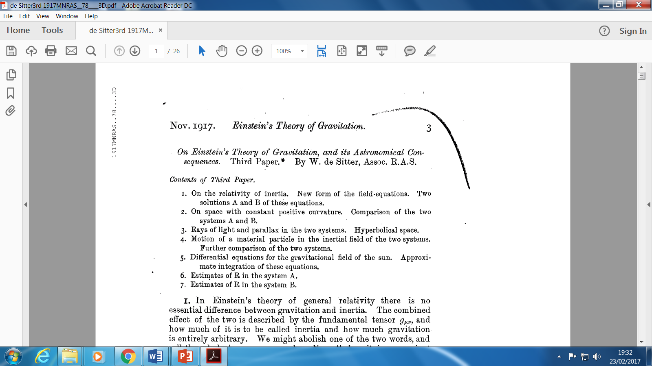


The de Sitter universe (1917)
Alternative cosmic solution for the GFE
A universe empty of matter (1917)
Closed curvature of space-time
Solution B
Solution enabled by cosmic constant
Curvature of space determined by cosmic constant
Einstein’s reaction
Unrealistic
Conflict with Mach’s principle
Interest from astronomers
Light from star would be redshifted
Chimed with astronomical measurements
$$G_{μν} − λg_{μν} = 0$$
$$ρ=0: λ = \frac{ 3}{ R^{2}}$$

Slide 14


The Einstein-de Sitter debate
de Sitter solution disliked by Einstein
Conflict with Mach’s principle
Problems with singularities? (1918)
Never accepted as realistic model
Lack of singularity conceded
Considered unrealistic
Not static?
The de Sitter confusion
Static or non-static - a matter of co-ordinates?
Weyl, Lanczos, Klein, Lemaître
$$ρ=0: λ = \frac{ 3}{ R^{2}}$$
Redshift prediction – astronomical interest

Slide 15

Scientific context (1917-30)
The general theory of relativity
A new theory of gravitation (Einstein 1915)
The Einstein World (1917)
Static, matter-filled universe
Closed spatial curvature
The de Sitter model (1917)
‘Static', empty universe
Closed spacetime curvature
Prediction of redshifts: connection with astronomy?
A cosmic debate
Einstein, de Sitter, Weyl, Klein, Lanczos

Slide 16
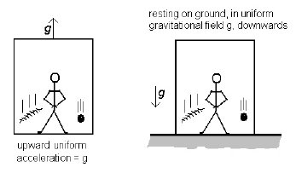
Scientific context:
The general theory of relativity (1915)
Extending the special theory (1907-)
Relativity and accelerated motion?
Relativity and gravity?
The principle of equivalence
Equivalence of gravity and acceleration
Consequence of Galileo’s principle
The principle of Mach
Inertia defined by matter
A long road (1907-1915)
Space-time defined by matter
Gravity = curvature of space-time

