Slide 1


The Big Bang: Fact or Fiction?
Renaming Hubble’s Law
Fair tribute or revisionist history?
Cormac O’Raifeartaigh FRAS
South East Technological University (Waterford)

Slide 2
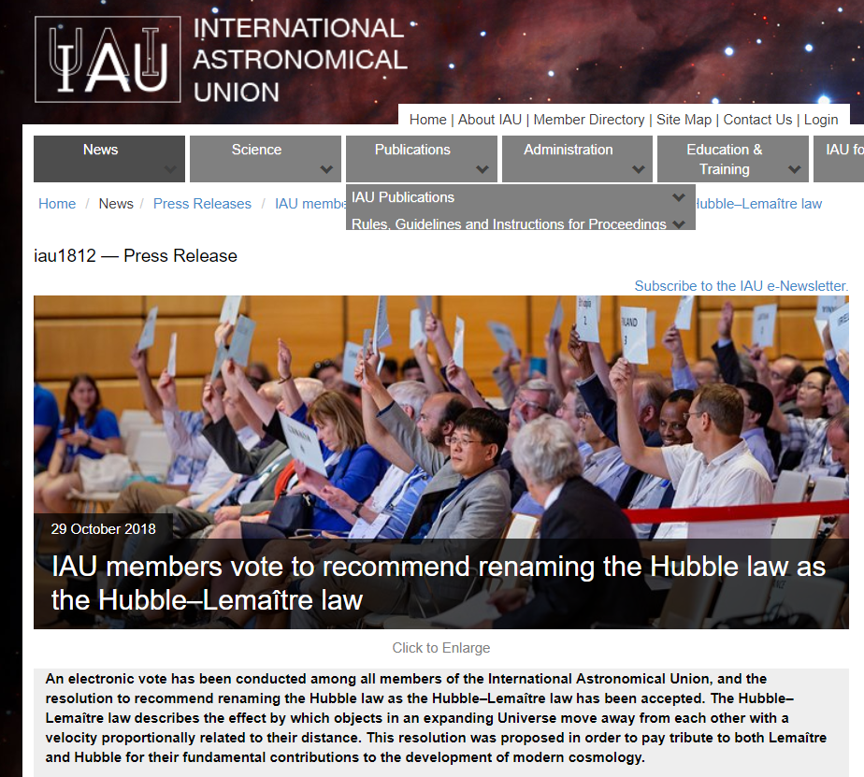

Slide 3


The rationale for renaming Hubble’s law
Rationale?
To right a wrong!
‘Hubble law’: ‘Hubble expansion: ‘Hubble flow’
Attributes too much to Hubble

Slide 4
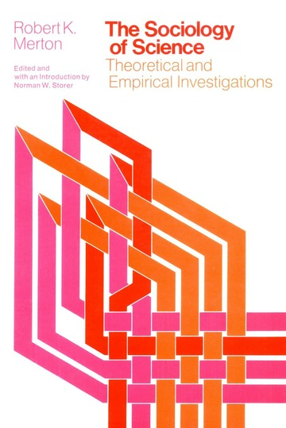
Just One Problem
Questionable history of science
Hubble’s law understood as an empirical relation for observables
Empirical laws common in science
Questionable physics
Confuses an approximate relation for astronomical objects with
an exact law of cosmic expansion predicted by theory
Don’t lose sight of physics in HoP!
Don’t conflate astronomy with cosmology
Conclusion
Hubble’s law should be Hubble’s law
Example: brings clarity to contemporary puzzle

Slide 5

Hubble’s Law: a brief history
A redshift/distance relation for the nebulae
Motivation: establishing galactic distances
Combined 24 nebular distances with redshifts
Distances using Cepheids and involved stars
Redshifts from Slipher: not acknowledged
‘Approx linear relation’
Cross = mean value for another 22 nebulae
Furthest data point not shown
An empirical relation
Nothing to do with cosmic expansion
Hubble graph (1929)

Slide 6

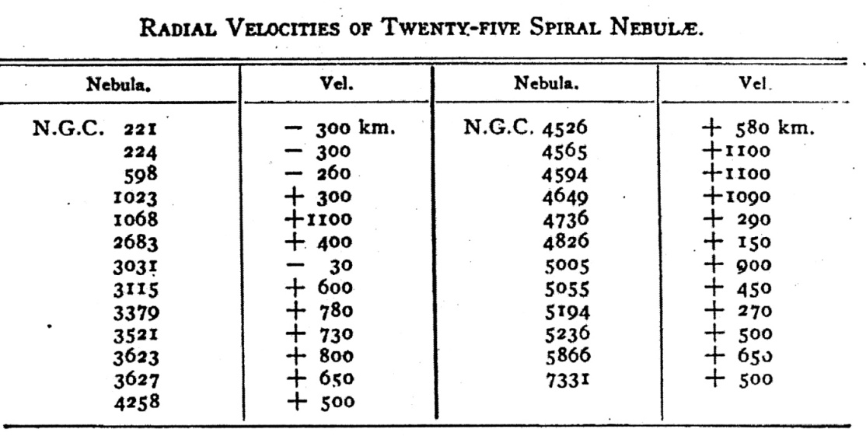
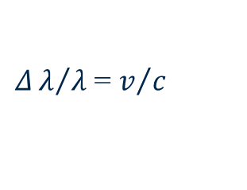
The redshifts of the nebulae
Spectrum of light from spiral nebulae (1909-)
Good results with fast camera lens
Many nebulae red-shifted (1912-1917)
Doppler effect
Largest redshifts for faintest nebulae
Relation between redshift and distance?
Distinct galaxies?
Not gravitationally bound by MW?
VM Slipher
$Δλ/λ$ = $v/c$
Well-known puzzle (Edd 1923)

Slide 7

The distances of the nebulae (1925)
Hooker telescope (Mt Wilson, 1917)
Edwin Hubble (1921): ambitious astronomer
Resolved Cepheid stars in nebulae (1925)
Distance using Leavitt’s period-luminosity relation
Spirals beyond Milky Way!
Verdict soon accepted
Nebulae = distinct galaxies
What do nebular redshifts represent?
Edwin Hubble (1889-1953)

Slide 8
Hubble’s law and a paradigm shift
RAS meeting (1930)
Eddington, de Sitter
If redshifts are velocities and effect is non-local
Explanation required
Not compatible with Newtonian gravity
Compatible with general relativity?
Attention to relativistic models of U
Universe of expanding radius over time
Proposed by Friedmann (1922) and Lemaître (1927)
An expansion of space?
Hubble graph (1929)

Slide 9


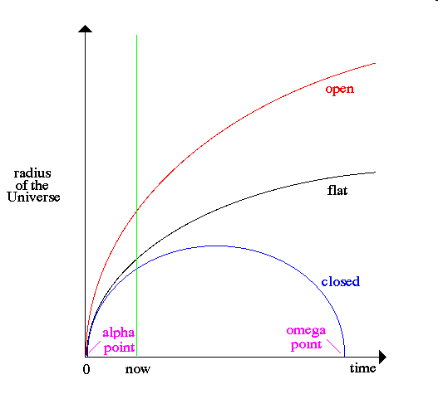
Friedman’s cosmology
Alexander Friedman (1922)
Time-varying solutions for the cosmos from GR
Expanding or contracting universe
Evolving universe
Time-varying density of matter
Positive or negative spatial curvature
Einstein’s reaction
Declared solution mathematically invalid (1922)
Retracted one year later (1923)
Considered solution unrealistic
Alexander Friedman
(1888 -1925)
“To this a physical reality can hardly be ascribed”

Slide 10

Lemaître’s cosmology
Georges Lemaître (1927)
Allow time-varying solutions from GR
Inspired by astronomical observation
Redshifts of the nebulae (Slipher)
Preliminary distances of the nebulae (Hubble 1925-26)
Derives linear relation from theory
Extracts expansion parameter from data
Mean velocity/mean distance
Einstein’s reaction
Expanding models ‘abominable’
Georges Lemaître
(1894-1966)

Slide 11
On the naming of phenomena
Who discovered the expanding universe?
Alexander Friedman
First non-static cosmologies
Georges Lemaître
Non-static cosmologies and the galaxies
VM Slipher
The redshifts of the nebulae
Edwin Hubble
The distances of the nebulae
A linear relation between distances and redshifts
Answer: all of them!

Slide 12
On the naming of Hubble’s law
Note: Hubble’s law ≠ cosmic expansion
An empirical law
Observed relation between redshift/distance of the nebulae
Similar to Ohm’s law, Boyle’s law, Charles’ law
Not interpreted by Hubble as cosmic expansion
Others also hesitant
Interpreted by some as manifestation of spatial expansion
Manifestation ≠ phenomenon itself
Exact law of cosmic expansion from theory

Slide 13
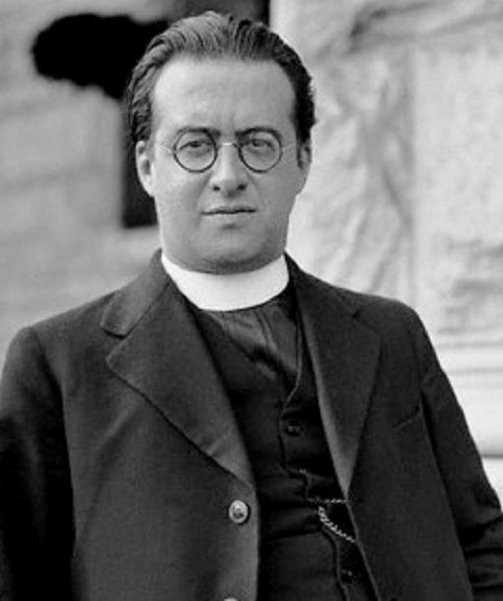
Supporting evidence
“Naturellement, avant la decouverte et l’etude des amas de nebuleuses, il ne pouvait être question d’établir la loi de Hubble”
“Naturally, before the discovery and study of the clusters of nebulae, there could be no question of establishing Hubble’s law”
Lemaȋtre (1950)

Slide 14
Hubble (1953)
“I propose to discuss the law of red-shifts—the correlation between distances of nebulae and displacements in their spectra. It is one of the two known characteristics of the sample of the universe that can be explored and it seems to concern the behaviour of the universe as a whole. For this reason it is important that the law be formulated as an empirical relation between observed data out to the limits of the greatest telescope. Then, as precision increases, the array of possible interpretations permitted by uncertainties in the observations will be correspondingly reduced. “

Slide 15
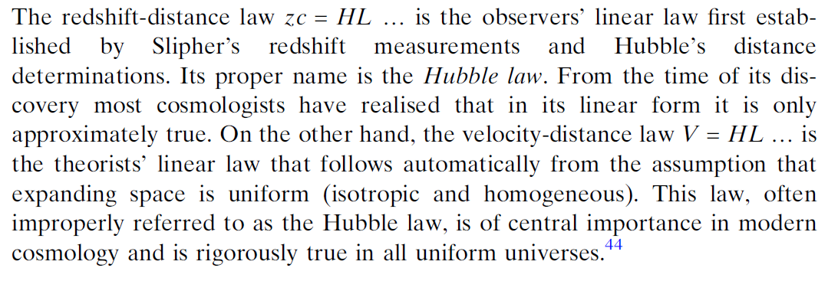
Supporting evidence
Edward R. Harrison Cosmology (CUP 1981)

Slide 16
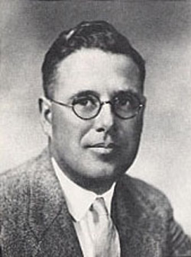
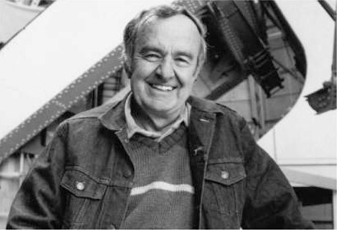
When did Hubble’s observations become Hubble’s law ?
Papers of the 1930s
Milne (1933); Walker (1933)
Papers of the 1940s
Cited as Hubble’s law by astronomers (Mt. Wilson)
‘Hubble’s law of the redshifts’ (Einstein)
Books/papers of the 1950s, 60s
The Creation of the Universe (Gamow, 1952)
The Unity of the Universe (Sciama, 1959)
The Expansion of the Universe (Couderc, 1952)
1970s
Hubble expansion; Hubble flow

Slide 17
Conclusions
Hubble’s law ≠ a law of cosmic expansion
Empirical relation between redshift/distance of the nebulae
Manifestation of cosmic expansion
Like the cosmic microwave background
Renaming Hubble’s law misrepresents history
Revisionist history
Renaming Hubble’s law misrepresents physics
Conflates Doppler shift with cosmological redshift
Conflates astronomy and cosmology
Two wrongs don’t make a right!

Slide 18
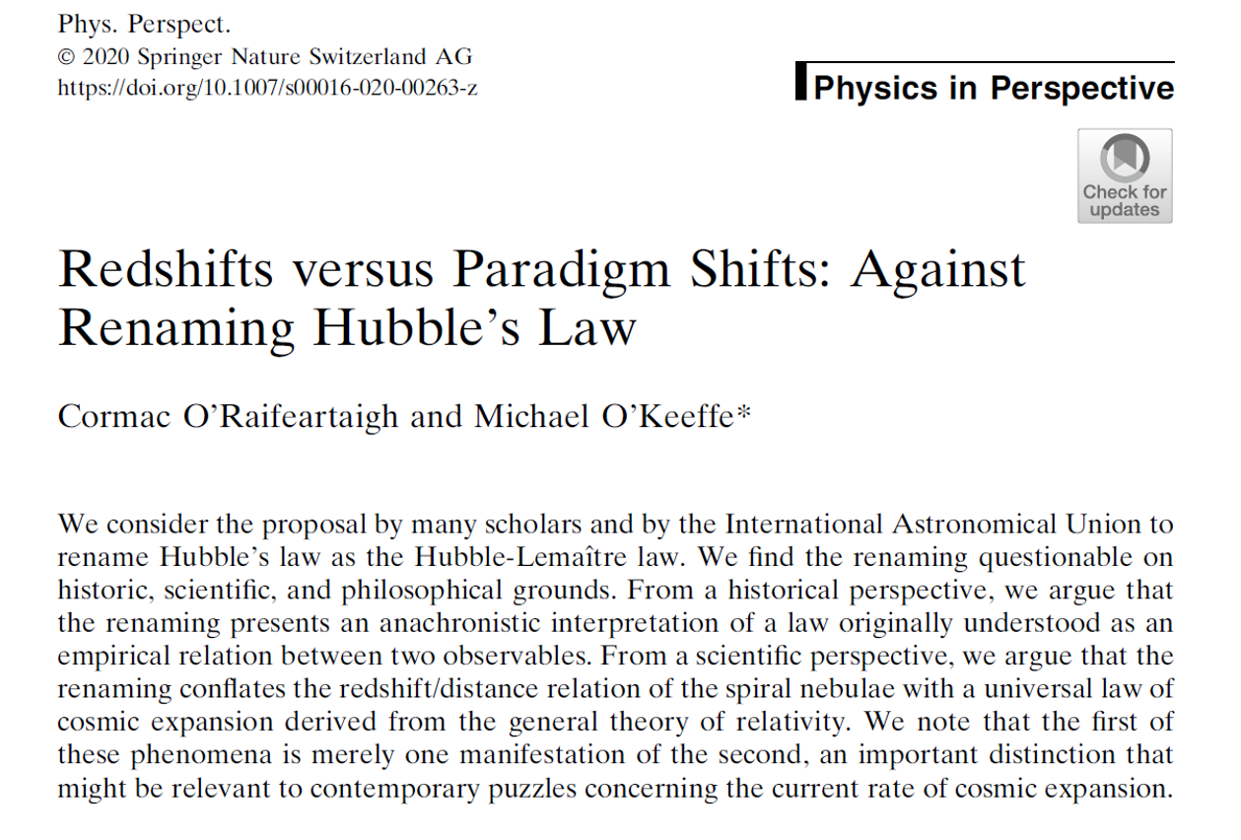

Slide 19
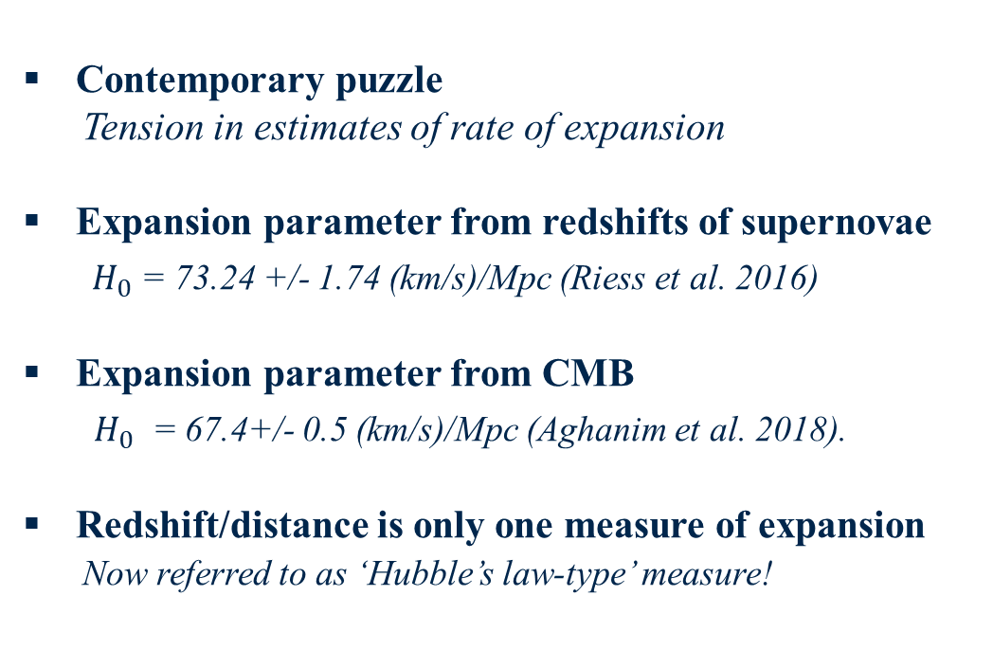
Coda: the importance of clarity
Contemporary puzzle
Tension in estimates of rate of expansion
Expansion parameter from redshifts of supernovae
$H_{0}$ = 73.24 +/- 1.74 (km/s)/Mpc (Riess et al. 2016)
Expansion parameter from CMB
$H_{0}$ = 67.4+/- 0.5 (km/s)/Mpc (Aghanim et al. 2018).
Redshift/distance is only one measure of expansion
Now referred to as ‘Hubble’s law-type’ measure!
Problem with Ʌ-CDM model of the cosmos?

Slide 20

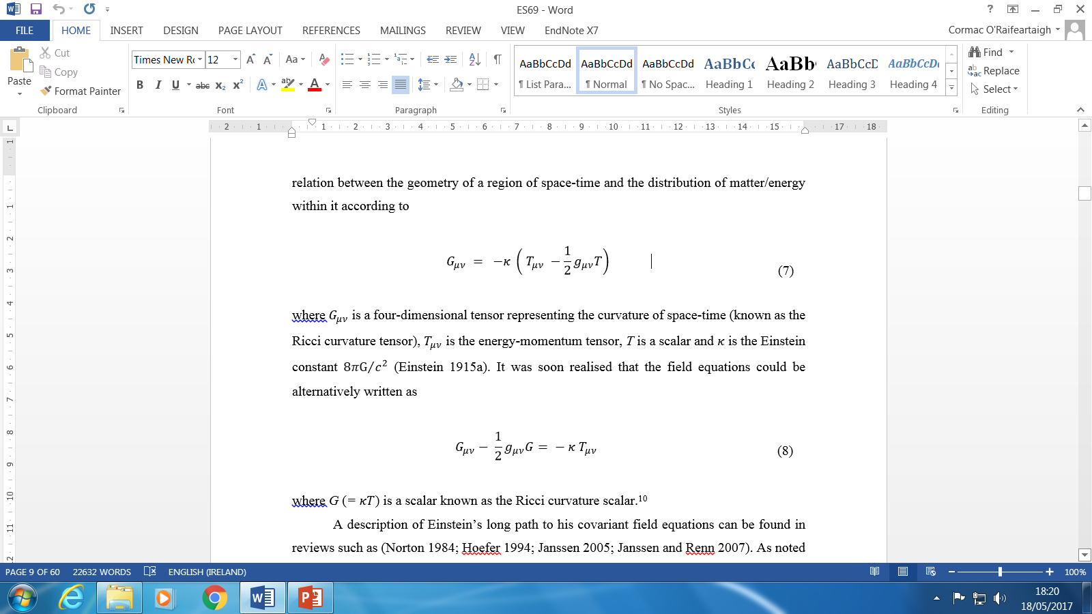

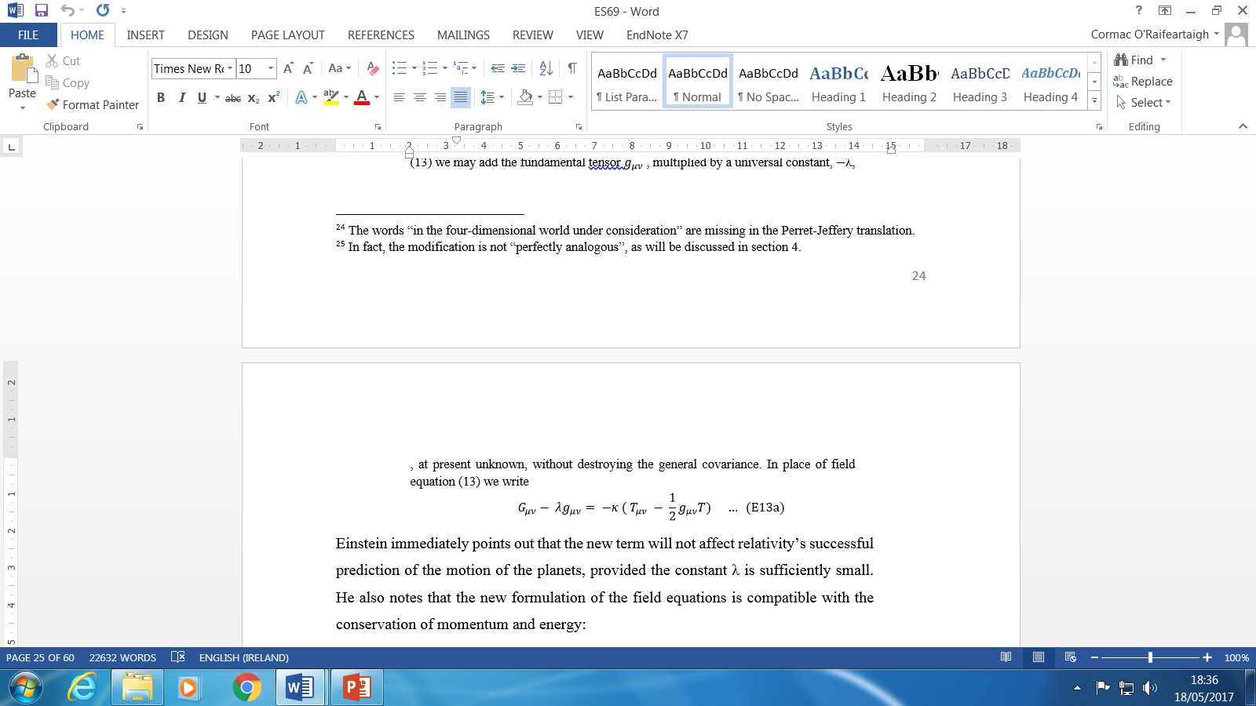
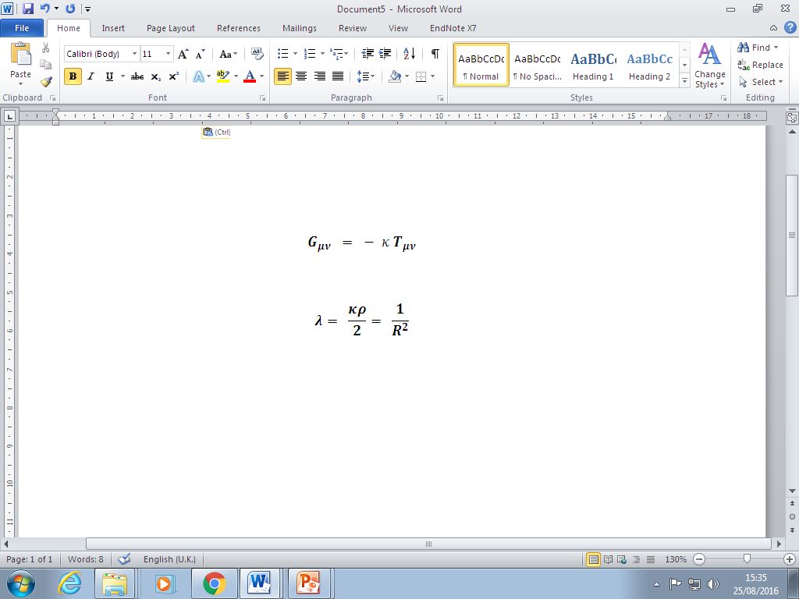

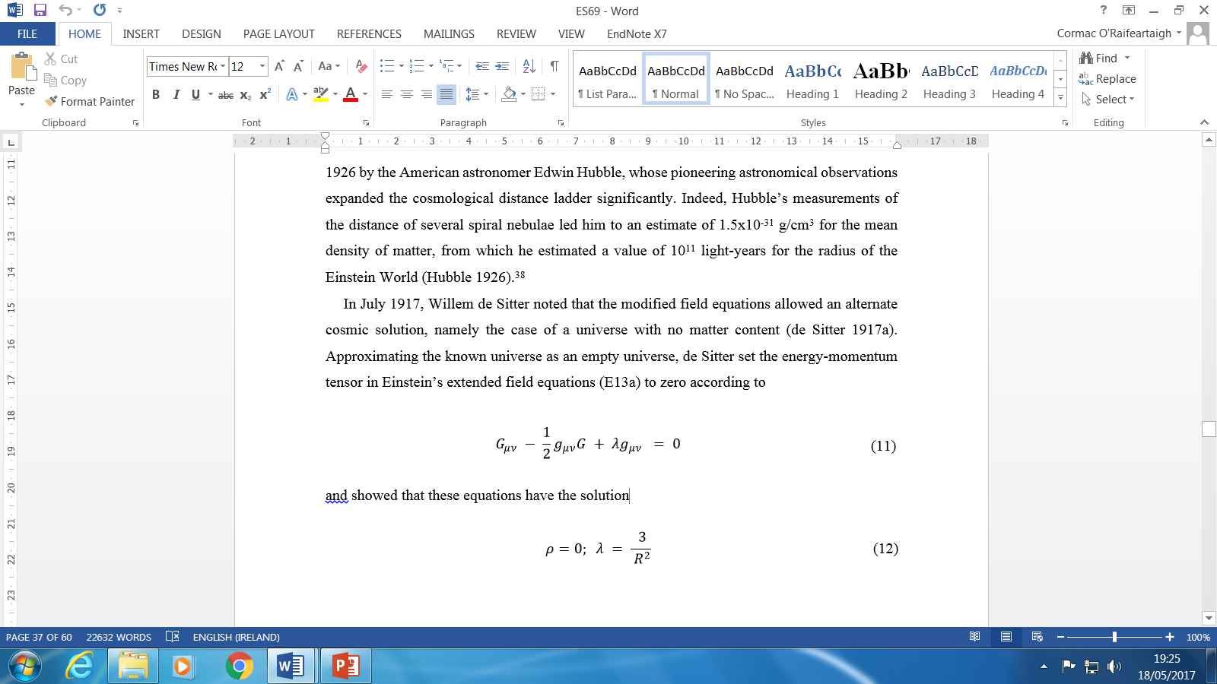
A brief history of theory
The general theory of relativity (1915)
A new theory of gravitation
The Einstein World (1917)
Static, matter-filled universe
Closed spatial curvature
The de Sitter model (1917)
‘Static', empty universe
Prediction of redshifts: connection with astronomy?
A cosmic debate
Einstein, de Sitter, Weyl, Klein, Lanczos

