Slide 1

The Big Bang: Fact or Fiction?
The Big Bang debate
A new perspective?
Dr Cormac O’Raifeartaigh

Slide 2
Cosmology
The study of the cosmos
Is it finite?
how big is it?
Is it eternal?
how old is it?
How did it begin?
Not science?

Slide 3
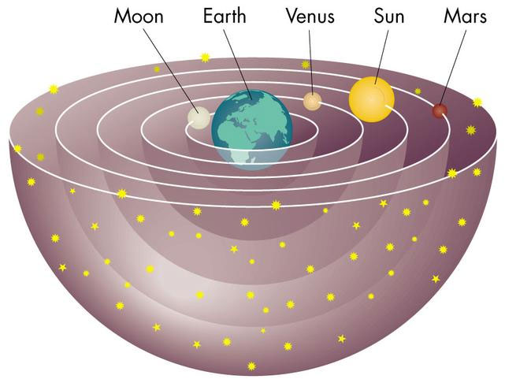
Greek cosmology
The geocentric universe
Earth motionless
Centre of universe
Eternal universe
All motion about earth
Aristotle (350 BC)
Ptolemy (200 AD)
Notes:
3 reasons

Slide 4
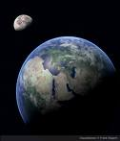
Newton (1642-1727)
Newton’s cosmology
planet orbits due to gravity
gravity caused by sun’s mass
attractive force
space, time fixed
Eternal, infinite universe
Paradoxes?

Slide 5

20th cent astronomy: the galaxies
powerful telescopes
photography
Cepheid variables
stellar distances
other galaxies
1920s: many galaxies
Edwin Hubble (1889-1958)

Slide 6
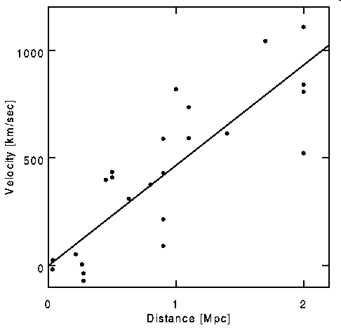
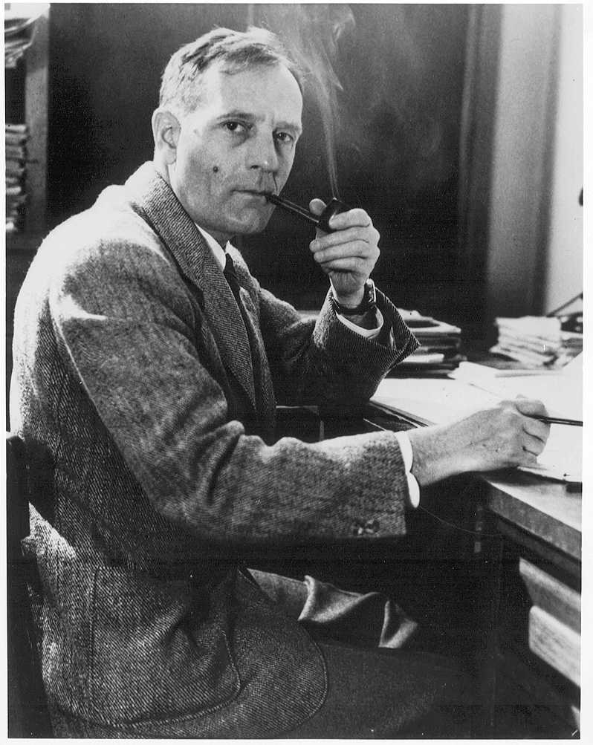
The expanding universe
1929: galaxies moving apart
Edwin Hubble (1889-1958)
Far-away galaxies rushing away
at a speed proportional to distance
v = H_{o}d

Slide 7
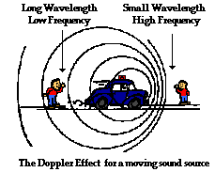
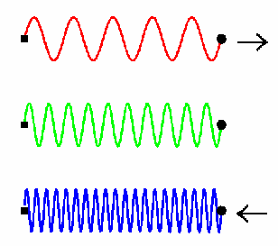

Note: Doppler Effect
frequency of light depends on
relative motion of observers
Redshift
Controversy?

Slide 8
The origin of the universe
rewind Hubble graph
universe smaller in the past
extremely dense, extremely hot?
primeaval atom?
Expanding and cooling ever since
Fr Georges Lemaitre

Slide 9
Lemaitre: Age of the universe
How long since BB?
velocity = distance / time
but v = H_{o} d
hence time = 1 / H_{o}
t~ 14 billion yr
Wrong estimate at first
Co-produced model?

Slide 10
Reception (classical): nonsense!
Newton
gravity pulls in not out
space is fixed
time has no beginning
What is pushing out?
What happened at time zero?
How can U be younger than stars?
Isaac Newton

Slide 11

Reception: general relativity
Modern theory of gravity (1916)
space and time = spacetime
spacetime affected by mass
gravity = distortion of spacetime
Evidence: orbit of Mercury, bending of starlight
Note: not Kuhnian paradigm shift
Einstein (1916)

Slide 12
Reception (relativity): nonsense!
Apply Einstein’s gravity to the cosmos
space-time dynamic?
Einstein: static universe (1917)
Friedmann: expanding universe
Einstein vs Lemaitre:
1933: Einstein capitulates
relativity supports BB
gravity vs expansion
small community only: pedagogy

Slide 13

The Big Bang model
14 billion years ago, U concentrated in tiny volume
primordial explosion of matter, energy, space and time
U expanding and cooling ever since
Misnomer: singularity problem
Not accepted

Slide 14
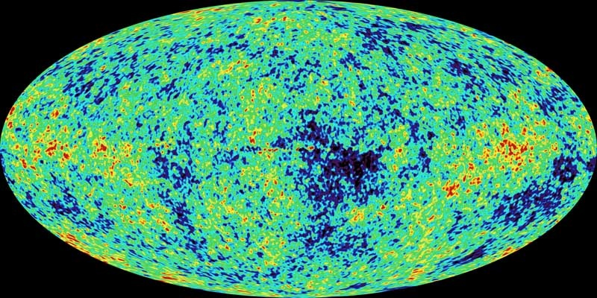
Predictions of Big Bang model
  √ 1. The expansion of the U
  2. Nucleosynthesis
  3. The cosmic background radiation

Slide 15
1940s: nuclear physics
nuclear fission
nuclear fusion
apply to Big Bang model
H, He nuclei (1 s)
atoms (300,000 yr)
U = 75% H, 25% He
heavier atoms formed in stars
confirmed by Hoyle
no impact
Georges Gamow (1906 –1968)

Slide 16

BB prediction 3: microwave background
BB : superhot superdense beginning
radiation from hot origin
released when atoms form recombination (300,000 yr)
radiation still observable?
low temp, microwave frequency
No-one looked (1940s)
Forgotten knowledge
Alpher, Gamow and Herman

Slide 17


Instead: steady-state model (1950s)
New attack on BB
Expanding universe
Consistent with relativity
BUT
No beginning
Matter continuously created
Fred Hoyle
Co-produced model?
Deviation?
Large impact

Slide 18
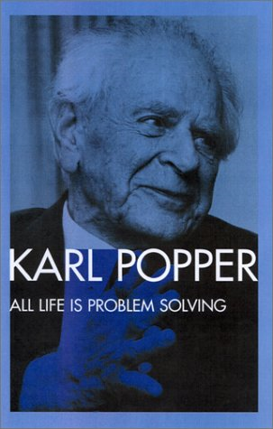
Steady-State prediction: eternal U
Continuous creation
Density of matter constant
U unchanging, eternal
Distant galaxies similar to present?
Youngest galaxies similar to present?
Falsification possible

Slide 19

Answer: radio-astronomy (1960s)
Ryle: radio sources
Study most distant galaxies
Study density and intensity
Density the same at all times? (SS)
Or different? (BB)
Cambridge
3C survey
Answer: different
Blow for SS
PULSARS!
Martin Ryle

Slide 20


Radio-astronomy: CMB (1965)
CMB observed accidentally
radio-astronomy
microwave frequency
temperature 3 K
Penzias and Wilson
Echo of Big Bang!
Gamow ignored

Slide 21

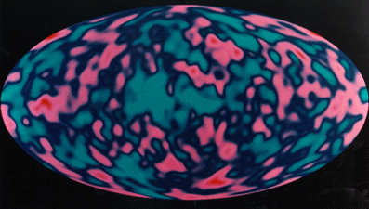
Modern measurements of CMB
accurate measurements
full spectrum
perfect fit with theory
COBE satellite (1992)

Slide 22
Cosmic background radiation
expected temperature
expected frequency
perfect blackbody spectrum
radiation quite uniform?
1 in 10,000
galaxy formation?
COBE (1992)
Nobel Prize 2006

Slide 23

Cosmology Today
Strong evidence for relativity
Black holes, GPS
Hawking theorems
Singularity at time zero?
Cosmic inflation (CMB)
Dark energy (CMB)
What happened at BB?
Quantum gravity

Slide 24
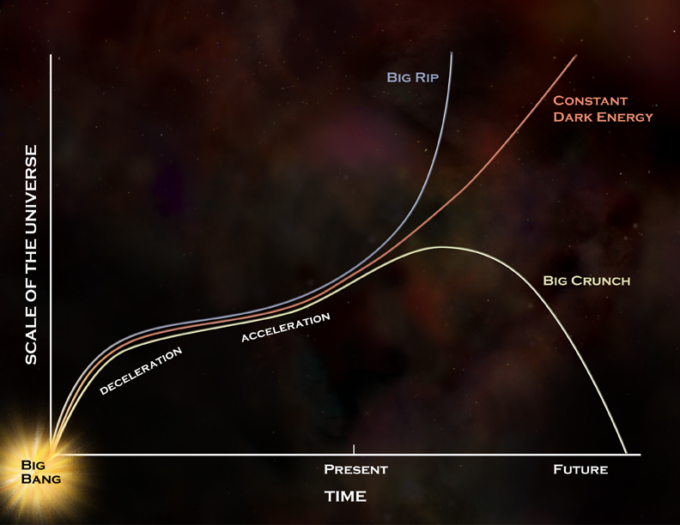
Revised Friedmann universes

Slide 25
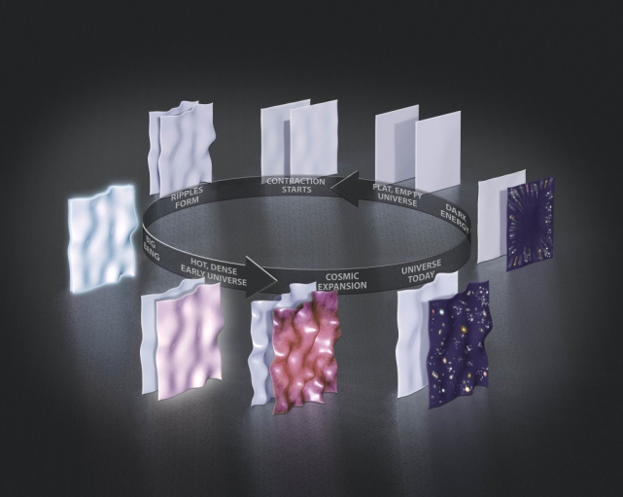
Summary
Evidence for BB model (expanding U 1929)
Accepted by relativists (1933)
Resisted by physics community
New avenues of evidence for BB (1948,49)
Ignored by physics community
Rise of rival SS model (1950)
Defeat of SS model (radiogalaxies, 1960)
New evidence for BB (CMB 1965)
Model gradually accepted (1968..)
Latest: cyclic universe?

