Slide 1

The Big Bang: Fact or Fiction?
New perspectives on steady-state cosmology
From Einstein to Hoyle
Cormac O’Raifeartaigh (Waterford Inst of Technology)
Simon Mitton (University of Cambridge)

Slide 2
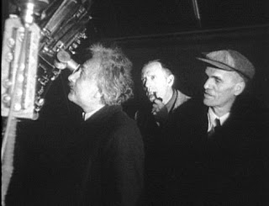
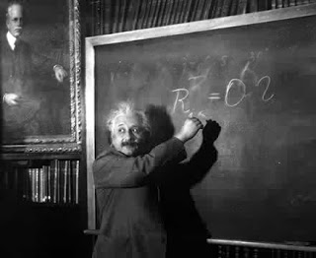
Einstein’s steady-state model
Unpublished AE manuscript
Written in early 1931
Contains ‘steady-state’ model of the cosmos
Expanding universe of constant matter density
Continuous formation of matter from vacuum
Anticipates controversial theory (Hoyle)
Inconsistent model
Fatal flaw
Abandoned, not amended
Evolving models embraced
Friedman-Einstein, Einstein-de Sitter
Einstein in California (1931)

Slide 3


Hubble’s law (1929)
Spiral nebulae extra-galactic (1925)
100-inch reflector at Mt Wilson
Resolved Cepheid stars in several nebulae
Leavitt’s period-luminosity relation
A distance/redshift relation for the spirals?
Redshifts of the nebulae by VM Slipher (1915,1917)
Approx linear relation (Hubble, 1929)
Some anomalies (Peacock)
Slipher not acknowledged
H = 585 kms⁻¹Mpc⁻¹

Slide 4


A cosmic puzzle
What is causing recession of the galaxies ?
If redshifts are velocities
If effect is non-local
Newton’s law of gravity
Gravity pulls in, not out
No other long range force for neutral matter
Space, time are fixed
Not affected by contents of universe
Eternal, infinite universe

Slide 5



General relativity (1915)
Space+ time = space-time
Space-time dynamic
Distorted by motion, mass
Gravity = curvature of space-time
G_{μν} = T_{μν}
Empirical evidence
Perihelion of Mercury
Bending of starlight (Eddington, 1919)
Albert Einstein

Slide 6

Einstein’s universe (1917)
Apply general relativity to the cosmos
Equations predict dynamic universe
Expanding or contracting
No evidence for such a universe
Unaware of Slipher redshifts
Add cosmic constant to give ‘static’ solution
G_{μν} + λg_{μν} = T_{μν}

Slide 7


Friedman models of the cosmos
Allow time-varying solutions to the field equations
Expanding, contracting universes
Geometry, evolution depends on matter content
Positive curvature (1922)
Hyperbolic curvature (1924)
Evolving models (Zf. Ph.)
Matter density varies over time
Ignored by community
Disliked by Einstein
Correction and retraction
Alexander Friedman 1888 -1925

Slide 8


Lemaître’s universe (1927)
Redshifts of galaxies = expansion of space?
Rate of expansion from mean distances and redshifts
H = 585 km/s/Mpc (1927)
No beginning: indefinite age
Starts from Einstein universe at t = - ∞
Rejected by Einstein
“Votre physique est abominable”
Ditto for Friedman models
Fr Georges Lemaître
Not an empirical law

Slide 9
An expanding universe? (1930-)
RAS meeting (1930)
Eddington, de Sitter
If redshifts are velocities, and effect is non-local
Hubble’s law = expansion of space?
Static relativistic models don’t fit data
Dynamic models required
Friedman-Lemaître models
Time-varying radius
Variable matter density
Evolving universe
Cosmic expansion?

Slide 10



The expanding, evolving universe (1930 -)
Eddington (1930, 31)
On the instability of the Einstein universe
Expansion caused by condensation?
de Sitter (1930, 31)
Further remarks on the expanding universe
Expanding universes of every flavour
Tolman (1930, 31)
On the behaviour of non-static models
Expansion caused by annihilation of matter ?
Einstein (1931, 32)
Friedman-Einstein model λ = 0, k = 1
Einstein-de Sitter model λ = 0, k =0
If redshifts represent expansion…
Evolving models

Slide 11
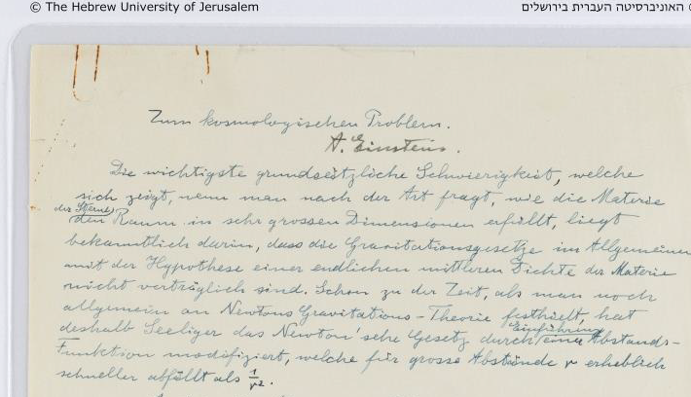

New: Einstein’s steady-state model (1931?)
Filed as draft of F-E model
Similar title, opening
Cites Hubble’s law
Cites instability of static model
Cites evolving models
Discusses age problem
Proposes alternative solution
Expanding, unchanging cosmos?
Continuous creation of matter
Associates with λ - energy of space

Slide 12
Einstein’s steady-state model: key quotes
New solution
“In what follows, I wish to draw attention to a solution to equation (1) that can account for Hubbel’s facts, and in which the density is constant over time”
Matter creation
“If one considers a physically bounded volume, particles of matter will be
continually leaving it. For the density to remain constant, new particles of matter
must be continually formed within that volume from space “
Dark energy
“The conservation law is preserved in that, by setting the λ-term, space itself is not empty of energy; its validity is well known to be guaranteed by equations (1).”

Slide 13
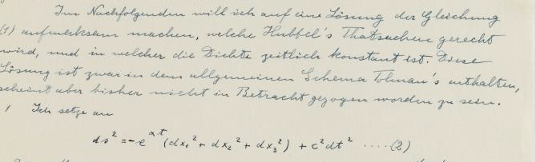
An abandoned model
A fatal flaw
De Sitter metric
Matter creation associated with λ
Null result masked by error
Derivation incorrect
Einstein’s crossroads
Identifed problem on revision
Declined to amend GFE
Evolving models?
Less contrived and set λ = 0

Slide 14

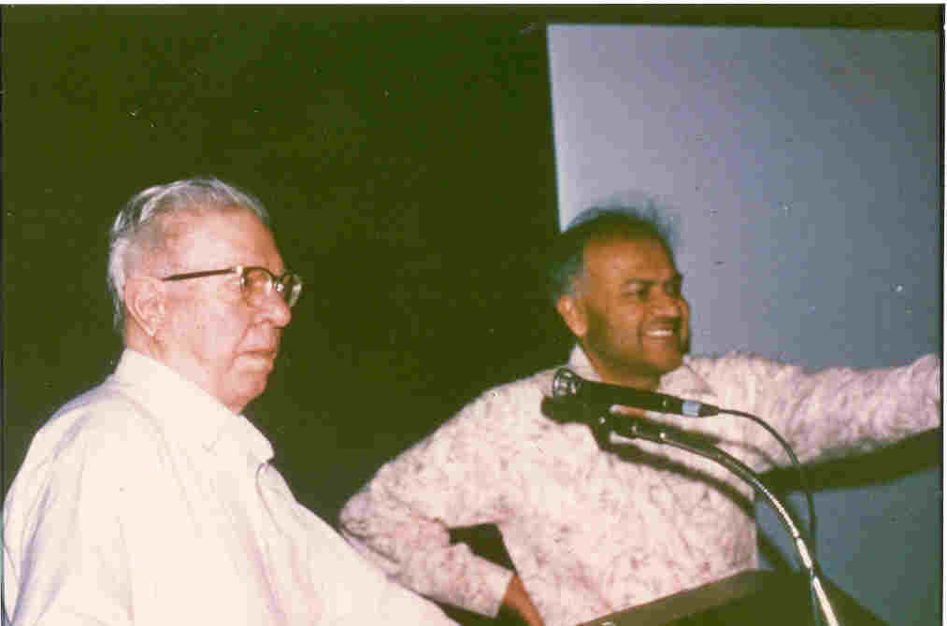
The steady-state universe (1948)
Expanding but unchanging universe
Hoyle, Bondi and Gold (1948)
No beginning, no age paradox
No assumptions about physics of early epochs
Continuous creation of matter
Very little matter required
Replace λ with creation term (Hoyle)
Conservation of energy violated
Improved version (1962)
Bondi, Gold and Hoyle
G_{μν} + C_{μν} = k T_{μν}
G_{μν} + λg_{μν} = k T (C_{μ}+ C_{ν)}
Hoyle and Narlikar (1962)

Slide 15


Evolving vs steady-state universe
Radio-astronomy
Galaxy distributions at different epochs
Cambridge 3C Survey (Ryle)
Cosmic microwave background
Low temperature, low frequency
Remnant of early universe
Optical astronomy
Amended timescale of expansion
(Baade, Sandage)

Slide 16
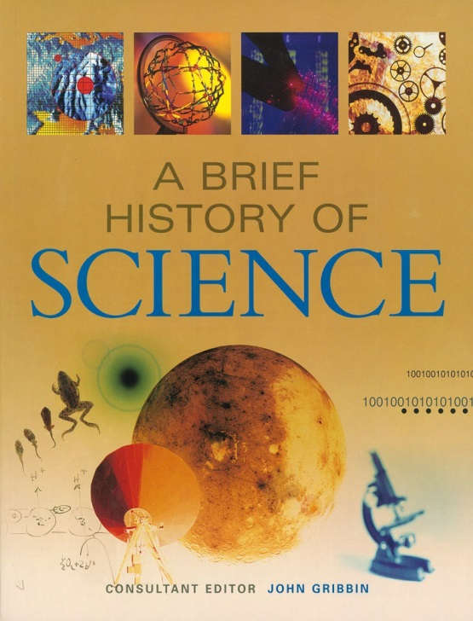
Significance of Einstein’s steady-state model
Unsuccessful theories important
Understanding the development of successful theories
New perspective on steady-state theory
Logical possibility: not a crank theory
Insight into Einstein’s philosophy
Discards model rather than add new term to GFE
Occam’s razor approach
Insight into scientific progress
Not Kuhnian paradigm shift
Slow dawning
Links with modern cosmology
Dark energy: creation energy and λ
Cosmic inflation: de Sitter metric

Slide 17
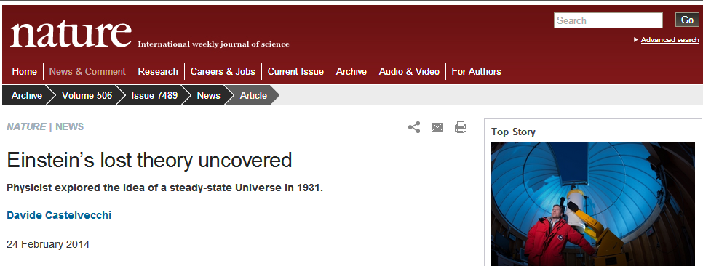
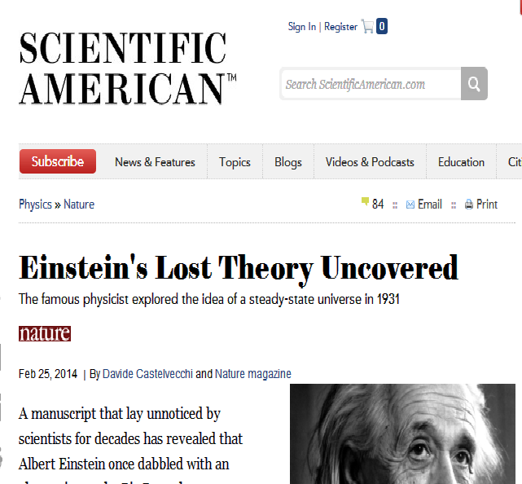
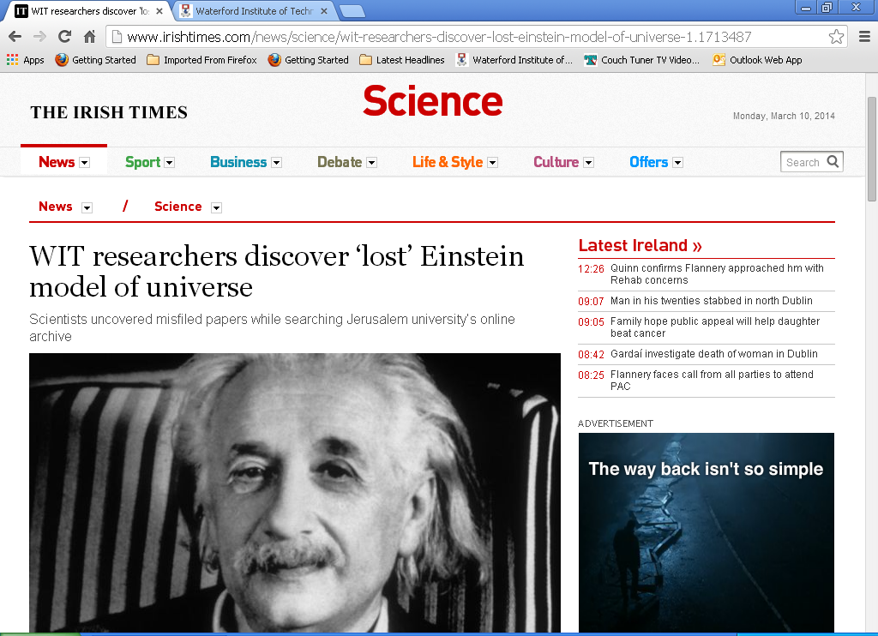
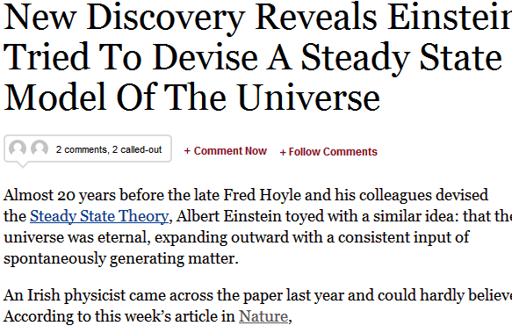
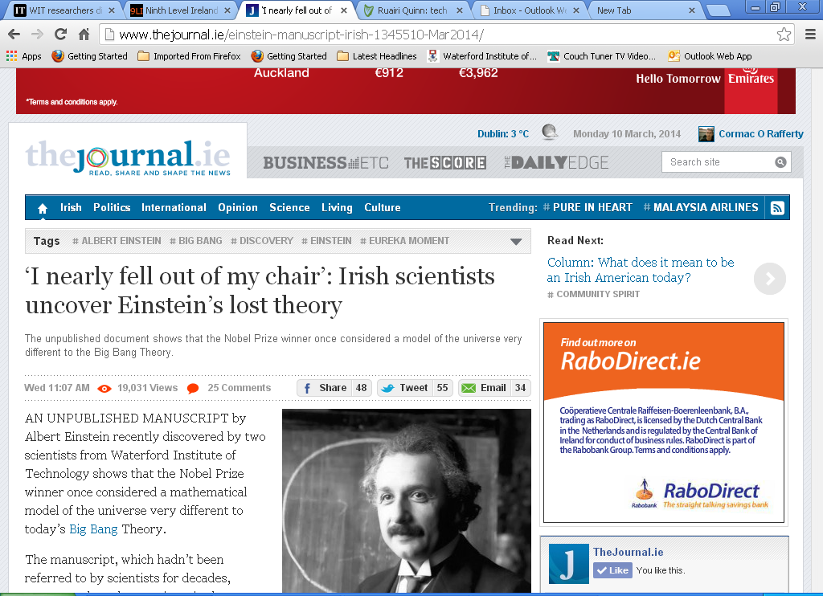

Slide 18

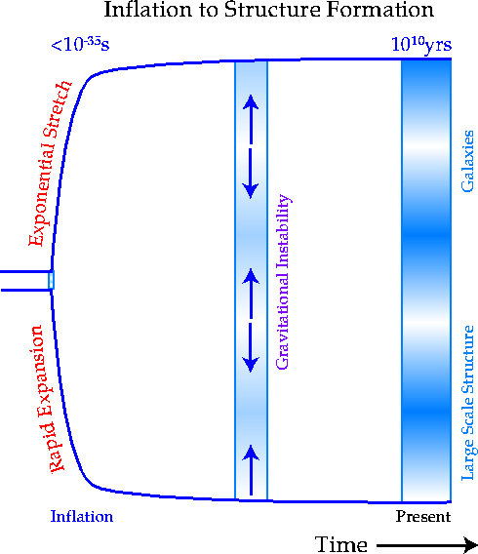
Einstein’s steady-state model and cosmology today
Dark energy (1998)
Accelerated expansion (observation)
Positive cosmological constant
Einstein’s dark energy
“The conservation law is preserved in that, by setting the λ-term, space itself is not empty of energy; its validity is well known to be guaranteed by equations (1).”
Cosmic inflation
Inflationary models use de Sitter metric
Used in all steady-state models
Flat curvature, constant rate of matter creation
Different time-frame!

