Slide 1


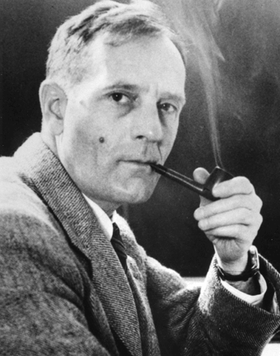
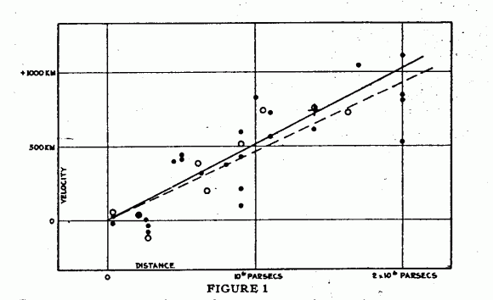
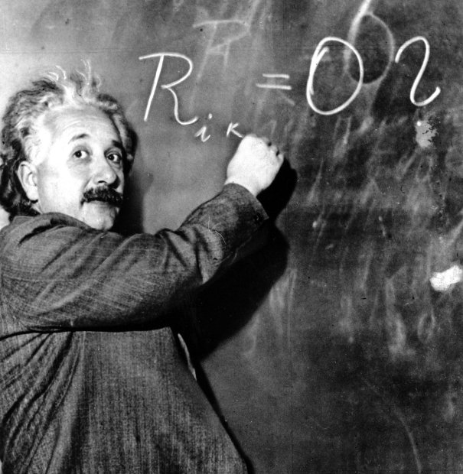
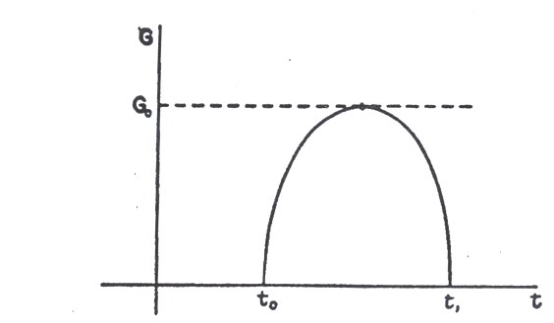
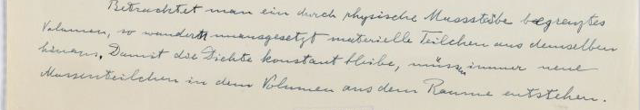
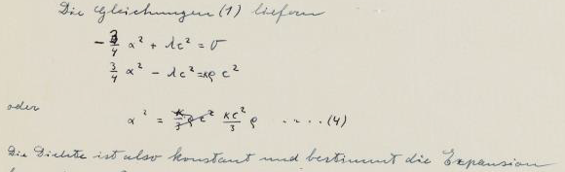
Einstein’s steady-state model of the universe
Cormac O’Raifeartaigh¹ and Simon Mitton²
¹ School of Science, Waterford Institute of Technology, Waterford, Ireland
² Department for the History and Philosophy of Science, Cambridge University, United Kingdom
INTRODUCTION
We recently discovered [1] an unpublished manuscript by Albert Einstein in which he attempted a 'steady-state' model of the universe. The document, which appears to have been written in early 1931, features a cosmic model where the mean density of matter in an expanding universe is maintained constant by a continuous formation of matter from empty space. This model of the cosmos is in marked contrast with Einstein's static model of 1917 or his dynamic models of 1931 and 1932, but anticipates the steady-state cosmology of Fred Hoyle in many ways. We suggest that the model was not published because it contains a mathematical flaw.
THE EXPANDING UNIVERSE
In 1929, the astronomer Edwin Hubble discovered a linear relation between the redshifts of the distant galaxies and their radial distance [2]. Many theorists interpreted the discovery as evidence for an expansion of space on the largest scales. Just such a phenomenon had been predicted in the 1920s by Alexander Friedmann and Georges Lemaître, by applying Einstein’s general theory of relativity to the cosmos as a whole.
EVOLVING MODELS OF THE UNIVERSE
Following Hubble’s observations, a plethora of dynamic models of the cosmos of the Friedmann-Lemaître type were proposed in the 1930s. In all these ‘evolving’ models, it was assumed that the mean density of matter in the universe would decrease as space expanded. Abandoning his earlier static model of 1917 [3], Einstein explored two evolving models, the Friedmann-Einstein model of 1931 and the Einstein-deSitter model of 1932 [4,5].
Edwin Hubble (1890-1944)
Graph of redshift vs distance
for the distant galaxies [2]
Einstein at Caltech in 1931
The Friedmann-Einstein model [4]
EINSTEIN’S STEADY-STATE MODEL
Einstein’s unpublished manuscript shows that, on first learning of Hubble’s data, he explored the possibility of a dynamic, non-evolving universe. In the manuscript, which appears to date from early 1931, Einstein considers an expanding universe in which the mean density of matter is maintained constant by a continuous formation of matter from the vacuum.
A FATAL FLAW
From the field equations, Einstein derives a pair of simultaneous equations that imply a relation between the density of matter ρ and the expansion coefficient α, concluding that the density remains constant. However, at some later point he realises that the derivation contains an error .
“If one considers a physically bounded volume, particles of matter will be continually leaving it. For the density to remain constant, new particles of matter must be continually formed within that volume from space”.
Einstein uses simultaneous equations to obtain a relation between the density of matter ρ and the expansion coefficient α. (equation 4). The text below the equation reads “The density remains constant and determines the expansion”.
AN ABANDONED MODEL
Einstein’s correction showed that it was not possible to model an expanding universe of constant matter density without modifying the field equations of general relativity. It appears that he abandoned his steady-state theory rather than amend the field equations, turning to evolving models of the cosmos instead [4,5].
HOYLE’S STEADY-STATE UNIVERSE
Some years later, Fred Hoyle independently proposed a steady-state model of the expanding universe in the context of general relativity [6]. Unlike Einstein, Hoyle achieved a mathematically consistent theory by adding a creation term to the field equations. After many years of heated debate, steady-state models of the cosmos were ruled out by observation.
REFERENCES
[1] O’Raifeartaigh C., McCann B., Nahm W. and Mitton S. 2014. Eur. Phys. J. (H) 39(2):1-15
[2] Hubble, E. 1929. Proc. Nat. Acad. Sci. 15: 168-173
[3] Einstein, A. 1917. Sitzungsb. König. Preuss. Akad. 142-152
[4] Einstein, A. 1931. Sitzungsb. König. Preuss. Akad. 235-237
[5] Einstein, A. and W. de Sitter. 1932. Proc. Nat. Acad. Sci.18: 213-214
[6] Hoyle, F. 1948. Mon. Not. Roy. Ast. Soc. 108: 372-382

