Slide 1

The Big Bang: Fact or Fiction?
One Hundred Years
of
General Relativity
Cormac O’Raifeartaigh FRAS
WIT Maths-Physics Seminar 20/04/2016

Slide 2

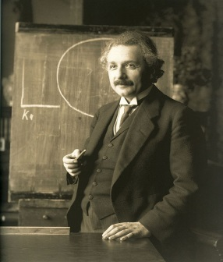

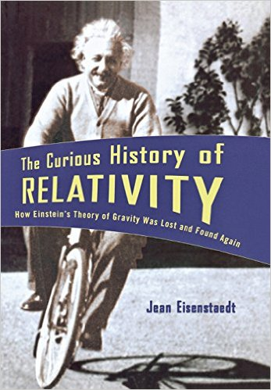
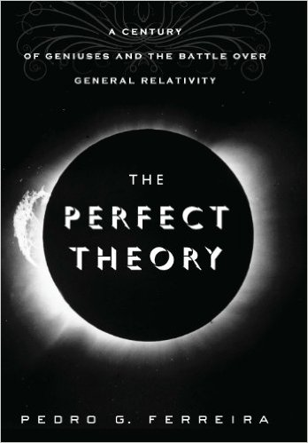
Overview
The genesis of the theory
The special theory of relativity (1905)
The general theory of relativity (1907-16)
Three classic tests (1916)
The perihelion of Mercury; the bending of starlight
The gravitational redshift
Cosmological predictions (1916-18)
Black holes; gravitational waves
The expanding universe; the big bang
The low watermark and the renaissance
Astronomy catches up (1960-)
A golden age – where next?

Slide 3

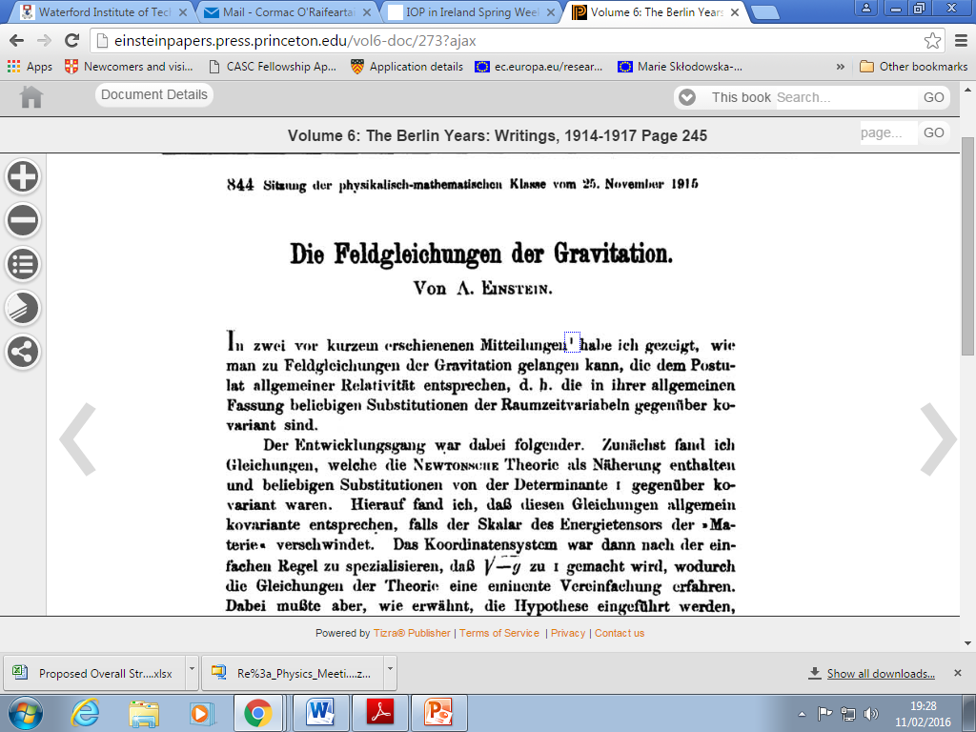
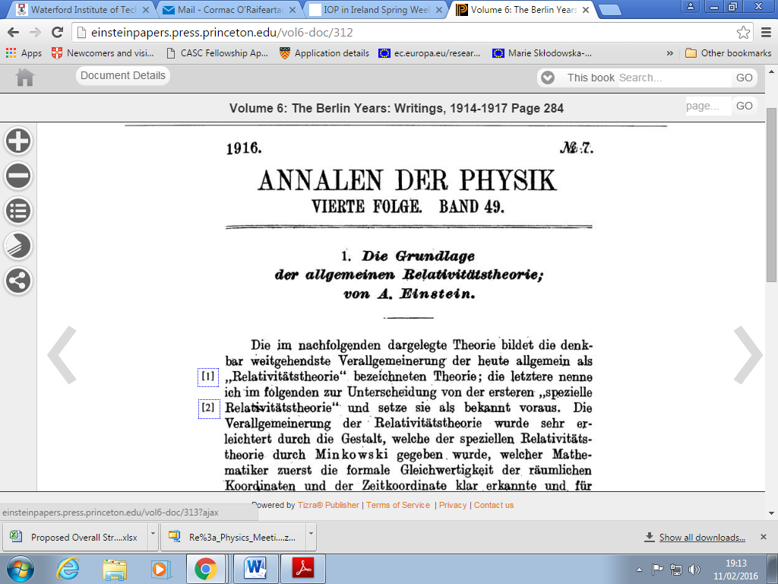
First formulation of the covariant field equations (PAS Nov 1915)
100 years of general relativity
First formulation of the
full theory (Ann. Phys. May 1916)

Slide 4
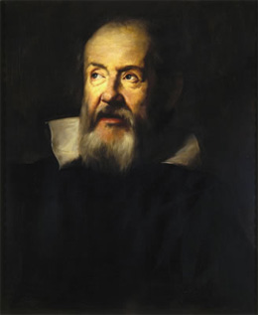
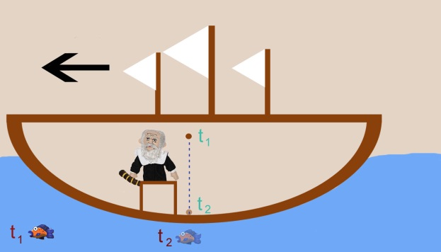
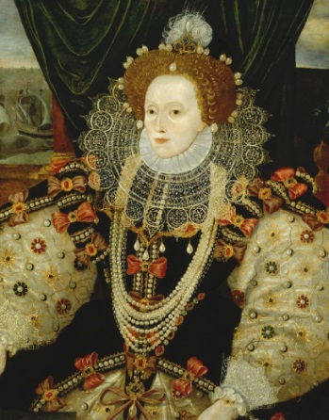
Relativity
The principle of relativity
Laws of mechanics identical for observers in uniform relative motion
Galileo
Motion of ball in cabin of sailing ship
Impossible to deduce motion of ship
Application
Elizabeth I captures Hugh O’Donnell
Everyday experience
Cup of tea on moving train
Life on moving earth (Galileo)
Galileo (1564-1642)
Elizabeth I (1558-1603)

Slide 5
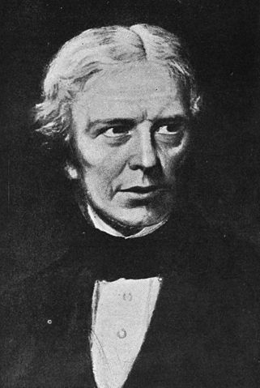
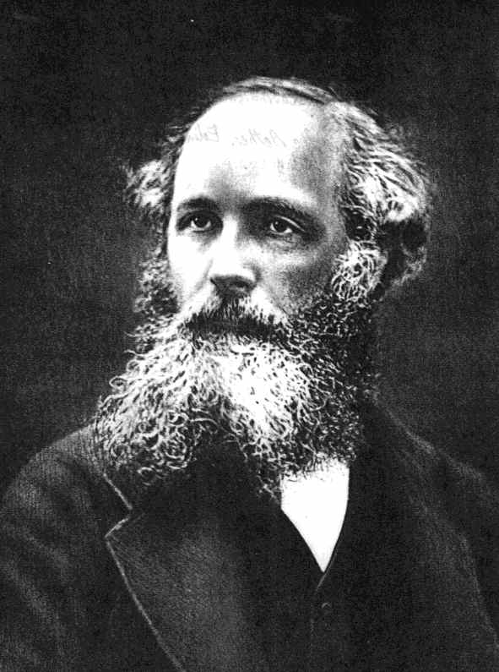
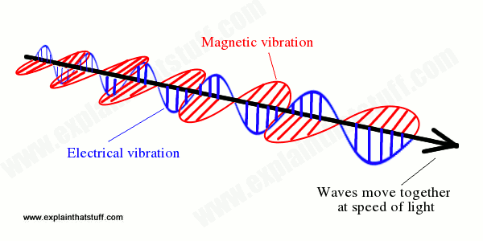
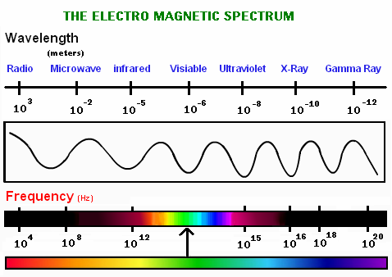
Relativity in the 19th century
Electromagnetism
Electricity and magnetism = electromagnetism
Speed of electromagnetic wave = speed of light in vac
Light = an electromagnetic wave
Changing electric and magnetic fields
The electromagnetic spectrum
Speed relative to what?
The concept of the ether
The search for the ether
Michelson-Morley experiment
Michael Faraday
JC Maxwell

Slide 6
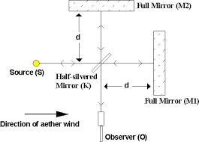
Michelson-Morley experiment
Expect: rays should arrive at O out of phase
Result: no effect detected

Slide 7
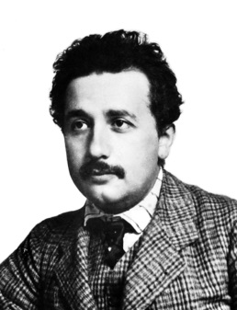
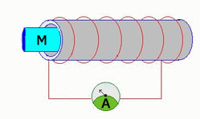
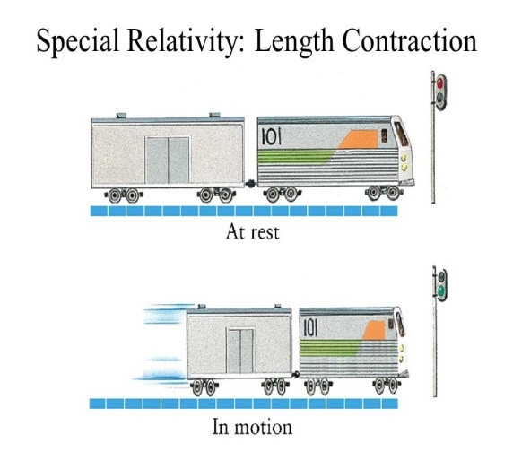
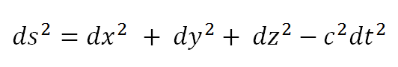
Einstein’s special theory of relativity
Two new principles (1905)
Laws of all physics identical for observers in relative uniform motion
Speed of light in vacuum identical for observers in relative uniform motion
Strange implications
Distance and time not universal v = ds/dt
Experienced differently by bodies in relative uniform motion
Predictions for high-speed bodies
Length contraction : time dilation
Mass increase; mass-energy equivalence E = mc²
Space + time = 4d spacetime
Space-time invariant for observers in inertial frames (Minkowski)

Slide 8
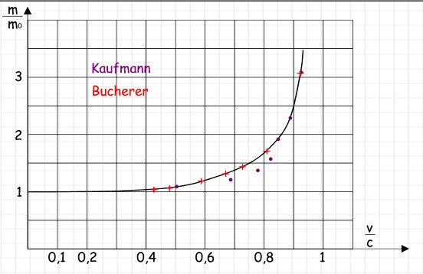

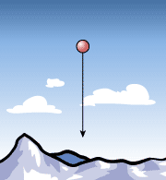

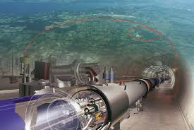
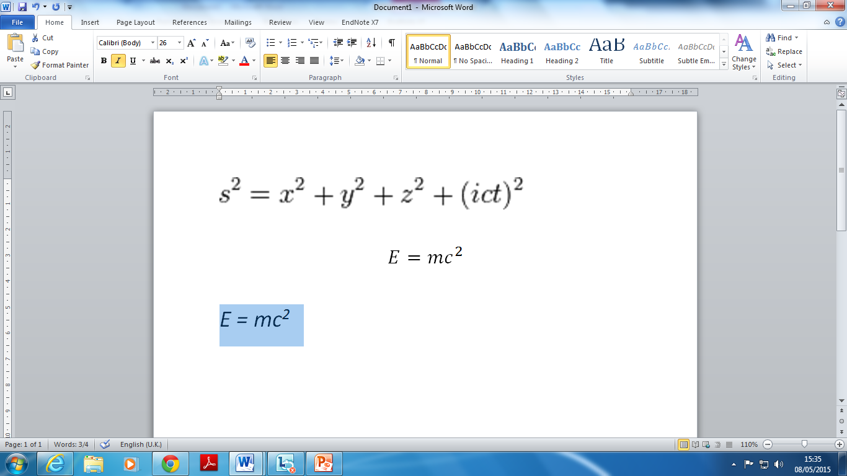
Evidence for special relativity
Mass increase
The experiments of Kaufmann and Bucherer
Invariance of the speed of light in vacuum
Always measured as c
Time dilation
The long-lived muon
2 μs → 22 μs
Particle experiments at the LHC
Maximum velocity = c
Mass increase x 1000
Length contraction
Particle creation

Slide 9


The general theory of relativity (1915,16)
General relativity
Relativity and accelerated motion? (1907)
Relativity and gravity?
The principle of equivalence
Cannot distinguish between gravity and acceleration
Mach’s principle
Inertial mass defined relative to matter
“No such thing as empty space”
A long road (1907-1915)
Space-time defined and curved by mass
Gravity = curvature of space-time
Falling man doesn’t
feel his weight
Curvilinear geometry, tensor algebra

Slide 10
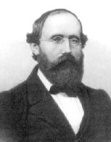

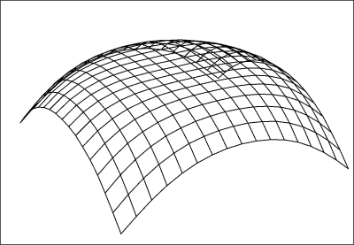

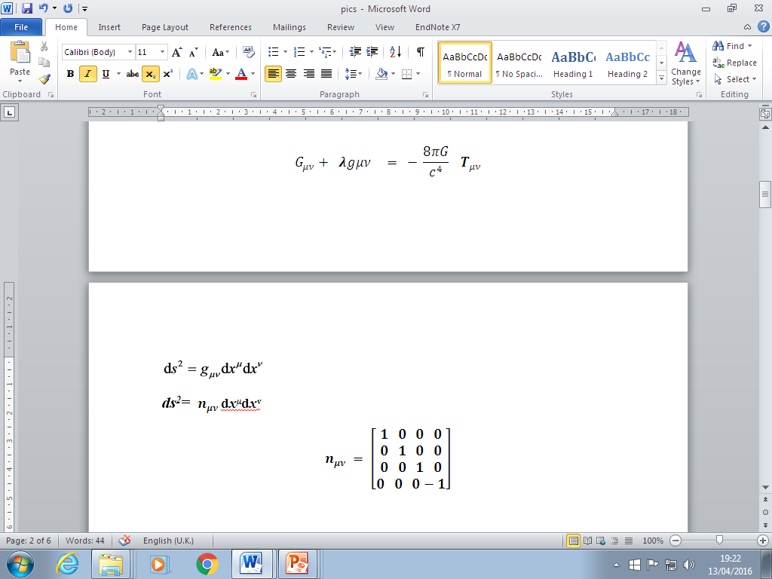
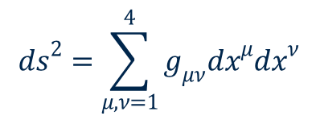
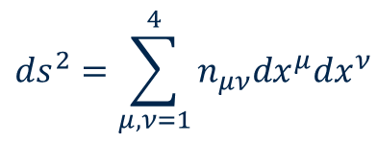

The field equations of GR
$$R_{μν} − \frac{1}{2}g_{μν}R = − T_{μν}$$
$G_{μν} = − T_{μν}$
10 non-linear differential equations that relate the spacetime
metric to the density and flow of energy and momentum in a region
SR
GR
$${ds}^{2}=\sum_{μ,ν=1}^{4}{n_{μν}{dx}^{μ}{dx}^{ν}}$$
$${ds}^{2}=\sum_{μ,ν=1}^{4}{g_{μν}{dx}^{μ}{dx}^{ν}}$$
g_{μν} are functions of the co-ordinates x

Slide 11
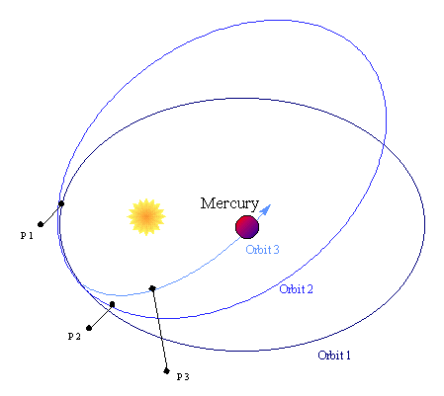
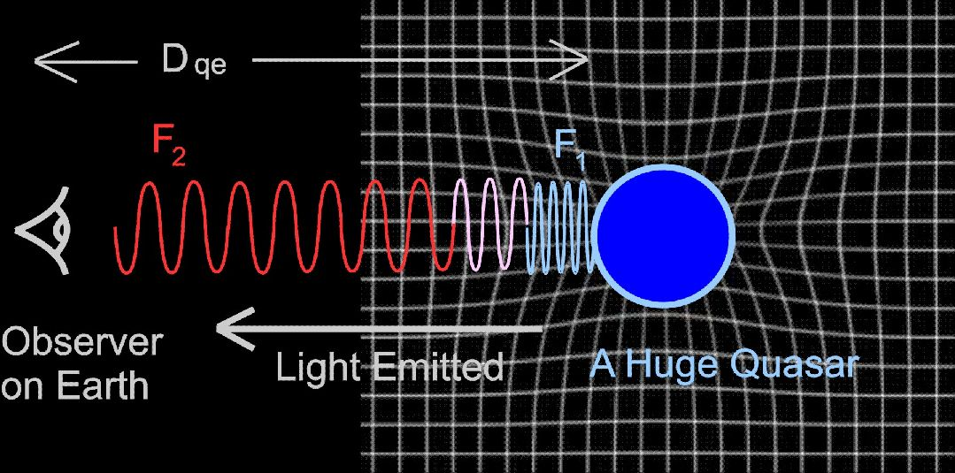
Three classic tests for GR (1916)
Different in principle from Newton’s gravity
Small deviations in predictions (weak scale)
The perihelion of Mercury
Well-known anomaly in Mercury’s orbit (43" per century)
Correctly predicted by GR (1916)
The bending of starlight by the sun (1.7")
Eclipse expeditions of Eddington and Dyson (1919)
Successful measurement (within error margin)
Gravitational redshift
Time dilation in strong gravitational field
Light from a massive star redshifted?

Slide 12
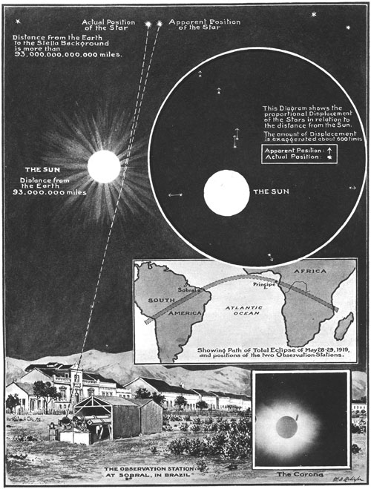
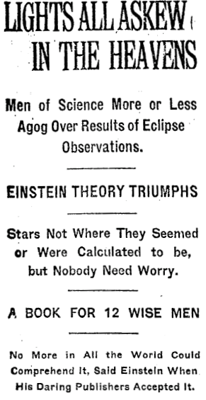
Eclipse Results (1919)
Sobral: 1.98" +/- 0.16
Principe: 1.7" +/- 0.4
Einstein famous (1919)
Controversy (Collins and Pinch 1970s)
Claim of bias; rebutted by astronomers (RAS)

Slide 13
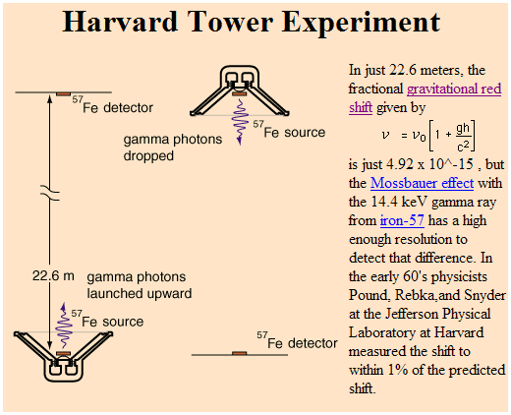
Gravitational redshift (1959)
Sirius B (Adams, 1925)
Gravity Probe A (1970s)
Redshifted light from quasars (1990s)

Slide 14
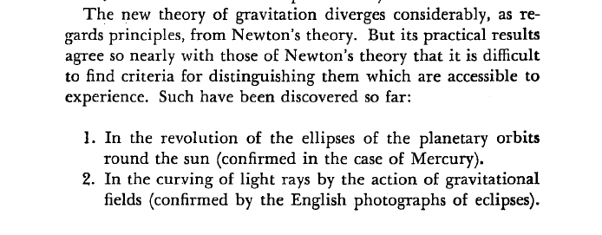
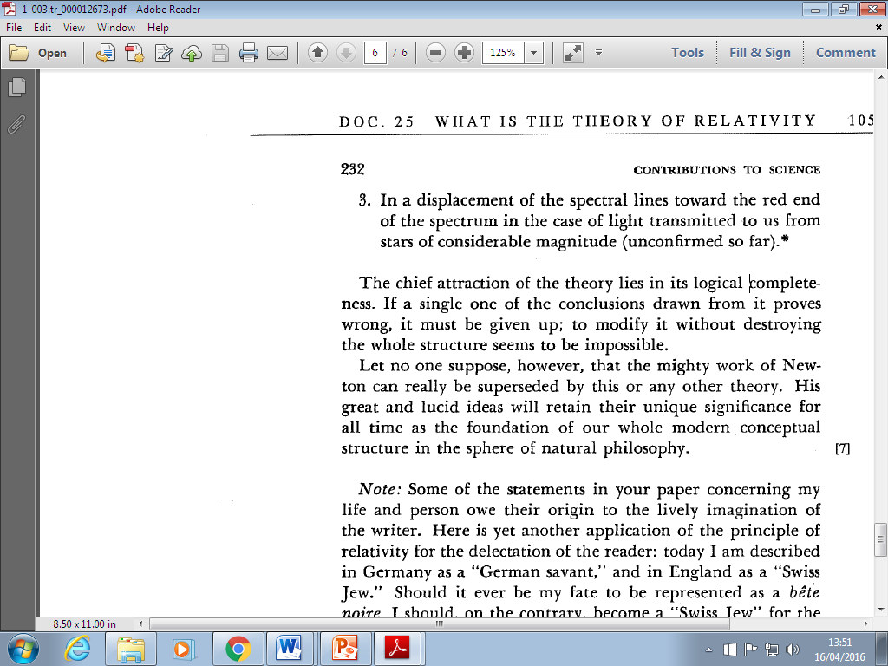
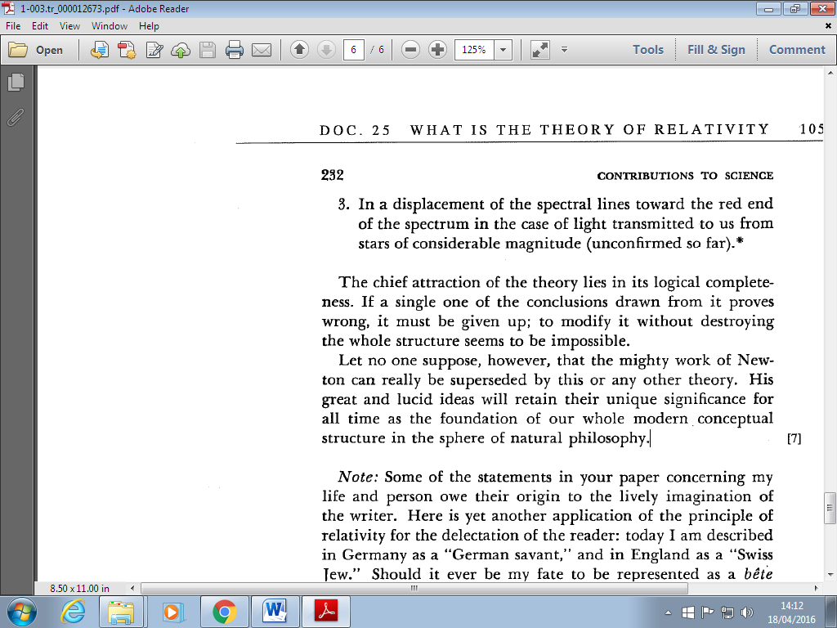
Three classic tests (1916)
Albert Einstein, The Times (Nov 28th 1919)

Slide 15
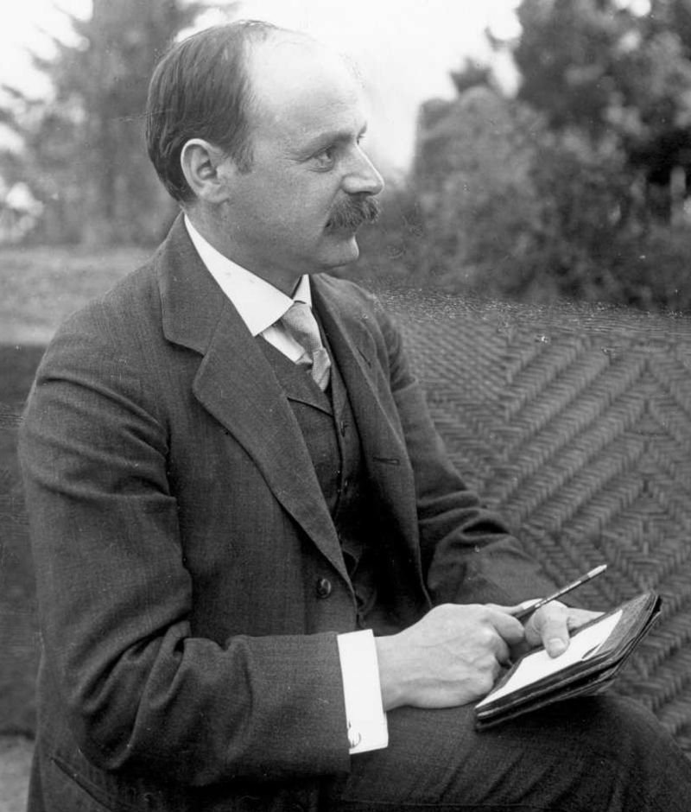
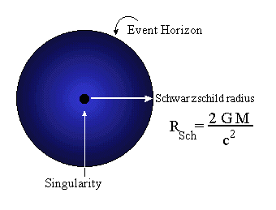
Cosmic prediction I: Black Holes
Schwarzschild (1916)
Exact solution for the field equations
Body of spherical symmetry
Enigma
Solution becomes singular at r = 0, r = 2GM/c²
Space closed up around mass?
Rejected
Co-ordinate problem (Eddington)
Prevented by internal pressure (Einstein 1922)
Physical reality?
Collapse of sun? Anderson (UCG)
Collapse of large stellar ensemble : Lodge (Oxford)
Karl Schwarzschild (1873–1916)

Slide 16
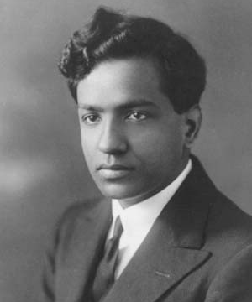
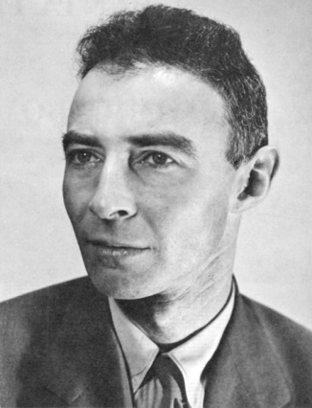
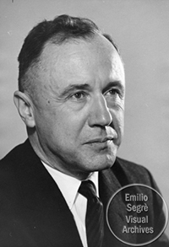
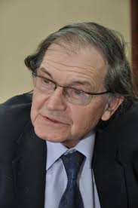
The physics of black holes
Chandrasekhar (1931)
The physics of white dwarf stars (quantum degeneracy)
SR: collapse to infinite density for M > 1.4 M☉
Rejected by Eddington, community
Oppenheimer (1939,40)
GR: Continued stellar collapse for M >3 M☉
Rejected by Einstein (1939)
Wheeler, Thorne, Zeldovitch (1960s)
Numerical relativity
Simulation of stellar collapse
Penrose (1965)
No avoiding BH singularity

Slide 17
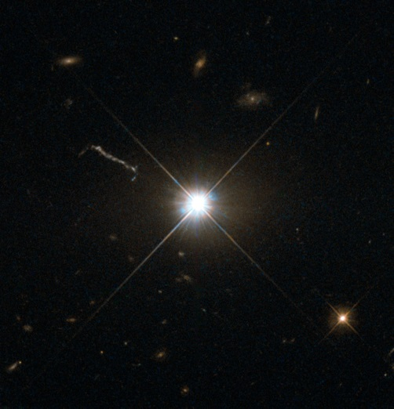
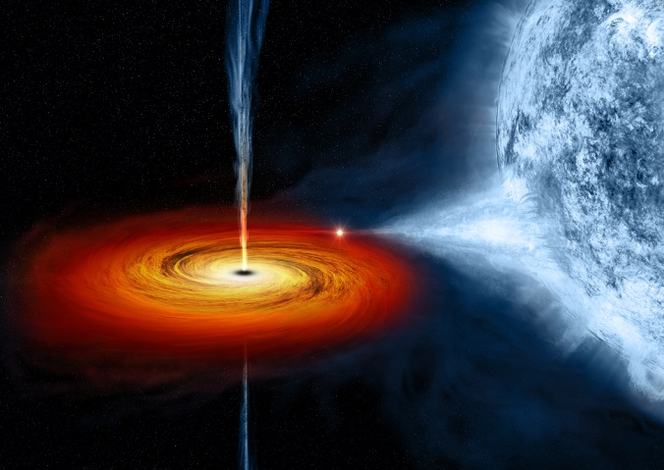
Black Holes: Observation
Compact astronomical objects (1960s)
Quasars: small, distant sources of incredible energy (1963)
Pulsars: rapidly rotating neutron stars (1967)
X-ray binaries
Cygnus X-1 (1964)
Matter pulled from star into massive companion emits X-rays
Orbit studies
Supermassive BH at centre of MW? (1990s)
Supermassive BH at centre of many galaxies (2000-)
2015-16
Gravitational waves from BH merger!
Quasar 3C273
Cygnus X-1 (1964)

Slide 18
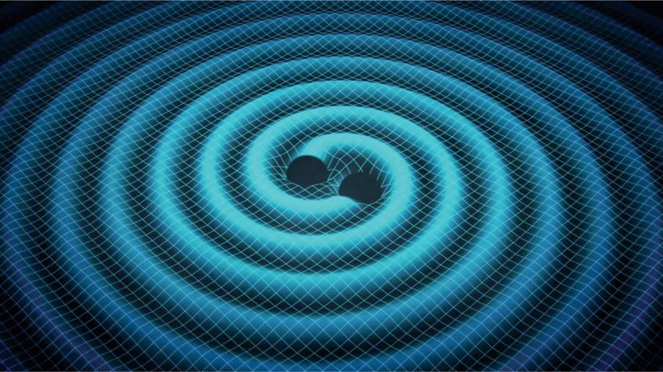
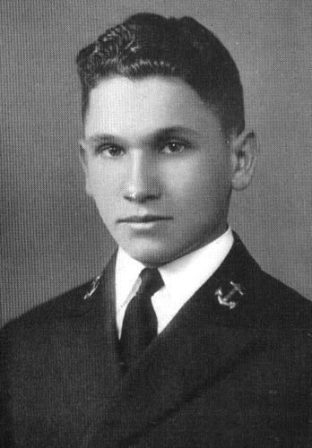
Cosmic prediction II: gravitational waves
Einstein (1916, 18)
Linearized wave-like solutions of GFE
Cosmic events cause tiny ripples in spacetime?
Einstein (1936, 37)
Cylindrical wave solutions - no gravitational waves (1936)
Corrected with assistance from HP Robertson (1937)
Wheeler (1960s)
Numerical wave solutions
Weber bars (1960s)
Reports signal of gravitational waves
Not reproduced, not accepted by community
Joseph Weber

Slide 19
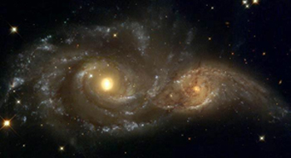
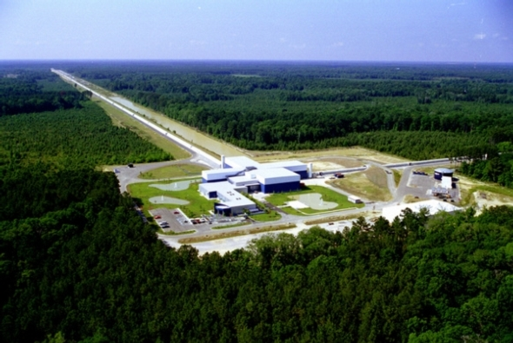
Gravitational Waves: Observation
Binary pulsar PSR1913+16
Hulse-Taylor (1974)
Decrease in orbital period exactly as predicted
Direct measurement?
Interferometers: 1980-
Interferometers with 4 km arms (LIGO, VIRGO)
Advanced LIGO (2015)
Clear signal (September 2015)
BH merger
Exact match with merging BHs
29 M☉, 36 M☉ ; 1.3 billion LY away
Hulse-Taylor pulsar

Slide 20
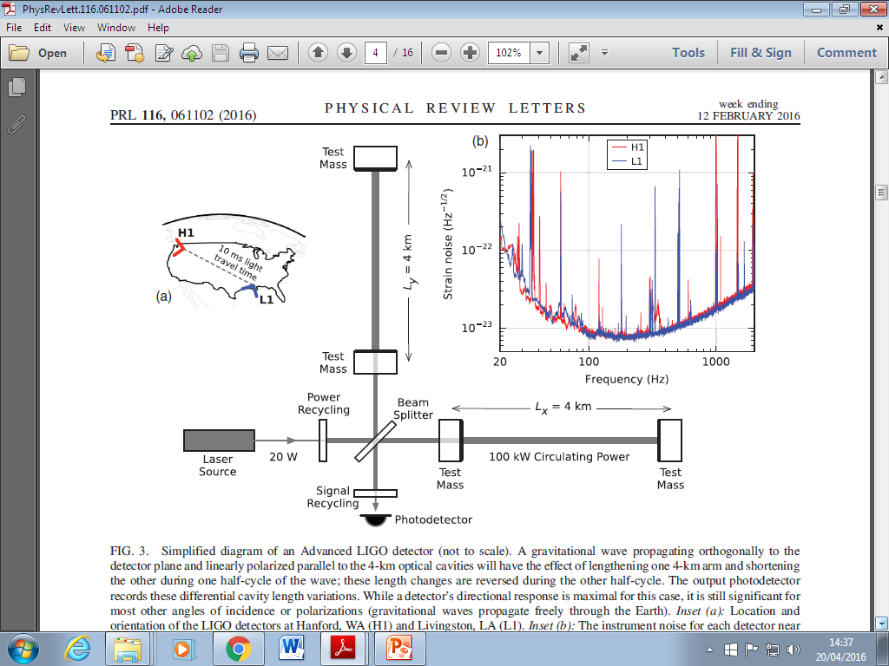
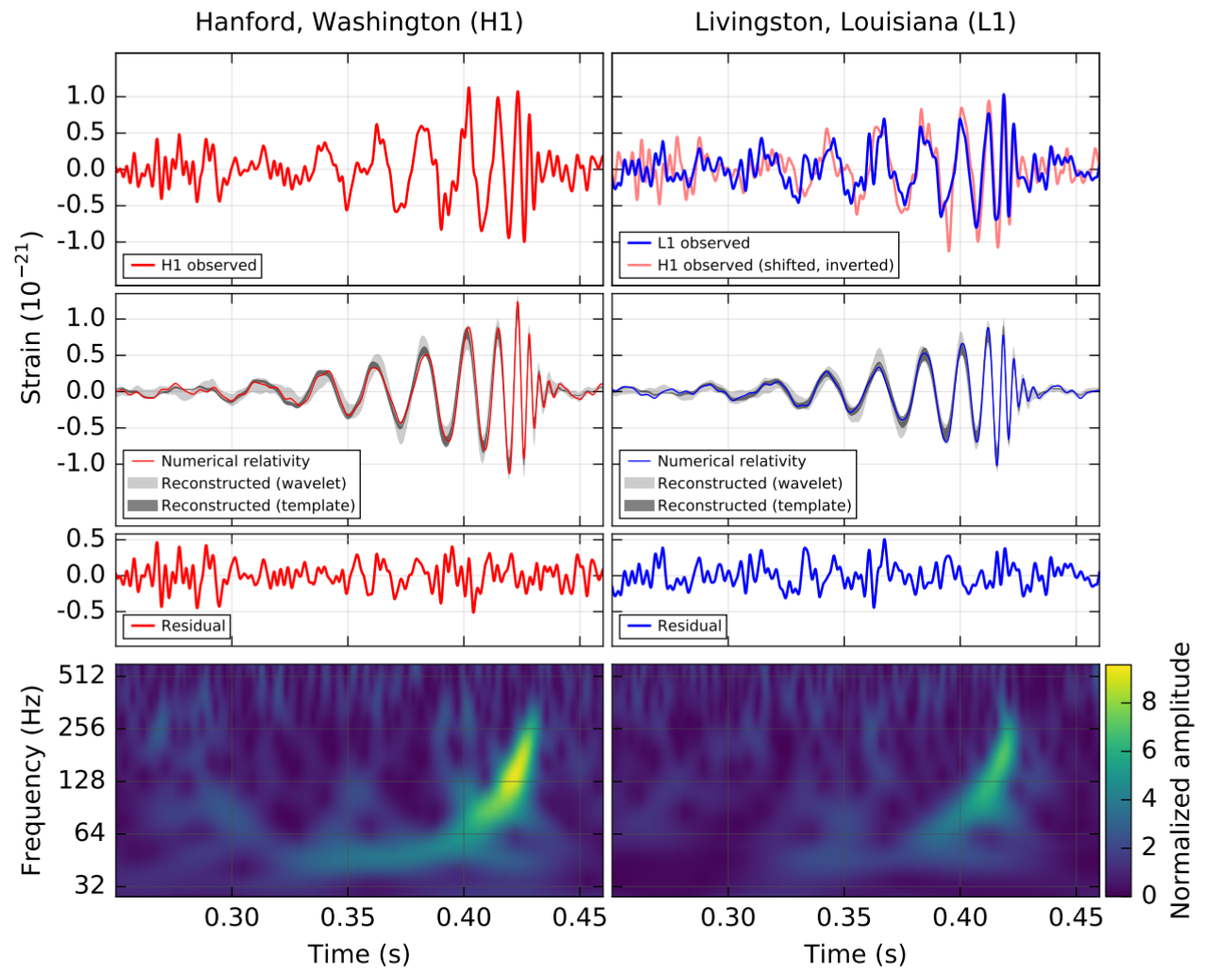
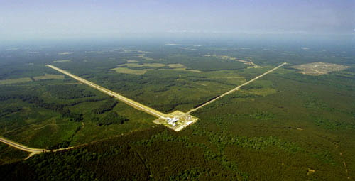
Shape of waveform
Frequency of orbit
BBH !

Slide 21
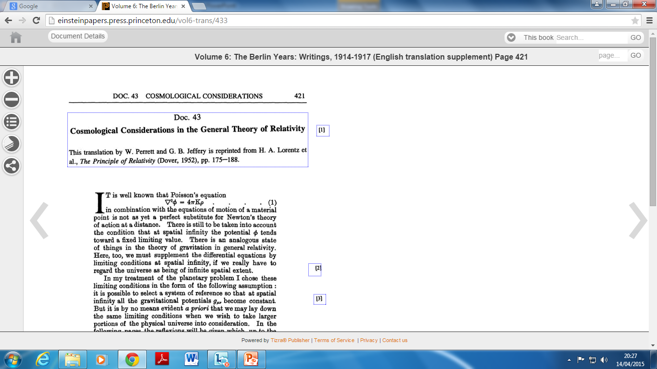


Cosmic prediction III: The expanding universe
Einstein: apply GR to the Universe (1917)
Ultimate test for new theory of gravitation
Assumptions
Static universe (small velocities of the stars)
Mach’s principle (metric tensor to vanish at infinity)
Isotropy and homogeneity (simplicity)
Boundary problem
Assume cosmos of closed curvature
But…no consistent solution
New term in field equations!
Cosmic constant - anti-gravity term
Radius and density defined by λ
G_{μν} = - ĸ T_{μν}
G_{μν} + λg_{μν} = - ĸ T_{μν}

Slide 22



Friedman’s universe
Allow time-varying solutions (1922)
Assume homogeneity, isotropy, positive curvature
Two independent differential equations from GFE
Evolving universes
Density of matter varies over time
Negative spatial curvature (1924)
Cosmic evolution, geometry depends on matter
Overlooked by community
Considered ‘suspicious’ by Einstein
Mathematical correction, later retracted
“To this a physical reality can hardly be ascribed”
G_{μν} + λg_{μν} = - ĸ T_{μν}
Alexander Friedman
(1888 -1925)

Slide 23



Hubble’s law (1929)
The redshifts of the spiral nebulae
Doppler shifts? (Slipher 1915, 1917)
The distances to the nebulae
Far beyond Milky Way (Hubble 1925)
A redshift/distance relation?
Linear relation (Hubble, 1929)
H = 500 kms⁻¹ Mpc⁻¹
Landmark result in astronomy
Furthest galaxies receding the fastest
What is causing the effect?

Slide 24



Lemaître’s universe (1927)
Redshifts of galaxies = expansion of space? Redshifts from Slipher, distances from Hubble
Expanding model of the cosmos from GR Similar but not identical to Friedman 1922
Starts from static Einstein Universe
Ignored by community
Belgian journal (in French)
Rejected by Einstein:“Votre physique est abominable”
Lemaître’s recollection (1958)
“Einstein not up-to-date with astronomy”
Fr Georges Lemaître

Slide 25


The expanding universe (1930)
RAS meeting (May 1930)
If redshifts are velocities, and if effect is non-local
Hubble’s law = expansion of space? (Edd., de Sitter)
Dynamic model required
Static model unstable
Lemaître model adopted
1927 expanding model republished in English (1931)
Observational section omitted (rightly)
Lemaître-Friedman cosmology accepted
Time-varying radius, decreasing density of matter

Slide 26




Models of the expanding universe (1930 -)
Tolman (1930, 31)
Expansion caused by annihilation of matter ?
Eddington (1930, 31)
On the instability of the Einstein universe
Expansion caused by condensation?
de Sitter (1930, 31)
Variety of expanding models
Heckmann (1931,32)
Spatial curvature (not translated)
Einstein (1931, 32)
Friedman-Einstein model λ = 0, k = 1
Einstein-de Sitter model λ = 0, k = 0
If redshifts represent expansion…
If effect is global…

Slide 27
Cosmic prediction IV: the big bang
Lemaître 1931: expanding U smaller in the past
Extrapolate to very early epochs
Extremely dense, extremely hot
Expanding and cooling ever since
‘Fireworks beginning’ at R = 0?
Fr Georges Lemaître
Rejected by community(1930-60)
Many assumptions
Timescale problem
Later called ‘The big bang’

Slide 28


A new line of evidence
Gamow and nuclear physics (1940s)
Student of Friedman
How were the chemical elements formed?
Problems with stellar nucleosynthesis
Elements formed in the infant hot universe?
Theory predicts U = 75% Hydrogen, 25% Helium
Agreement with observation
Victory for big bang model
Georges Gamow
Heavier atoms formed in stars

Slide 29


Bonus: cosmic background radiation
Infant universe very hot
Dominated by radiation
Radiation still observable today?
Low temp, microwave frequency
A fossil from the early universe!
Released when atoms formed (300,000 yr)
Alpher, Gamow and Herman
No-one looked

Slide 30


The steady-state universe (1948)
Expanding but unchanging universe
Hoyle, Bondi and Gold (1948)
Disliked extrapolation to early epochs
Perfect cosmological principle?
Requires continuous creation of matter
Very little matter required
No beginning, no age paradox
Replace λ with creation term (Hoyle)
Improved version (1962)
Bondi, Gold and Hoyle
G_{μν} + C_{μν} = - k T_{μν}
G_{μν} + λg_{μν} = k T (C_{μ}+ C_{ν)}
Hoyle and Narlikar (1962)

Slide 31


Steady-state vs big bang (1950-70)
Optical astronomy (1950s)
Revised distances to the nebulae (Baade, Sandage)
New timescale of expansion
Radio-astronomy (1960s)
Galaxy distributions at different epochs
Cambridge 3C Survey (Ryle)
Theory of nucleosynthesis
Cosmic microwave background (1965)
Low temperature, low frequency
Remnant of young, hot universe
Allen Sandage
Martin Ryle

Slide 32

Cosmic background radiation (exp)
CMB discovered accidentally
Universal signal (1965)
Low frequency (microwave)
Low temperature (3K)
Penzias and Wilson (1965)
Echo of Big Bang!

Slide 33

Modern measurements of the CMB
Details of background radiation
Full spectrum
Comparison with theory
Perturbations?
Ground telescopes
Balloon experiments
Satellite experiments
COBE satellite (1992)

Slide 34


Today’s cosmological puzzles
Characteristics of background radiation
Isotropy, homogeneity, flatness (1970-80)
The theory of inflation (1981)
Exponential expansion within first second?
Explanation for homogeneity, flatness, galaxy formation
Which model of inflation? Bubble inflation?
Dark energy (1998)
Observation of accelerated expansion
The return of the cosmological constant
U mainly composed of dark energy
G_{μν} + λg_{μν} = - ĸ T_{μν}
Nature of DE unknown

Slide 35

100 years of general relativity
Published 1915, 1916
From Swiss patent office to Berlin
A new theory of gravity
Gravity = curvature of spacetime
Classic predictions supported by experiment
Perihelion of Mercury: bending of light by a star
Gravitational redshift ; GPS
Cosmological predictions supported by experiment
Black holes: gravitational waves
The expanding universe: the big bang
Skeptical of extrapolations

Slide 36


Where next for general relativity?
More general theory
Unified field theory; the forces of nature (Einstein)
Reconcile GR with quantum theory
Quantum gravity
Some progress
QT and black hole thermodynamics
Hawking-Bekenstein radiation
Quantum cosmology
The quantum big bang
Stephen Hawking
A universe from nothing?

Slide 37


Einstein’s cosmology: conclusions
Major test for general relativity
Conscious of assumptions of homogeneity, isotropy
Embraces dynamic cosmology
New evidence – new models (JMK)
Timespan of expanding models puzzling
Steady-state universe?
Evolving models (less contrived)
Cosmic constant not necessary
Extraction of parameters compatible with observation
Closed and open models
Timespan problem attributed to simplifying assumptions
Verdict (1933, 1945): more observational data needed
Hubble constant revised
Cosmic microwave background
Homogeneous, flat universe
No mention of origins

Slide 38
Einstein’s steady-state model (Jan 31)
Problem with evolving models
“De Sitter and Tolman have already shown that there are solutions to equations (1) that can account for these [Hubbel’s] observations. However the difficulty arose that the theory unvaryingly led to a beginning in time about 10^{10 –} 10¹¹ years ago, which for various reasons seemed unacceptable.”
New solution
“In what follows, I wish to draw attention to a solution to equation (1) that can account for Hubbel’s facts, and in which the density is constant over time..
If one considers a physically bounded volume, particles of matter will be continually leaving it. For the density to remain constant, new particles of matter must be continually formed within that volume from space “
Mechanism
“The conservation law is preserved in that, by setting the λ-term, space itself is not
empty of energy; its validity is well known to be guaranteed by equations (1).”

Slide 39
Some key quotes (Einstein 1931)
“The cosmological problem is understood to concern the question of the nature of space and the manner of the distribution of matter on a large scale, where the material of the stars and stellar systems is assumed for simplicity to be replaced by a continuous distribution of matter.”
“Now that it has become clear from Hubbel’s results that the extra-galactic nebulae are uniformly distributed throughout space and are in dilatory motion (at least if their systematic redshifts are to be interpreted as Doppler effects), assumption (2) concerning the static nature of space has no longer any justification….”
“Several investigators have attempted to account for the new facts by means of a spherical space whose radius P is variable over time. The first to try this approach, uninfluenced by observations, was A. Friedman,¹ on whose calculations I base the following remarks. ”
“However, the greatest difficulty with the whole approach… is that according to (2 a), the elapsed time since P = 0 comes out at only about 10¹⁰ years. One can seek to escape this difficulty by noting that the inhomogeneity of the distribution of stellar material makes our approximate treatment illusory.”

Slide 40

A useful find
New perspective on steady-state theory (1950s)
Logical idea: not a crank theory
Tolman, Schroedinger, Mimura : considered steady-state universe
Insight into scientific progress
Unuccessful theories important in the development of science
Links with modern cosmology
Creation energy and λ: dark energy
de Sitter metric: cosmic inflation
Insight into Einstein’s cosmology
Turns to evolving models rather than introduce new term to GFE
Pragmatic approach: F-E model

Slide 41



Einstein’s greatest hits (cosmology)
Einstein’s model of the Static Universe (1917)
First relativistic model of the cosmos
Einstein’s steady-state model (Jan 31)
Natural successor to static model: abandoned
Friedman-Einstein model of the Universe (1931)
Use of Hubble constant to extract observational parameters
Einstein-de Sitter model of the Universe (1932)
1933 review: 1945 review (Appendix)
Conversations with Gamow, Godel, Straus
No mention of origins

Slide 42

III Astronomy and the Universe
The Great Debate (1900-1925)
Spiral nebulae = galaxies beyond Milky Way?
The Hooker telescope (1917)
Edwin Hubble (1921)
The distances of the nebulae (1925)
Cepheid variables resolved in two nebulae
Leavitt’s period-luminosity relation
Spirals far beyond Milky Way
A universe of galaxies

Slide 43



The motion of the nebulae
The redshift of the nebulae
V.M Slipher (Lowell Observatory)
Light from most nebulae redshifted (1915, 1917)
Doppler effect
Frequency of light depends on
motion of source relative to observer
Nebulae moving outward?
Galaxies moving outward?
Vesto Slipher
Lowell Observatory

Slide 44
The runaway galaxies (1929)
A relation between redshift and distance for the galaxies?
Combine 24 distances with redshifts
Redshifts from Slipher: not acknowledged
Linear relation: Hubble’s law (1929)
v = H_{o}d with H = 500 kms⁻¹Mpc⁻¹
Landmark result in astronomy
Far-away galaxies rushing away
at a speed proportional to distance
Edwin Hubble (1889-1953)
Why ?

Slide 45
Lemaître’s universe (1927)
Expanding model of the cosmos from GR
Similar to Friedman 1922 model
Starts from static Einstein universe
Recession of nebulae = expansion of space? Redshifts from Slipher, distances from Hubble
H = 585 kms⁻¹Mpc⁻¹
Ignored by community
Belgian journal (in French)
Rejected by Einstein:“Votre physique est abominable”
Einstein not up-to-date with astronomy?
Fr Georges Lemaître

Slide 46
The expanding universe (1930)
RAS meeting (1930)
Eddington, de Sitter
If redshifts are velocities, and if effect is non-local
Static cosmic models don’t match observations
Expanding universe?
Hubble’s law = expansion of space?
H = 500 kms⁻¹Mpc⁻¹
Friedman-Lemaître model circulated
Time-varying radius
Time-varying density of matter
Evolving universe

Slide 47
Models of the expanding universe (1930 -)
Eddington (1930, 31)
On the instability of the Einstein universe
Expansion caused by condensation?
Tolman (1930, 31)
On the behaviour of non-static models
Expansion caused by annihilation of matter ?
de Sitter (1930, 31)
Further remarks on the expanding universe
Expanding universes of every flavour
Einstein (1931, 32)
Friedman-Einstein model λ = 0 , k = 1
Einstein-de Sitter model λ = 0, k = 0
Evolving models
No mention of origins
Occam’s razor?

Slide 48

The big bang model

Slide 49




Coda: Einstein’s 1931 model
Einstein’s first dynamic model of the cosmos
Often cited, rarely read (not translated)
Adopts Friedman 1922 model
Time-varying, closed universe: k =1
Cosmic constant redundant: set λ = 0
Use Hubble to extract parameters
Radius R $\sim$10⁸ lyr
Density of matter ρ $\sim$10⁻²⁶ g/cm³
Timespan problem
10¹⁰ yr: conflict with astrophysics
Attributed to simplifying assumptions (homogeneity)

Slide 50


Einstein’s 1931 model revisited
First translation into English
O’Raifeartaigh and McCann 2014
Anomalies in calculations of radius and density
R $\sim$10⁸ lyr : should be 10⁹ lyr
ρ $\sim$10⁻²⁶ g/cm³ : should be 10⁻²⁸ g/cm³
t $\sim \text{10}\text{10} \text{y}\text{r} \text{: }\text{should} \text{be} \text{10}\text{9} \text{y}\text{r}$
Source of error?
Error in Hubble constant (Oxford blackboard)
D² $\sim$10⁻⁵³ instead of 10⁻⁵⁵ cm⁻²
Not a cyclic model
“Model fails at P = 0 ”
Contrary to what is often stated

Slide 51


Bonus: Einstein’s steady-state model
Unpublished manuscript
Archived as draft of Einstein’s 1931 model
Similar title, opening
Something different
Cosmological constant λ
“Constant matter density determines expansion”
Steady-state model
Continuous formation of matter from vacuum
Fatal flaw; abandoned
Anticipates Hoyle’s theory

Slide 52



Abandoned model
de Sitter line element
Correct geometry
Simultaneous equations
Error in derivation
Null solution
Einstein’s crossroads
Realised problem on revision
Declined to amend model
Evolving models
Less contrived and set λ = 0

Slide 53






Slide 54
Einstein’s universe: conclusions
Cosmology = test for general relativity
Introduces λ-term to the field equations
Embraces dynamic cosmology
New evidence – new models
Steady-state vs evolving universe
Evolving models simpler: remove λ-term
The evolving universe
Extract observational parameters
Timespan problem attributed to simplifying assumptions
No discussion of origins
Wary of extrapolations
Hubble constant revised
Cosmic microwave background
Homogeneous, flat universe

Slide 55





Slide 56
Einstein’s steady-state model: key quotes
New solution
“In what follows, I wish to draw attention to a solution to equation (1) that can account for Hubbel’s facts, and in which the density is constant over time”
Matter creation
“If one considers a physically bounded volume, particles of matter will be
continually leaving it. For the density to remain constant, new particles of matter
must be continually formed within that volume from space “
Dark energy
“The conservation law is preserved in that, by setting the λ-term, space itself is not empty of energy; its validity is well known to be guaranteed by equations (1).”

Slide 57





Einstein-de Sitter model (1932)
Curvature not a given in dynamic models
Not observed empirically
Remove spatial curvature (Occam’s razor)
Simplest Friedman model
Time-varying universe with λ = 0, k = 0
Important hypothetical case: critical universe
Critical density : ρ =10⁻²⁸ g/cm³
Becomes standard model
Despite high density of matter
Despite age problem
Time evolution not considered in paper – see title

Slide 58






Einstein-de Sitter model revisited
Einstein’s cosmology review of 1933
Review of dynamic models from first principles
Culminates in Einstein-de Sitter model
Cosmic constant banished
Possibility of flat geometry
Parameters extracted
Critical density of 10⁻²⁸ g/cm³ : reasonable
Timespan of 10¹⁰ years: conflict with astrophysics
Attributed to simplifications (incorrect estimate)
Published in 1933!
French book; small print run
Intended for scientific journal; not submitted
Significant paper

Slide 59

Einstein’s steady-state theory: a significant find?
New perspective on steady-state theory (1950s)
Logical possibility: not a crank theory
Insight into scientific progress
Evolution of successful theories
No Kuhnian paradigm shift to ‘big bang’ model
Slow dawning
Insight into Einstein’s philosophy
Simple solution?
Discards model rather than introduce new term to GFE
Occam’s razor approach
Links with modern cosmology
Dark energy, cosmic inflation
Paradigm shift or
slow dawning ?

Slide 60


Explanation for runaway galaxies?
Newton
Gravity pulls in not out
Space is fixed
Time has no beginning
Isaac Newton
How can galaxies be receding?
What is pushing out?

Slide 61


Results: publications
Einstein’s 1931 model
Einstein’s cosmic model of 1931 revisited; an analysis and translation of a forgotten model of the universe. O’Raifeartaigh, C. and B. McCann. 2014 Eur. Phys. J (H) 39(1):63-85
Einstein’s steady-state manuscript
Einstein’s steady-state theory: an abandoned model of the cosmos. O’Raifeartaigh, C., B. McCann, W. Nahm and S. Mitton. 2014 Eur. Phys. J (H) 39(3):353-367
Einstein-de Sitter model
Einstein’s cosmology review of 1933: a new perspective on the Einstein-de Sitter model of the cosmos. O’Raifeartaigh, C., M.O’Keeffe, W. Nahm and S. Mitton. 2015. To be published in Eur. Phys. J (H)
Review paper: conclusions

Slide 62




Slide 63

Taking $T_{44}= {ρc}^{2}$ (all other components zero) in the time component of equation (1) we obtain $\left(R_{44}− \frac{1}{2}g_{44}R\right)− {λg}_{44}= κρc$².
This gives on analysis - 3α² /4 + 3α² /2 - λc² = κρc²
the second of Einstein’s simultaneous equations.
From the spatial component of equation (1), we obtain $\left(R_{ii}− \frac{1}{2}g_{ii}R\right)− {λg}_{ii}= 0 .$
This gives on analysis 3α² /4 - 3α² /2 + λc² = 0
for the first of the simultaneous equations.
It is plausible that Einstein made a sign error here, initially getting 3α²/4 + 3α²/2 + λc² = 0 for this equation. (W. Nahm)

Slide 64

Einstein’s steady-state model and cosmology today
Accelerated expansion (1998)
Supernova measurements
Dark energy – positive cosmological constant
Einstein’s dark energy
“The conservation law is preserved in that, by setting the λ-term, space itself is not empty of energy; its validity is well known to be guaranteed by equations (1).”
Anticipates positive cosmological constant
De Sitter line element
$ds^{2}= −$e^{αt} $\left({dx}_{1 }^{2}+ {dx}_{2 }^{2}+ {dx}_{3 }^{2}\right)+ c^{2}{dt}_{ }^{2}…$
Necessary for all steady-state models
Identical to inflationary models (different time-frame)

Slide 65

Some key quotes (Einstein 1917)
“In a consistent theory of relativity, there can be no inertia relative to “space”, but only an inertia of masses relative to one another”
“I have not succeeding in formulating boundary conditions for spatial infinity. Nevertheless, there is still a way out…for if it were possible to regard the universe as a continuum which is finite (closed) with respect to is spatial dimensions, we should have no need at all of any such boundary conditions”
“The most important fact that we draw from experience as to the distribution of matter is that the relative velocities of the stars are very small compared with the velocity of light….. There is a system of reference relative to which matter may be looked upon as being permanently at rest ”
“However, the system of equations ..allows a readily suggested extension which is compatible with the relativity postulate... For on the left hand side of the field equation…we may add the fundamental tensor $g_{μν}$ , multiplied by a universal constant , $− λ$, at present unknown, without destroying the general covariance ”
Schroedinger’s comment (1918): Einstein’s response (1918)

Slide 66


de Sitter’s universe
Alternative solution of the GFE
A universe empty of matter (1917)
Solution B
Cosmic constant proportional to curvature of space
Disliked by Einstein
Conflict with Mach’s principle
Problems with singularities? (1918)
The de Sitter confusion
Static or non-static - a matter of co-ordinates?
Weyl , Lanczos, Klein, Lemaître
$$λ=3/R$$
Prediction of redshifts – Slipher effect?

Slide 67


An abandoned model
Correct geometry
de Sitter metric
Simultaneous equations
Eliminate λ
Relation between α²$and ρ$
Einstein’s crossroads
Null solution on revision
Tolman? (Nussbaumer 2014)
Declined to amend GFE
Evolving models
Less contrived: set λ = 0
9α² /4 + λc² = 0
3α² /4 - λc² = ĸρc²
α² = $\frac{ĸc^{2}}{3}ρ$

Slide 68


Steady-state universe (1948)
Alternative to big bang (Fred Hoyle)
Expanding universe
BUT
Continuous creation of matter?
Unchanging universe
No beginning, no age problem
No assumptions about early epochs
Very little matter needed

Slide 69

The big bang – evidence
  1. The expansion of the U
  2. The abundance of H and He
  3. The distribution of the galaxies
  4. The cosmic microwave background
How did it start?

Slide 70

COBE measurements of CMB
Expected temperature
Expected frequency
Perfect blackbody spectrum
Radiation very uniform
Variation of 1 in 10⁵
Seeds of galaxies ?
COBE (1992)
Nobel Prize

Slide 71

3. Einstein’s steady-state model
Unpublished manuscript
Archived as draft of F-E model (1931)
Similar title, opening to F-E model
Something different
Cosmological constant
“The density is thus constant and determines the expansion”
Steady-state model of the Expanding Universe
Anticipates Hoyle solution
Written in early 1931
Fatal flaw: abandoned
9α² /4 + λc² = 0
3α² /4 - λc² = ĸρc²
α² = $\frac{ĸc^{2}}{3}ρ$

Slide 73

2. Einstein-de Sitter model (1932)
Remove spatial curvature
Curvature not a given in dynamic models (Heckmann)
Not observed empirically (Occam’s razor)
Simplest Friedman model
Time-varying universe with λ = 0, k = 0, p =0
Estimate of density : ρ =10⁻²⁸ g/cm³
Becomes standard model
Despite high density of matter, age problem
Time evolution not considered
Longer version with time evolution (Einstein 1933)

Slide 74







Einstein’s 1931 model (F-E)
Einstein’s first expanding model
Rarely cited (not translated)
Adopts Friedman 1922 model
Instability of static solution
Hubble’s observations
Sets cosmic constant to zero
Redundant
Extraction of cosmic parameters
P $\sim$10⁸ lyr : ρ $\sim$10⁻²⁶ g/cm³
t $\sim$10¹⁰ yr : conflict with astrophysics
Attributed to simplifying assumptions (homogeneity)

Slide 75

Einstein’s 1931 model revisited
First translation into English
O’Raifeartaigh and McCann 2014
Not a cyclic model
“Model fails at P = 0 ”
Contrary to what is usually stated
Anomalies in calculations of radius and density
Einstein: P $\sim$10⁸ lyr, ρ $\sim$10⁻²⁶ g/cm³ , t $\sim$10¹⁰ yr
We get: P $\sim$10⁹ lyr, ρ $\sim$10⁻²⁸ g/cm³ , t $\sim$10⁹ yr
Source of error?
Oxford blackboard: D² $\sim$10⁻⁵³ cm⁻² should be 10⁻⁵⁵ cm⁻²
Time miscalculation t $\sim \text{10}\text{10} \text{y}\text{r}\text{ (}\text{should} \text{be} \text{10}\text{9} \text{y}\text{r}$)
Non-trivial error: misses conflict with radioactivity
Oxford lecture
(May 1931)

Slide 76

IV The ‘big bang’ model (1931)
Infant U concentrated in tiny volume
Extremely dense, hot
Expanding and cooling ever since
Where do the laws of physics come from?
Singularity problem
∞ density, ∞ temp at t = 0 ?
Wrong age (Hubble constant)

