Slide 1

The Big Bang: Fact or Fiction?
The Einstein World
Historical and philosophical aspects of
Einstein’s 1917 Static Model of the Universe
Cormac O’Raifeartaigh FRAS
Thinking about Space and Time:
100 Years of Applying and Interpreting General Relativity (Bern, 2017)

Slide 2

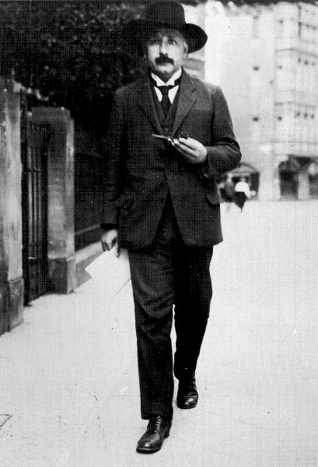
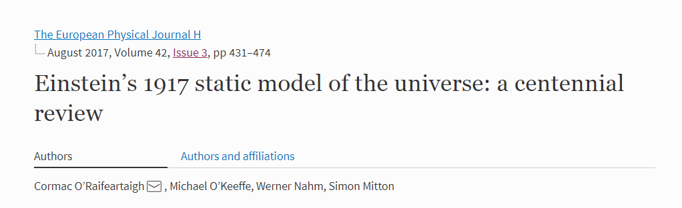
Overview
Historical remarks
Biographical context (1915-1917)
Scientific context: from GR to cosmology
Einstein’s 1917 model of the cosmos
Basic assumptions: basic principles
A guided tour
Theoretical, empirical and philosophical issues
Einstein and alternate cosmologies
Einstein vs de Sitter, Friedman, Lemaître
Einstein’s expanding models
Conclusions

Slide 3
I Historical remarks
Appointed to Berlin Chair
Arrives April 1914
Family leave Berlin, June 1914
World War I (1914-18)
Living alone, food shortages
Dietary problems, illness
Second ‘miraculous’ period
Covariant field equations (1915)
Exposition, solutions and predictions (1916)
First relativistic model of the cosmos (1917)
Papers on gravitational waves
Papers on the quantum theory of radiation
Papers on unified field theory
Einstein in Berlin (1916)

Slide 4
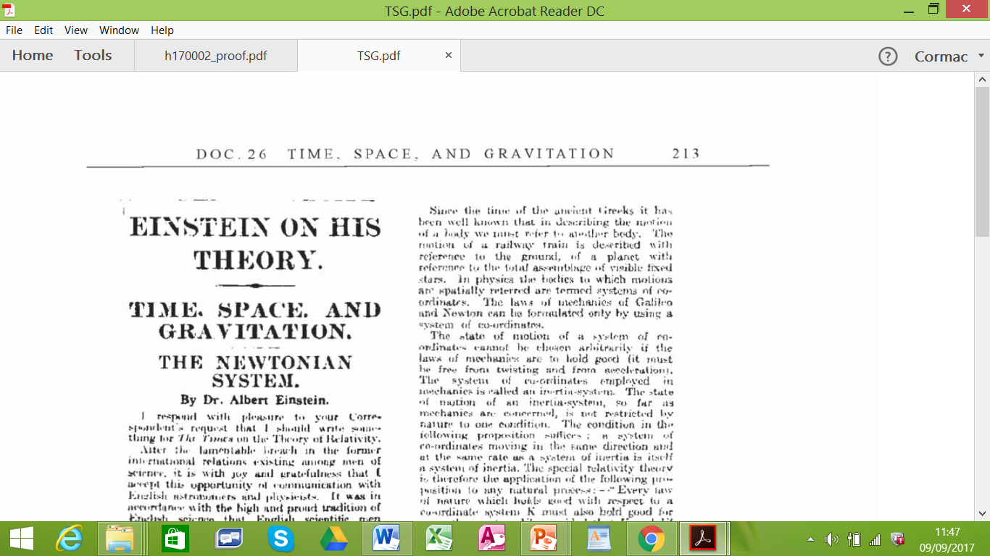
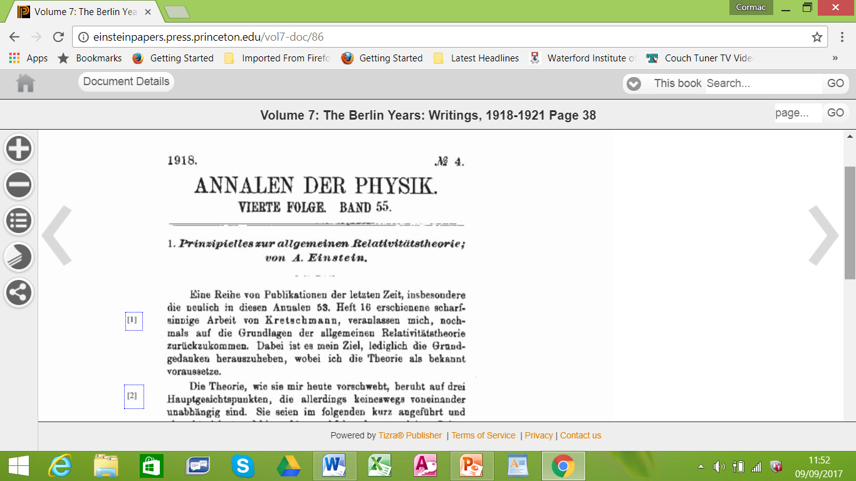
Scientific context
Recall GR = ‘principle-led’ theory
The general principle of relativity (1907-)
Relativity and accelerated motion
The principle of equivalence
Equivalence of gravity and acceleration
The principle of Mach
Relativity of inertia
Structure of space determined by matter
No space without matter
Some cosmological considerations ‘built in’ to GR

Slide 5


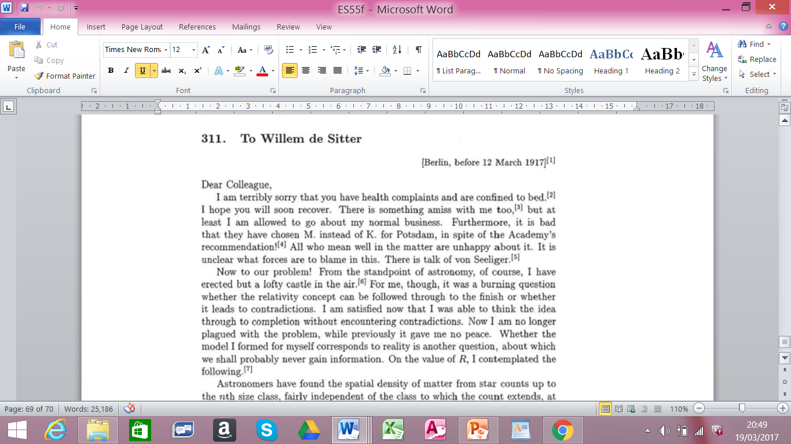
Relativistic cosmology (1915-17)
A natural progression
Ultimate test for any theory of gravitation
Ultimate test for Mach’s principle
Assumption 1: static universe
Observation, experience (QA)
Assumption 2: uniform distribution of matter
Simplicity (Copernican principle?)
Assumption 3/Principle: Mach’s principle
No space without matter
Boundary conditions at infinity?

Slide 6
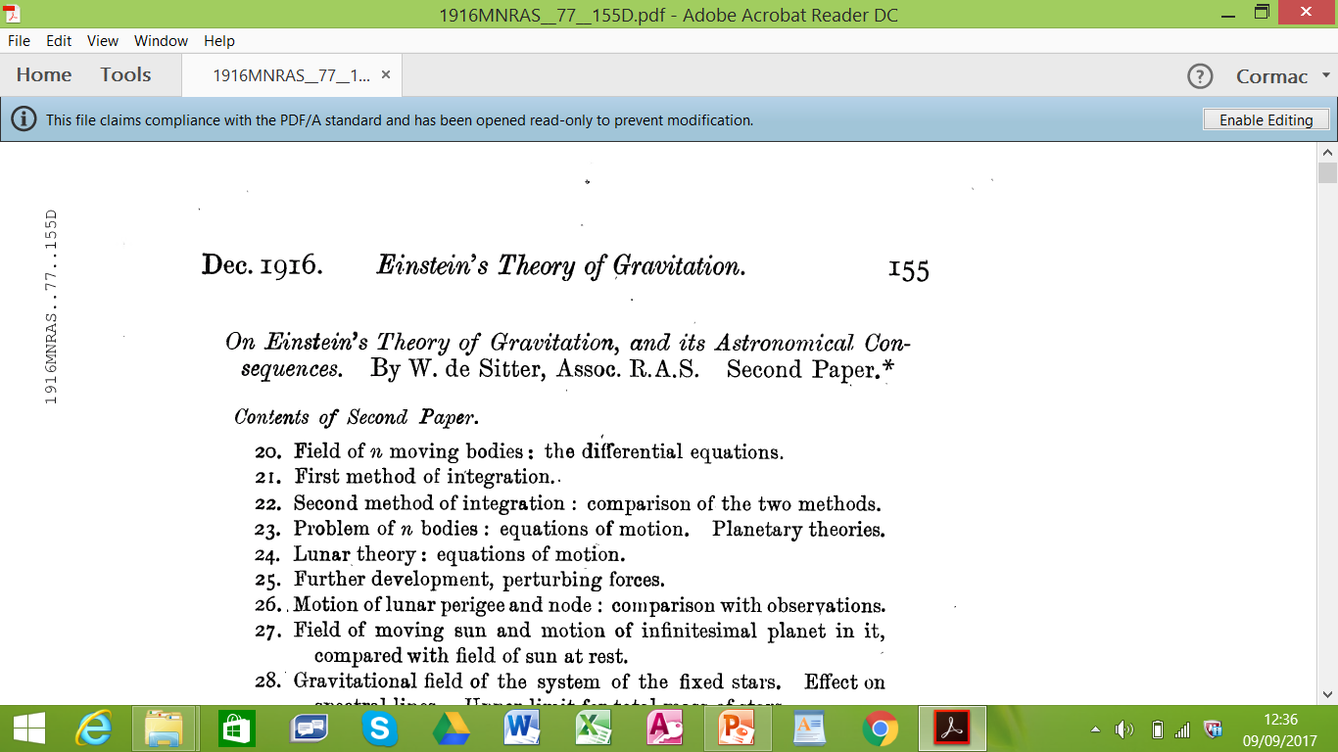
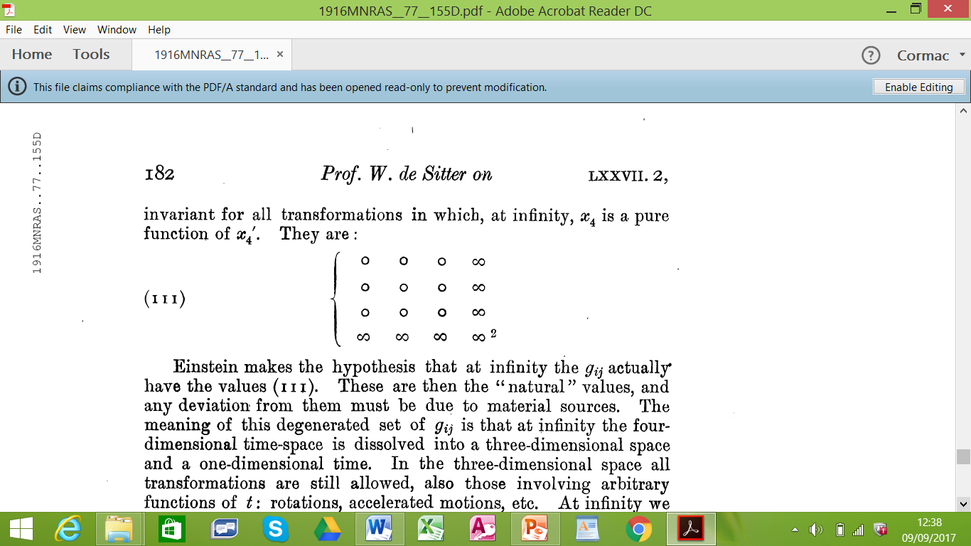
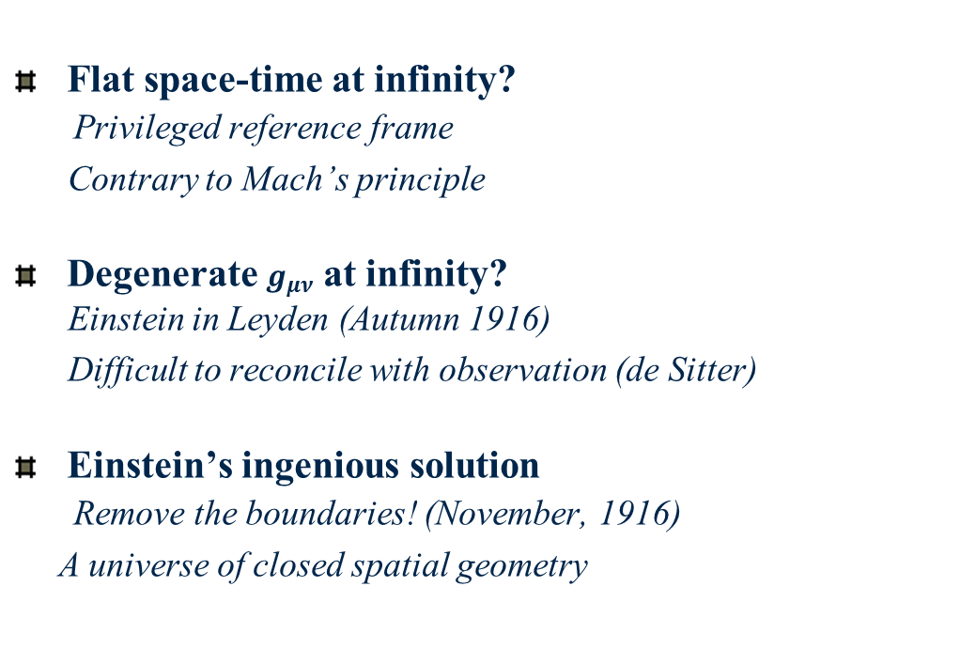
The problem of boundary conditions
Flat space-time at infinity?
Privileged reference frame
Contrary to Mach’s principle
Degenerate $g_{μν}$at infinity?
Einstein in Leyden (Autumn 1916)
Difficult to reconcile with observation (de Sitter)
Einstein’s ingenious solution
Remove the boundaries! (November, 1916)
A universe of closed spatial geometry
“I have perpetrated something which exposes me ..
to the danger of being committed to a madhouse”

Slide 7
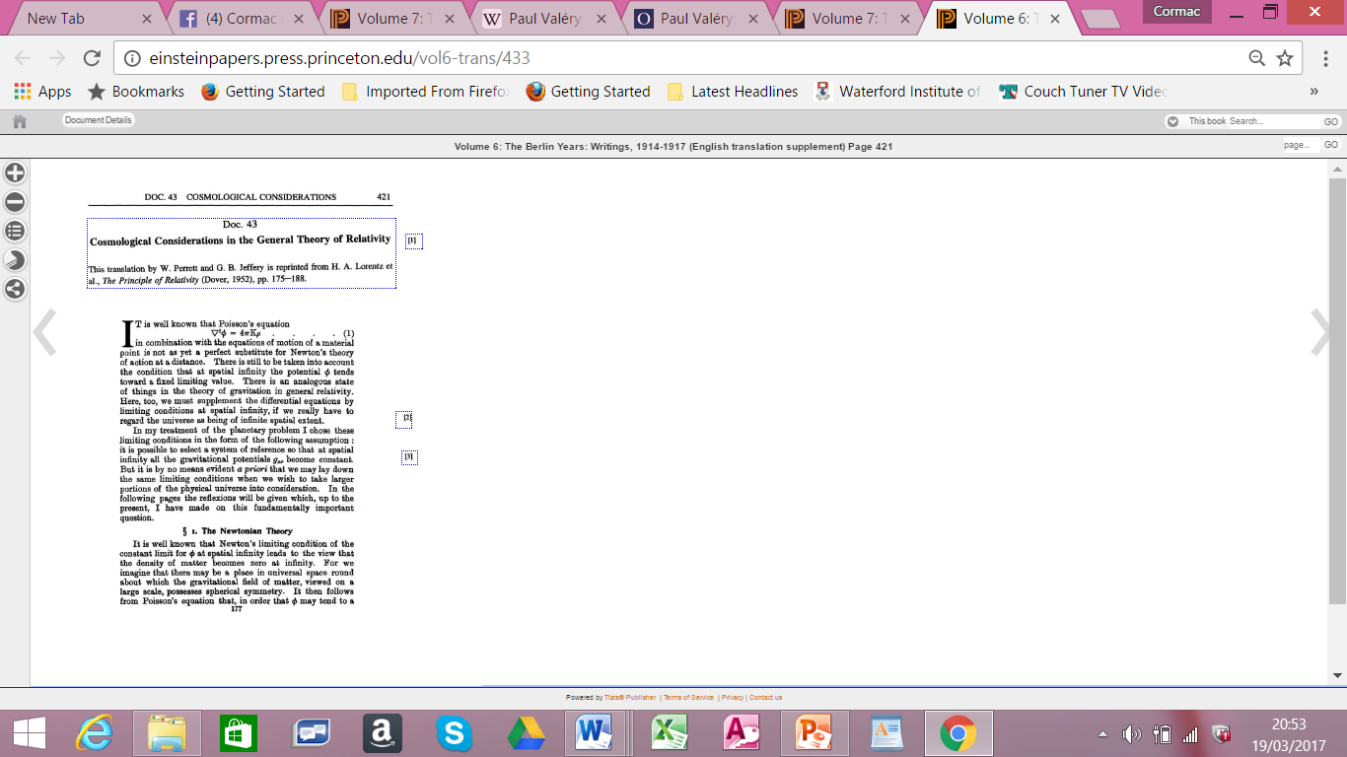
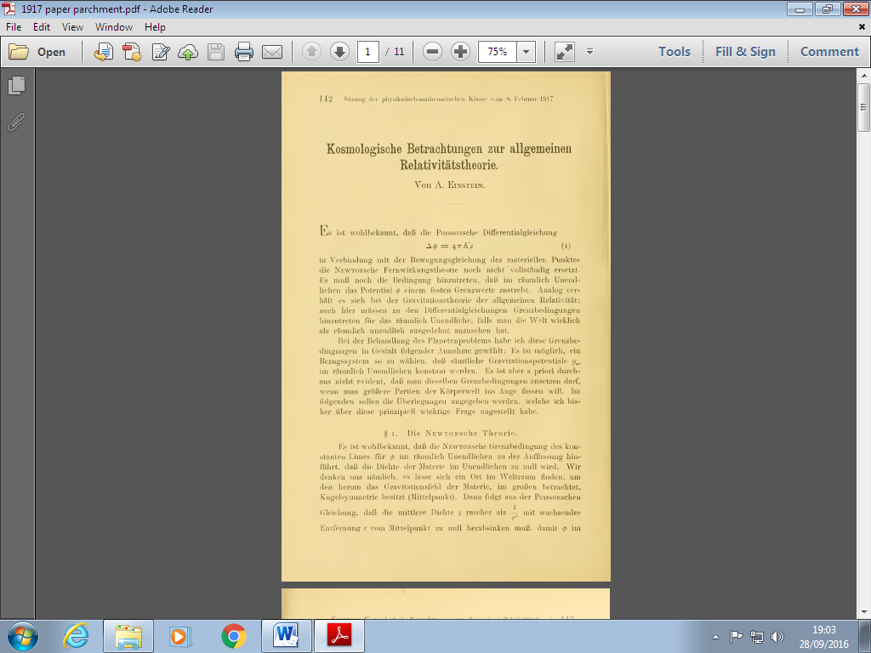
II A guided tour of the paper

Slide 8
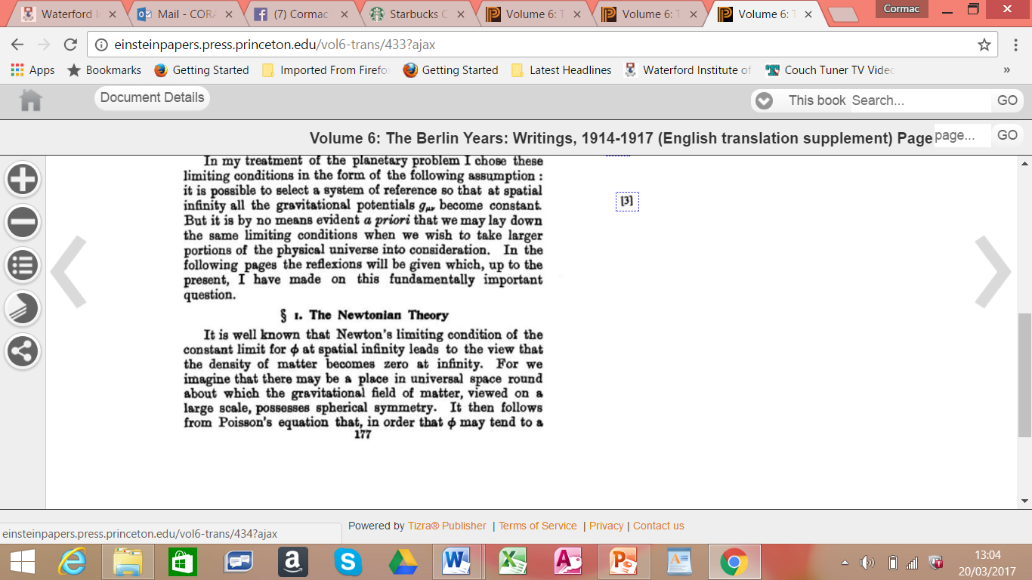
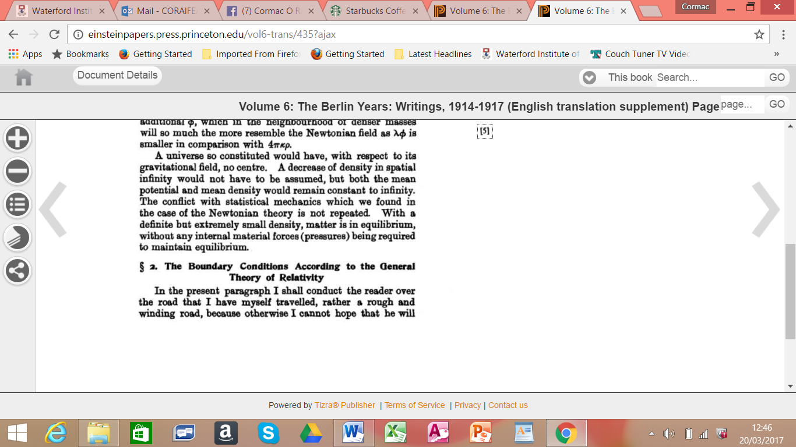
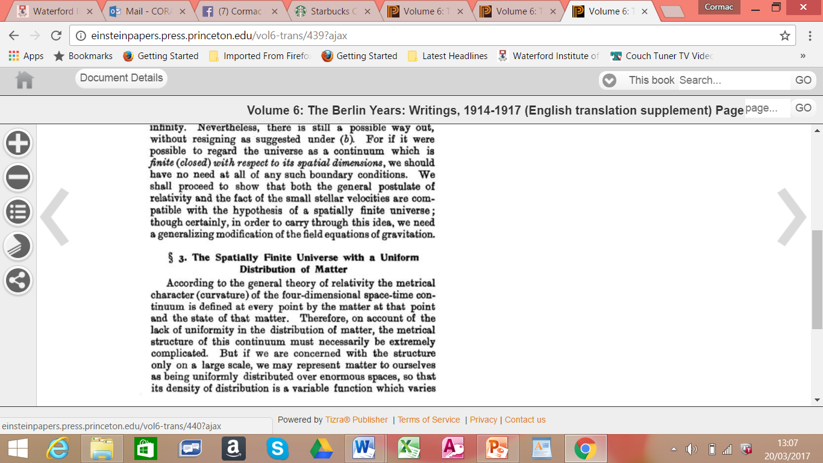
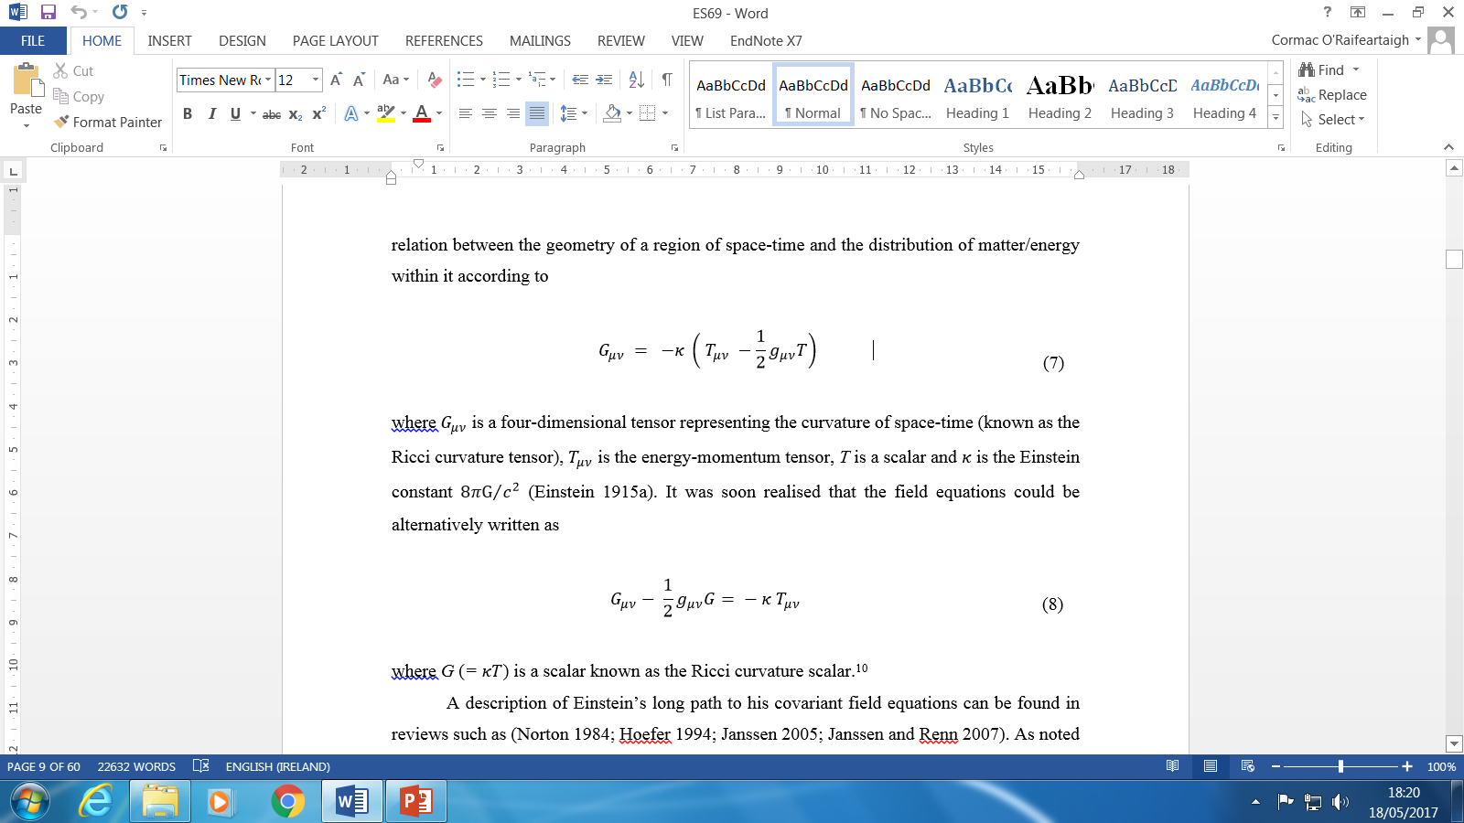
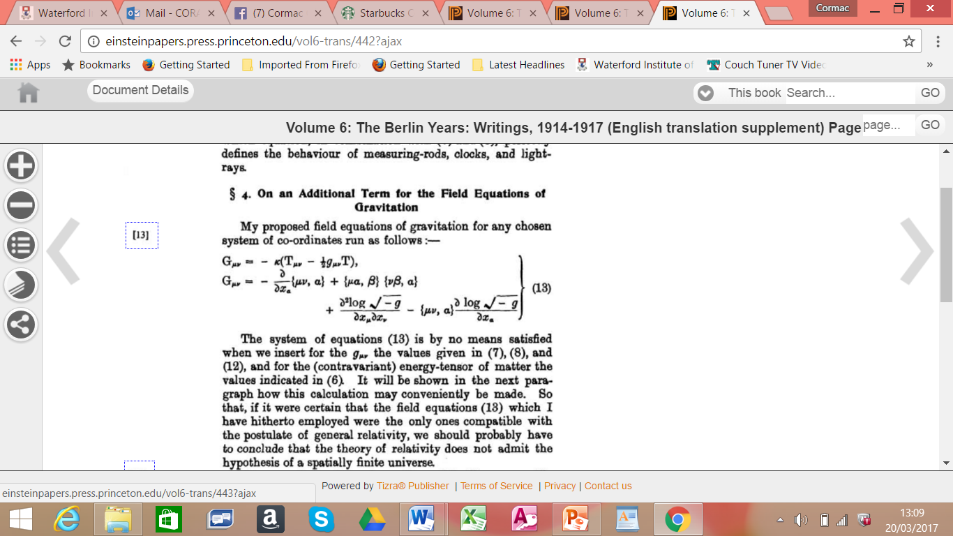
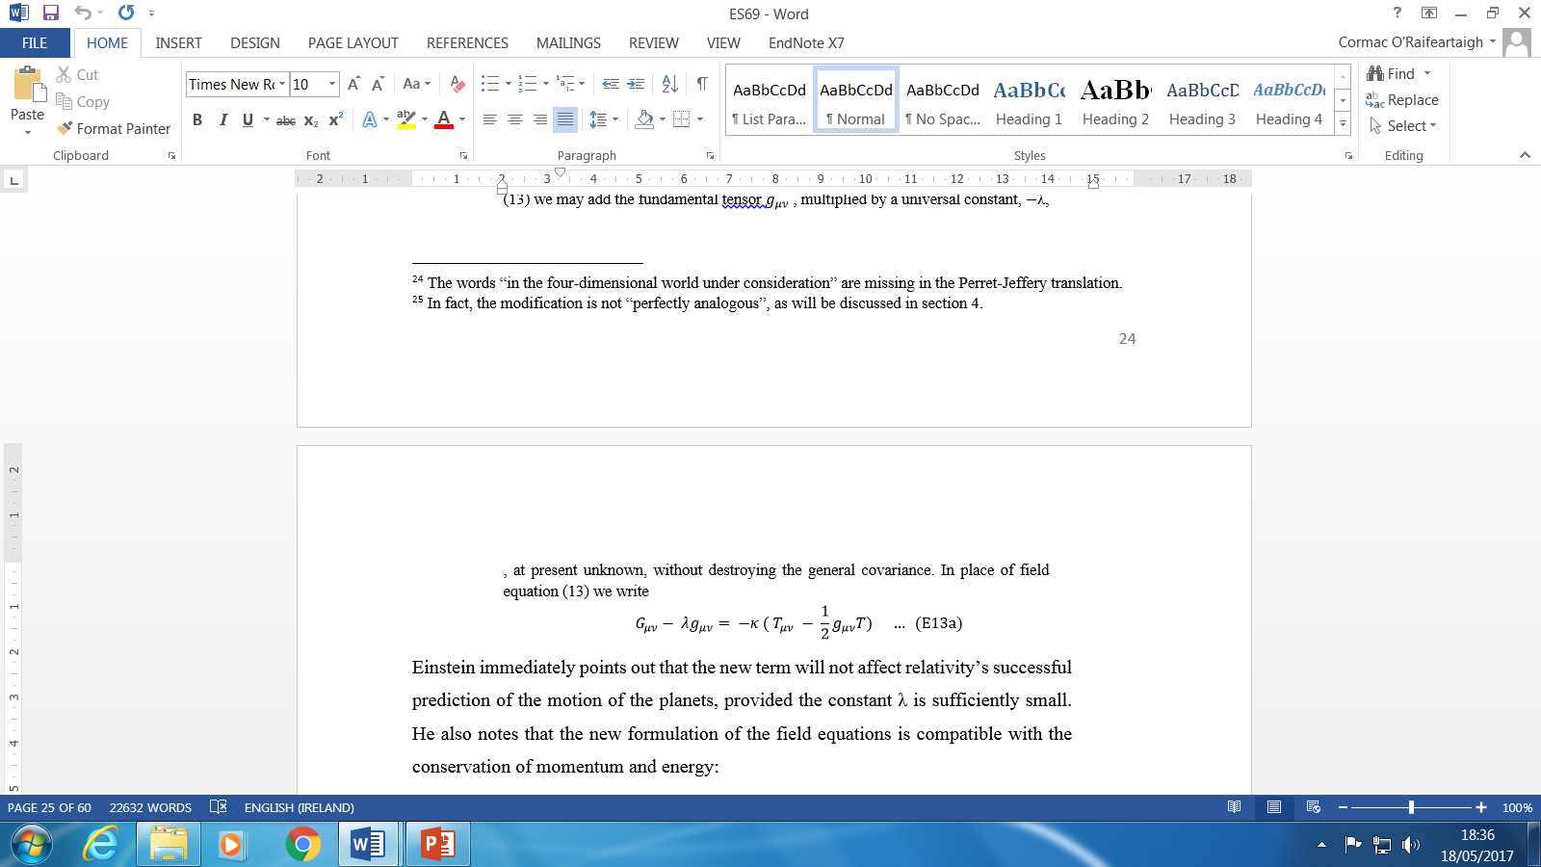
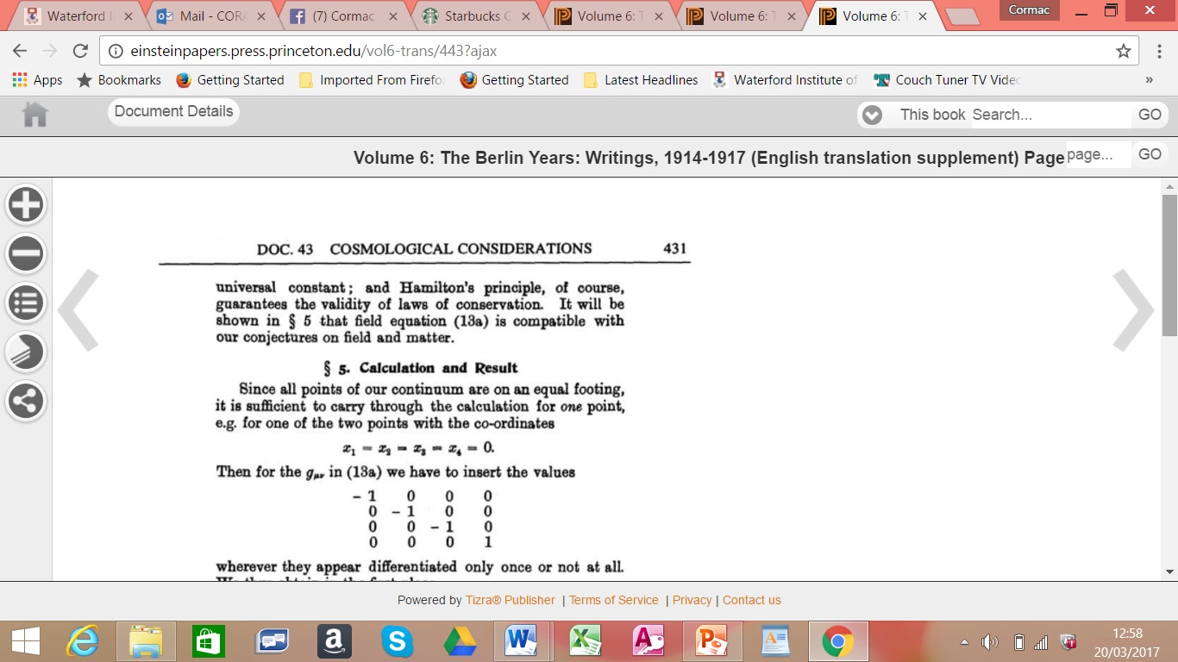
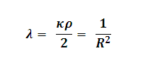
Structure of Einstein’s 1917 paper

Slide 9


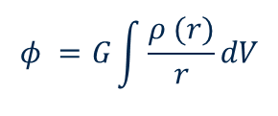

1. The Newtonian theory
Divergence of gravitational force
Assuming non-zero, uniform density of matter
Well-known paradox (Bentley-Newton)
Einstein’s formulation of problem
Mean density must decrease more rapidly than 1/ r²
for constant gravitational potential at infinity: island solution
Stability paradox
Island of matter unstable statistically
Evaporation argument ρ∞ = 0 → ρ_{c} = 0
Solution: modify Poisson’s equation
Finite solution for potential
“A foil for what is to follow”
$∇^{2}φ=4πGρ$ (P1)
$$φ =G\int{\frac{ρ (r)}{r}}dV$$
$∇^{2}φ−λφ = 4πGρ$ (P2)
$$φ =−\frac{4π}{λ}Gρ$$
Independent of modifications by Seeliger, Neumann

Slide 10

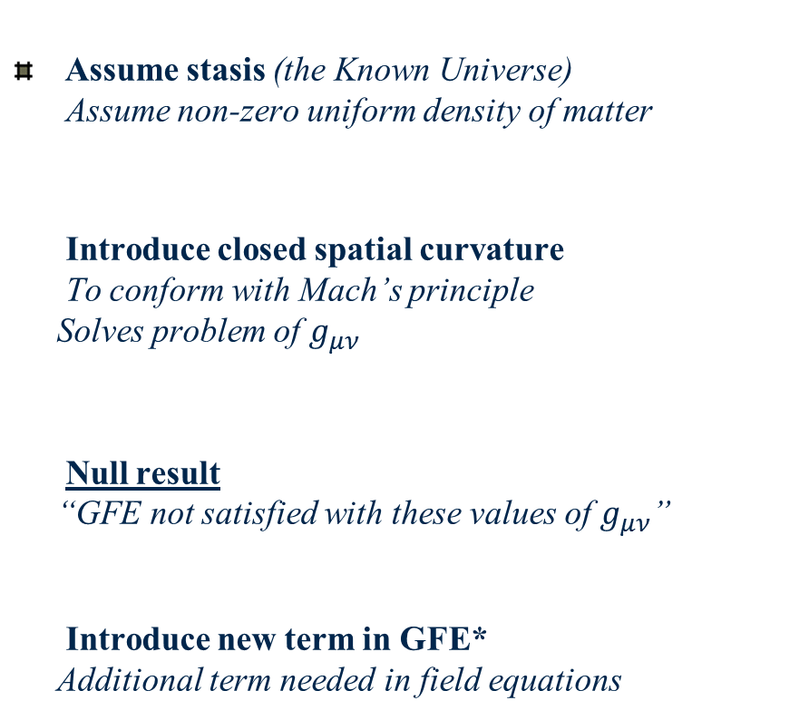
3. The spatially closed universe
4. An additional term in the GFE
Assume stasis (the Known Universe)
Assume non-zero uniform density of matter
Introduce closed spatial curvature
To conform with Mach’s principle
Solves problem of $g_{μν}$
Null result
“GFE not satisfied with these values of $g_{μν}$”
Introduce new term in GFE*
Additional term needed in field equations

Slide 11
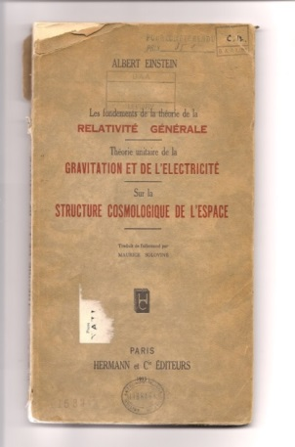
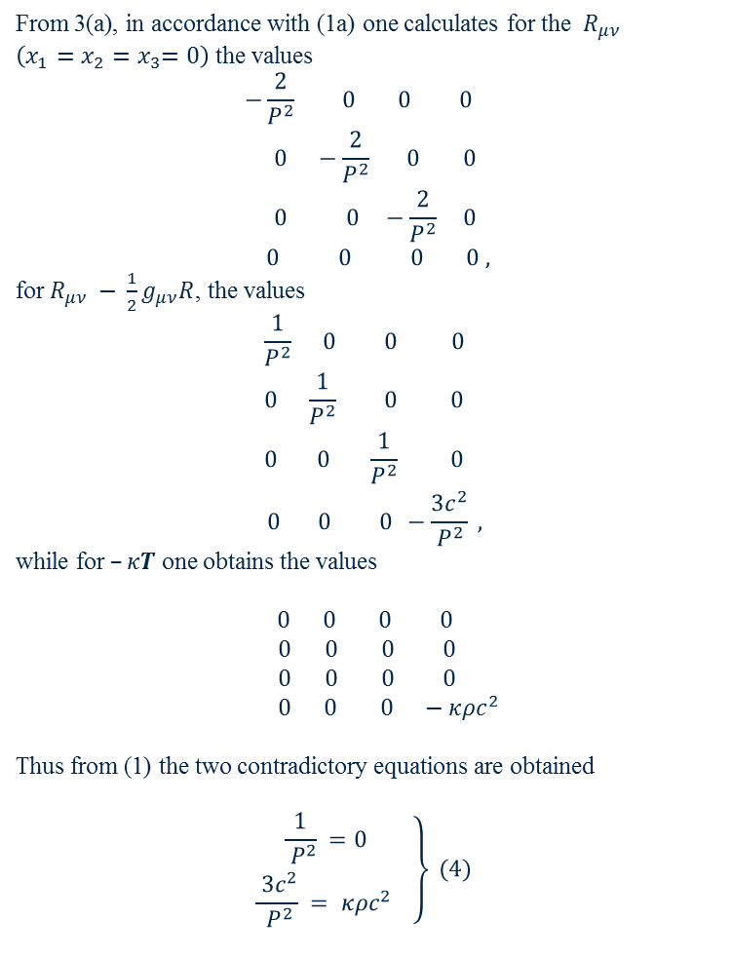

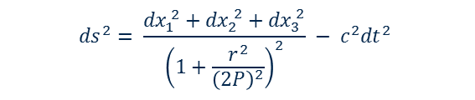
The need for a cosmological constant
From 3(a), in accordance with (1a) one calculates for the ${ R}_{μν}$ $\left(x_{1}=x_{2}{=x}_{3}=0\right)$ the values
$$\begin{matrix}\begin{matrix}−\frac{2}{P^{2}} 0 0 0 \\ 0 −\frac{2}{P^{2}} 0 0\end{matrix} \\ \begin{matrix} 0 0 −\frac{2}{P^{2}} 0 \\ 0 0 0 0 ,\end{matrix}\end{matrix}$$
for $R_{μν} − \frac{1}{2}g_{μν}R$, the values
$$\begin{matrix}\begin{matrix}\frac{1}{P^{2}} 0 0 0 \\ 0 \frac{1}{P^{2}} 0 0 \end{matrix} \\ \begin{matrix}0 0 \frac{1}{P^{2}} 0 \\ 0 0 0 −\frac{3c^{2}}{P^{2}} ,\end{matrix}\end{matrix}$$
while for $–κT$ one obtains the values
$0 0 0 0$
$$0 0 0 0$$
$$0 0 0 0$$
$0 0 0 −κρc^{2}$
Thus from (1) the two contradictory equations are obtained
$$\left.\begin{matrix}\frac{1}{ P^{2}} =0 \\ \frac{ 3c^{2}}{ P^{2}} = κρc^{2} \end{matrix}\right\} (4)$$
$$G_{μν} − \frac{1}{2}g_{μν}G = −κ T_{μν}$$
$${ds}^{2}= \frac{{dx}_{1}^{ 2}+{dx}_{2}^{ 2}+{dx}_{3}^{ 2}}{{\left(1+\frac{r^{2}}{{\left(2P\right)}^{2}}\right)}^{2}} − c^{2}{dt}^{2}$$
Einstein 1933
λ term needed for (static) solution

Slide 12
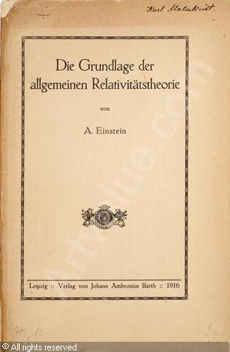
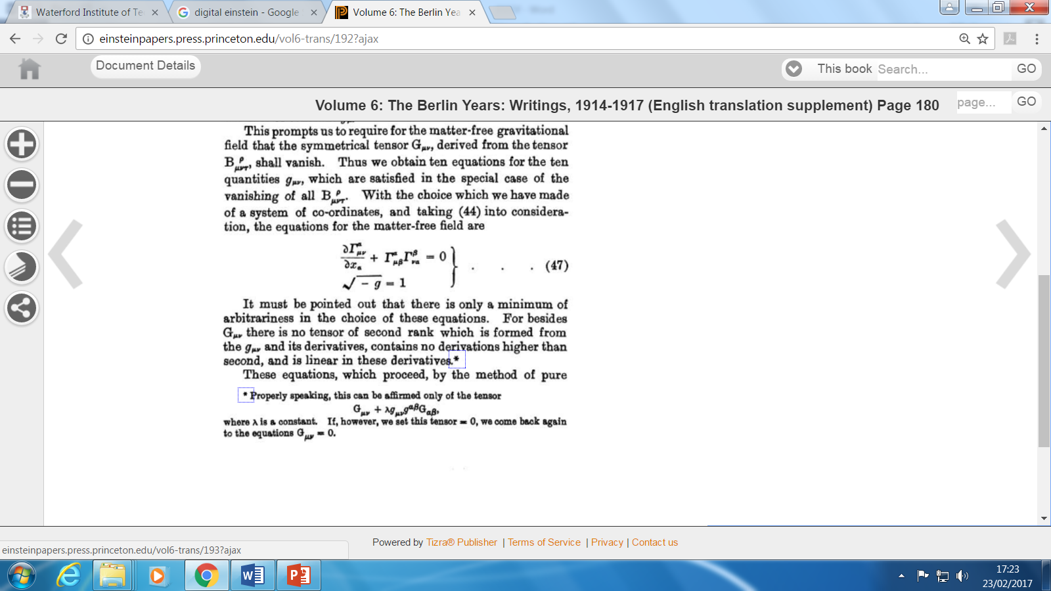

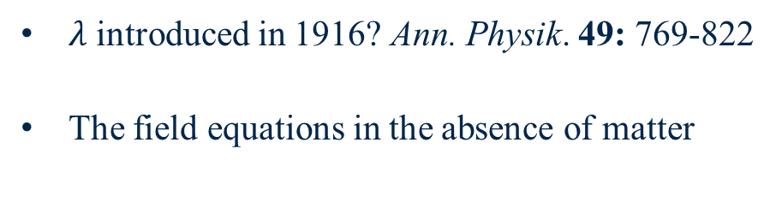
A precursor for the cosmological constant
$λ$ introduced in 1916? Ann. Physik. 49: 769-822
The field equations in the absence of matter
Prepared the way for $λg_{μν}$ in 1917

Slide 13
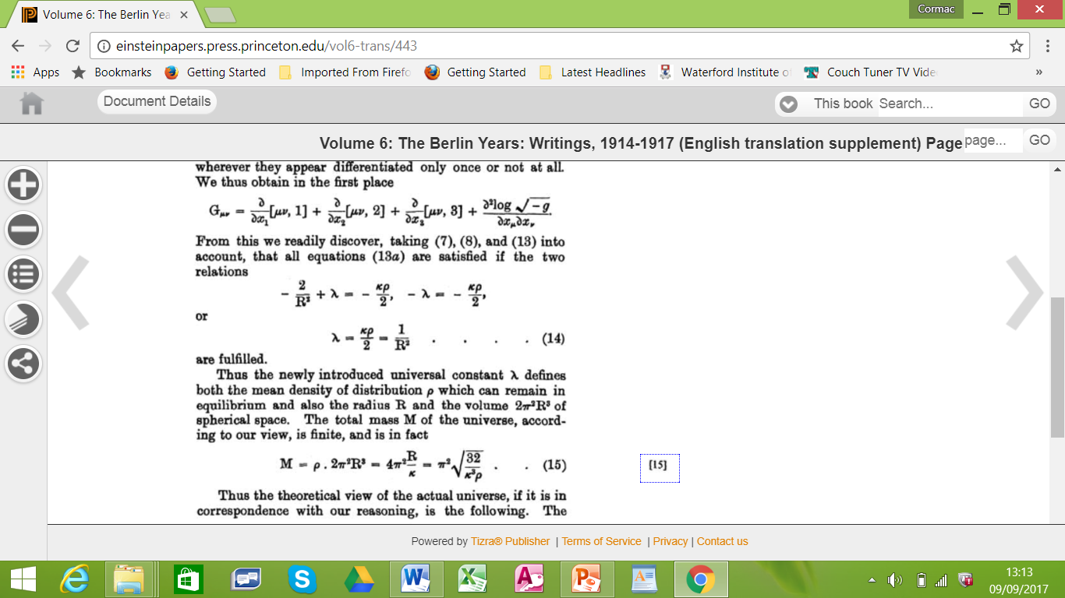
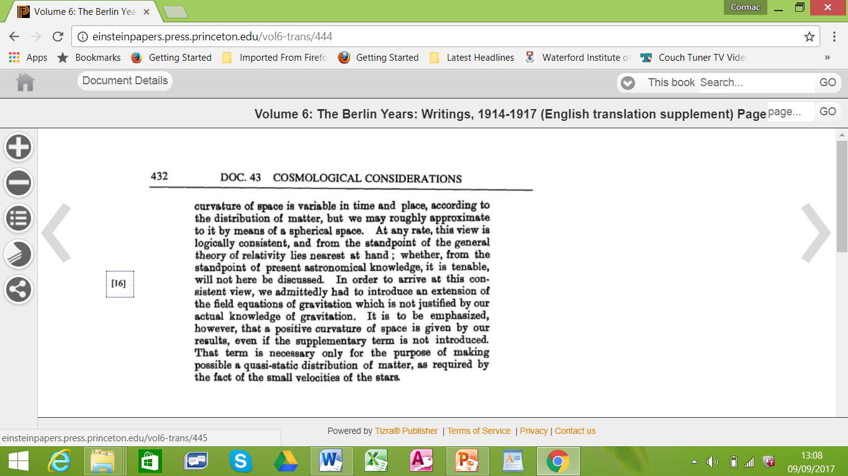
5. Calculation and result
Calculation and result
Caveats
Consistent model without reference to astronomy
Extension of GFE required
Necessitated by assumption of stasis

Slide 14
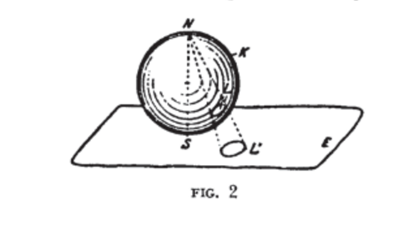
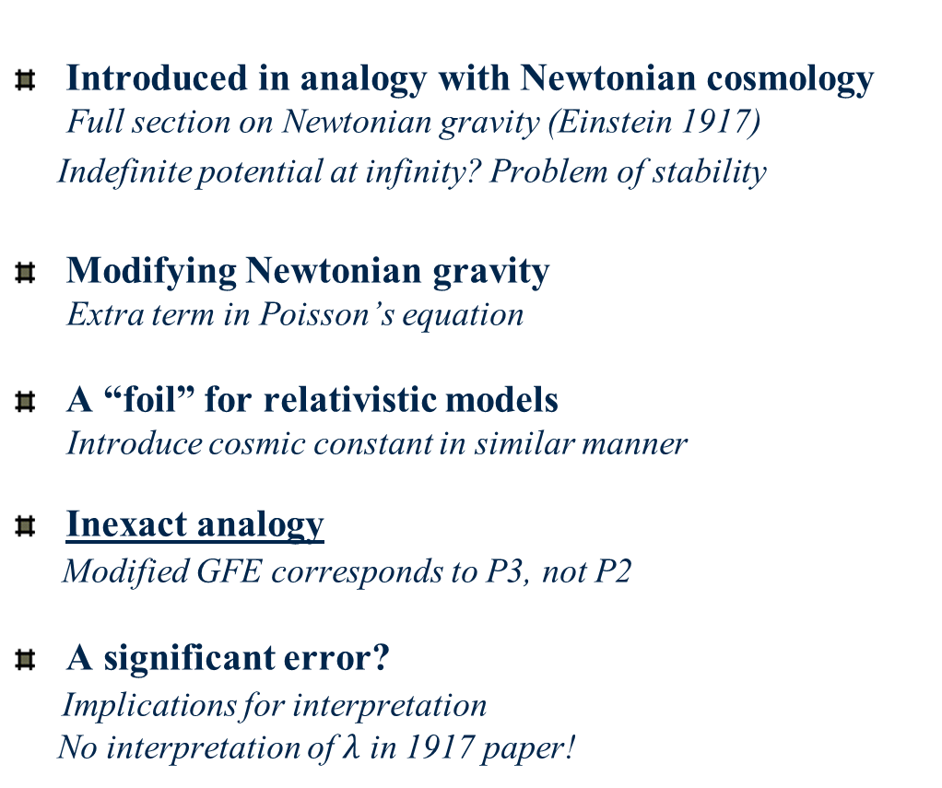



On the cosmological constant (i)
Introduced in analogy with Newtonian cosmology
Full section on Newtonian gravity (Einstein 1917)
Indefinite potential at infinity? Problem of stability
Modifying Newtonian gravity
Extra term in Poisson’s equation
A “foil” for relativistic models
Introduce cosmic constant in similar manner
Inexact analogy
Modified GFE corresponds to P3, not P2
A significant error?
Implications for interpretation
No interpretation of $λ$ in 1917 paper!
$∇^{2}φ=4πGρ$ (P1)
$∇^{2}φ−λφ = 4πGρ$ (P2)
$$∇^{2}φ{ + c}^{2} λ=4πGρ (P3)$$

Slide 15
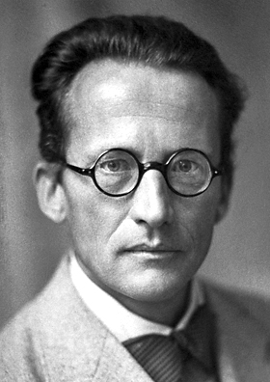

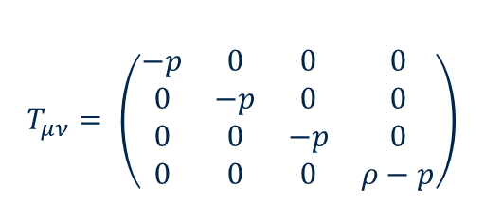
On the cosmological constant (ii)
Schrödinger, 1918
Cosmic constant term not necessary for cosmic model
Introduce negative pressure term in energy-momentum tensor
Einstein’s reaction
New formulation equivalent to original
(Questionable: physics not the same)
Schrödinger, 1918
Could pressure term be time-dependent ?
Einstein’s reaction
If not constant, time dependence unknown
“I have no wish to enter this thicket of hypotheses”
Erwin Schrödinger 1887-1961
$$T_{μν}= \left(\begin{matrix}−p & 0 & 0 & 0 \\ 0 & −p & 0 & 0 \\ 0 & 0 & −p & 0 \\ 0 & 0 & 0 & ρ−p\end{matrix}\right)$$

Slide 16
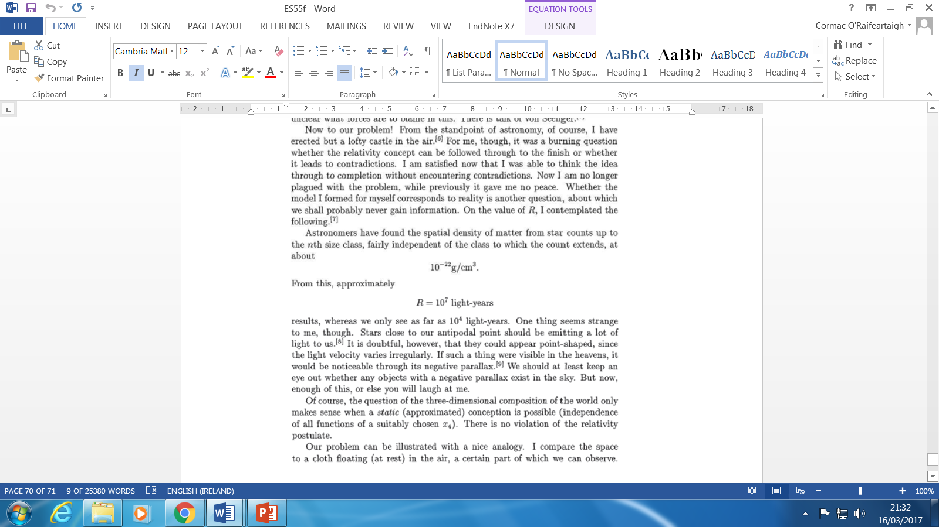
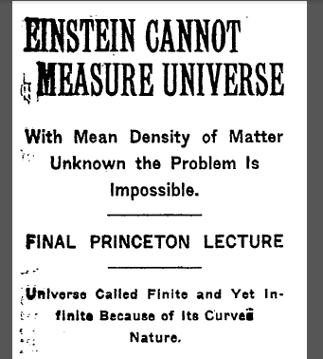
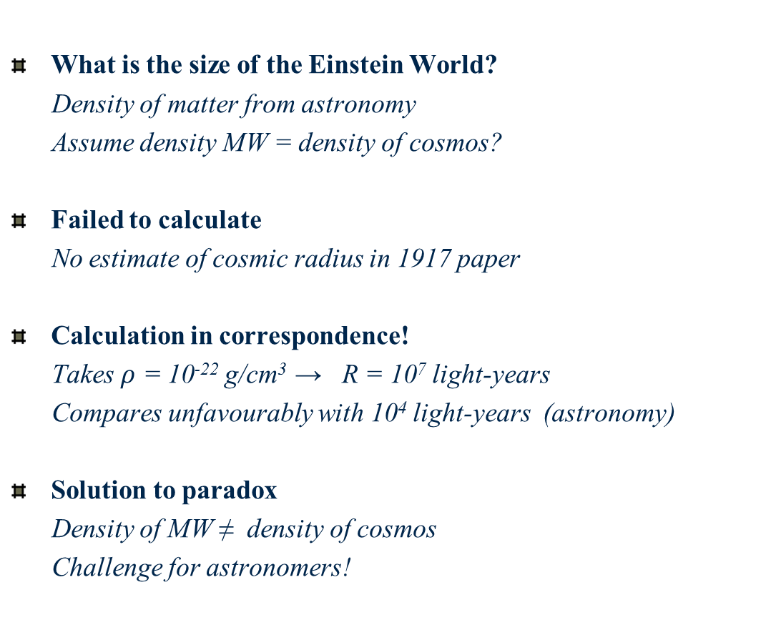
On the size of the Einstein World
What is the size of the Einstein World?
Density of matter from astronomy
Assume density MW = density of cosmos?
Failed to calculate
No estimate of cosmic radius in 1917 paper
Calculation in correspondence!
Takes $ρ$ = 10⁻²² g/cm³ → R = 10⁷ light-years
Compares unfavourably with 10⁴ light-years (astronomy)
Solution to paradox
Density of MW ≠ density of cosmos
Challenge for astronomers!

Slide 17
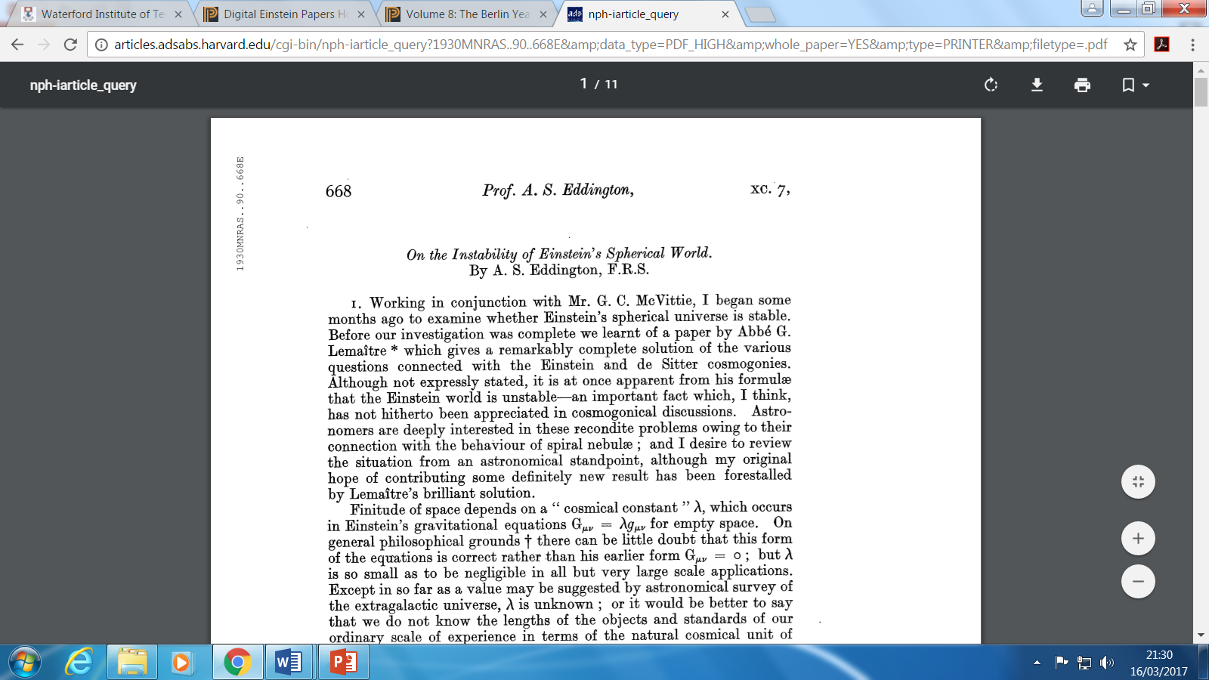
On the stability of the Einstein World
How does cosmic constant term work?
Assume uniform distribution of matter
Perturbation
What happens if the density of matter varies slightly?
Failed to consider
No mention of issue in 1917
No mention of issue for many years
Lemaître (1927)
Cosmos expanding from Einstein World
Eddington (1930)
Einstein World unstable

Slide 18
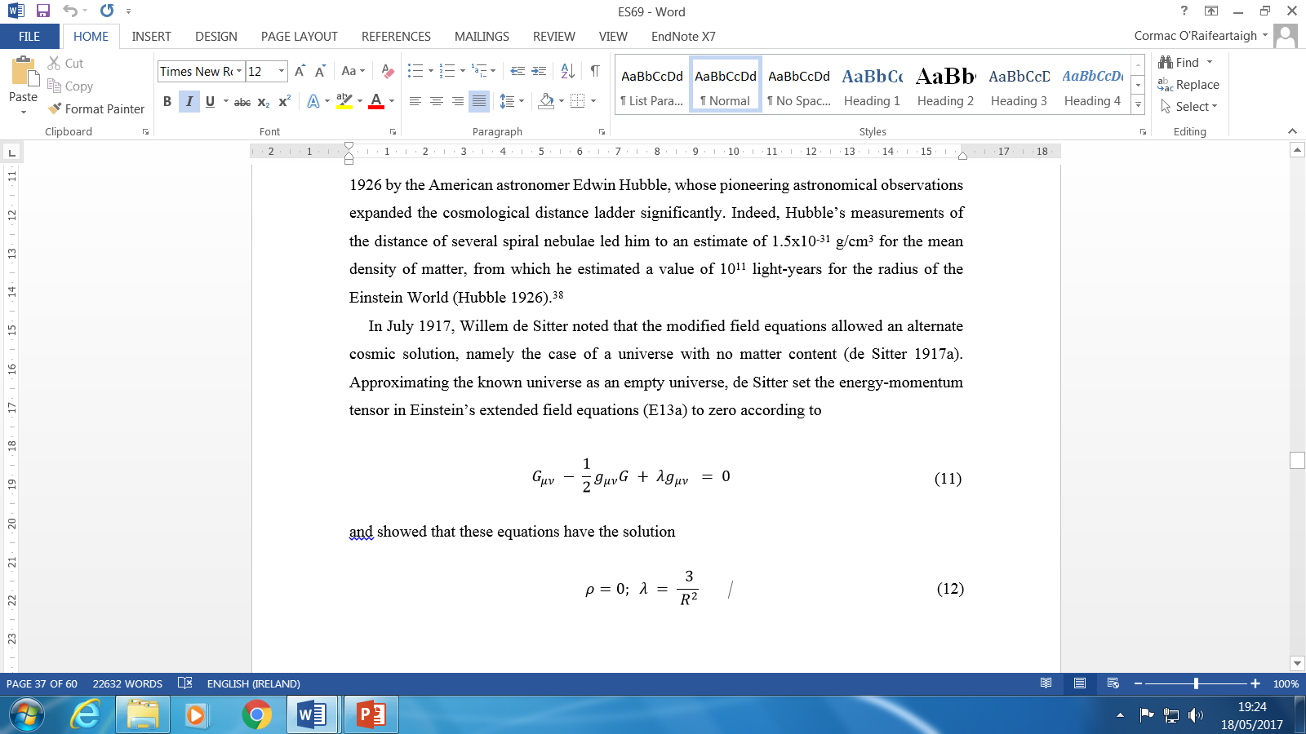

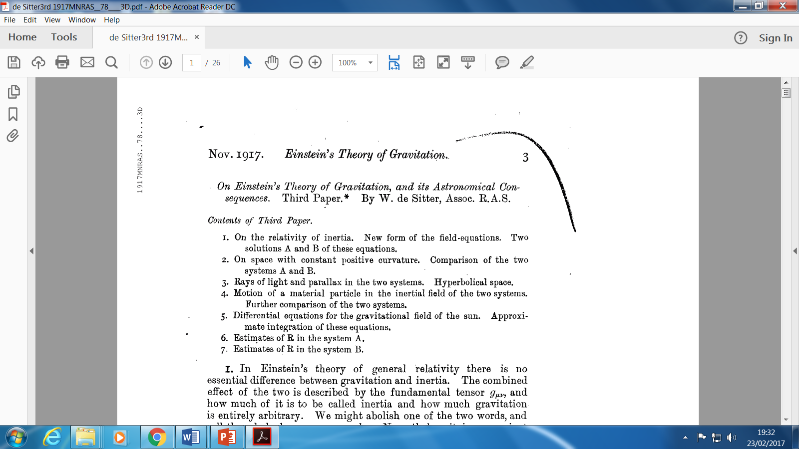
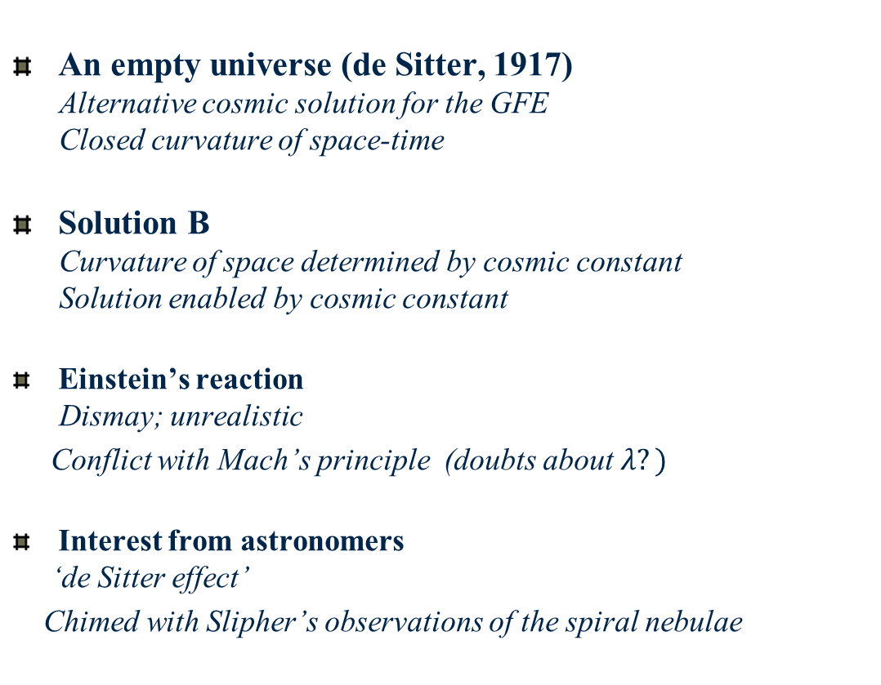
III Einstein and alternate cosmologies
An empty universe (de Sitter, 1917)
Alternative cosmic solution for the GFE
Closed curvature of space-time
Solution B
Curvature of space determined by cosmic constant
Solution enabled by cosmic constant
Einstein’s reaction
Dismay; unrealistic
Conflict with Mach’s principle (doubts about $λ?)$
Interest from astronomers
‘de Sitter effect’
Chimed with Slipher’s observations of the spiral nebulae
Willem de Sitter

Slide 19

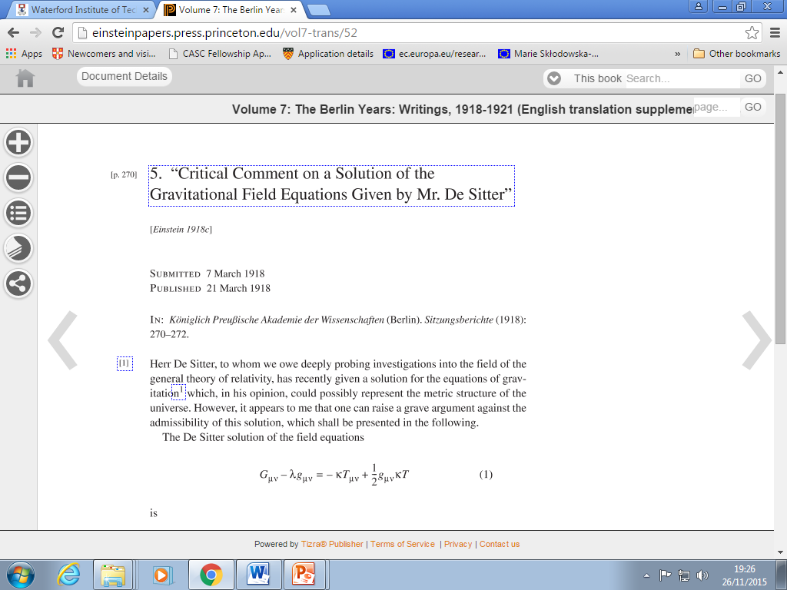

The Einstein-deSitter-Weyl-Klein debate
de Sitter solution disliked by Einstein
Conflict with Mach’s principle
Problems with singularities? (1918)
Lack of singularity conceded (non-static case)
Considered unrealistic
Arguing past each other?
Not Machian
Not static ?
A second de Sitter confusion
Weyl, Lanczos, Klein, Lemaître
Static or non-static - a matter of co-ordinates?
$$ρ=0: λ = \frac{ 3}{ R^{2}}$$

Slide 20


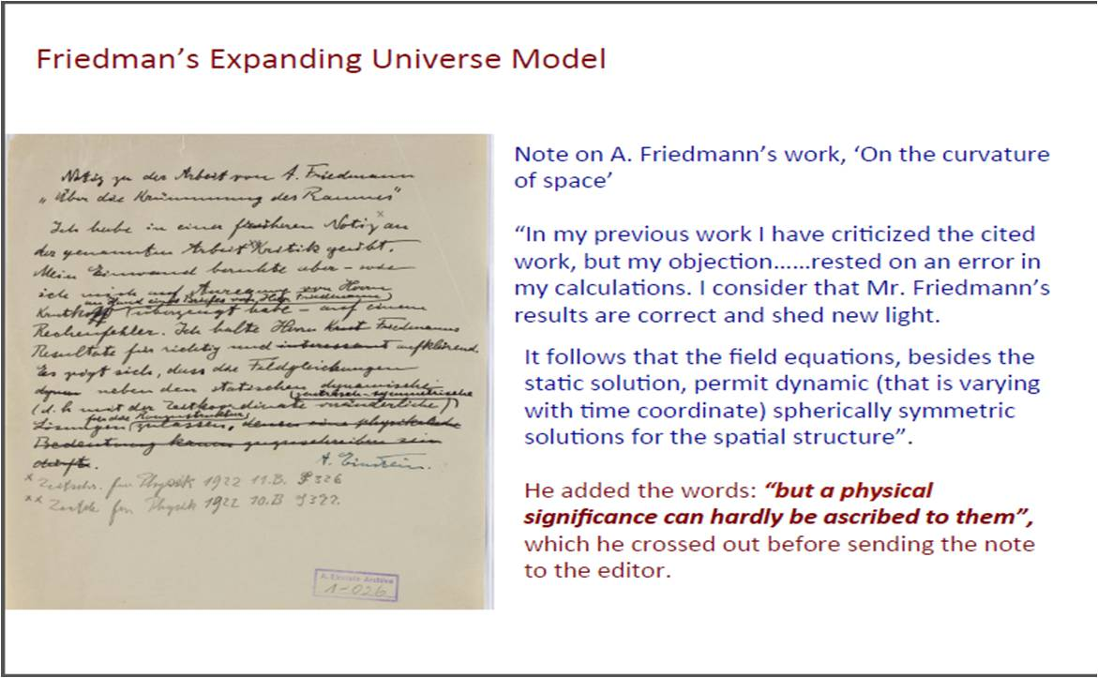
Einstein vs Friedman
Alexander Friedman (1922)
Allow time-varying solutions for the cosmos
Expanding or contracting universe
Evolving universe
Time-varying density of matter
Positive or negative spatial curvature
Depends on matter Ω =d/d_{c}
Einstein’s reaction
Declared solution invalid (1922)
Retracted one year later (1923)
Hypothetical (unrealistic) solution
Alexander Friedman
(1888 -1925)
“To this a physical reality can hardly be ascribed”

Slide 21


Einstein vs Lemaître
Georges Lemaître (1927)
Allow time-varying solutions (expansion)
Retain cosmic constant
Inspired by astronomical observation
Redshifts of the nebulae (Slipher)
Extra-galactic nature of the nebulae (Hubble)
Expansion from static Einstein World
Instability (implicit)
Einstein’s reaction
Expanding models “abominable” (conversation)
Georges Lemaître
(1894-1966)
Einstein not au fait with astronomy?

Slide 22


A watershed in cosmology
Hubble’s law (1929)
A redshift/distance relation for the spiral nebulae
Linear relation: h = 500 kms⁻¹Mpc⁻¹
Evidence of cosmic expansion?
RAS meeting (1930): Eddington, de Sitter
Friedman-Lemaître models circulated
Time-varying radius and density of matter
Einstein apprised
Cambridge visit (June 1930)
Sojourn at Caltech (Spring 1931)
Edwin Hubble (1889-1953)

Slide 23



The expanding universe (1930-32)
Eddington (1930, 31)
On the instability of the Einstein universe
Expansion caused by condensation?
Tolman (1930, 31)
On the behaviour of non-static models
Expansion caused by annihilation of matter ?
de Sitter (1930, 31)
Further remarks on the expanding universe
Expanding universes of every flavour
Einstein (1931, 32)
Friedman-Einstein model k =1, λ = 0
Einstein-de Sitter model k = 0, λ = 0
Expanding models
Einstein’s steady–state model (~1931): λ = energy of the vacuum?

Slide 24
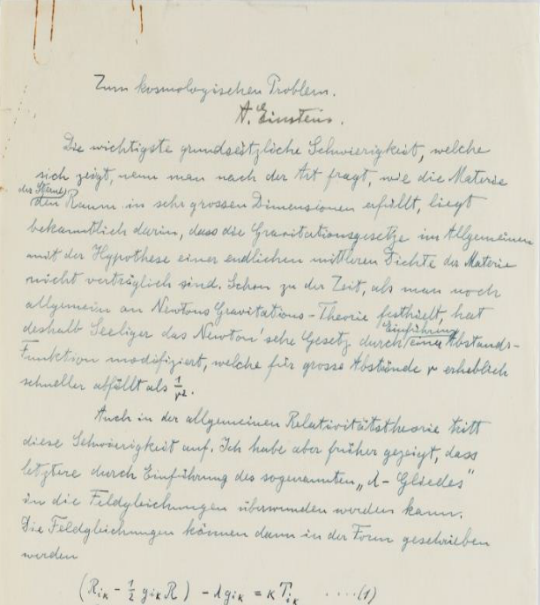

Einstein’s steady-state model (~1931)
Unpublished manuscript
Archived as draft of Friedman-Einstein model
Similar title, opening
Steady-state model
“The density is constant and determines the expansion”
Associates creation of matter with λ
Fatal flaw
Null solution
Abandoned in favour of evolving models
O’Raifeartaigh et al. 2016
Nussbaumer 2016

Slide 25
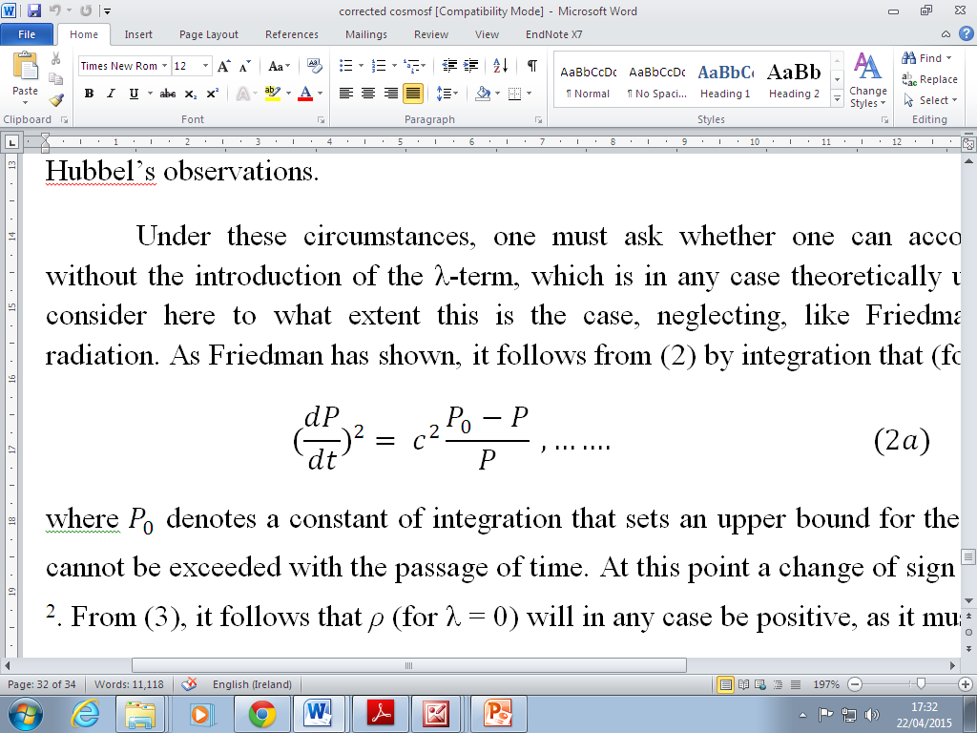
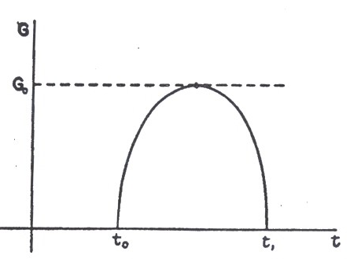
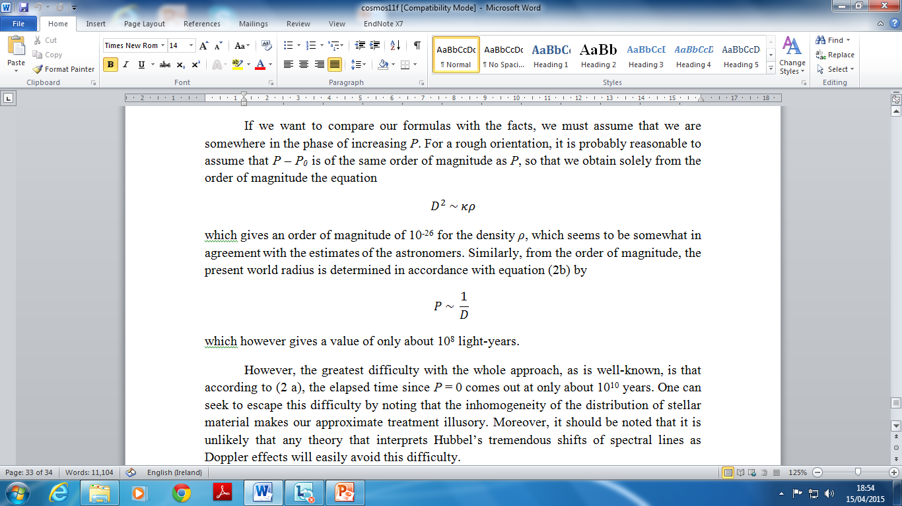
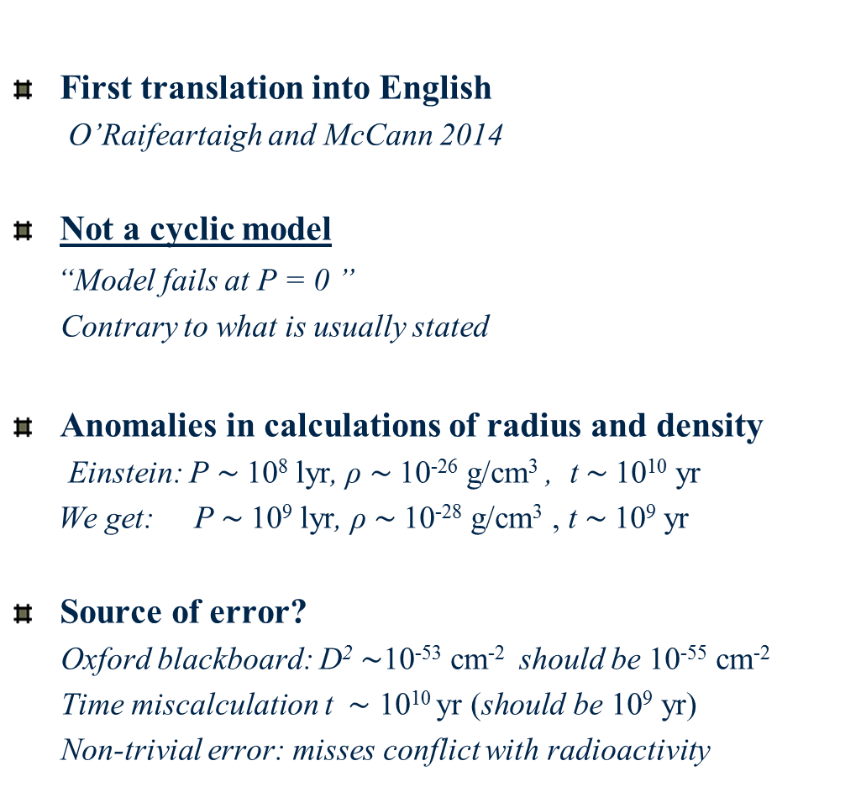
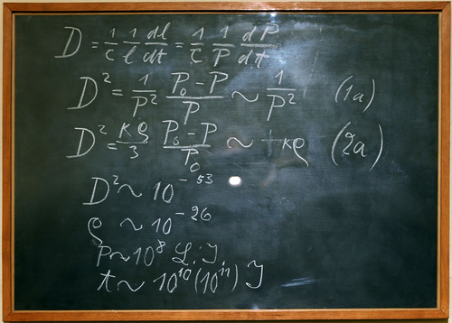
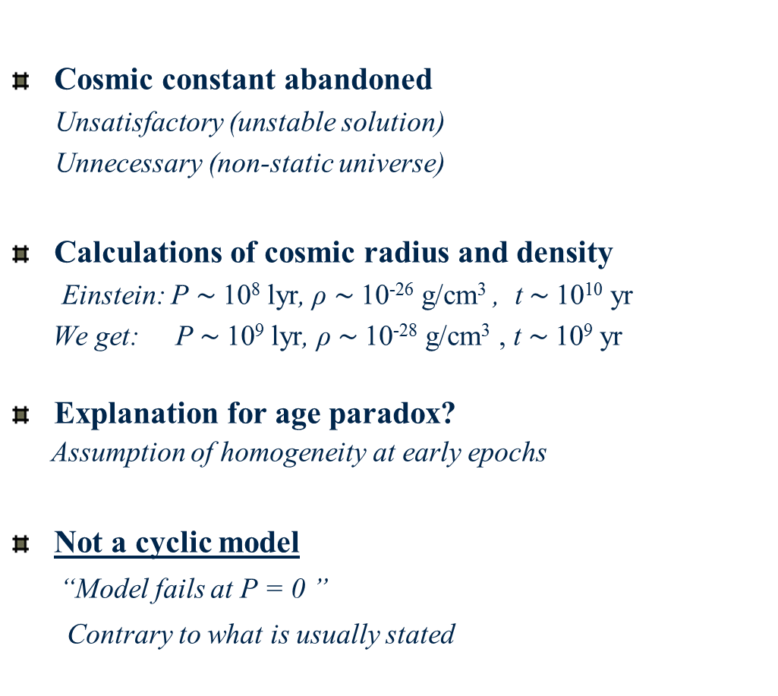
The Friedman-Einstein model (1931)
Cosmic constant abandoned
Unsatisfactory (unstable solution)
Unnecessary (non-static universe)
Calculations of cosmic radius and density
Einstein: P $\sim$10⁸ lyr, ρ $\sim$10⁻²⁶ g/cm³ , t $\sim$10¹⁰ yr
We get: P $\sim$10⁹ lyr, ρ $\sim$10⁻²⁸ g/cm³ , t $\sim$10⁹ yr
Explanation for age paradox?
Assumption of homogeneity at early epochs
Not a cyclic model
“Model fails at P = 0 ”
Contrary to what is usually stated

Slide 26

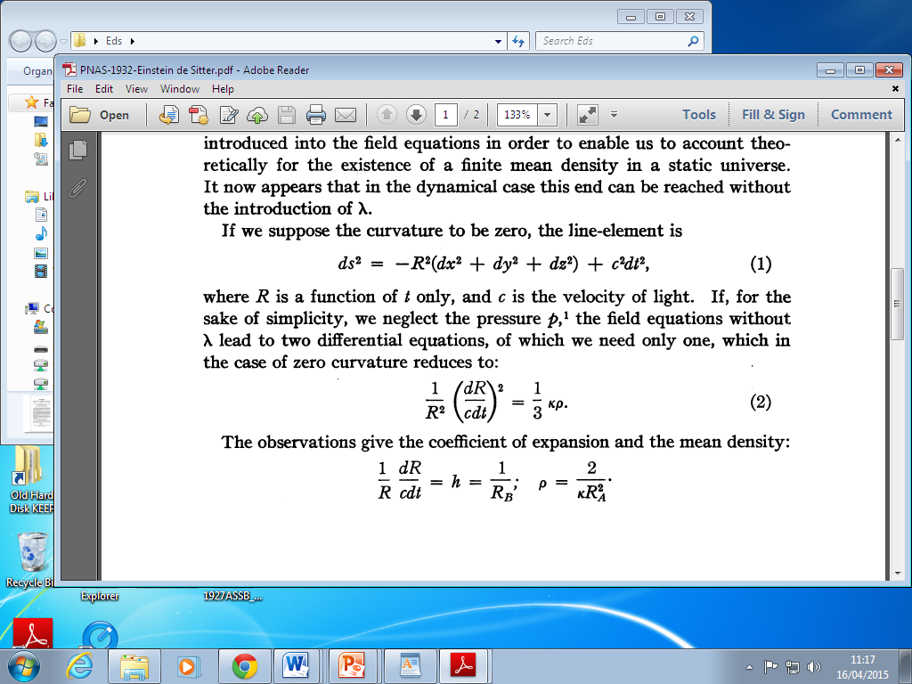
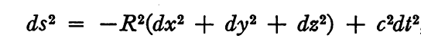


Einstein-de Sitter model (1932)
Curvature not a given in dynamic models
Not observed empirically
Remove spatial curvature (Occam’s razor)
Simplest Friedman model
Time-varying universe with λ = 0, k = 0
Important hypothetical case: critical universe
Critical density : ρ =10⁻²⁸ g/cm³
Becomes standard model
Despite high density of matter
Despite age problem
Time evolution not considered in paper – see title

Slide 27


“My greatest blunder”
Einstein’s description of cosmic constant term
Reported by George Gamow
Controversy
Queried by Straumann, Livio
Not in Einstein’s papers or other reports
Our findings
Consistent with actions
Einstein’s remark reported by Gamow, Alpher, Wheeler
Meaning of remark
Failure to spot instability of static solution
Failure to predict expanding universe
Georges Gamow

Slide 28
Conclusions
Historical aspects of 1917 paper
Continuation of relativity project
Philosophical aspects of 1917 paper
Inspired by Mach’s principle
Assumptions
Non-zero mean density of matter (uniform)
Static universe (observation)
Failure to spot instability of static solution
New evidence
Happy to embrace expanding universe
Minimal models - Occam’s razor
No mention of origins

Slide 29
Coda: The Einstein World today
The question of origins
BB model ≠ a theory of origins
The singularity problem
The quantum gravity problem
The cyclic universe
From BC to BB
The emergent universe
Inflating from a static Einstein World
On the stability of the Einstein World
Advanced GR: LQG, DGR, B-D, f(R), f (R,T)
Relevance of past theories in modern science

Slide 30


Slide 31
The Friedman-Einstein model
First translation into English
O’Raifeartaigh and McCann 2014
Not a cyclic model
“Model fails at P = 0 ”
Contrary to what is usually stated
Anomalies in calculations of radius and density
Einstein: P $\sim$10⁸ lyr, ρ $\sim$10⁻²⁶ g/cm³ , t $\sim$10¹⁰ yr
We get: P $\sim$10⁹ lyr, ρ $\sim$10⁻²⁸ g/cm³ , t $\sim$10⁹ yr
Source of error?
Oxford blackboard: D² $\sim$10⁻⁵³ cm⁻² should be 10⁻⁵⁵ cm⁻²
Time miscalculation t $\sim \text{10}\text{10} \text{y}\text{r}\text{ (}\text{should} \text{be} \text{10}\text{9} \text{y}\text{r}$)
Non-trivial error: misses conflict with radioactivity

