Slide 1

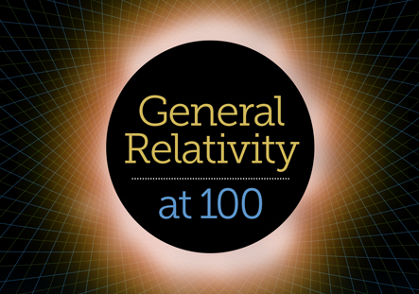

The Big Bang: Fact or Fiction?
A new perspective on Einstein’s cosmology
Cormac O’Raifeartaigh
Waterford Institute of Technology
Dublin Institute for Advanced Studies
Brendan McCann, Michael O’Keeffe (Waterford IT)
Simon Mitton (Cambridge Univ.), Werner Nahm (Dublin IAS)

Slide 2
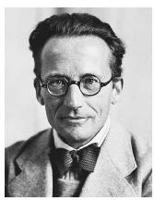


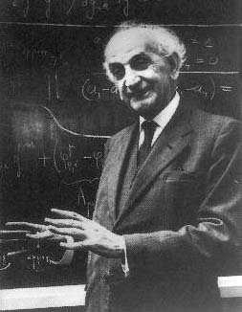
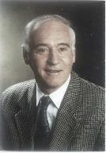
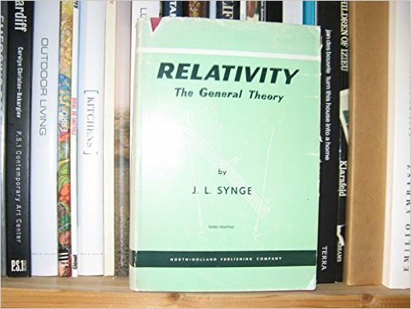
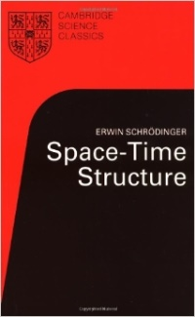
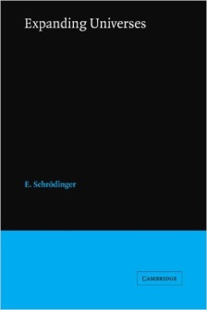
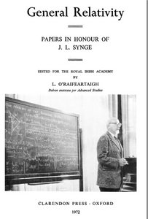
Dublin Institute for Advanced Studies
75 years of DIAS
Founded in 1940 (de Valera)
Modelled on Princeton Research Institute (IAS)
Two schools
School of Theoretical Physics
School of Celtic Languages
Only pen and paper required
Major centre for relativity
Erwin Schrödinger, J.L. Synge,
K. Lanczos, L. O’Raifeartaigh
Pirani, Bertotti,…

Slide 3

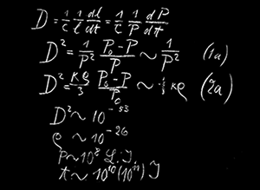
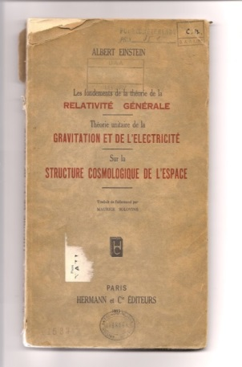
Overview
Introduction
Einstein’s cosmological considerations 1915-1930
1. Einstein’s cosmic model of 1931
Some new observations
2. Einstein’s steady-state model
Unfinished symphony
3. Einstein’s cosmology review of 1933
Further development of the Einstein-de Sitter model
Conclusions
The Oxford blackboard (1931)

Slide 4




Einstein’s cosmology (1915-1930)
The general theory of relativity (1915, 1916)
A relation between spacetime and matter
Gravity = curvature of spacetime
Principles
Principle of equivalence
Mach’s principle: no inertia relative to space
Matter has a primary role, space has a derived one
A burning question: a consistent model of the Cosmos?
“Can relativity be followed through to the finish?”(1918)
Cosmological considerations (1917)
Result of long deliberation s :“A rough and winding road”
$$R_{μν} − \frac{1}{2}g_{μν}R = −κ T_{μν}$$

Slide 5
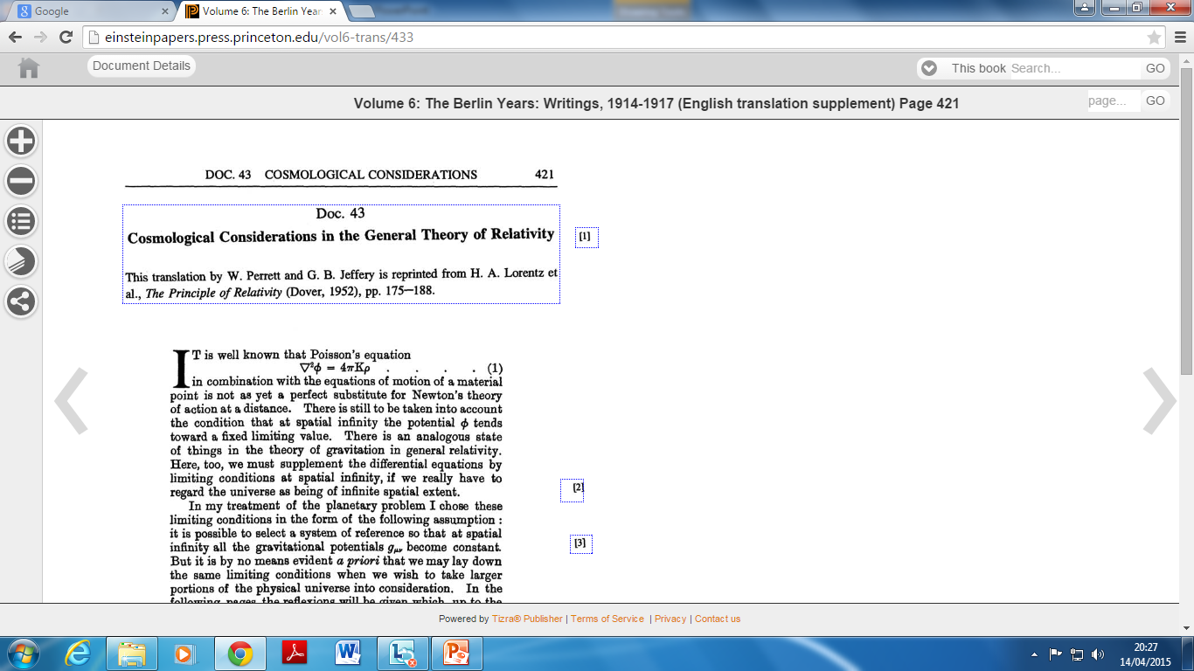

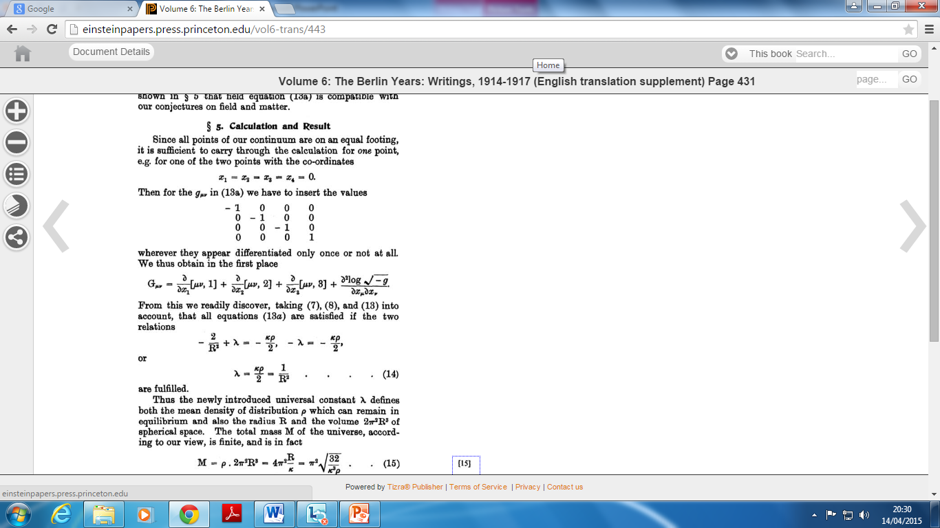


Einstein’s model of the Static Universe
Apply general relativity to the Universe (1917)
Ultimate test for new theory of gravitation
Assumptions
Static universe (small velocities of the stars)
Mach’s principle (metric tensor to vanish at infinity)
Isotropy and homogeneity (simplicity)
Boundary problem
A cosmos of closed curvature
No consistent solution
Field equations modified!
Additional term in GFE (1916)
Radius and density defined by λ
$$R_{μν} − \frac{1}{2}g_{μν}R = −κ T_{μν}$$
$$R_{μν} − \frac{1}{2}g_{μν}R − λg_{μν} = − κ T_{μν}$$

Slide 6
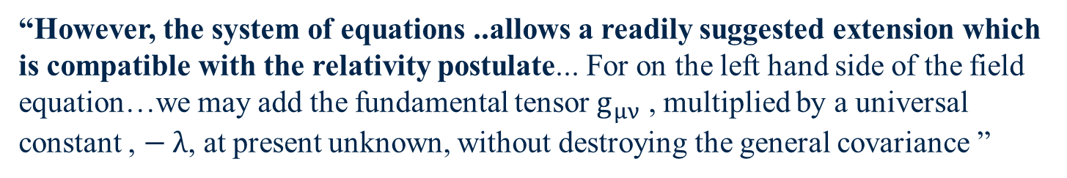
Some key quotes (Einstein 1917)
“In a consistent theory of relativity, there can be no inertia relative to “space”, but only an inertia of masses relative to one another”
“I have not succeeding in formulating boundary conditions for spatial infinity. Nevertheless, there is still a way out…for if it were possible to regard the universe as a continuum which is finite (closed) with respect to is spatial dimensions, we should have no need at all of any such boundary conditions”
“The most important fact that we draw from experience as to the distribution of matter is that the relative velocities of the stars are very small compared with the velocity of light….. There is a system of reference relative to which matter may be looked upon as being permanently at rest ”
“However, the system of equations ..allows a readily suggested extension which is compatible with the relativity postulate... For on the left hand side of the field equation…we may add the fundamental tensor $g_{μν}$ , multiplied by a universal constant , $− λ$, at present unknown, without destroying the general covariance ”
Schroedinger’s comment (1918): Einstein’s response (1918)

Slide 7

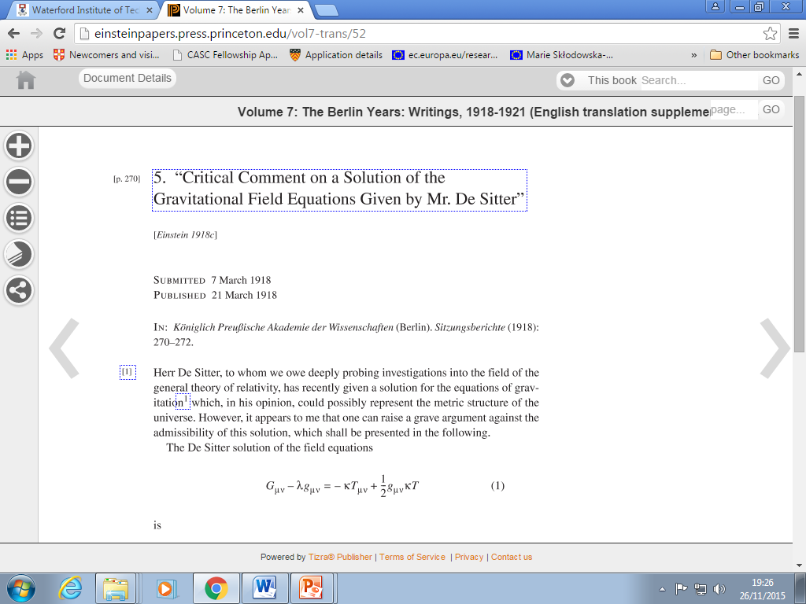
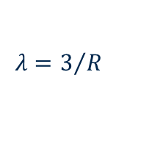
Einstein vs de Sitter
Alternative solution of the GFE
A universe empty of matter (1917)
Solution B
Cosmic constant proportional to curvature of space
Disliked by Einstein
Problems with singularities? (1918)
Conflict with Mach’s principle
The de Sitter confusion
Static or non-static - a matter of co-ordinates?
Weyl , Lanczos, Lemaître
$$λ=3/R$$
Prediction of redshifts – Slipher effect?

Slide 8


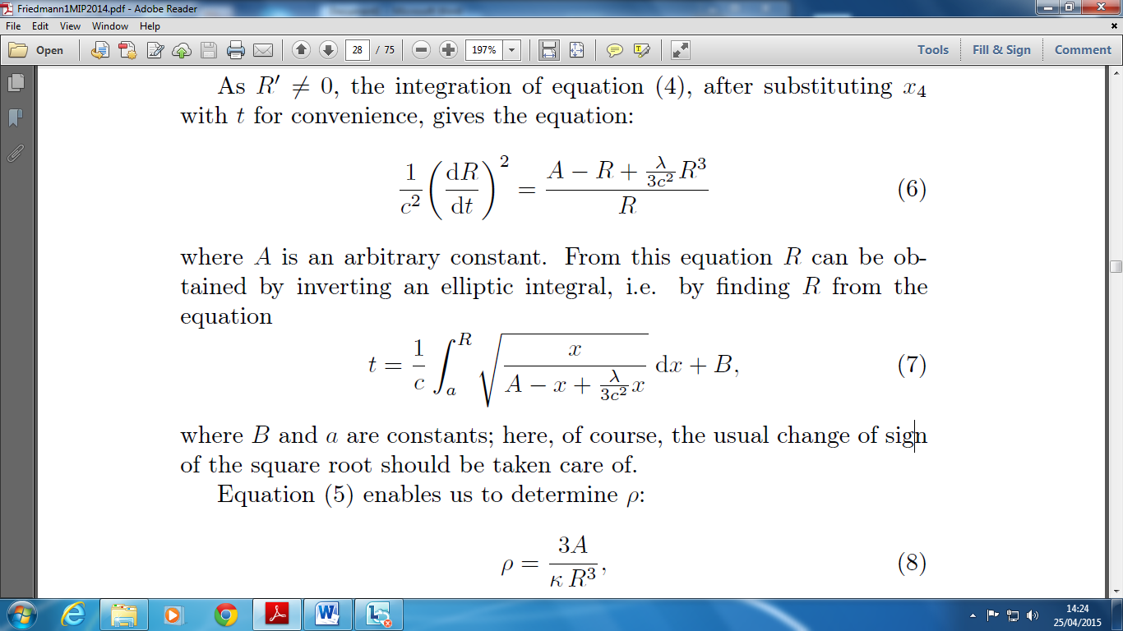
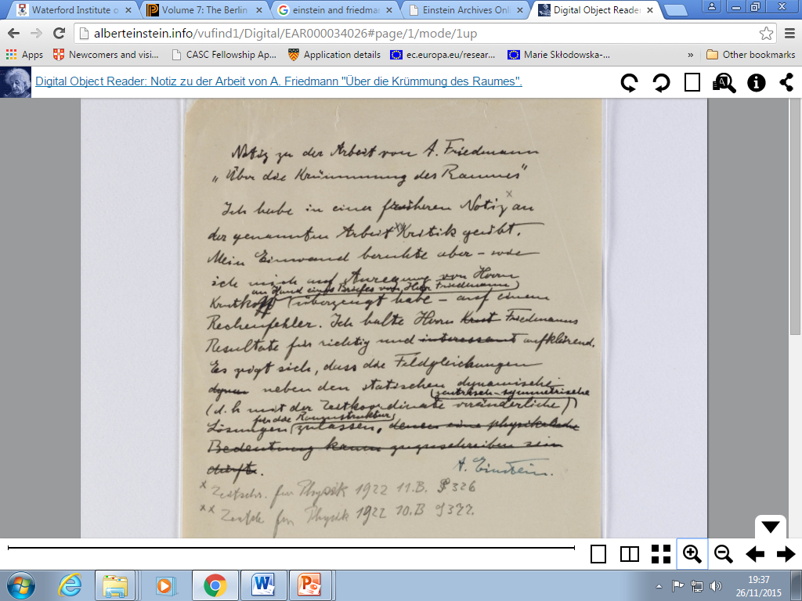
Einstein vs Friedman
Allow time-varying solutions (1922)
Assume homogeneity, isotropy, positive curvature
Two independent differential equations from GFE
Evolving universes
Density of matter varies over time
Overlooked by community
Considered ‘suspicious’ by Einstein
Mathematical correction, later retracted
“To this a physical reality can hardly be ascribed”
Negative spatial curvature (1924)
Cosmic evolution, geometry depends on matter
Overlooked by community
Alexander Friedman
(1888 -1925)

Slide 9

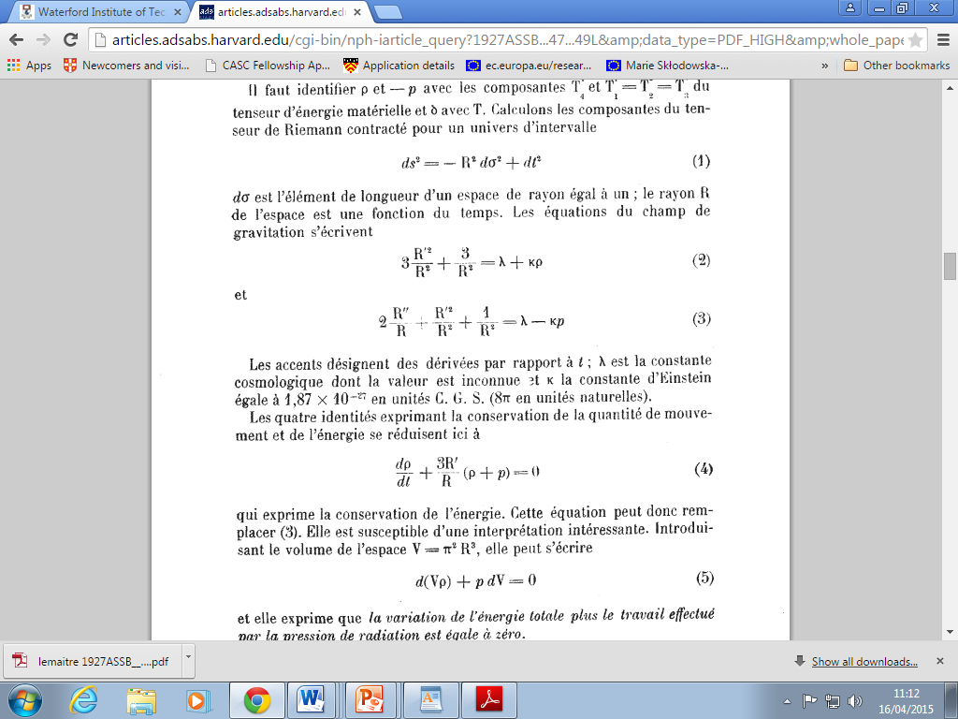

Einstein vs Lemaître (1927)
Expanding model of the Universe from GR
Similar but not identical to Friedman 1922
Starts from static Einstein Universe
Redshifts of galaxies = expansion of metric? Redshifts from Slipher, distances from Hubble
H = 585 kms⁻¹Mpc⁻¹
Ignored by community
Belgian journal (in French)
Rejected by Einstein:“Votre physique est abominable”
Lemaître’s recollection (1958)
“Einstein not up-to-date with astronomy”
Fr Georges Lemaître

Slide 10



Hubble’s law (1929)
A redshift/distance relation for the nebulae?
Motivation: establishing distances of all nebulae
Linear relation (Hubble, 1929)
20 redshifts from Slipher: not acknowledged
Most important data point not shown (8Mpc, 4000 km/s)
Landmark result in astronomy
H = 500 kms⁻¹ Mpc⁻¹
Not the expanding universe!
Astronomy, not cosmology

Slide 11
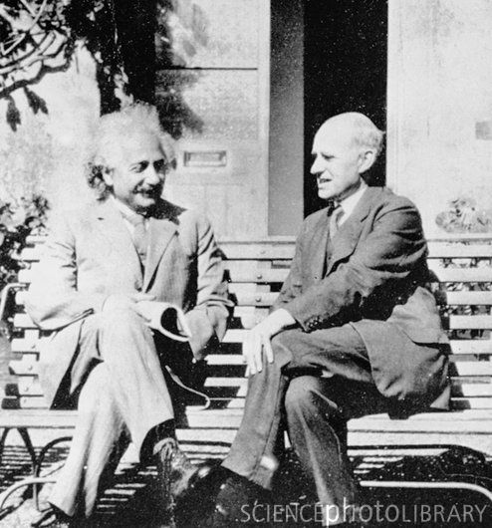
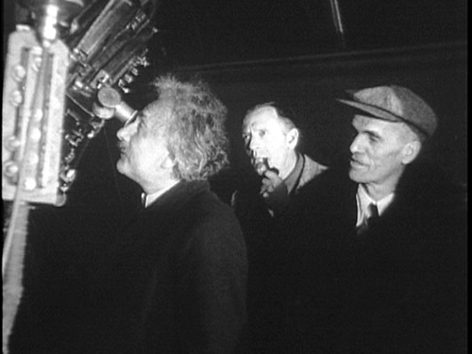
The watershed
RAS meeting (1930)
If redshifts are velocities, and if effect is non-local
Hubble’s law = expansion of space? (Edd., de Sitter)
Dynamic model required
“Motion in Einstein’s model or matter in de Sitter’s?”
Lemaître’s intervention
1927 expanding model republished in English (1931)
Observational section omitted (rightly)
Lemaître model circulated
Time-varying radius, density of matter
Friedman 1922 models become known
Positive curvature

Slide 12



Models of the evolving universe (1930 -)
Tolman (1930, 31)
Expansion caused by annihilation of matter ?
Eddington (1930, 31)
On the instability of the Einstein universe
Expansion caused by condensation?
de Sitter (1930, 31)
Variety of expanding models
Heckmann (1931,32)
Spatial curvature (not translated)
Einstein (1931, 32) JMK
Friedman-Einstein model λ = 0, k = 1
Einstein-de Sitter model λ = 0, k = 0
If redshifts represent expansion…
If effect is global…

Slide 13
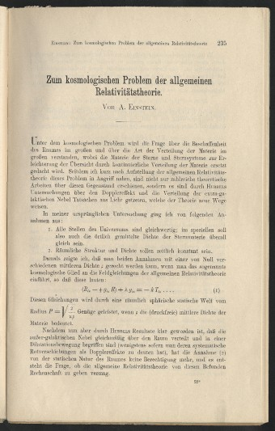
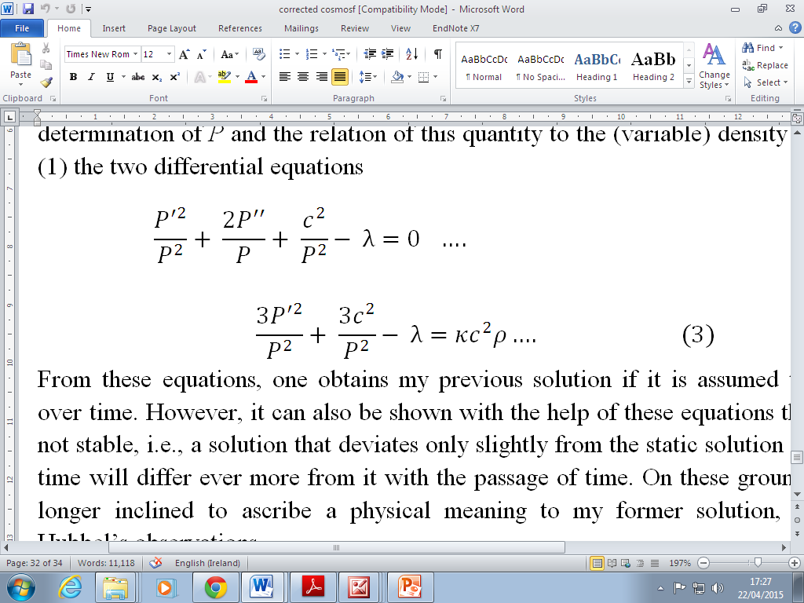
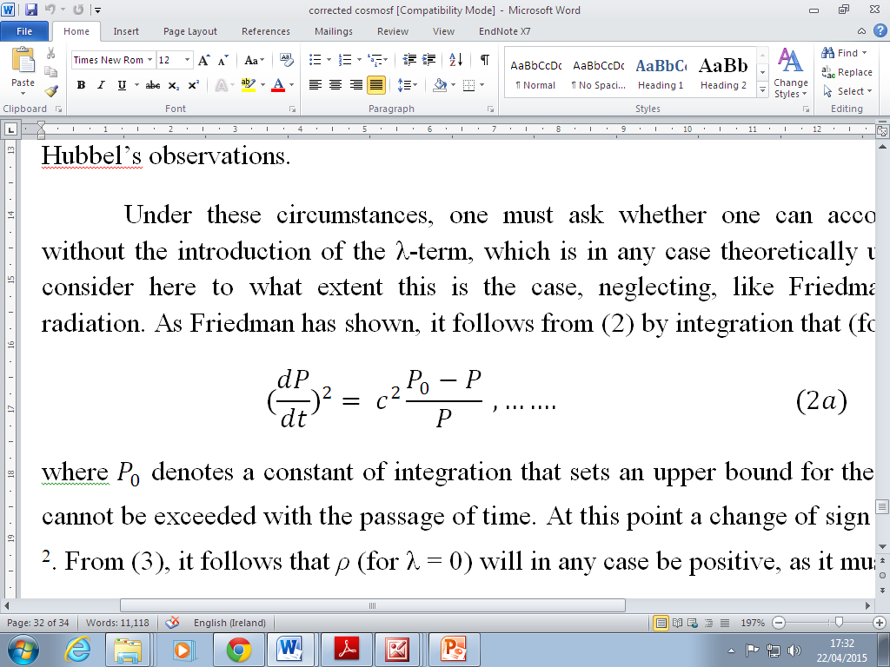
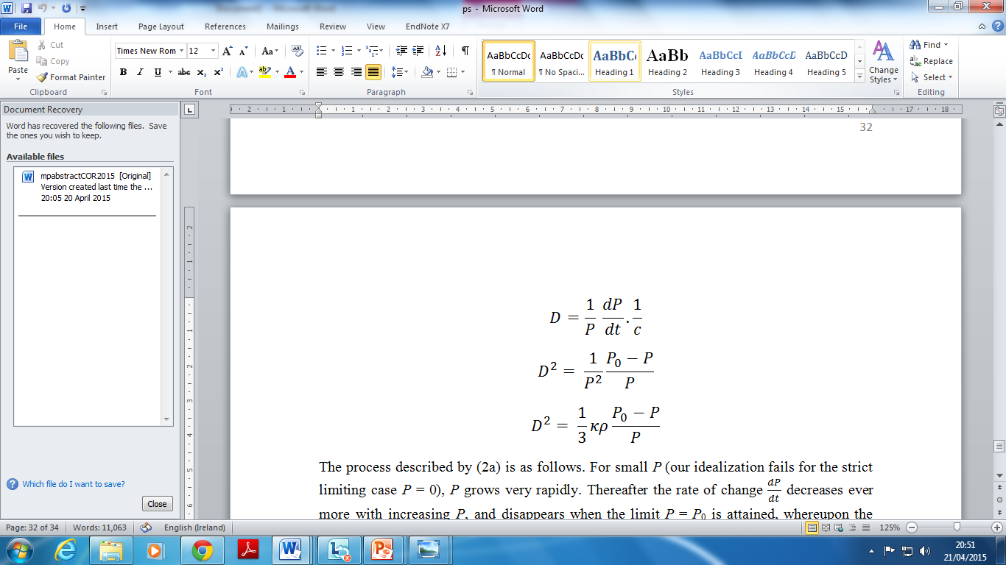
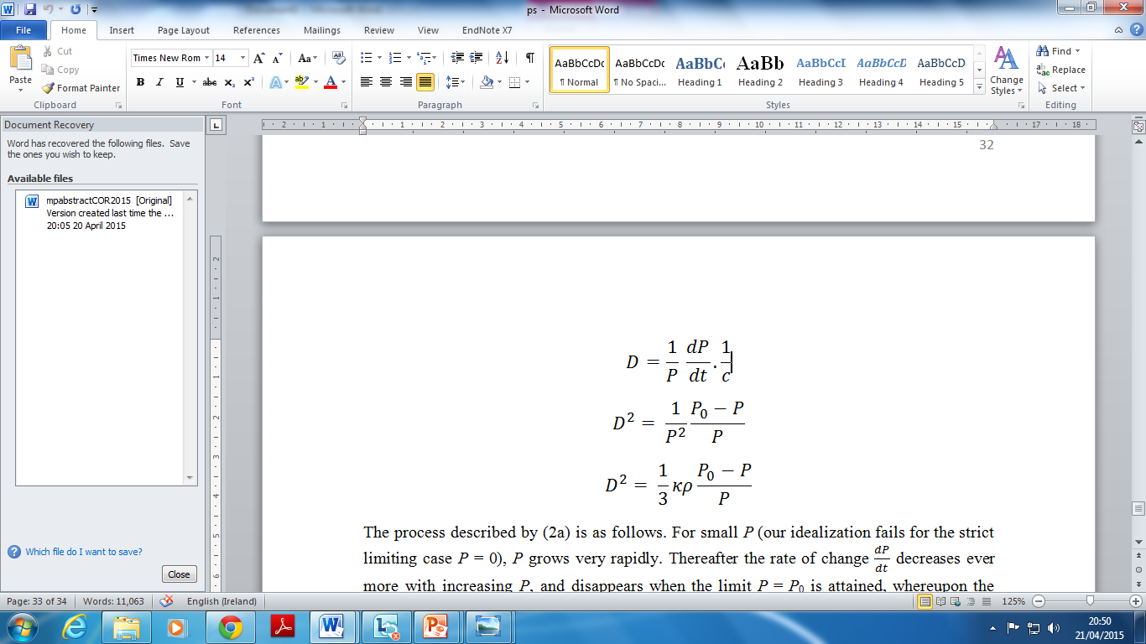
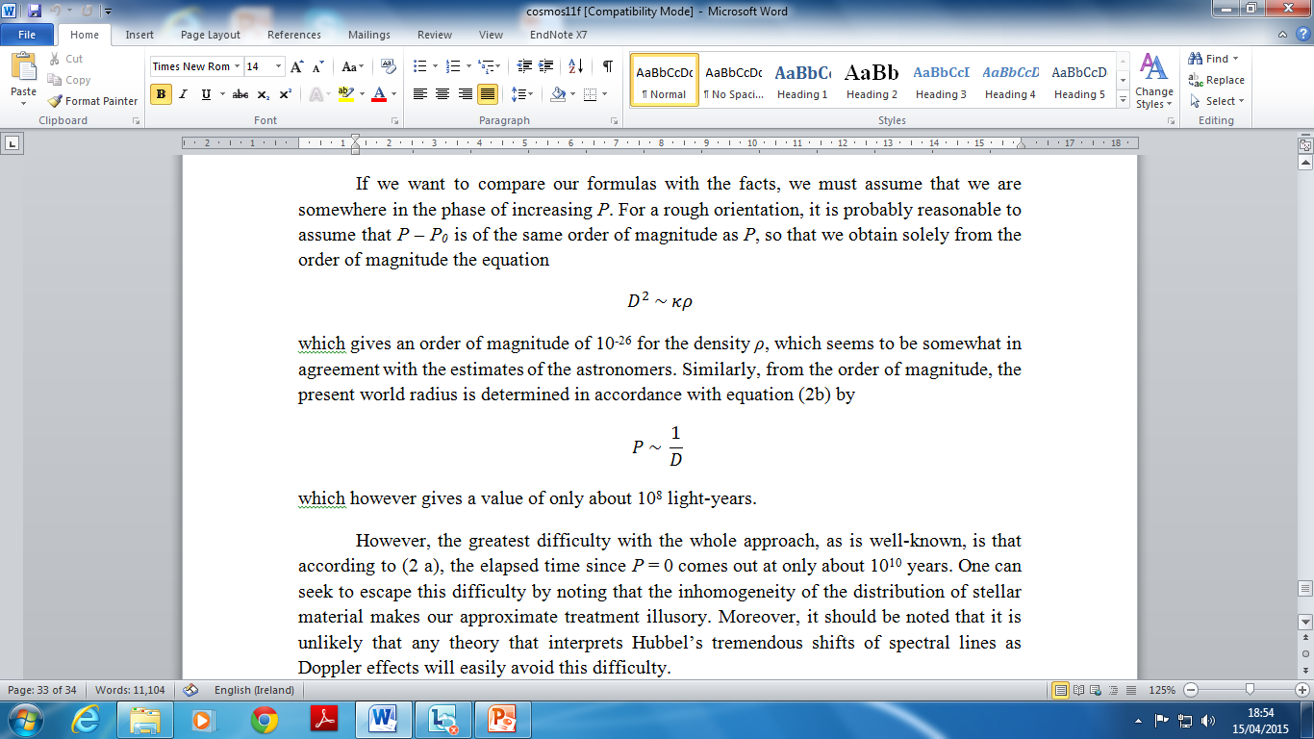
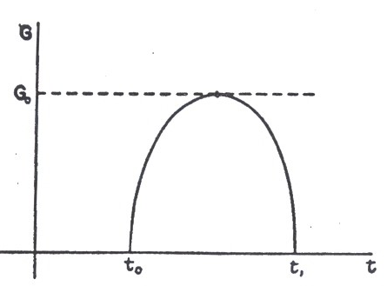

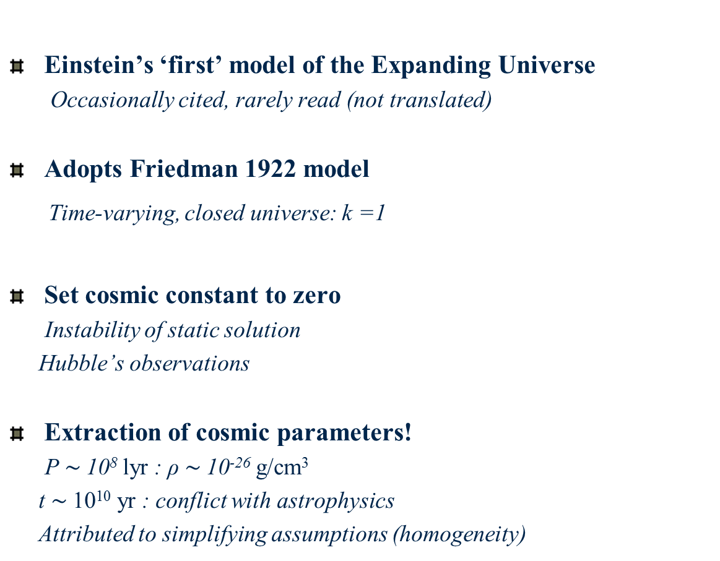
Einstein’s 1931 model (F-E)
Einstein’s ‘first’ model of the Expanding Universe
Occasionally cited, rarely read (not translated)
Adopts Friedman 1922 model
Time-varying, closed universe: k =1
Set cosmic constant to zero
Instability of static solution
Hubble’s observations
Extraction of cosmic parameters!
P $\sim$10⁸ lyr : ρ $\sim$10⁻²⁶ g/cm³
t $\sim$10¹⁰ yr : conflict with astrophysics
Attributed to simplifying assumptions (homogeneity)

Slide 14
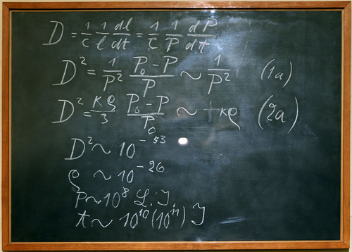
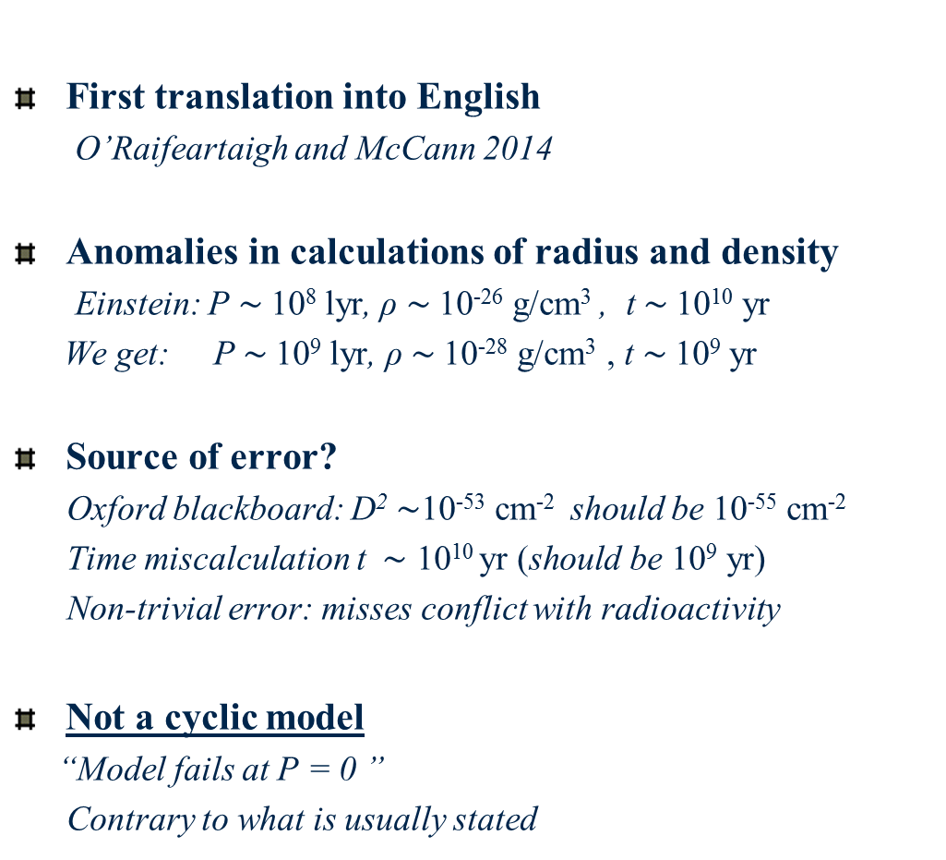
Einstein’s 1931 model revisited
First translation into English
O’Raifeartaigh and McCann 2014
Anomalies in calculations of radius and density
Einstein: P $\sim$10⁸ lyr, ρ $\sim$10⁻²⁶ g/cm³ , t $\sim$10¹⁰ yr
We get: P $\sim$10⁹ lyr, ρ $\sim$10⁻²⁸ g/cm³ , t $\sim$10⁹ yr
Source of error?
Oxford blackboard: D² $\sim$10⁻⁵³ cm⁻² should be 10⁻⁵⁵ cm⁻²
Time miscalculation t $\sim \text{10}\text{10} \text{y}\text{r}\text{ (}\text{should} \text{be} \text{10}\text{9} \text{y}\text{r}$)
Non-trivial error: misses conflict with radioactivity
Not a cyclic model
“Model fails at P = 0 ”
Contrary to what is usually stated
Oxford lecture
(May 1931)

Slide 15
Some key quotes (Einstein 1931)
“The cosmological problem is understood to concern the question of the nature of space and the manner of the distribution of matter on a large scale, where the material of the stars and stellar systems is assumed for simplicity to be replaced by a continuous distribution of matter.”
“Now that it has become clear from Hubbel’s results that the extra-galactic nebulae are uniformly distributed throughout space and are in dilatory motion (at least if their systematic redshifts are to be interpreted as Doppler effects), assumption (2) concerning the static nature of space has no longer any justification….”
“Several investigators have attempted to account for the new facts by means of a spherical space whose radius P is variable over time. The first to try this approach, uninfluenced by observations, was A. Friedman,¹ on whose calculations I base the following remarks. ”
“However, the greatest difficulty with the whole approach… is that according to (2 a), the elapsed time since P = 0 comes out at only about 10¹⁰ years. One can seek to escape this difficulty by noting that the inhomogeneity of the distribution of stellar material makes our approximate treatment illusory.”

Slide 16
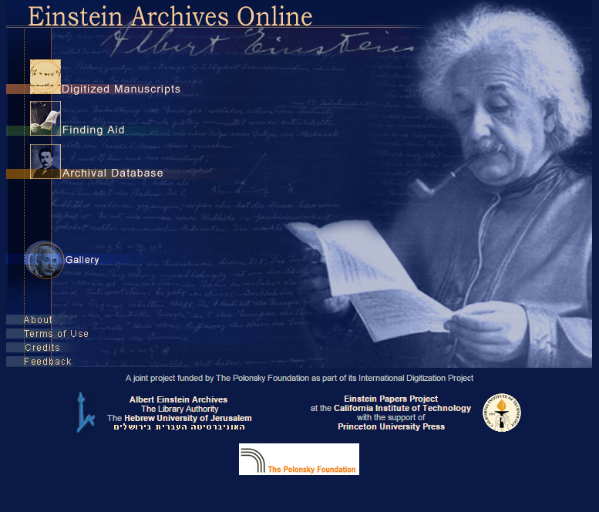
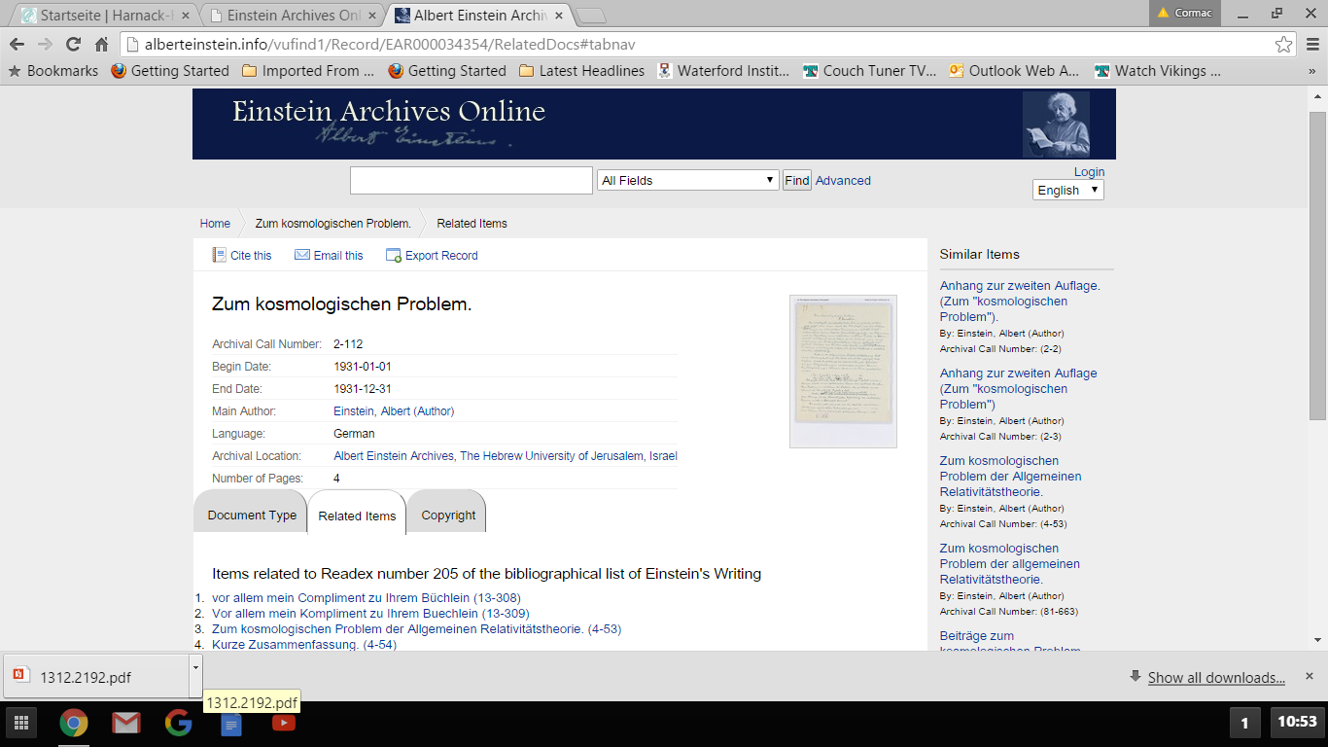
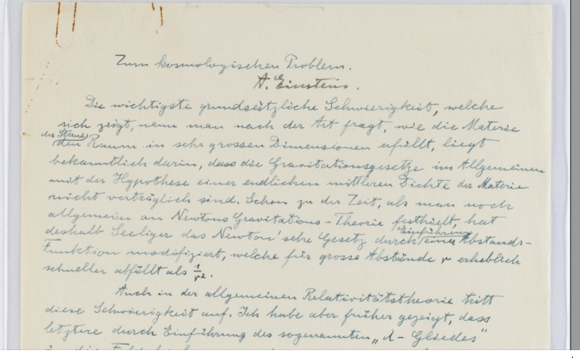

“The density is thus constant and determines the expansion”

Slide 17
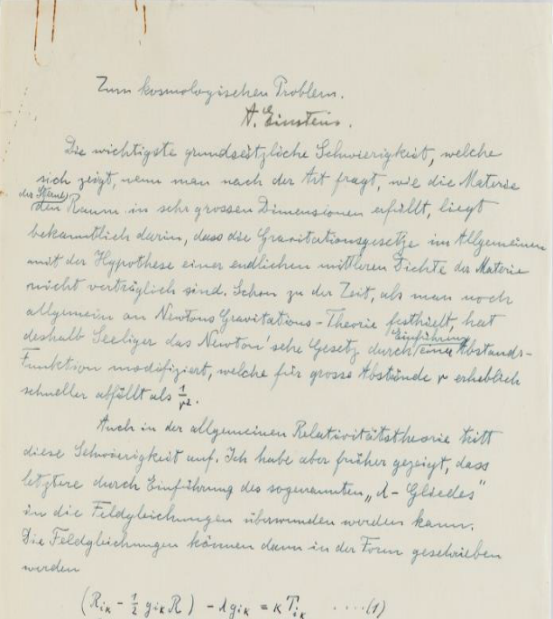

2. Einstein’s steady-state model
Unpublished manuscript
Archived as draft of F-E model (1931)
Similar title, opening to F-E model
Something different
Cosmological constant
“The density is thus constant and determines the expansion”
Steady-state model of the Expanding Universe
Anticipates Hoyle solution
Written in early 1931
Fatal flaw: abandoned
9α² /4 + λc² = 0
3α² /4 - λc² = ĸρc²
α² = $\frac{ĸc^{2}}{3}ρ$

Slide 18
Einstein’s steady-state model (Jan 31)
Problem with evolving models
“De Sitter and Tolman have already shown that there are solutions to equations (1) that can account for these [Hubbel’s] observations. However the difficulty arose that the theory unvaryingly led to a beginning in time about 10^{10 –} 10¹¹ years ago, which for various reasons seemed unacceptable.”
New solution
“In what follows, I wish to draw attention to a solution to equation (1) that can account for Hubbel’s facts, and in which the density is constant over time..
If one considers a physically bounded volume, particles of matter will be continually leaving it. For the density to remain constant, new particles of matter must be continually formed within that volume from space “
Mechanism
“The conservation law is preserved in that, by setting the λ-term, space itself is not
empty of energy; its validity is well known to be guaranteed by equations (1).”

Slide 19
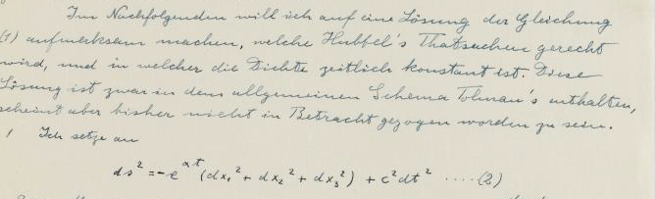
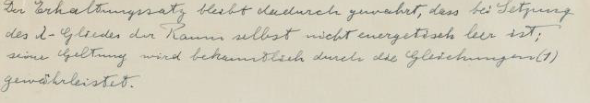
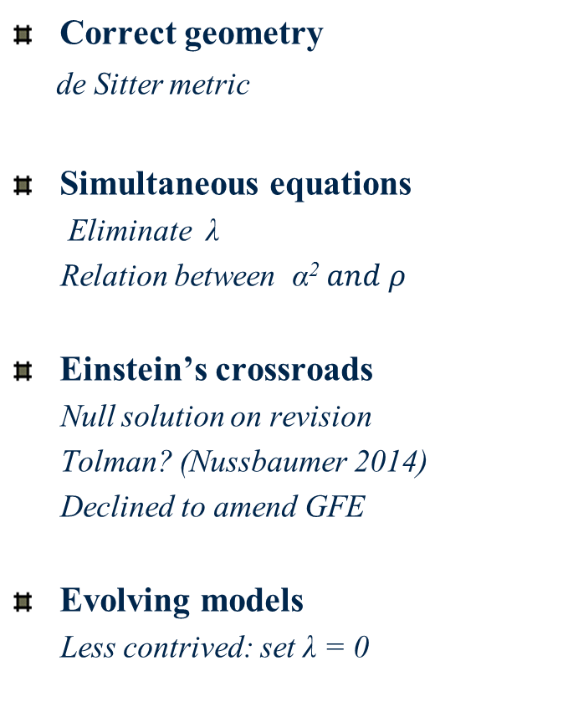

An abandoned model
Correct geometry
de Sitter metric
Simultaneous equations
Eliminate λ
Relation between α²$and ρ$
Einstein’s crossroads
Null solution on revision
Tolman? (Nussbaumer 2014)
Declined to amend GFE
Evolving models
Less contrived: set λ = 0
9α² /4 + λc² = 0
3α² /4 - λc² = ĸρc²
α² = $\frac{ĸc^{2}}{3}ρ$

Slide 20
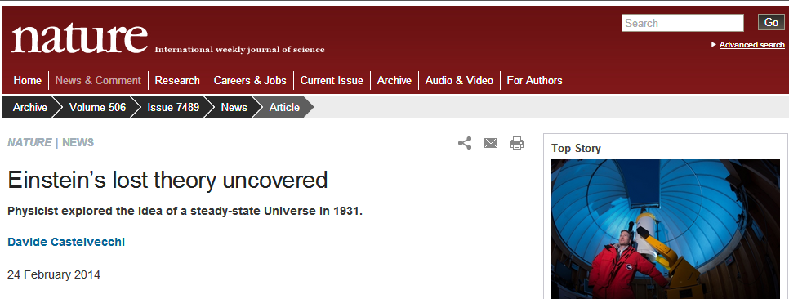
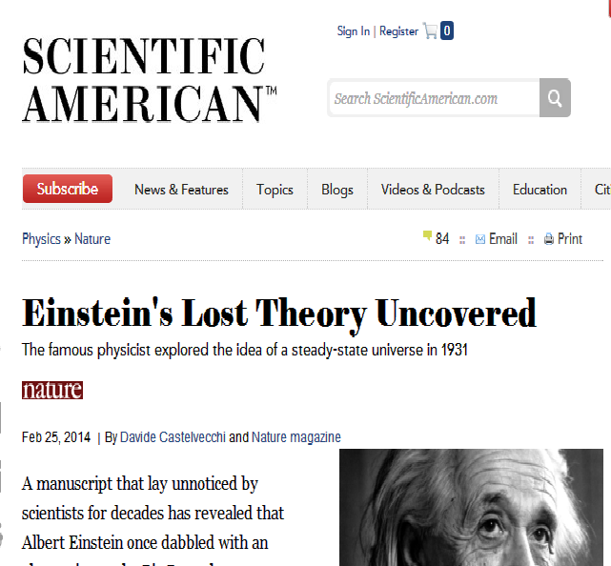
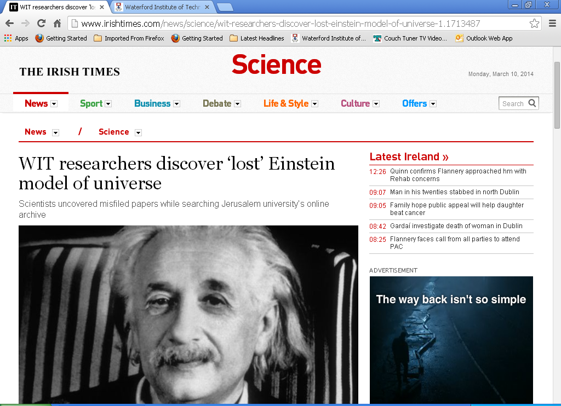
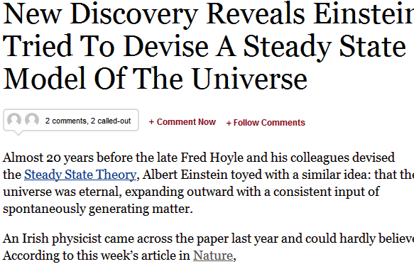
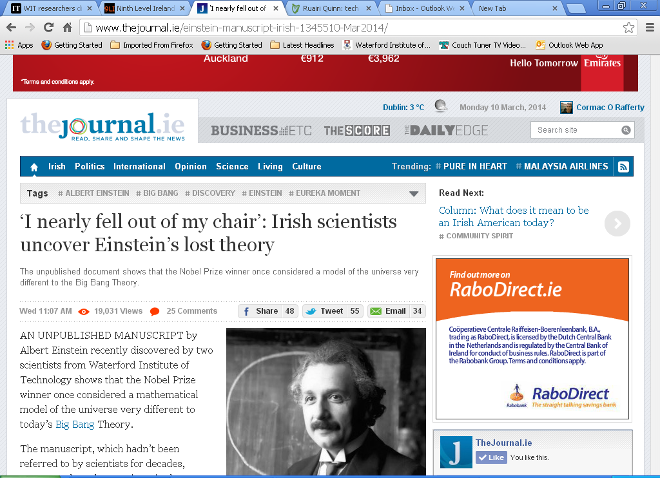

Slide 21
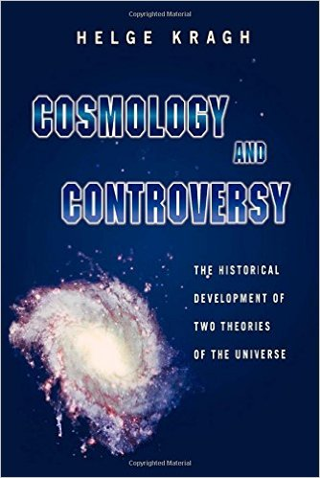
A useful find
New perspective on steady-state theory (1950s)
Logical idea: not a crank theory
Tolman, Schroedinger, Mimura : considered steady-state universe
Insight into scientific progress
Unuccessful theories important in the development of science
Links with modern cosmology
Creation energy and λ: dark energy
de Sitter metric: cosmic inflation
Insight into Einstein’s cosmology
Turns to evolving models rather than introduce new term to GFE
Pragmatic approach: F-E model

Slide 22

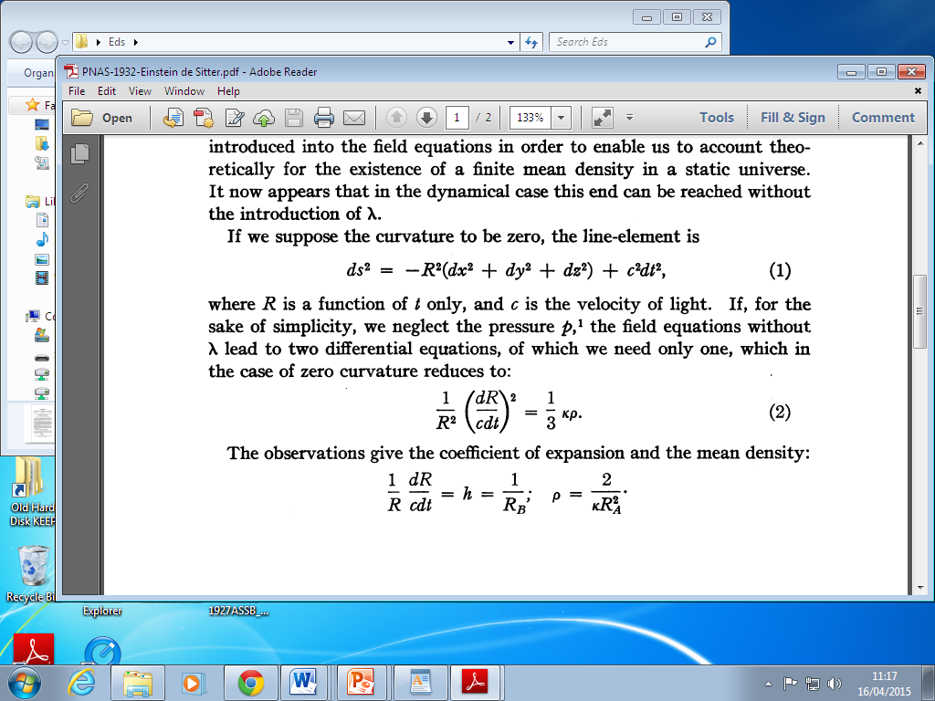
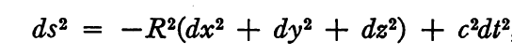
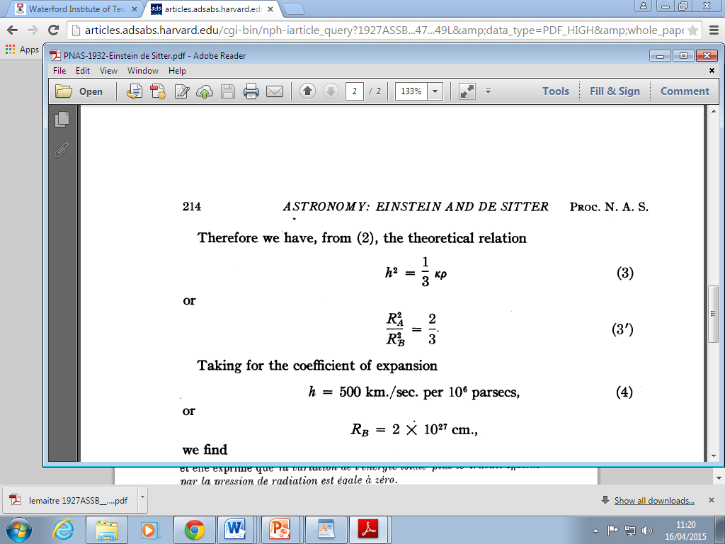
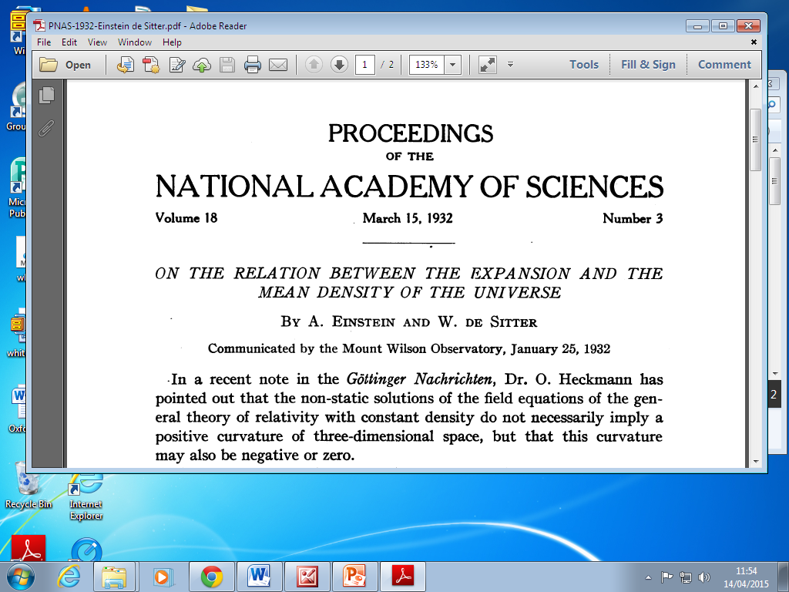
3. Einstein-de Sitter model (1932)
Curvature not a given in dynamic models (Heckmann)
Not observed empirically
Remove spatial curvature (Occam’s razor)
Simplest Friedman model
Time-varying universe with λ = 0, k = 0, p =0
Estimate of density : ρ =10⁻²⁸ g/cm³
Important hypothetical cosmos: critical case
Becomes standard model
Despite high density of matter, age problem
Time evolution not considered
Eddington’s anecdote

Slide 23

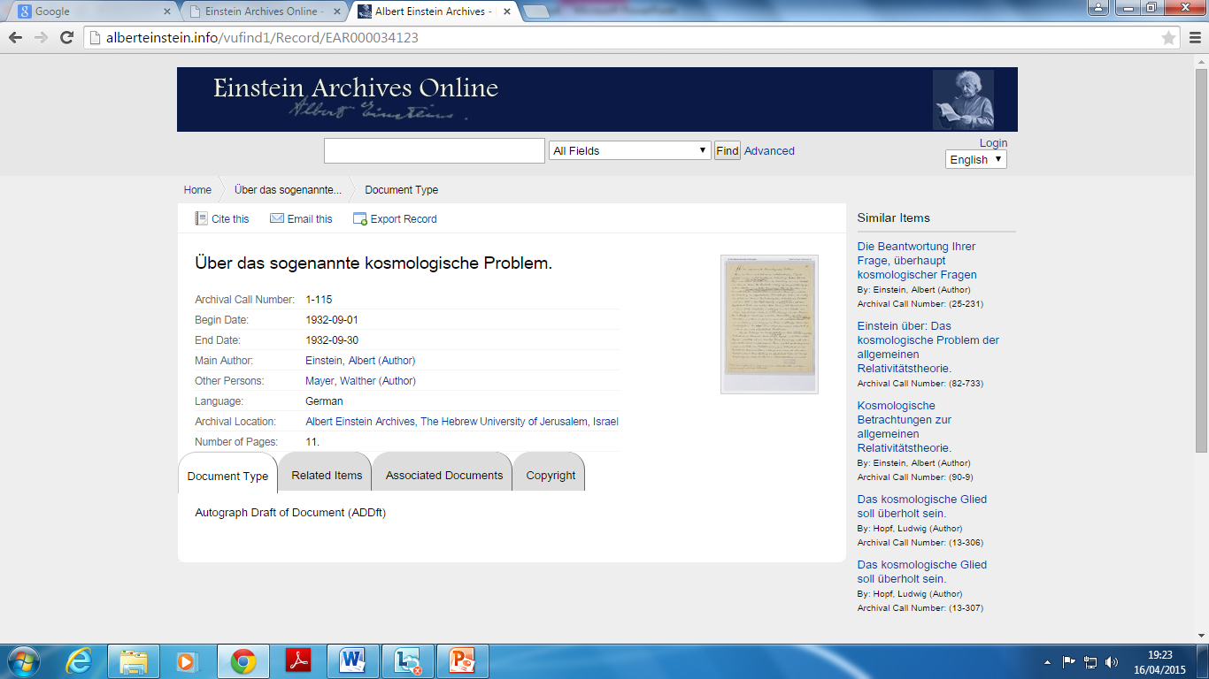
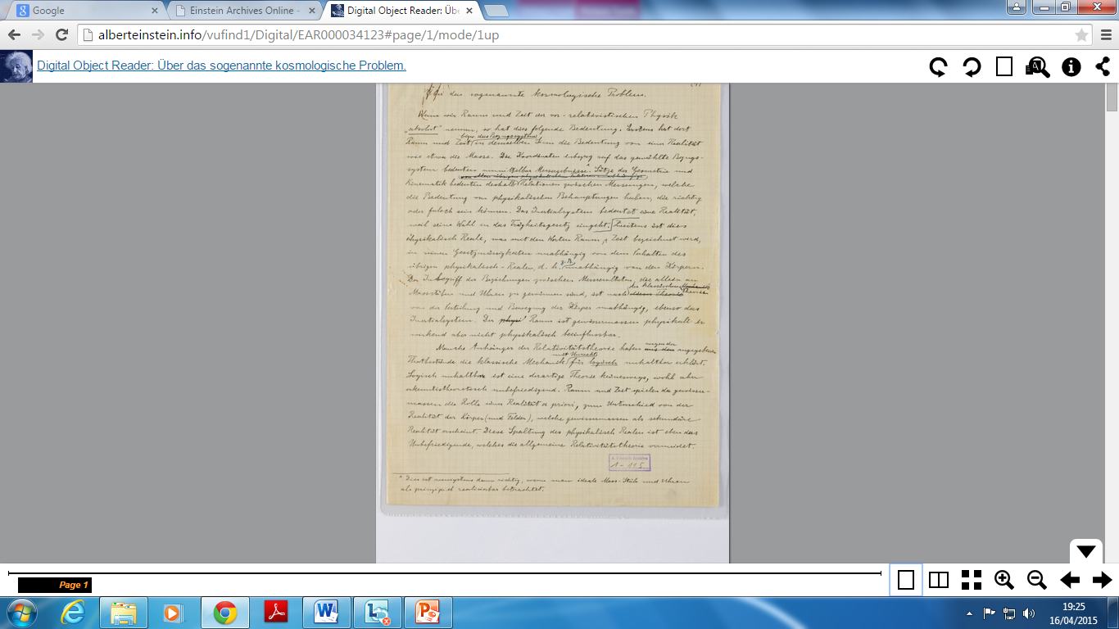

Slide 24
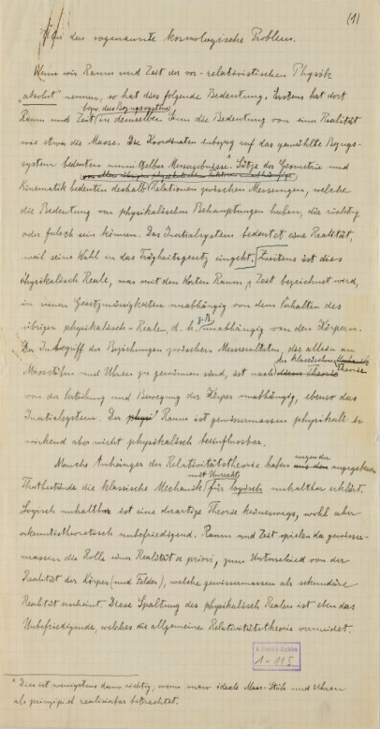




Einstein-de Sitter model revisited
Einstein’s cosmology review of 1933
Overview of dynamic models from first principles
Significant exposition
Culminates in Einstein-de Sitter model
Including time evolution
Published in 1933
French book (transl. Solovine); small print run
Intended for scientific journal; not submitted
Parameters extracted
Critical density of 10⁻²⁸ g/cm³ : reasonable
Timespan of 10¹⁰ years: incorrect estimate
Conflict with astrophysics: attributed to simplifications

Slide 25

Some key quotes (Einstein 1933)
“Since, according to the general theory of relativity, the metric properties of space are not given in themselves but are instead determined by material objects that force a non-Euclidean character on the continuum, a problem arises….since we may assume that the stars are distributed with a finite density everywhere in the world, that is, a non-zero average density of matter in general, there arises the question of the influence of this mean density on the (metric) structure of space on a large scale; this is the so-called cosmological problem “
“Thus the theory can now, without the introduction of a $λ$-term, accommodate a finite (mean) density of matter $ρ$ on the basis of equations (1), using relation 3(a) with $P$ (and $ρ$) variable over time”
“It follows from these considerations that in the light of our present knowledge, the fact of a non-zero density of matter need not be reconciled with a curvature of space, but instead with an expansion of space. Of course, this does not mean that such a curvature (positive or negative) does not exist. However, there is at present no indication of its existence. In any case, it may well be substantially smaller than might have been suggested by the original theory (see equation 5).”

Slide 26



Einstein’s cosmology: conclusions
Major test for general relativity
Conscious of assumptions of homogeneity, isotropy
Embraces dynamic cosmology
New evidence – new models (JMK)
Timespan of expanding models puzzling
Steady-state universe?
Evolving models (less contrived)
Cosmic constant not necessary
Extraction of parameters compatible with observation
Closed and open models
Timespan problem attributed to simplifying assumptions
Verdict (1933, 1945): more observational data needed
Hubble constant revised
Cosmic microwave background
Homogeneous, flat universe
No mention of origins

Slide 27


Einstein’s greatest hits (cosmology)
Einstein’s model of the Static Universe (1917)
First relativistic model of the cosmos
Einstein’s steady-state model (Jan 31)
Natural successor to static model: abandoned
Friedman-Einstein model of the Universe (1931)
Use of Hubble constant to extract observational parameters
Einstein-de Sitter model of the Universe (1932)
1933 review: 1945 review (Appendix)
Conversations with Gamow, Godel, Straus
No mention of origins

Slide 28


Further reading

Slide 29


Coda: Einstein vs Hoyle
Fred Hoyle in Princeton (1952, 53)
Einstein remark to Manfred Clynes
“Romantic speculation” (Michelmore 1962)
Letter to Jean Jacques Fehr (1952)
“The cosmological speculations of Mr Hoyle, which presume a formation of atoms from space, are in my view much too poorly grounded to be taken seriously. On the whole, it seems to me more reasonable to seek a solution to problems far closer to hand, e.g., the theory of quantum phenomena or the further development of the general theory of relativity. The popular literature on the subject is not very fruitful, as it encourages flights of fancy rather than clear thinking. In my opinion, this is less because of the nature of the problem itself than because our theoretical insight is still extremely deficient.”

Slide 30
Further reading
Einstein’s 1931 model
Einstein’s cosmic model of 1931 revisited; an analysis and translation of a forgotten model of the universe. O’Raifeartaigh, C. and B. McCann. 2014 Eur. Phys. J (H) 39(1):63-85
Einstein’s steady-state manuscript
Einstein’s steady-state theory: an abandoned model of the cosmos. O’Raifeartaigh, C., B. McCann, W. Nahm and S. Mitton. 2014 Eur. Phys. J (H) 39(3):353-367
Einstein-de Sitter model
Einstein’s cosmology review of 1933: a new perspective on the Einstein-de Sitter model of the cosmos. O’Raifeartaigh, C., M.O’Keeffe, W. Nahm and S. Mitton. 2015. Eur. Phys. J (H) 40 (3) 301-335
Review paper

Slide 31


Observational parameters needed (1930s)
Spatial curvature k = -1,0,1?
Cosmic constant λ = 0?
Deacceleration q₀ = - $\ddot{R}/{\dot{R}}^{2}$
Density of matter ρ < ρ_{crit} ?
Timespan τ = 10¹⁰ yr?
Hubble constant ${\dot{R}}/R$ = 500 kms⁻¹Mpc⁻¹?
What do redshifts represent?
Is expansion a local effect?
Hubble and Tolman 1935

Slide 32


Einstein’s steady-state model and cosmology today
Dark energy (1998)
Accelerated expansion (observation)
Positive cosmological constant
Einstein’s dark energy
“The conservation law is preserved in that, by setting the λ-term, space itself is not empty of energy; its validity is well known to be guaranteed by equations (1).”
Cosmic inflation
Inflationary models use de Sitter metric
Used in all steady-state models
Flat curvature, constant rate of matter creation
Different time-frame!

Slide 33
Einstein vs Hoyle
Hoyle in Princeton (1952, 53)
Einstein remark to Manfred Clynes
“Romantic speculation” (Michelmore 1962)
Letter to Jean Jacques Fehr (1952)
“The cosmological speculations of Mr Hoyle, which presume a formation of atoms from space, are in my view much too poorly grounded to be taken seriously. On the whole, it seems to me more reasonable to seek a solution to problems far closer to hand, e.g., the theory of quantum phenomena or the further development of the general theory of relativity. The popular literature on the subject is not very fruitful, as it encourages flights of fancy rather than clear thinking. In my opinion, this is less because of the nature of the problem itself than because our theoretical insight is still extremely deficient.”

Slide 34

Steady-state cosmology today
Observable universe not in a steady state
Evolution of galaxies
Cosmic microwave background
Inflationary cosmology = steady-state model
de Sitter metric
Steady-state model with different time-frame! (Hoyle 1990)
Matter creation term not mandatory in Hoyle models (McCrea 1951)
Eternal inflation
Different regions undergo different inflation?
Inflation begets further inflation (Vilenkin 1983; Linde 1986)
Observable universe embedded in global steady-state cosmos?
Hoyle’s revenge! (Hoyle and Narlikar 1966; Barrow 2005)

Slide 35

Einstein’s steady-state model and cosmology today
Accelerated expansion (1998)
Supernova measurements
Dark energy – positive cosmological constant
Einstein’s dark energy
“The conservation law is preserved in that, by setting the λ-term, space itself is not empty of energy; its validity is well known to be guaranteed by equations (1).”
Anticipates positive cosmological constant
De Sitter line element
$ds^{2}= −$e^{αt} $\left({dx}_{1 }^{2}+ {dx}_{2 }^{2}+ {dx}_{3 }^{2}\right)+ c^{2}{dt}_{ }^{2}…$
Necessary for all steady-state models
Identical to inflationary models (different time-frame)

Slide 36


Einstein’s cosmology (traditional view)
Static, bounded model of the cosmos (1917)
Resistance to empty de Sitter ‘static’ solution
Resistance to time-varying models
Friedman, Lemaitre
Einstein the conservative
Hidebound by philosophical prejudice
Disinterested in evolving cosmologies
Dynamic model 1932 (1931)
Minimalist, cursory models
A new perspective? Guided by physical intuition

Slide 37

Taking $T_{44}= {ρc}^{2}$ (all other components zero) in the time component of equation (1) we obtain $\left(R_{44}− \frac{1}{2}g_{44}R\right)− {λg}_{44}= κρc$².
This gives on analysis - 3α² /4 + 3α² /2 - λc² = κρc²
the second of Einstein’s simultaneous equations.
From the spatial component of equation (1), we obtain $\left(R_{ii}− \frac{1}{2}g_{ii}R\right)− {λg}_{ii}= 0 .$
This gives on analysis 3α² /4 - 3α² /2 + λc² = 0
for the first of the simultaneous equations.
It is plausible that Einstein made a sign error here, initially getting 3α²/4 + 3α²/2 + λc² = 0 for this equation.

