Slide 1

The Big Bang: Fact or Fiction?
The Big Bang
Is it true?
Cormac O’Raifeartaigh

Slide 2
I Cosmology
The study of the universe
Is it finite?
How big is it?
Is it eternal?
How old is it?
How did it begin?
How will it end?
Not science?

Slide 3
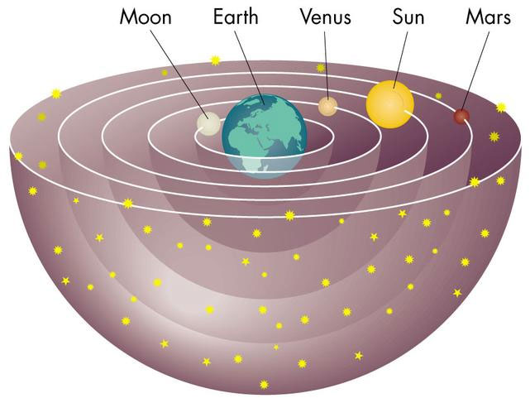
The Greek universe
Earth motionless
Centre of universe
All motion about earth
Stars quite close
Aristotle (350 BC)
Ptolemy (200 AD)
Eternal universe
Notes:
3 reasons

Slide 4
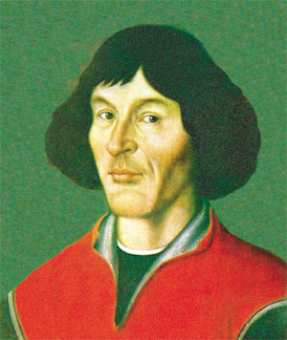
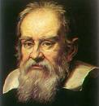
The Renaissance universe
Copernicus (15th cent)
Sun-centered system?
Kepler (16th cent)
Elliptical orbits of the planets
Galileo (16th cent): telescope
Moons of Jupiter, phases of Venus,
Many stars
Many solar systems?
Notes:
Use of telescope

Slide 5

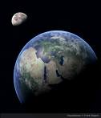
Newton (1642-1727)
Newton’s universe
Planet orbits due to gravity
Gravity caused by sun’s mass
Attractive force
Eternal universe
Olber’s Paradox?

Slide 6
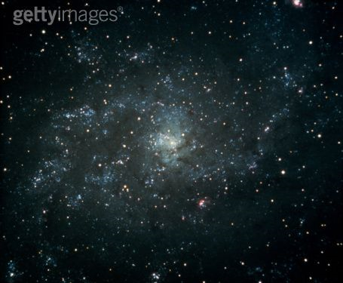
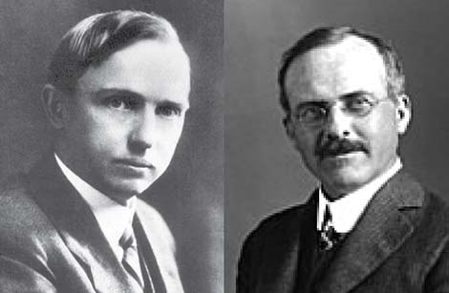
Astronomy (19th, 20th cent)
Powerful telescopes
Photography
The great debate (1920)
Within the Milky Way?
Distinct galaxies?
Spiral nebulae
Harlow Shapley vs Heber Curtis
How big is the Universe?

Slide 7


The galaxies (1925)
Edwin Hubble
Cepheid stars in nebulae
Standard candles
Huge distance
Hooker 100-inch reflector
Many galaxies

Slide 8

The runaway galaxies (Hubble)
Galaxies moving away
Investigated relation between distance and motion
Hubble’s Law (1929)
Far-away galaxies rushing away
at a speed proportional to distance
v = H_{o}d

Slide 9

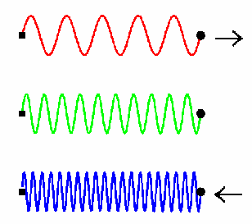

Motion of galaxies: redshift
frequency of light depends on
motion of source relative to observer
Doppler Effect
measure motion of stars
from light emitted
Vesto Slipher

Slide 10
The runaway galaxies (Hubble)
Galaxies moving away
Investigated relation between distance and motion
Hubble’s Law (1929)
Far-away galaxies rushing away
at a speed proportional to distance
v = H_{o}d

Slide 11

Explanation ?
Newton
Gravity pulls in not out
Space is fixed
Time has no beginning
Isaac Newton
How can galaxies be receding?
What is pushing out?

Slide 12


Modern theory of gravity
General theory of relativity (Einstein, 1916)
speed of light = speed limit
space + time not fixed
affected by mass
causes other mass to move
gravity = curvature of space-time

Slide 13
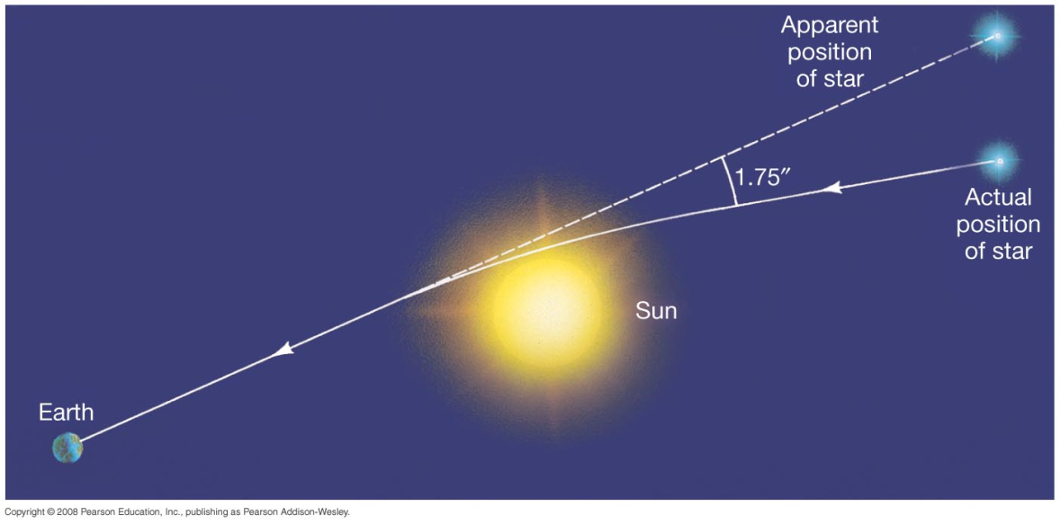
Evidence for general relativity
Bending of light by gravity (1919)
Black holes
Time stretching by gravity
GPS

Slide 14

Relativity and the universe
Apply Einstein’s gravity to the cosmos
Predicts dynamic Universe
Space expanding, contracting
Hubble expansion
Friedmann: 3 possibilities Ω =d/d_{c}
Depends on matter
Einstein: static universe
Notes:
Hawking-Penrose theorems- expanding U must begin with a singularity

Slide 15

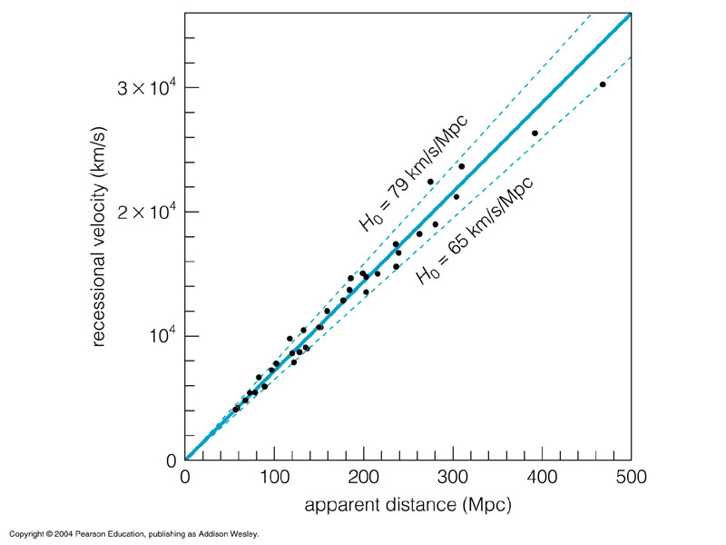
An origin for the universe?
Rewind Hubble graph
U smaller in the past
Extremely dense, extremely hot
Evolving universe
Fr Georges Lemaitre
Calculate age
Younger than the stars?

Slide 16

The ‘big bang’ model (1931)
U originally concentrated in tiny volume
Extremely dense, hot
Expanding and cooling since
Singularity problem
∞ density, ∞ temp at t = 0 ?
Wrong age (Hubble)

Slide 17


Additional evidence
How did the chemical elements form?
Nuclear physics (1940s)
Not in the stars
In Lemaitre’s infant universe ?
H, He nuclei (1 s)
U = 75% H, 25% He
Agrees with observation
Georges Gamow
Heavier atoms formed in stars

Slide 18
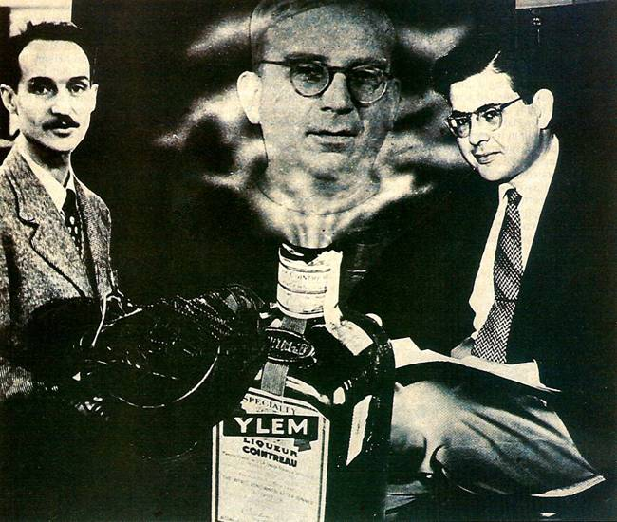

Prediction: cosmic radiation?
Radiation of infant universe
Released when atoms formed (300,000 yr)
Still observable today?
Low temp, microwave frequency
Alpher, Gamow and Herman
No-one looked (1940s)

Slide 19


Steady-state model (1950s)
Rival model
Expanding universe
BUT
Matter continuously created
No beginning
Fred Hoyle

Slide 20

Steady-State vs Big Bang
Continuous creation?
Density of matter constant ?
U unchanging, eternal ?
Young universe similar to today ?
Falsification possible

Slide 21

Radio-astronomy (1960s)
Study most distant galaxies
Compare with local galaxies
Density the same at all times? (SS)
Or different? (BB)
Cambridge
3C survey
Answer: different
End of steady-state model
Martin Ryle

Slide 22

Bonus: cosmic radiation (1965)
CMB discovered accidentally
Universal signal
Low frequency (microwave)
Low temperature (3K)
Penzias and Wilson
Echo of Big Bang!
BB model goes mainstream

Slide 23
The big bang – is it true?
  √ 1. The expansion of the U
  √ 2. The abundance of H and He
  √ 3. The evolution of galaxies
  √ 4. The cosmic background radiation
Superhot, superdense
Expanding and cooling
How did it start?

Slide 24

Part II Modern measurements
New measurements of CMB
Full spectrum
Comparison with theory
Balloon experiments
Satellite experiments
COBE satellite (1992)

Slide 25
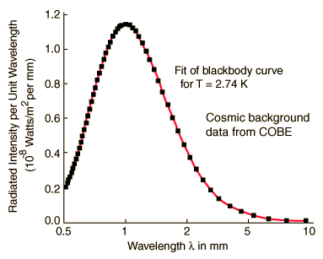
COBE measurements of CMB
Expected temperature
Expected frequency
Perfect blackbody spectrum
Radiation very uniform
Galaxy formation?
Variation of 1 in 10⁵
COBE (1992)
Nobel Prize 2006

Slide 26

Problems
Background radiation raised new questions
Horizon problem why so uniform?
Galaxy problem how did galaxies form?
Flatness problem fine balance?
Singularity problem
∞ density, ∞ curvature at t = 0 ?
Stephen Hawking
quantum gravity?

Slide 27
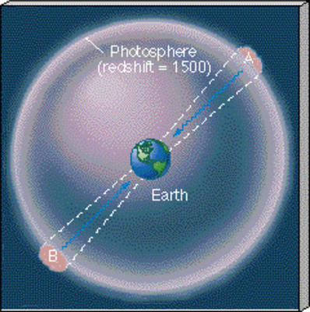
The horizon problem
Two distant regions of background radiation have very similar temps
Why?
Too far apart to be causally connected
Finite speed of light
Finite age of cosmos
Is U too big?

Slide 28
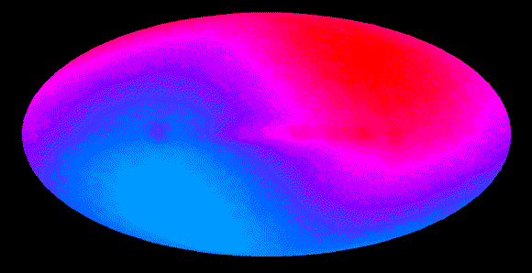
Galaxy formation problem
Microwave background smooth on large scale
No obvious deviations from homogeneity (1 in 100,000)
How did slight perturbations become galaxies?

Slide 29
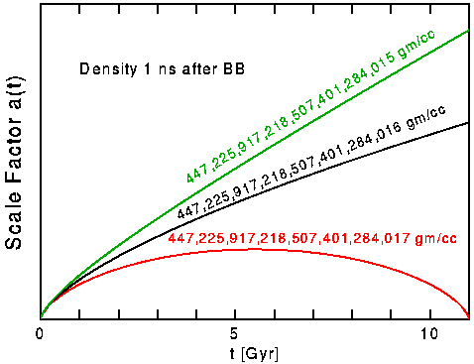
The flatness problem
Slightest deviation from flatness
→
Runaway expansion or crunch
Not observed
Ω = 1
Why so finely balanced initially?
Astrophysics: Ω= 0.3 (matter)
  At t = 1 s, Ω = 1 to within 1:10¹⁵)

Slide 30
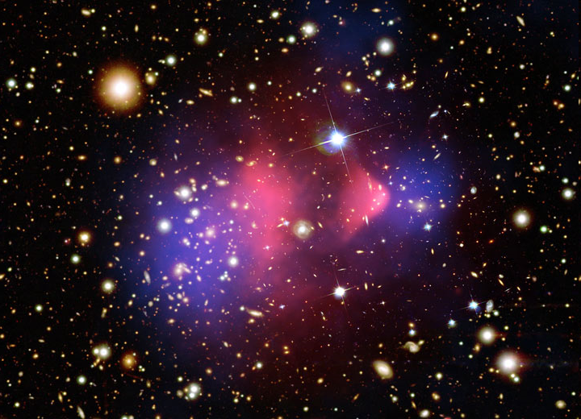
Dark Matter
First suggested in 1930s
Stellar motion
normal gravitational effect but
cannot be seen directly
Explains motion of stars
Explains motion of galaxies
Explains gravitational lensing
Matter = OM (30%) + DM (70%)
Ω = 0.3
Also suggested by nucleosynthesis

Slide 31
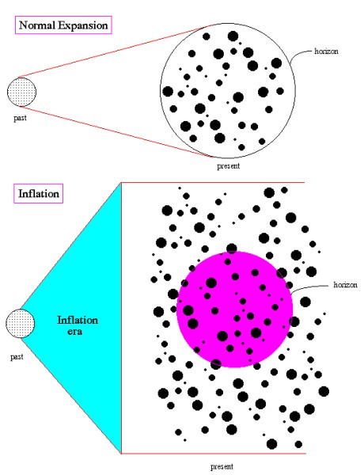
Solution: Inflation (1981)
Initial exponential expansion
Driven by phase transition
Repulsive force
Expansion of 10²⁶ in 10⁻³² s
Smooths out inhomogeneities
Smooths out curvature
‘No hair’ universe

Slide 32
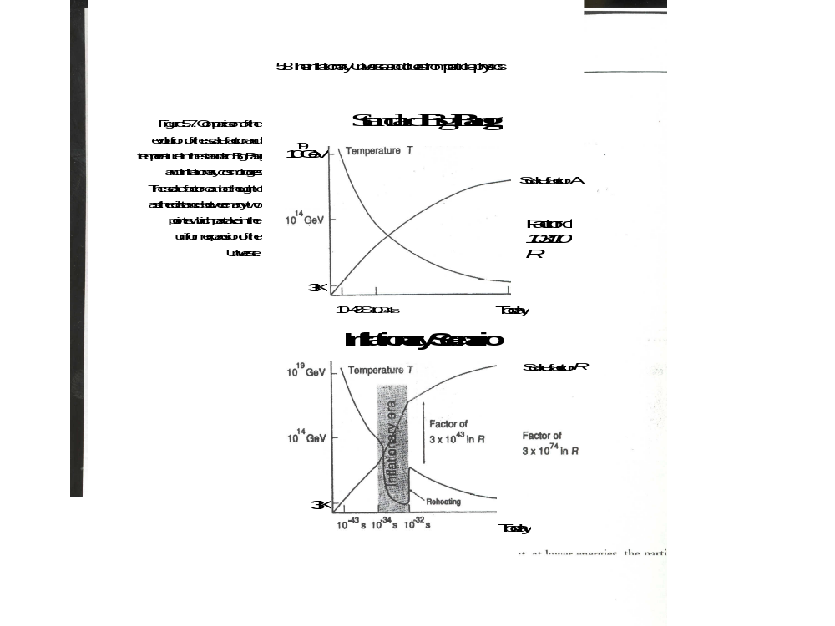

Slide 33
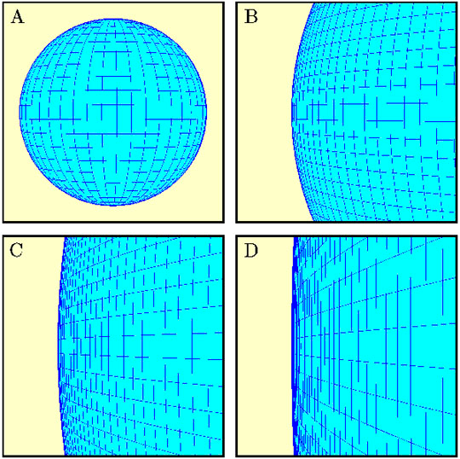
The inflationary universe
Solves flatness problem
Geometry driven towards flatness
Solves horizon problem
Early U incredibly small
Mechanism for galaxy formation
Natural variations inflated
Ω = 1 ?
Conflict between theorists and experimentalists

Slide 34
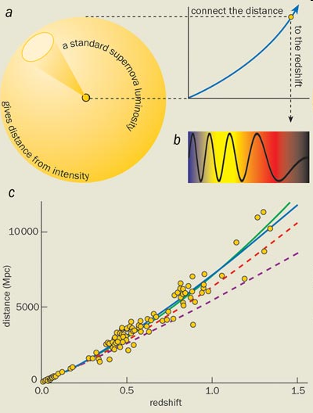
New evidence
Measurements of supernovae (1998)
Furthest galaxies too far away
Hubble expansion accelerating
Geometry of U flat
Support for inflation
Caused by dark energy

Slide 35
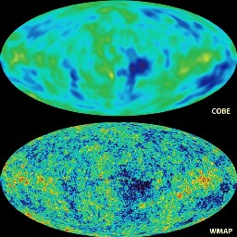
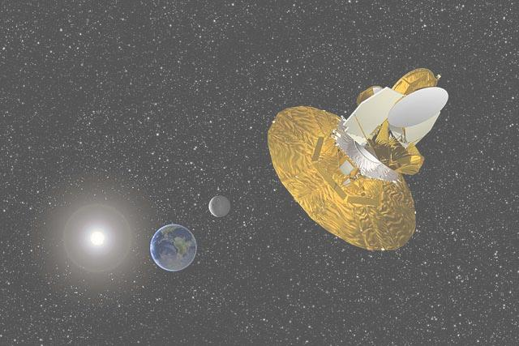
WMAP Satellite (2002)
Details of CMB spectrum
Details of galaxy formation
Details of flatness of U
Cosmic microwave background

Slide 36
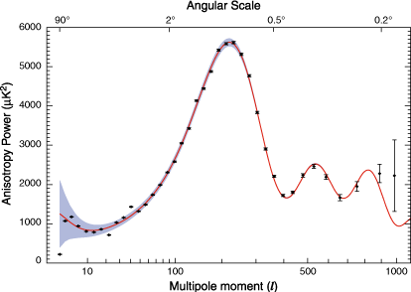
WMAP measurements of CMB (2005)
Flat geometry (to 1%)
Spectrum of T variations
Agreement with supernova data
Strong support for inflation
Fit to theory

Slide 37
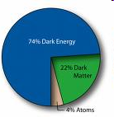
New big bang model: Λ-CDM
A flat, accelerating universe containing matter, dark matter and dark energy
Ordinary matter: 4% (astrophysics)
Dark matter: 22% (astrophysics)
Dark energy : 74% (supernova, CMB)
ΛCDM
Ω = 1

Slide 38
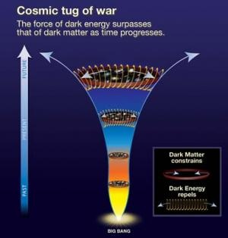
Dark Energy
Cosmological constant?
Predicted by relativity
Natural tendency of space to expand
Energy of vacuum?
Why so small?
Why of similar density to matter?
Not well understood
Fate of universe?

Slide 39
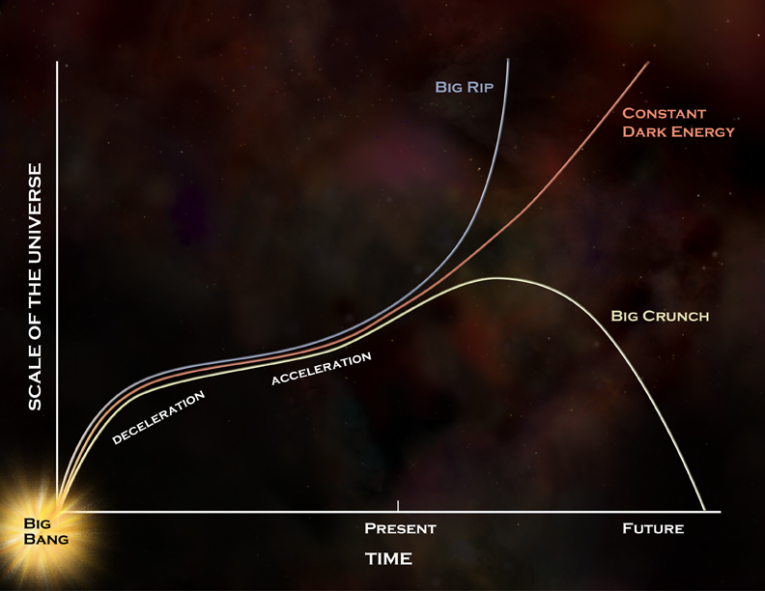
Putting it all together
Basic evidence (BB model)
The expanding universe
The abundance of the elements
The evolving galaxies
The cosmic background radiation
Modern measurements
The CMB spectrum
Inhomogeneties (galaxy formation)
Flat Geometry (supernovae)
A flat, accelerating universe containing
matter, dark matter and dark energy

Slide 40

Is it true? Problems
Nature of dark energy?
Fate of universe?
Nature of dark matter?
Which model of inflation?
The multiverse
What happened at time zero?
Quantum gravity?
Something from nothing?

Slide 41
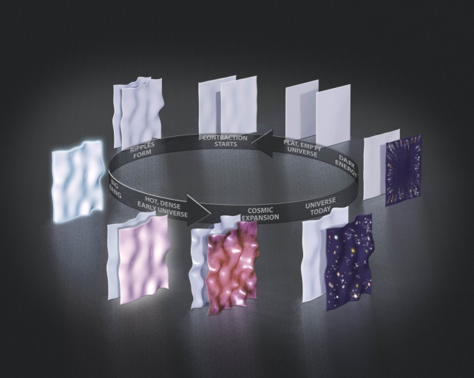
Alternative: the cyclic universe
Breakdown at time zero
No model of bang itself
Multiple bangs?
Colliding branes
Prediction of string theory
Cyclic universe
Eternal universe
Cyclic universe
Tests?

Slide 42
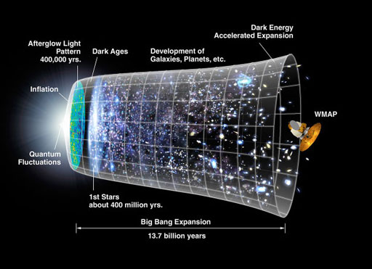
Further reading: The Big Bang (Simon Singh)
Antimatter (CÓR)

