Slide 1

The Big Bang: Fact or Fiction?
The discovery of the expanding universe
Dr Cormac O’Raifeartaigh
Waterford Institute of Technology

Slide 2
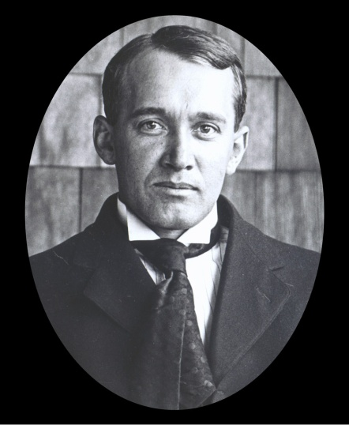
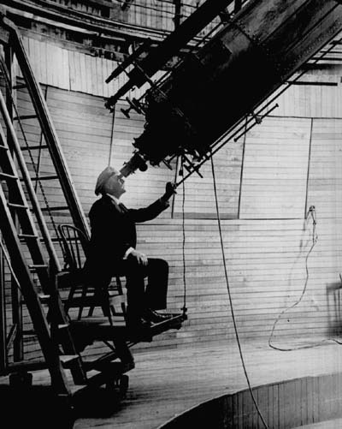
Three major discoveries
The size of the universe (-1925)
Redshifts and the great debate
The expanding universe (1930, 31)
Redshifts and Lemaitre’s relativity
An origin for the universe (1931-)
Redshifts and the big bang
Vesto Slipher 1875-1969

Slide 3
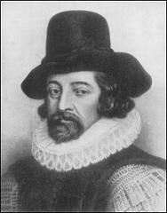
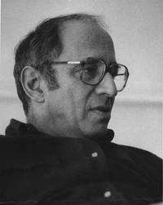
On the philosophy of discovery
Hypothesis, observation and discovery
Theory vs experiment
Discovery vs justification
Credit in science
Re-discovery
The unimportance of social context
Francis Bacon
Kuhn, Feyerabend, Latour

Slide 4
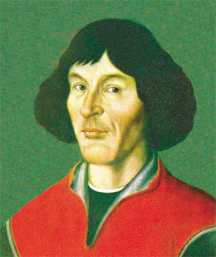
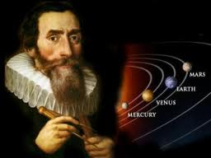
The discovery of the heliocentric universe
Copernicus (1473 - 1543 )
Commentariolus, On the revolutions
Explanation for retrograde motion
Circles and epicycles
Kepler (1571 – 1630)
Elliptical orbits of the planets
Observations of Tyco de Brahe
Galileo (1571 – 1630)
Moons of Jupiter, phases of Venus
Criticized by peers and Church
Copernicus
Kepler
Notes:
Use of telescope

Slide 5
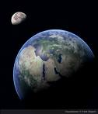
Isaac Newton (1642-1727)
Newton’s universe
Kepler orbits due to gravity
Attractive force caused by mass
Explanation for solar system
Universal law of gravity
Incomplete - mechanism?
Paradigm ‘shift’ or slow dawning?
Accumulation of theory and evidence

Slide 6
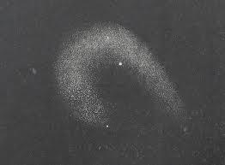
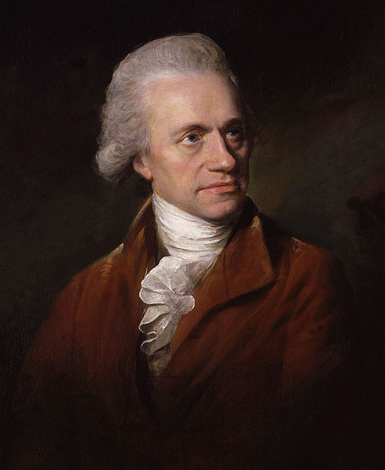
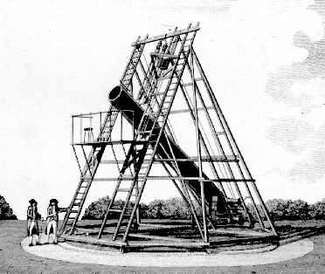
I The discovery of the nebulae
Observed by Marius (1614), Halley, Messier
Island universes: Kant, Laplace
Collections of stars at immense distance?
Evolving universe? (1755-96)
Wilhem Herschel
36-inch reflecting telescope
Catalogue of a thousand (1786)
Problem of resolution, distance

Slide 7
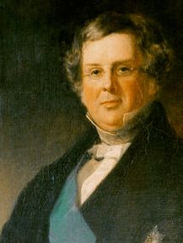
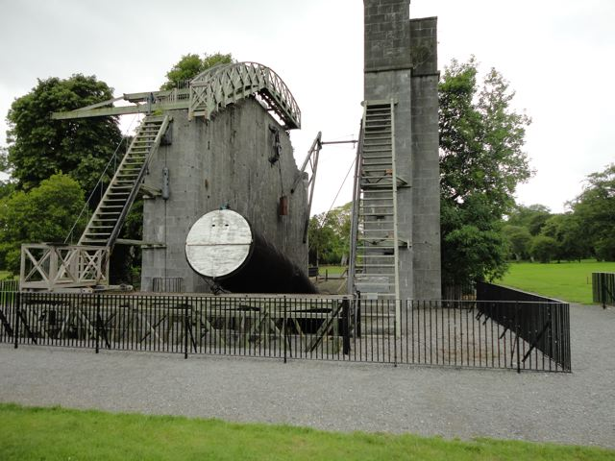
The Leviathan of Birr Castle
Third Earl of Ross (1800-1867)
72-inch reflecting telescope (1845)
Most powerful telescope in the world
Spiral structure of some nebulae
Contain many stars
Distinct galaxies?
Two types of nebula?
Problem of distance measurement

Slide 8
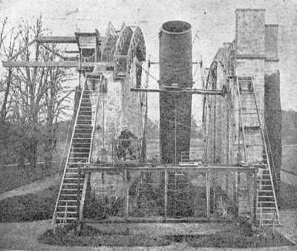
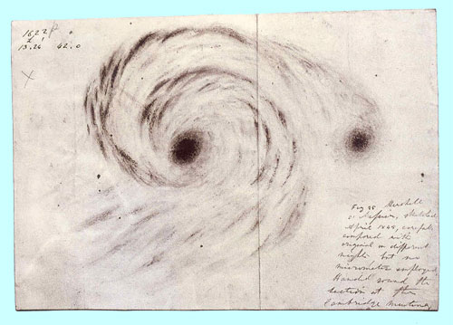
Leviathan of Birr castle
M51 (Lord Rosse)

Slide 9
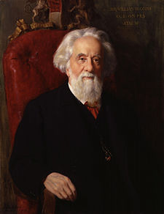
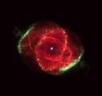
Spectra of the nebulae
Photography, spectroscopy
Analyse light of the nebulae?
Two types of spectra (1864)
Planetary nebulae - line spectra (gases)
Spiral nebulae - continuous spectra (stars)
Sir William Huggins
Spiral nebulae contain stars

Slide 10
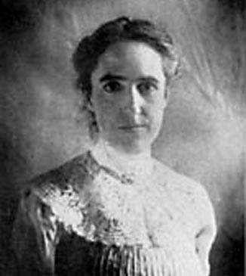
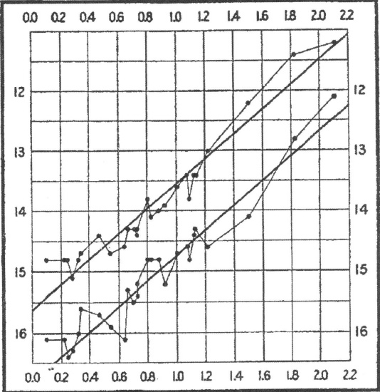
Discovery of distance scale
Henrietta Swan Leavitt (1908, 12)
Period-luminosity relationship for Cepheids
Measure intrinsic luminosity from period
Calculate distance (1918)
Standard candles
Henrietta Leavitt
Leavitt’s law

Slide 11


Doppler shifts of the nebulae
Analyse light of the nebulae? Lowell/Slipher
Camera speed, not telescope size
Andromeda nebula blue-shifted (1912)
Interpret as radial velocity Δλ/λ= v/c
Approaching at 300 km/s
Other spiral nebulae red-shifted (1917)
Receding at 1000 km/s
Vesto Slipher
Much faster than stars

Slide 12
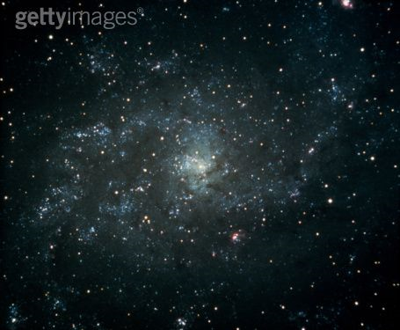
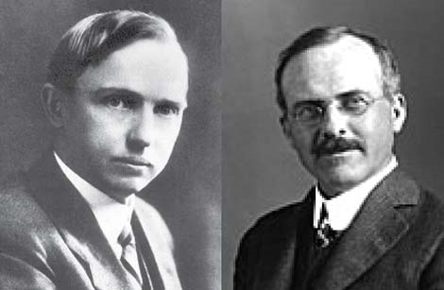
The great debate revisited (1920)
Stellar structure of spiral nebulae
Redshifts – not gravitationally bound?
Many faint novae – great distance?
Distinct galaxies
OR
Big galaxy model (300,000 Lyr)
Rotation data (Van Maanen)
Andromeda nova/supernova
Harlow Shapley vs Heber Curtis

Slide 13


A clear resolution (1923-5)
Hooker telescope (Mt Wilson, 1917)
100-inch reflector
Edwin Hubble (1921)
Ambitious astronomer
Resolved Cepheid stars in nebulae
Applied Leavitt’s law
Nebulae at huge distance! (1923-25)
Edwin Hubble (1889-1953)

Slide 14
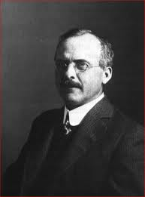
Discovery of the galaxies
Spiral nebulae are distinct galaxies
Verdict quickly accepted
Universe very large
Kuhnian paradigm shift? NO
Slow dawning of an idea
Accumulation of evidence
What do galaxy redshifts represent?

Slide 15

II The expanding universe
What do the redshifts represent?
Recession velocities for distant galaxies?
If so, why?
Newtonian gravity pulls in
What is pushing out?
Isaac Newton
Space, time fixed

Slide 16


General relativity (1915)
Space+time = space-time
Space-time dynamic
Distorted by motion, mass
Causes other mass to move
Gravity = curvature of space-time
G_{μν} = T_{μν}
Eddington experiment (1919)

Slide 17

Two models of the cosmos
Einstein (1917)
Cosmological principle
Matter-filled universe - contracting
No evidence for such a universe
Add cosmic constant - static, stable
Closed curvature, finite radius
G_{μν} + λg_{μν} = T_{μν}
De Sitter (1918)
Empty universe
Apparently static (co-ordinate system)
Redshifts due to matter/time dilation
Explanation for redshifts of the galaxies?

Slide 18
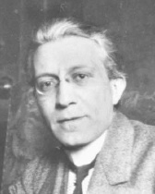
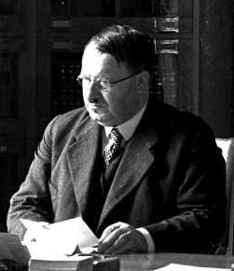
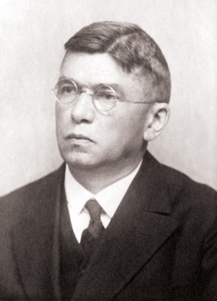
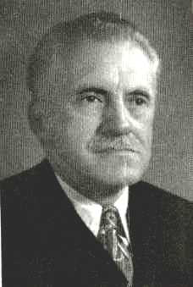
De Sitter redshifts and astronomy
Silberstein (1923)
Δλ/λ = +/- r/R (global clusters)
Carl von Wirtz (1924)
Redshifts for nebulae different to clusters
Time dilation effect?
Lundmark (1924)
‘The determination of the curvature of spacetime
in de Sitter’s world’ Stars and globular clusters
Stromberg (1925)
Vel/dist relation for globular clusters?

Slide 19

Friedmann universes
General solutions (1922, 24)
Time-varying radius
Expanding or contracting
Three possible curvatures
Depends on matter Ω =d/d_{c}
Periodic solutions
Hypothetical models (ZfPh)
Disliked by Einstein (‘suspicious’)
Alexander Friedmann 1888 -1925

Slide 20
Lemaitre’s universe (1925,27)
De Sitter model expanding
New solution combining best of E and deS
Matter-filled universe of increasing radius (1927)
Connection with astronomy
Predicts redshifts = expansion of space
Rate of expansion from average measurements of
distance and redshift H = 585 km/s/pc
Obscure journal
Rejected by Einstein
Fr Georges Lemaitre
Weyl (1925)
Robertson (1928)

Slide 21

Hubble and the redshifts (1929)
Redshift/distance relation for the nebulae?
Natural next step, test of theory
New distance measure?
Combine distance measurements with
Slipher redshifts (24 galaxies)
Approx linear relation (1929)
Empirical relation
Rapid acceptance (except Shapely)
New model of the universe required (Eddington)
v = kr

Slide 22
The expanding universe (1930,31)
Lemaitre’s intervention
Eddington, de Sitter convinced
Translated theory (1931)
Hubble graph + theory
Space is expanding (relativists)
Astronomers sceptical (Hubble)

Slide 23
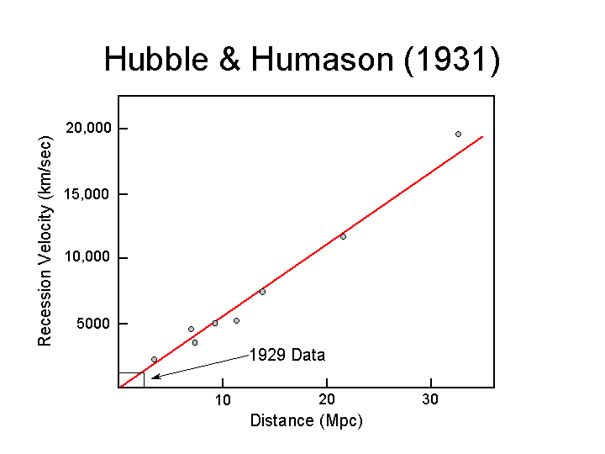
Hubble-Humason graph (1931)
Distance measurements for
40 nebulae/galaxies
Corresponding redshifts by Humason
Reduced scatter
Linear relation
Justification

Slide 24

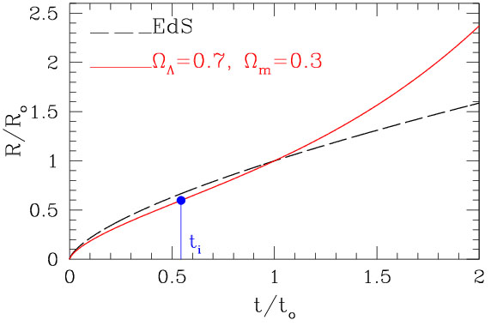
Einstein-deSitter universe (1932)
Space is expanding forever
Flat geometry
Critical mass density (Λ =0)
Standard model
Problem of matter density
Problem of age

Slide 25
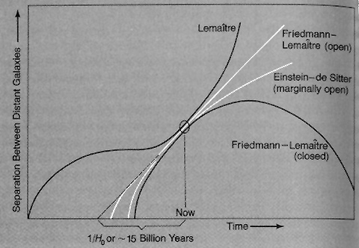
Lemaitre’s universe (1934)
Expansion from radioactive decay
Stagnation period
Accelerated expansion
Positive cosmic constant
No age problem
Λ = Energy of vacuum
p = - ρ₀ c² , ρ₀ = λc²/8πG
Cyclic universe?

Slide 26
The discovery of the expanding universe
Lemaitre Theory and experiment
Hubble/Slipher Empirical law
Friedmann Dynamic solutions
Ross, Huggins, Leavitt, Shapely ,Einstein, deSitter,
Weyl, Lanzcos , Silberstein,Wirtz, Lundmark, Stromberg..
Slow dawning, accumulation of theory and evidence
The facts emerge independent of social context

Slide 27

III An origin for the universe
Expanding U implies beginning
Lemaitre (1931)
The beginning of the world according
to quantum theory
Giant primeval atom?
Decays to today’s matter

Slide 28
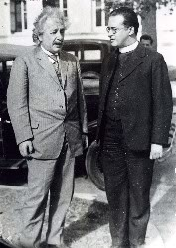
Reception: not accepted
Unpopular with astronomers
(Not with a Bang!)
Rarely cited by theorists
Creation theory? (Einstein)
Radioactive mechanism wrong
Far ahead of its time
Nucleosynthesis, radio-galaxy counts, cosmic microwave background

Slide 29
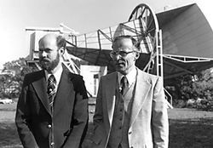
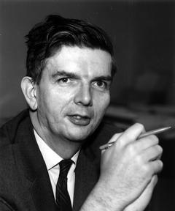
Who discovered the big bang?
Lemaitre (primeval atom)
Gamov, Alpher and Herman (nucleosynthesis)
Alpher and Herman (prediction of cmb)
Penzias and Wilson (cmb)
Dicke and Peebles (explanation)
Martin Ryle (radio counts)
COBE experiment
WMAP experiment
Slow dawning, accumulation of theory and evidence

Slide 30

Additional evidence (1940s)
Nuclear physics (1940s)
How did the chemical elements form?
Not in the stars
In Lemaitre’s primeval atom ?
H, He nuclei (1 s)
Predicts U = 75% H, 25% He
Agrees with observation
Georges Gamow
Heavier atoms formed in stars

Slide 31

Prediction: cosmic radiation?
Infant universe full of radiation
Released when atoms formed (300,000 yr)
Still observable today?
Low temp, microwave frequency
Alpher, Gamow and Herman
No-one looked (1940s)

Slide 32


Steady-state model (1950s)
Rival model
Expanding universe
BUT
Matter continuously created
No beginning
Fred Hoyle

Slide 33

Steady-State vs Big Bang
U unchanging, eternal ?
Density of matter constant ?
Continuous creation?
Falsification possible
Young universe different to today ?

Slide 34

Radio-astronomy (1960s)
Study most distant galaxies
Look back in time
Compare with local galaxies
Density the same at all times? (SS)
Or different? (BB)
Martin Ryle
Answer: different
Cambridge
3C survey
End of steady-state model

Slide 35

Bonus: cosmic radiation (1965)
CMB discovered accidentally
Universal signal
Low frequency (microwave)
Low temperature (3K)
Penzias and Wilson
Echo of Big Bang!
BB model goes mainstream

Slide 36
The big bang – is it true?
  √ 1. The expansion of the U
  √ 2. The abundance of H and He
  √ 3. The evolution of galaxies
  √ 4. The cosmic background radiation
Superhot, superdense
Expanding and cooling
How did it start?

Slide 37

IV Modern measurements
New measurements of CMB
Full spectrum
Comparison with theory
Balloon experiments
Satellite experiments
COBE satellite (1992)

Slide 38
COBE measurements of CMB
Expected temperature
Expected frequency
Perfect blackbody spectrum
Radiation very uniform
Variation of 1 in 10⁵
Galaxy formation?
COBE (1992)
Nobel Prize 2006

Slide 39

Problems
Background radiation raised new questions
Horizon problem why so uniform?
Galaxy problem how did galaxies form?
Flatness problem fine balance?
Singularity problem
∞ density, ∞ curvature at t = 0 ?
Stephen Hawking
quantum gravity?

Slide 40
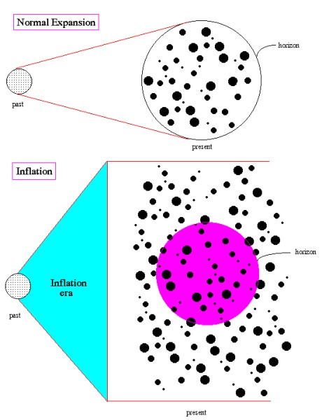
The Theory of Inflation
Initial exponential expansion
Driven by phase transition
Repulsive force
Expansion of 10²⁶ in 10⁻³² s
Smooths out inhomogeneities
Smooths out curvature
‘No hair’ universe

Slide 41
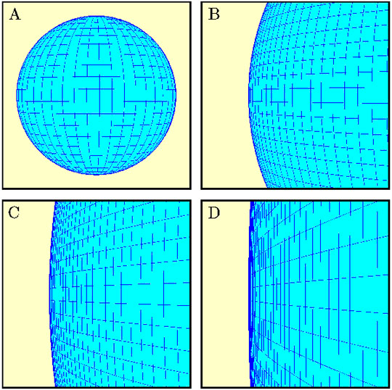
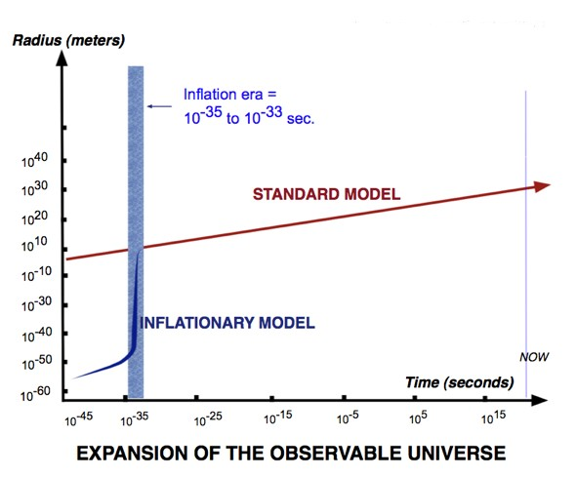
The inflationary universe (1981)
Solves horizon problem
Early U incredibly small
Mechanism for galaxy formation
Natural variations inflated
Solves flatness problem
Geometry driven towards flatness
Ω = 1 ?
Conflict between theorists and experimentalists

Slide 42
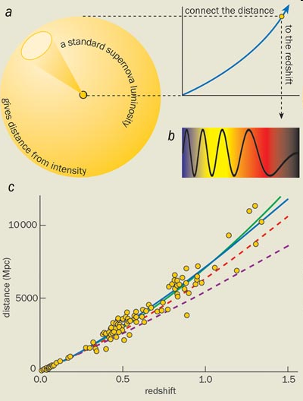
Supernova astronomy (1998)
Supernovae as standard candles (1998)
Furthest galaxies too far away
Expansion speeding up!
Geometry of U flat (Ω = 1)
Support for inflation

Slide 43
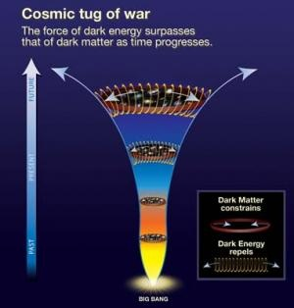
Cause of acceleration: dark energy
Predicted by relativity
Cosmological constant
Natural tendency of space to expand
Energy of vacuum?
Why so small?
Why of similar density to matter?
Not well understood
Fate of universe?

Slide 44
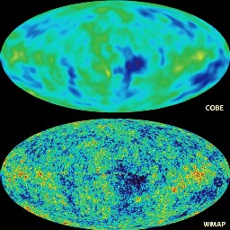
WMAP Satellite (2002)
Details of CMB spectrum
Details of galaxy formation
Details of flatness of U
Cosmic microwave background

Slide 45
WMAP measurements of CMB (2005)
Flat geometry (to 1%)
Spectrum of T variations
Strong support for inflation
Strong support for dark energy
Fit to theory

Slide 46
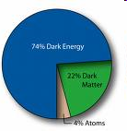
New big bang model: Λ-CDM
A flat, accelerating universe containing matter, dark matter and dark energy
Ordinary matter: 4% (astrophysics)
Dark matter: 22% (astrophysics)
Dark energy : 74% (supernova, CMB)
ΛCDM
Ω = 1

Slide 47

The big bang - problems
Nature of dark energy?
Role in BB?
Which model of inflation?
The multiverse?
The singularity problem?
What banged?
What does time zero mean?

Slide 48
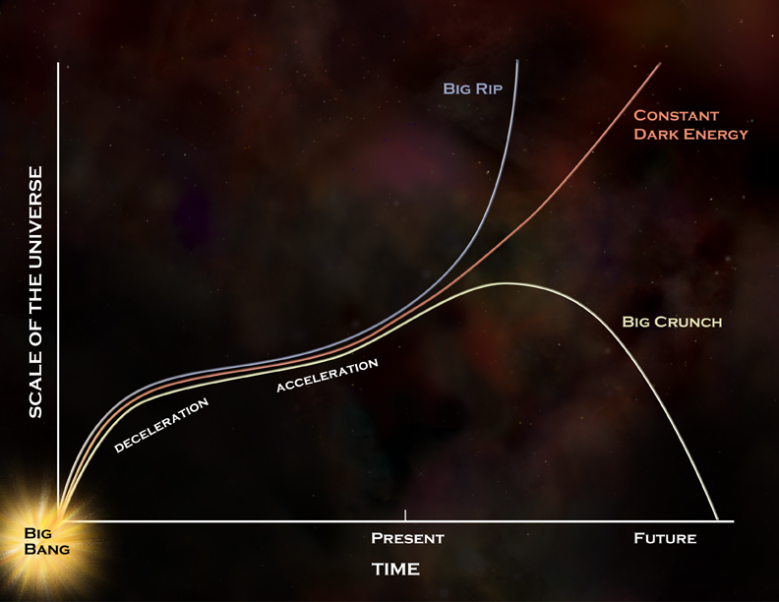
Putting it all together
Basic evidence (BB model)
The expanding universe
The abundance of the elements
The evolving galaxies
The cosmic background radiation
Modern measurements
The CMB spectrum
Tiny variations
Flat geometry (supernovae)
A flat, accelerating universe containing
matter, dark matter and dark energy

Slide 49
Today’s model
A flat universe containing matter,
dark matter and dark energy
Ordinary matter: 4% (astrophysics)
Dark matter: 22% (astrophysics)
Dark energy : 74% (supernova, CMB)
ΛCDM
Ω = 1

Slide 50
Next: Planck Satellite (ESA)
1. Improved sensitivity
2. Full spectrum of T anisotropy
New acoustic peaks
Scale invariance?
3. Polarization measurements
E-modes: fluctuations
B-modes: gravity waves?

Slide 51
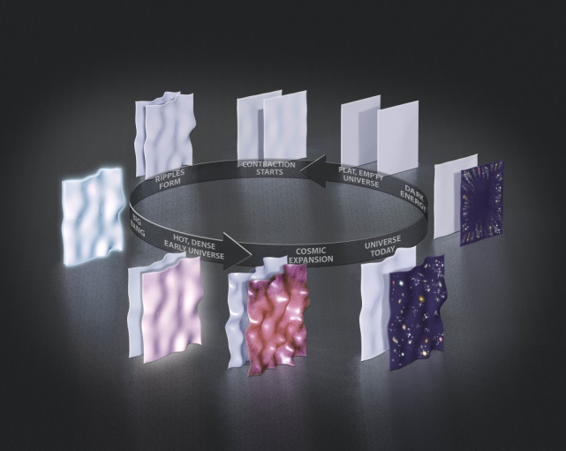
The singularity: a cyclic universe?
Breakdown at time zero
No model of bang itself
Multiple bangs?
Colliding branes
Prediction of string theory
Cyclic universe
Eternal universe
Cyclic universe
Tests?

Slide 52
Further reading: The Origin of the universe (John Barrow)
Antimatter (CÓR)

