Slide 1

The Big Bang: Fact or Fiction?
VM Slipher
and
the discovery of the expanding universe
Cormac O’Raifeartaigh
Waterford Institute of Technology

Slide 2
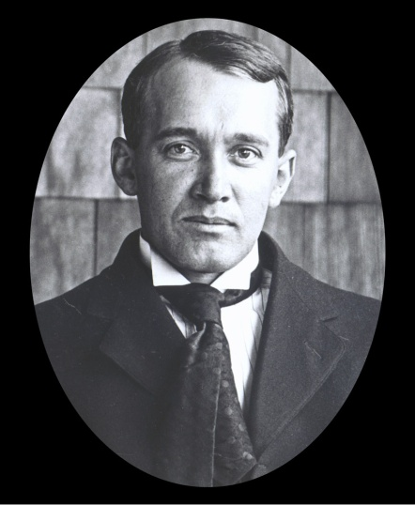
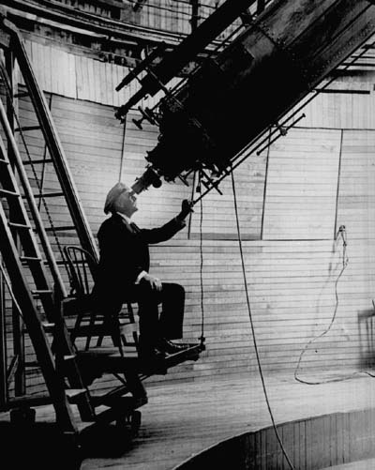
Overview
A brief history of experiment (1912-1931)
The redshifts of the nebulae (Slipher)
The distances to the nebulae (Hubble)
The Hubble-Slipher graph
A brief history of theory (1915-1931)
The static universes of Einstein and de Sitter
The dynamic universes of Friedman and Lemaitre
The expanding universe (1931)
On the naming of laws and equations
Vesto Slipher 1875-1969

Slide 3
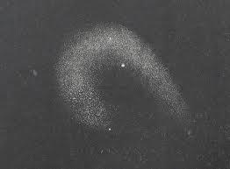
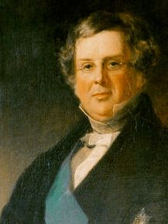
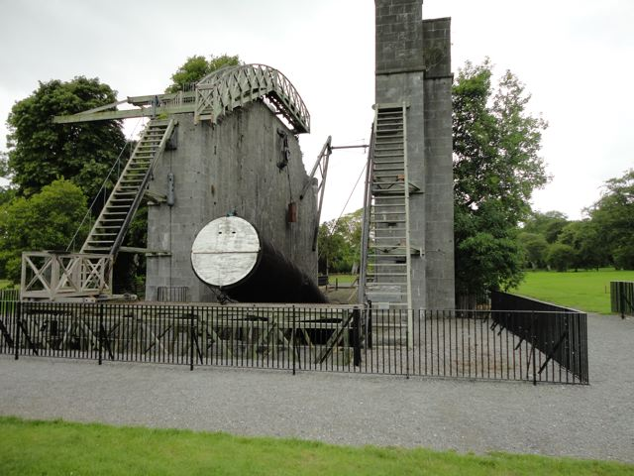
I The nebulae
Observed by Marius (1614), Halley, Messier
‘Island universes’: Kant, Laplace (1755-96)
Collections of stars at immense distance?
Are stars born in the nebulae?
Wilhem Herschel
36-inch reflecting telescope
Catalogue of a thousand (1786)
Earl of Rosse
72-inch reflecting telescope (1845)
Some nebulae have spiral structure, stars
Problem of resolution, distance

Slide 4
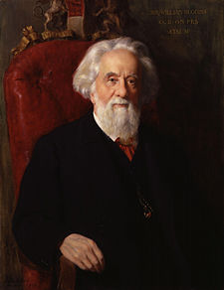
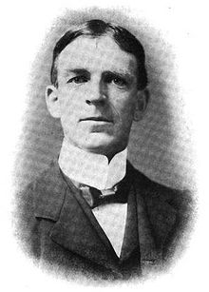
The spectra of the nebulae
Photography and spectroscopy (19th cent)
Emission and absorption lines of celestial objects
Composition of the stars and planetary nebulae
William Huggins
Radial motion of the stars
Doppler effect
William Campbell
Spectroscopy of spiral nebulae?
Information on evolution of solar system
Difficult to resolve
Sir William Huggins (1824 – 1910)
William Campbell ( 1862 – 1938)

Slide 5
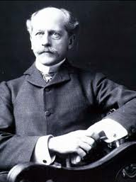
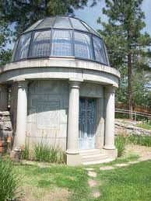
The Lowell observatory
Founded by Percival Lowell (1894)
Eccentric astronomer
24-inch refracting telescope
Flagstaff, Arizona
Controversial
Canals on Mars
Employed VM Slipher (1901)
Brashear spectrograph
Spectroscopy of planetary atmospheres
Percival Lowell (1855 – 1916)

Slide 6


Spectra of the spiral nebulae
Analyse light of the spiral nebulae? (1909)
Evolving solar system? Lowell
Slipher reluctant
Larger telescopes failed
Experiments with spectrograph camera
Good results with fast camera lens
Clear spectrum for Andromeda nebula (1912)
Significantly blue-shifted
Approaching at 300 km/s
Many spiral nebulae red-shifted (1917)
Vesto Slipher
Δλ/λ= v/c

Slide 7
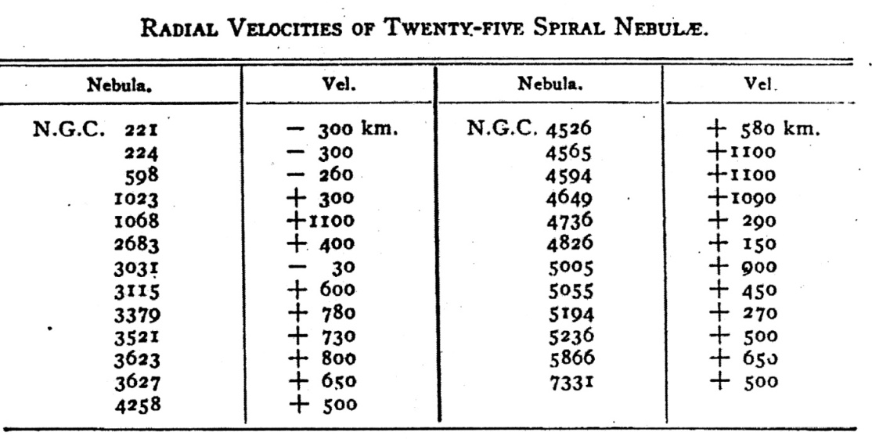
Redshifts of the spiral nebulae
Spectra of 25 spirals (1917)
Large outward velocities
Some receding at 1000 km/s
Much faster than stars
Gravitationally bound by MW?
Island universe debate
“Island universe hypothesis gains favour”

Slide 8
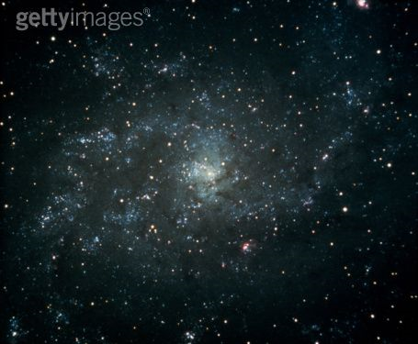
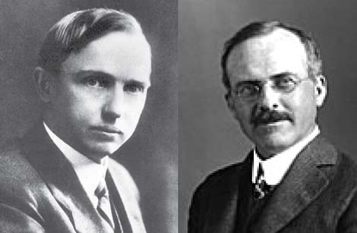
The great debate revisited (1920)
Distinct galaxies
Stellar structure of spiral nebulae
Redshifts – not gravitationally bound?
Many faint novae – great distance?
OR
Big galaxy model (300,000 Lyr)
Rotation data (Van Maanen)
Andromeda nova/supernova
Harlow Shapley vs Heber Curtis

Slide 9


A clear resolution (1925)
Hooker telescope (Mt Wilson, 1917)
100-inch reflector
Edwin Hubble (1921)
Ambitious astronomer
Resolved Cepheid stars in nebulae
Leavitt’s period-luminosity relation
Spirals beyond Milky Way! (1925)
Edwin Hubble (1889-1953)

Slide 10

A velocity/distance relation
What do the redshifts of the galaxies mean?
Is there a relation between v and r ?
Combine redshifts with 24 distances
Approx linear relation (Hubble, 1929)
Slipher data not acknowledged
Becomes known as Hubble’s law
m = 585 km/s/Mpc

Slide 11
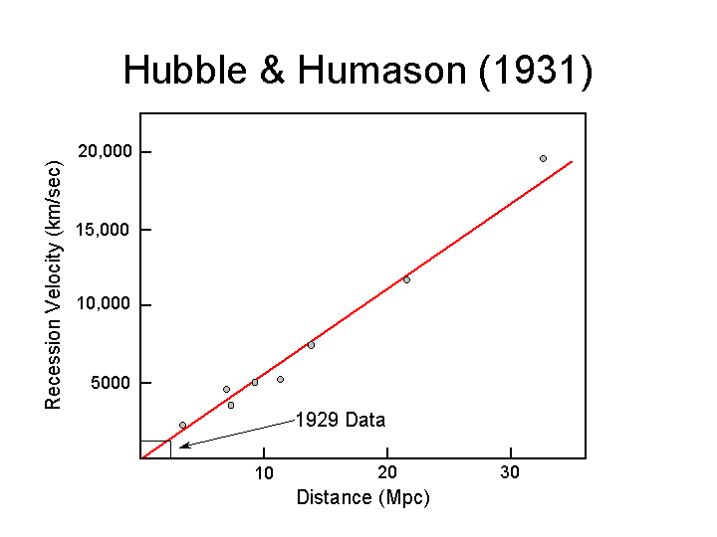
Hubble-Humason graph (1931)
Distance measurements for
40 nebulae/galaxies
Corresponding redshifts by Humason
Reduced scatter - linear
Justification
Explanation?
Hubble did not discover
the expanding universe

Slide 12

II The expanding universe
What do the redshifts represent?
Recession velocities for distant galaxies?
If so, why?
Newtonian gravity pulls in
What is pushing out?
Isaac Newton
Space, time fixed

Slide 13


General relativity (1915)
Space+time = space-time
Space-time dynamic
Distorted by motion, mass
Causes other mass to move
Gravity = curvature of space-time
G_{μν} = T_{μν}
Eddington experiment (1919)

Slide 14

Two models of the cosmos
Einstein (1917)
Assume uniform density of matter
Equations predict dynamic universe
No evidence for such a universe
Add cosmic constant – ‘static’
Closed curvature, finite radius
G_{μν} + λg_{μν} = T_{μν}
De Sitter (1918)
Assume empty universe
Apparently static (co-ordinate system)
Redshifts due to time dilation/matter
Explanation for redshifts of the galaxies?

Slide 15
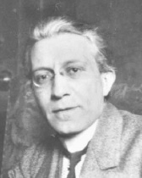
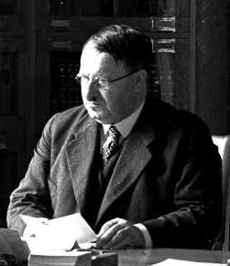
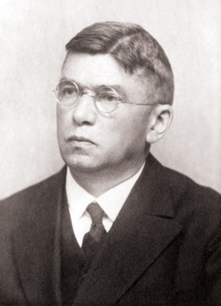
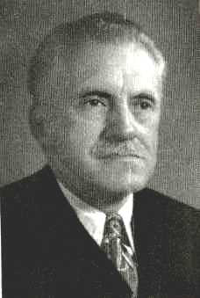
De Sitter effect and astronomy
Silberstein (1923)
Δλ/λ = +/- r/R (global clusters)
Carl von Wirtz (1924)
Redshifts for nebulae different to clusters
Time dilation effect?
Lundmark (1924)
‘The determination of the curvature of spacetime
in de Sitter’s world’ Stars and globular clusters
Stromberg (1925)
Vel/dist relation for globular clusters?

Slide 16

Friedman universes
General solutions (1922, 24)
Time-varying radius
Expanding or contracting
Positive or negative curvature
Depends on matter Ω =d/d_{c}
Hypothetical models (ZfPh)
All possible universes (to be decided by astronomy)
Disliked by Einstein (‘suspicious’)
Alexander Friedman 1888 -1925

Slide 17
Lemaitre’s expanding universe
De Sitter model is not static (1925)
New solution combining best of E and deS
Matter-filled universe of increasing radius (1927)
Connection with astronomy
Redshifts = expansion of space-time metric?
Rate of expansion from average measurements of
distance and redshift H = 585 km/s/Mpc
Obscure journal
Rejected by Einstein
Fr Georges Lemaitre
Weyl (1925)
Lanczos (1923)
Robertson (1928)

Slide 18
III The expanding universe (1931)
Hubble-Slipher graph (1929)
Einstein, de Sitter models don’t fit
Lemaitre reminds Eddington of his paper
Paper translated (MNAS, 1931)
Satisfactory explanation
Space is expanding (relativists)
Astronomers sceptical (Hubble)
Expansion of space

Slide 19
Who discovered the expanding universe?
Friedman Evolving universe
Lemaitre Expanding U and experiment
Hubble/Slipher Empirical evidence
All of them!
FLRW metric, but nothing for Slipher
‘Hubble graph’ should be Hubble-Slipher graph
‘Hubble expansion ‘should be Hubble-Lemaitre expansion

Slide 20
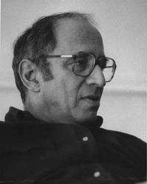
P.S. On paradigm shifts
Slow emergence of theory and evidence
Experiment: Rosse, Huggins, Leavitt, Shapely , Slipher, Hubble
Theory: Einstein, de Sitter, Weyl, Lanzcos, Friedman, Lemaitre, Robertson, Walker
Slow acceptance by community
Many astronomers doubt relativistic universe
No upsurge of interest in cosmology until 1965
Slow dawning, not incommensurate paradigm shift
Thomas Kuhn

Slide 21

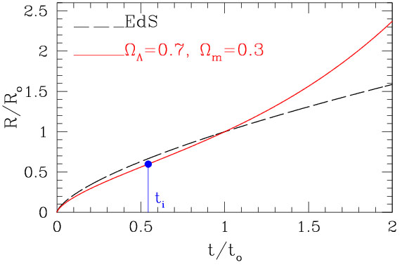
Einstein-deSitter universe (1932)
Einstein rejects static universe (1931)
Removes cosmic constant (Λ=0)
U of Flat geometry
Critical mass density
Standard model (age problem)

Slide 22
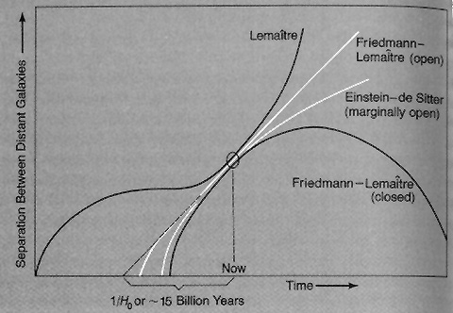
Lemaitre’s universe (1934)
Positive cosmic constant
Accelerated expansion
Expansion from radioactive decay
Stagnation period
No age problem
Λ = Energy of vacuum
p = - ρ₀ c² , ρ₀ = λc²/8πG
Cyclic universe?

