Slide 1

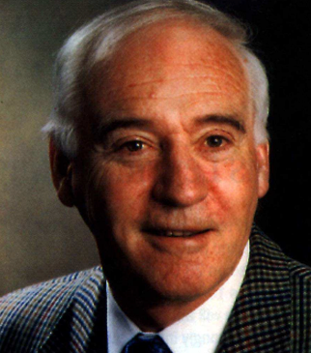
The Big Bang: Fact or Fiction?
Lochlainn O’Raifeartaigh
Life and science
Cormac O’Raifeartaigh
LMU Munich 2012

Slide 2
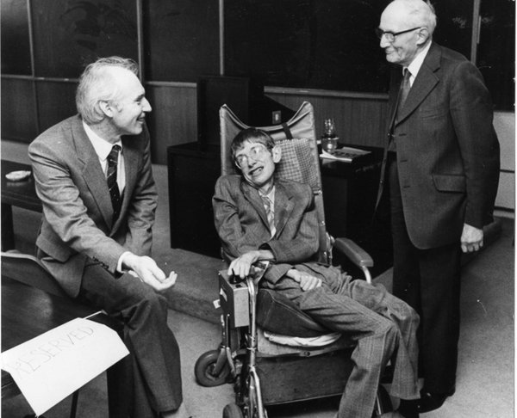
‘Superstars of Science’
The Irish Times (July, 2012)
Name the scientists!
Walton not well-known
Lochlainn less well-known
Theorists not well-known
No biographies
Does it matter?
DIAS (Dublin, 1983)

Slide 3
Schrӧdinger’s legacy at DIAS
Interest in general relativity
Two classic books
Synge/Lanzcos
DIAS training in GR
Influence on Lochlainn
Contrast with USA
DIAS (Dublin, 1983)

Slide 4
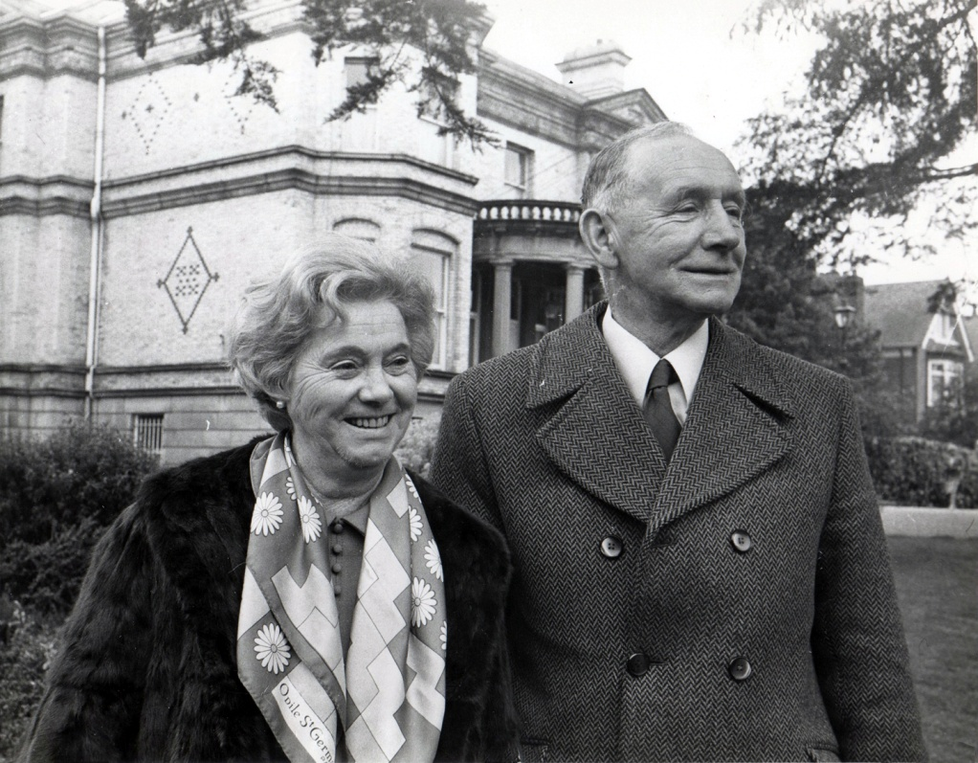
Background
B. Dublin (1933)
Kincora Rd, Clontarf
Tarlach O’Raifeartaigh
Teacher/Inspector
SG Dept of Education
Nancy Morrissey
Japanese scholar
One of six children
Eldest boy
Terry and Nancy Rafferty

Slide 5
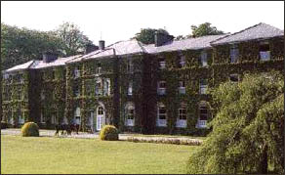
Education
St Joseph’s, Marino
Primary School
Castleknock College
Secondary School
Leaving Cert (1950)
Maths prize
Matriculation (UCD)
Entrance scholarship
Castleknock College

Slide 6
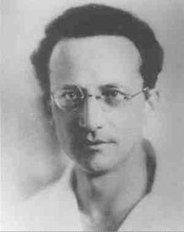
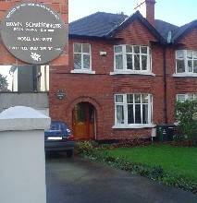
The Schrödinger connection
Kincora Rd
Schrödinger residence
Friends with Ruth
Stamp collecting
Physics influence?
School friends
John Gardner
Science vs engineering

Slide 7
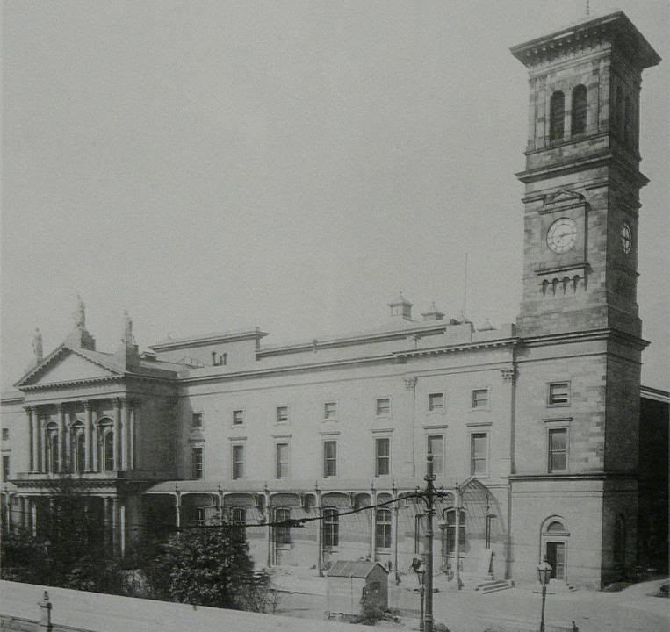
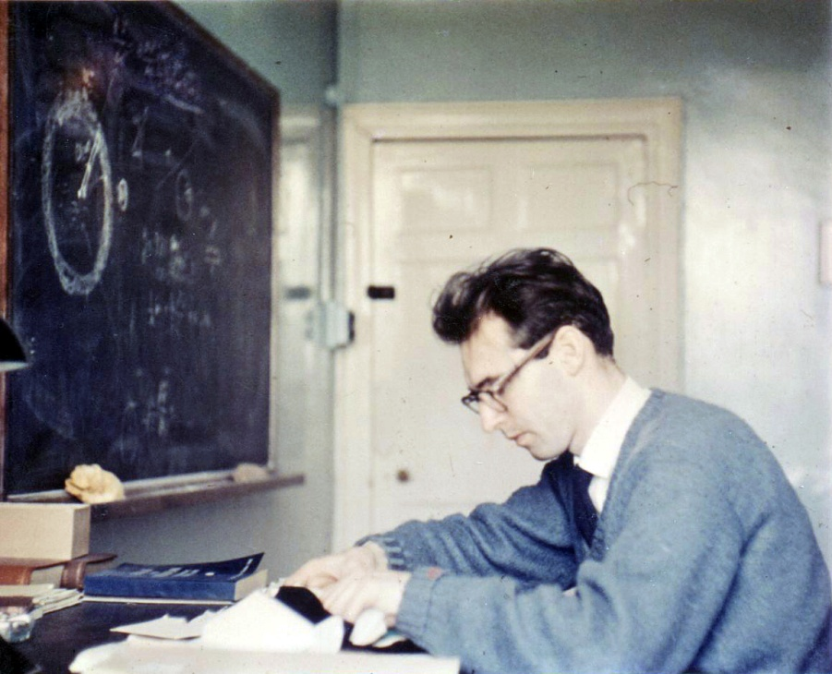
University
First science (UCD)
Mathematical sciences
BSc Hons (1st class) 1954
Masters (UCD)
MSc (1st class)1956
Dublin Institute for Advanced Studies (1956)
Relativity with Synge
Three papers on relativity

Slide 8
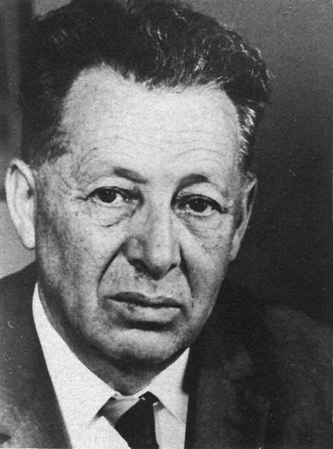
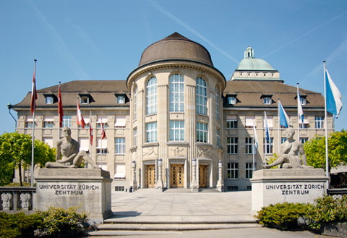
The Swiss years
University of Zurich
(Heitler, Pauli, Jost)
Mum moves to Zurich
Conor arrives (1960)
PhD (1960)
Happy in Zurich
S-matrix in non-local field
theory of Arnous and Heitler
Walter Heitler
Three papers

Slide 9
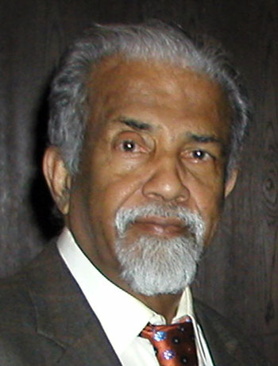
DIAS/Madras
Assistant professor (DIAS, 1961)
Finbar arrives
George Sudarshan
(Berne, 1961)
Madras Inst. for Math. Sci (1963)
Lectures on Local Lie Groups
Return to DIAS (1963-4)
Cormac arrives
George Sudarshan
2010 Dirac Medal

Slide 10
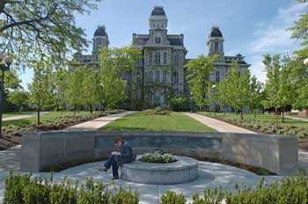
American years
Syracuse University (1964-67)
George Sudarshan
Gellmann symmetry groups (SU3)
Success (Ω⁻)
Combine internal symmetry
with space-time symmetry?
Lochlainn arrives
Knowledge of group theory
University of Syracuse

Slide 11
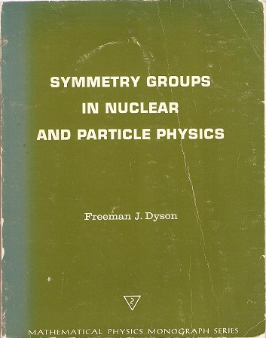
No-go theorem
Early difficulties
Bill McGlynn
O’Raifeartaigh theorem (1965)
Definitive treatment
Halted some research programs
Criticized
Vindicated
Coleman-Mandula theorem (1967)
Freeman Dyson (1966)

Slide 12
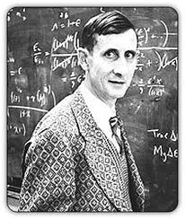
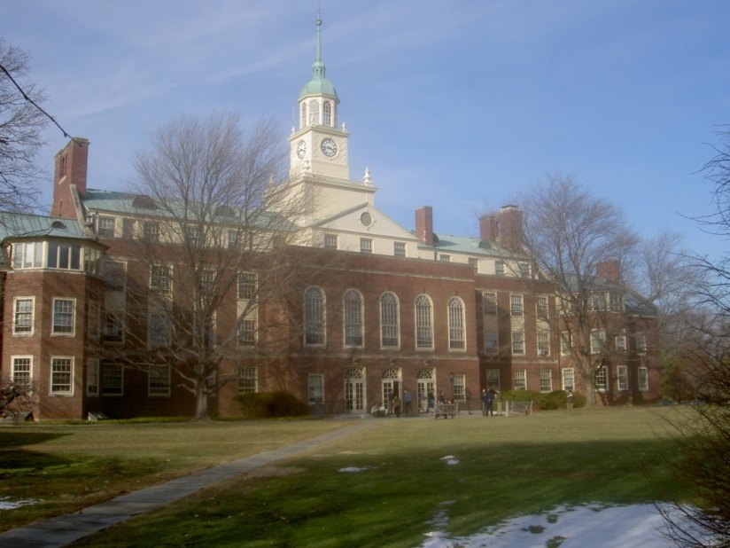
Princeton
Princeton (IAS, 1967)
Freeman Dyson
Oppenheimer in audience
Serenity
Institute for Advanced Study
Princeton, New Jersey

Slide 13
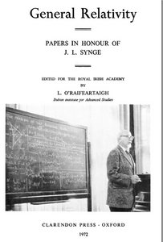
Return to DIAS
Dublin (IAS, 1968)
Bring kids up in Ireland
Book on relativity (Ed.)
Penrose, Ellis, Sciama, Lanczos,
Chandrasekhar, Israel
Relativity tape with Lanczos (AL)
Special and general relativity
Contrast with the US

Slide 14
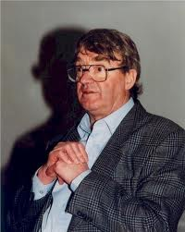
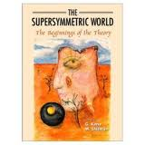
1970s: Supersymmetry
Super gauge symmetry
Wess and Zumino (1974)
Circumvent no-go theorems
Mix fermions with bosons
Aspen summer school (Jaffe)
Supersymmetry breaking?
Four SUSY papers (75-76)
O’Raifeartaigh mechanism of SUSY breaking
Same technique as no-go theorem!
Julius Wess

Slide 15
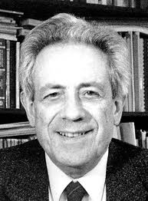
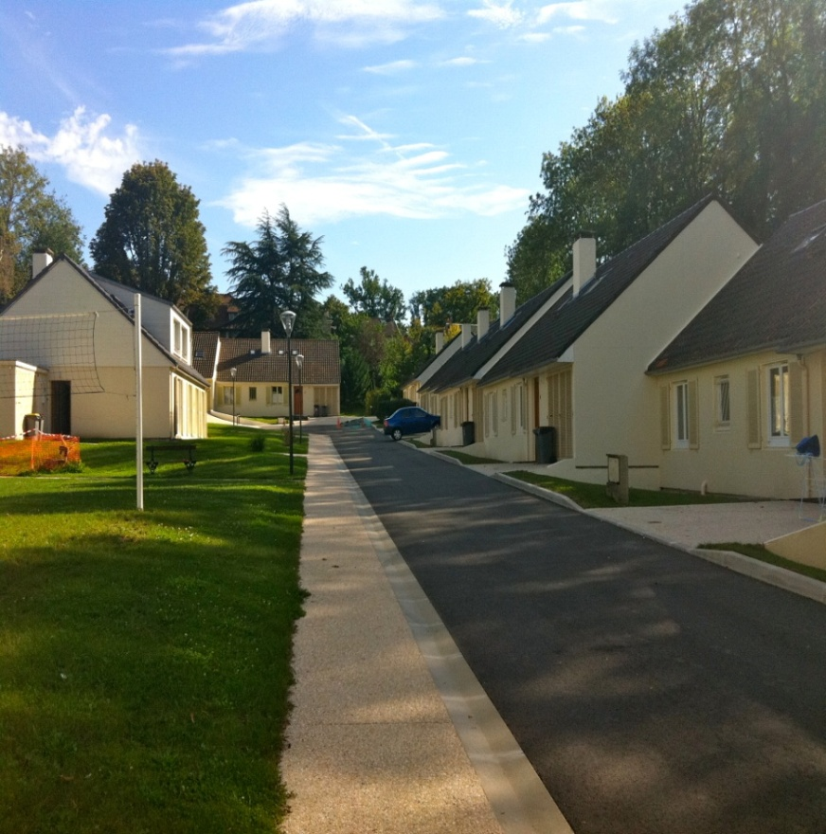
Bures-sur-Yyvette (1975-76)
IHÉS (Gif-sur-Yvette)
Louis Michel
Résidence de l’Ormaille
Family at local schools
Papers on gauge symmetry
Michel and KC Wali
Ski conference in Austria!

Slide 16
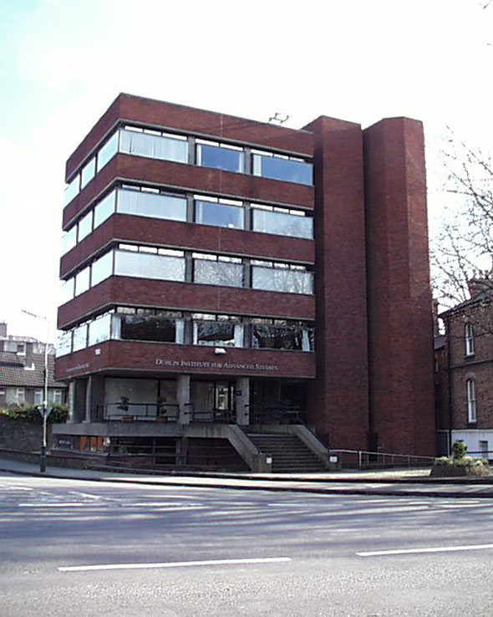
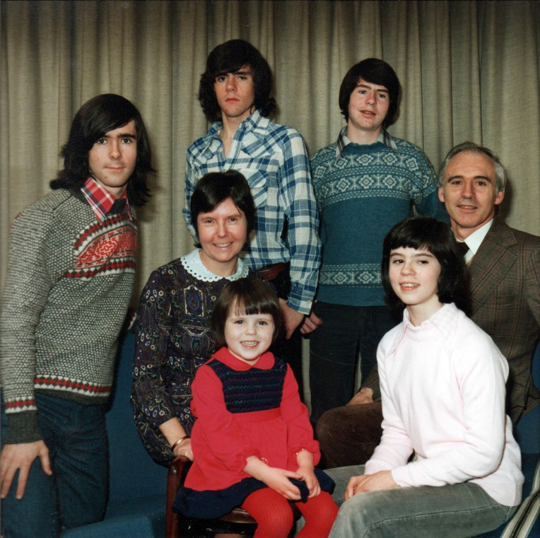
Middle years at DIAS
Back at DIAS (1980s)
Secondary schools/exams
Health issues
Physics of magnetic monopoles
12 papers
(1978 – 1984)

Slide 17
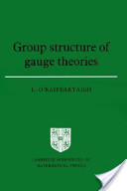
Bures-sur-Yyvette II
IHÉS (1983-84)
Louis Michel
Group Structure of Gauge Theories
(CUP, 1986)
I Structure of groups
II Interactions as gauge theories
Graduate student level
Unified gauge theory of the interactions

Slide 18
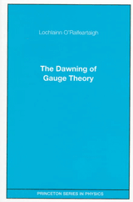
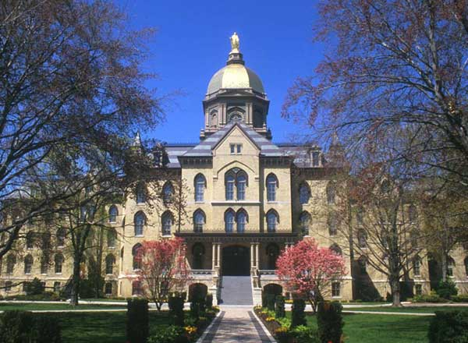
USA II
University of Notre Dame (1994)
Bill McGlinn
The Dawning of Gauge Theory
(Princeton, 1997)
History of gauge theory
Japanese journals (Izumi)
Physics history by physicists

Slide 19
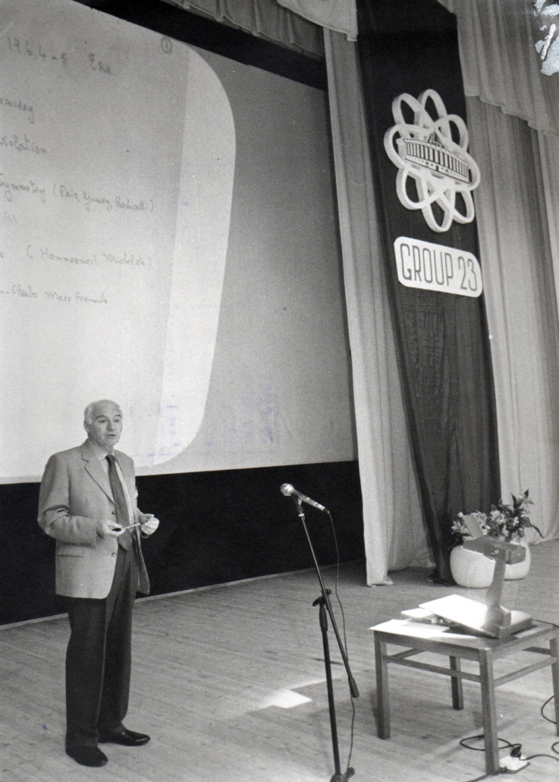
Honours
Royal Irish Academy Member (1963)
Academia Europaea Member (1991)
Institute of Physics Fellow (1990)
Von Humbolt Award (1996)
Wigner Medal (2000)
For applications of group theory in physics

Slide 20
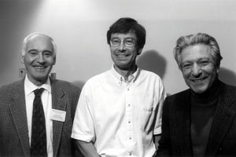
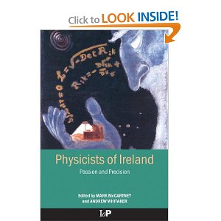
Scientific Legacy
O’Raifeartaigh Theorem (1965)
O'Raifeartaigh Model (1976)
Analysis of magnetic monopoles (1976-2000)
‘Application of group theory to physics’
SUSY 30 years
Unified gauge theory of the fundamental interactions
Acknowledgements
R. Jackiw, N. Straumann, S. Sen

Slide 22
