Slide 1

The Big Bang: Fact or Fiction?
Science, Society and the Universe
A brief history of cosmology
Cormac O’Raifeartaigh FRAS
UCD School of Physics 2017

Slide 2
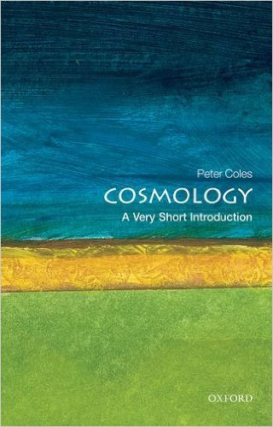

Useful Texts
A Very Short Introduction to Cosmology
Peter Coles (OUP)
The Big Bang
Simon Singh
Cosmology
Edward Harrison (CUP)
The Cambridge Illustrated History of Astronomy
Michael Hoskin (CUP)

Slide 3
Cosmology: the study of the universe
Is the universe finite?
How big is it?
Is the universe eternal?
How old is it?
How did the universe begin?
How will it end?
What is the nature of time?
What is the nature of space?
Science or philosophy?

Slide 4

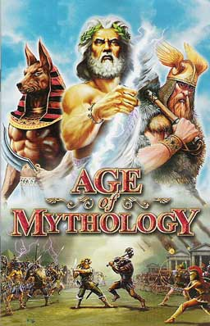
Earliest cosmology
The age of magic
Every that happened due to spirits
The anthropomorphic universe
Fashioned in the image of mankind
The age of mythology
Creation myths
The anthropocentric universe
Spirits become remote Gods and Goddesses
Sumerians, Assyrians, Babylonians, Minoans,
Greek, Jews, Chinese, Norse, Celts, Mayans

Slide 5
Early mythology
Babylonians, Egyptians and Hebrews (6000 BC)
Earth in the center of an oyster, covered by dome
Water underneath and overhead, closed in on all sides
Moderate dimensions
Sun, moon and stars progress across dome
Universe guided by deity, explained by myth

Slide 6
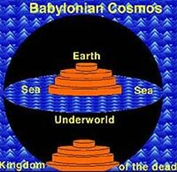
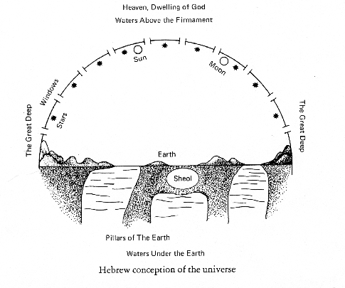
The Babylonian universe
The Hebrew universe

Slide 7

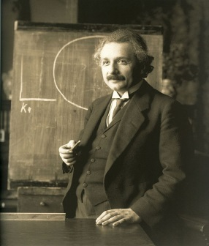

Earliest observations: astronomy
Chaldean priests (3800 BC)
Timetables of the motion of the stars and the planets
Stars stationary, planets move across a lane in the sky (zodiac)
Length of the year
Astronomy and astrology, calendars
Predicted astronomical events
Observation without explanation

Slide 8

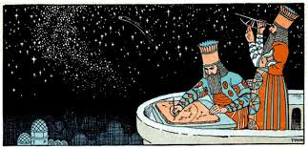
The Babylonians
Observations of the stars
Nabonassar (747 BC)
Calendar
360 days = 1 year
Lunar months: varied
Measuring time
The gnomon (sundial); 12 parts of the day
1 hour = 60 minutes: 1 minute = 60 sconds
Observations of the planets
The Zodiac
Circle on which the planets moved

Slide 9
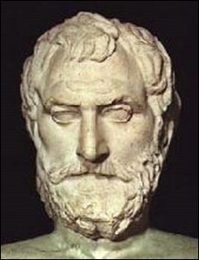
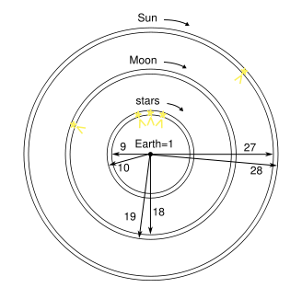
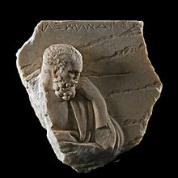
The cosmology of ancient Greece
Ionian philosophers (6th cent BC)
Natural causes: not concerned with deities
Thales of Miletos (625-547 BC)
What is the basic material of the Universe? Water
Earth floats on water
Anaximander of Miletos (610-545 BC)
Raw material of universe: undefined apeiron
Earth floats in universe infinite in time and space
Mechanical model of the universe
Estimated sizes and distances to sun and moon
Anaximenes of Miletos (585-528 BC)
Raw material: air. Earth floats on air
Stars evolved from earth ; float on sphere above

Slide 10
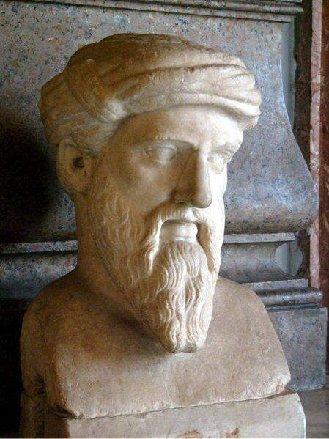
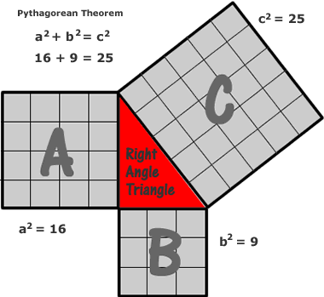
Pythagoras of Samos (570-495 BC)
Founder of science
Mathematization of experience: numbers sacred and eternal
Highest form of philosophy
All things have form, all form defined by numbers
Pitch of a note depends on the length of string that produces it
Intervals in the scale produced by simple numeric ratios
Reality could be reduced to number series and number ratios
Theorem: Areas of the two smaller squares of the sides of
right-angled triangle will equal the area of the larger square

Slide 11
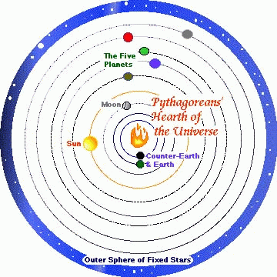
The Pythagoran universe
Earth is a sphere
Ships on horizon
Lunar eclipses
Shape of moon and sun
Orbits
Sun, moon and planets revolve around central fire
Each planet hums on a different pitch
Intervals between orbits governed by laws of harmony
Major influence
Plato
Kepler

Slide 12
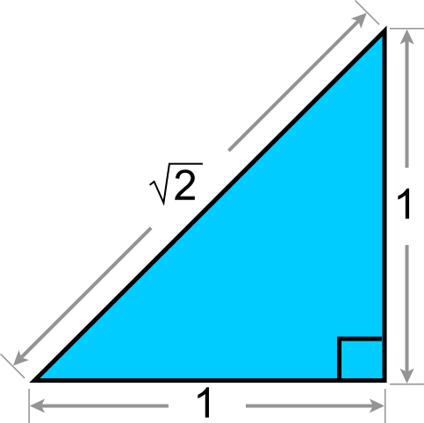
Downfall of the Pythagorans
Discovery of irrational numbers
The diagonal of a square
Arithmetic and geometry
Breakdown in point-to-point correspondence
Tried to keep secret
Dissolution of brotherhood
Also due to egalitarian practices, socialist society
Pythagoras: founder of European culture, source of Platonism

Slide 13
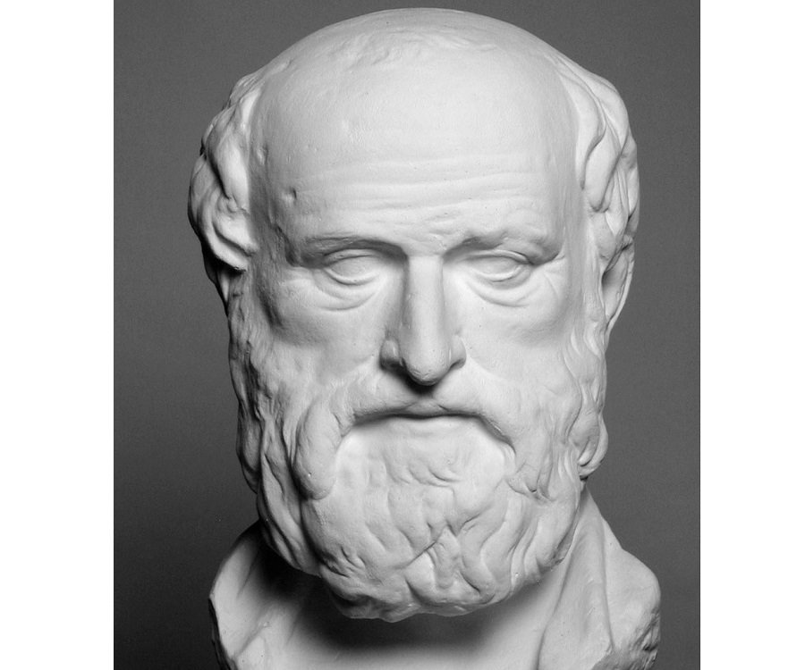
Legacy of Pythagoran School
Spherical earth
Attracts everything to its center
Aristarchus of Samos (310 BC)
"On the sizes and distances of the sun and moon"
Eratosthenes
Measured circumference of earth from summer solstice
Deduced relative size of moon (from lunar eclipse)
Deduced distance of moon from earth (from geometry)
Deduced sun-earth/moon-earth distance (from half-moon)
Deduced sun-earth distance
Deduced relative size of sun (from solar eclipse)
Eratosthenes 276 –195 BC
r_{S}/ d_{S} = r_{M} /d_{M}

Slide 14
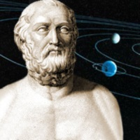
Philolaus and Aristarchus
Earth sphere has motion: rotates about its own axis
Daily revolution of the sky caused by earth's own motion
Separated day and night, annual motion of the planets
Earth orbits sun
First suggestion of heliocentric system
Quoted by Archimedes: yet heliocentric system was discarded
Aristarchus 310-230 BC

Slide 15
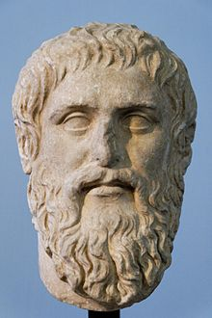
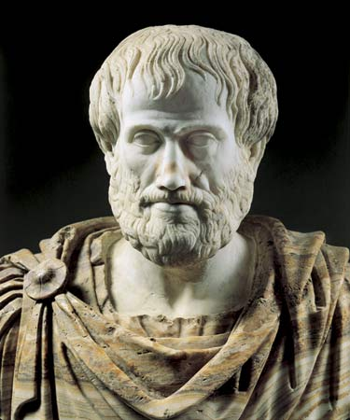
Plato and Aristotle
Heroic age followed by decline
Should have been Aristarchus - Copernicus - Galileo
Plato: certainty in mathematics, not naturalism
Shape of the world must be a perfect sphere
All motion perfect circles at uniform speed
Science dominated by Aristotle (logic and empiricism)
God spins the world from outside it, not from center
Earth and moon space subject to change: nowhere else
All celestial bodies orbit earth in perfect circles
Plato 424 – 348 BC
Spherical universe rotates about spherical earth
Aristotle 384 – 322 BC

Slide 16
The dogma of Plato and Aristotle
Planetary motion must be shown to be result of circular motions
Aristotle: used 54 spheres to account for motion of the planets
Ptolemy (AD 150) : ultimate earth-centered model
Complicated epicycle system for circular motion of celestial objects
Ferris Wheel universe
Tradition
Enshrined in ‘He Magele Syntaxis’ ( later ‘The Almagest’)
Kept alive by Islamic scholars during the middle ages
Re-introduced to Europe in 1175 - 1600
Dogma dismissed reality: 3 fundamental conceits
Dualism of celestial and terrestrial motion
Immobility of earth
All heavenly motion perfectly circular

Slide 17
Why was Aristarchus universe discarded?
Objects fall towards earth
No wind blowing against us
No obvious motion of stars
(stars too far away to observe stellar parallax)
Heliocentric model rejected
Geocentic model retained
One snag: motion of planets
Anomaly in paradigm
Aristarchus 310-230 BC
Aristotle 384 – 322 BC

Slide 18
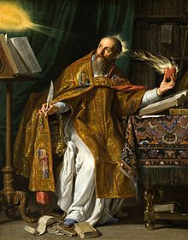
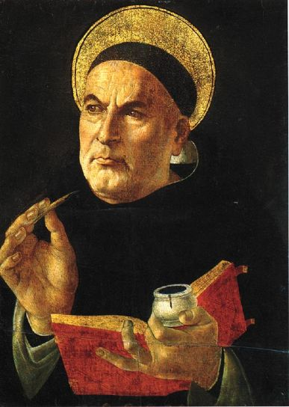
Towards the Middle Ages
Platonism adopted by Christianity (St Augustine etc)
Ignored early Greeks, adopted only Plato's philosophy: neoplatonism
11cent AD: same view as 5th cent BC
Medieval philosophy
Aristotle's 55 spheres, Ptolemy's 40 epicyles
Replaced by10 revolving spheres: disregarded stellar observation
1000 AD: Portolano charts for navigation
12-16th century: Aristotlean philosophy adopted
Muslims: carried fragments of Euclid , Archimedes and Aristotle to Europe
Improved Calendric astronomy and planetary tables
Important Indian numerals (including zero) and algebra
Christianity and Aristotelianism (Thomas Aquinas)
St. Augustine (354-430)
Aquinas: first proof of God (based on Aristotelian physics)
Unmoved mover = God
St. Aquinas (1225-1274)

Slide 19
Summary
By 1500 AD, Europe knew less than Archimedes in 200 BC
1. Splitting of Universe into 2 spheres
2. Geocentric dogma
3. Uniform motion in perfect circles dogma
4. Divorce of mathematics from science
5. Inability to realise tendency of a body in motion to stay in motion
These 5 handicaps were to be overcome by
Copernicus, Kepler and Galileo

Slide 20
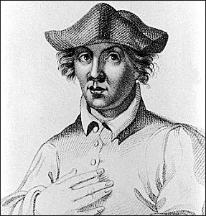
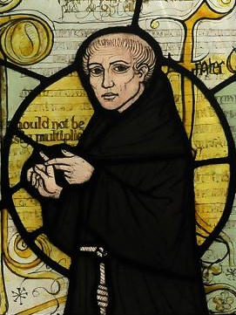
The Renaissance
Universities: Revival of learning
Bologna, Paris, Oxford and Cambridge
Roger Bacon, William of Ockham and Albert the Great
Study of nature: empiricism
Ockham’s razor
Opposed Aquinas
“All other things equal, simpler explanation more likely’’
Nicole d’Oresme
Geocentric universe not proven
Nicholas of Cusa
Earth not hub of universe
Nicolas Copernicus
Roger Bacon (1220-1292)
William of Ockham (1280-1349)

Slide 21
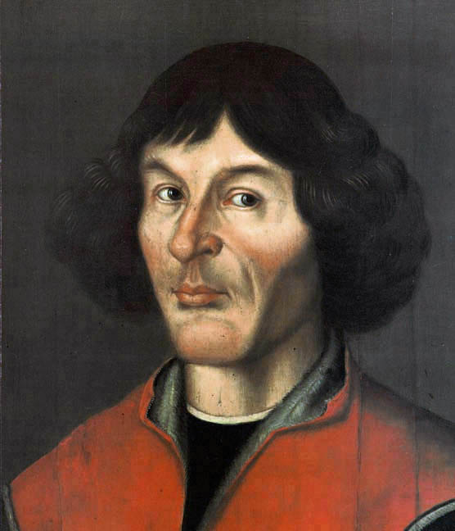
Nicolas Copernicus (1473-1543)
Born in Poland (Prussia) in 1743
Studied at the Universities of Krakow, Bologna and Padua
Trained as Catholic canon
Polyglot, polymath
Simple instruments for observing the sky
Used observations of the Chaldeans and the Greeks
Improved astronomical tables
Published Commentariolus (1514)
Nicolas Copernicus
(1473-1543)

Slide 22
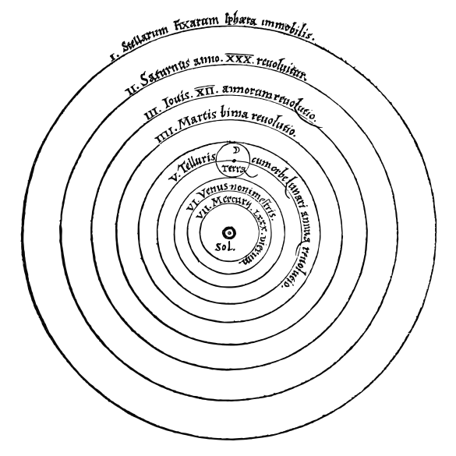
Nicolas Copernicus
Commentariolus (1514) : 7 axioms
1. Heavenly bodies do not share a common center
2. Earth is not the centre of the universe
3. Centre of the universe is near the sun
4. Earth’s distance to sun negligible compared to distance to stars
5. Daily motion of stars is due to rotation of the earth
6. Earth, planets revolve around sun
7. Retrograde motion of the planets is due to motion of earth
Distributed to friends, academics: became well-known
Earth cannot be stationary, Ptolemy system inconsistent
Heliocentric model (aware of early Greeks)
Nicolas Copernicus
(1473-1543)

Slide 23
Nicolas Copernicus
Book of the Revolutions of the Heavenly Spheres (1543)
Published with aid of Georg von Lauchen (Rheticus)
Technical version of Commentariolus
Ahead of its time (earth just a planet like others)
Problems
Copernican system quite complicated (48 epicycles)
Less accurate predictions of planetary motion
Universe de-centralized: no natural center of directions
Undermined by preface (Osiander)
Nicolas Copernicus
(1473-1543)
Not adopted for many years: unnecessary, opposed by Church

Slide 24
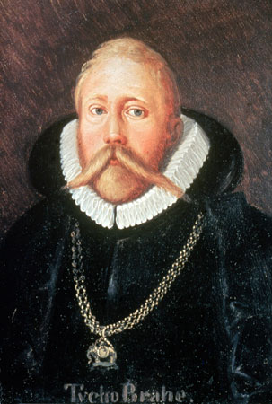
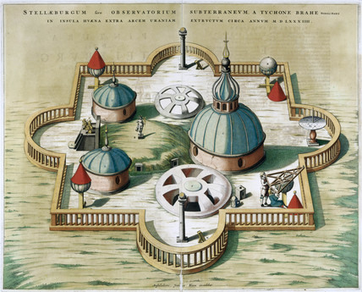
2. Tycho de Brahe
Danish nobleman
Observational astronomy to new level
Own observatory on island of Hven
Expensive instruments: precise and continuous data
Observed distant nova (SN1572)
Observed distant comet (1577)
Heavens not immutable
Sympathetic to Copernican ideas
‘Mixed’ model of universe (1588)
Migrated to Prague (imperial mathematician)
Employed Kepler to study Mars
Gave data sparingly to Kepler
Died from drink (1600)
Tycho de Brahe
1546-1601

Slide 25
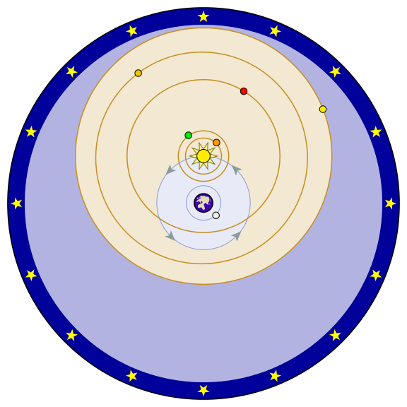
The Tychonian model
Observational astronomy to new level (own observatory)
Observations showed heavens not immutable
Sympathetic to Copernican ideas
Critical of Copernicus’s observations
Convinced of immobility of earth
Lack of stellar parallax v. sizes of stars
Aristotlean physics, religion
‘Mixed’ model of universe (1588)
Planets orbit sun
Sun and moon orbit earth
Tycho de Brahe
1546-1601
Geo-heliocentric model

Slide 26
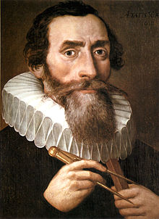
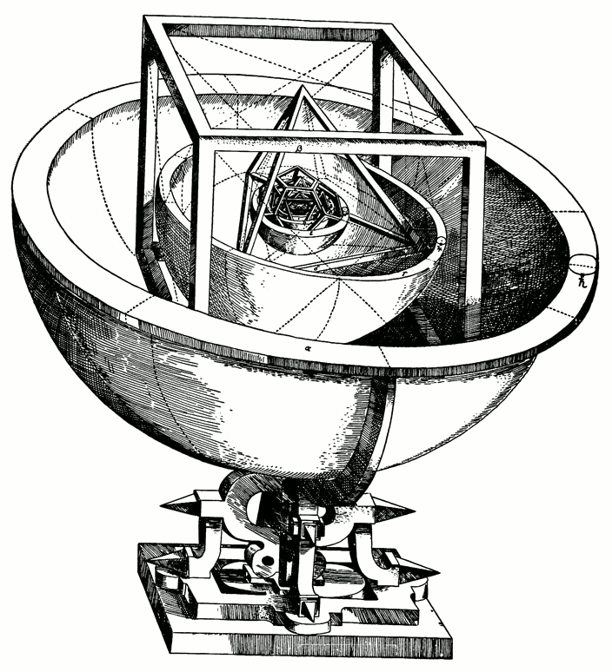
Johannes Kepler
Born in Germany: not high-born
Mathematical prodigy
Attended University of Tubingen
Trained as Lutheran cleric
Became teacher of mathematics and astronomy in Graz
Defended Copernicus while still a young priest
Mysterium Cosmographicum (1596)
Reconciled Copernican model with scripture
First public commitment by astronomer to Copernican system
Platonic solid model of the cosmos
Hired by Tycho de Brahe (1600)
Given Mars project, but limited data
Not convinced by Tychonian model
Tycho dies after a few months
Johannes Kepler
1571-1630
Platonic solids

Slide 27
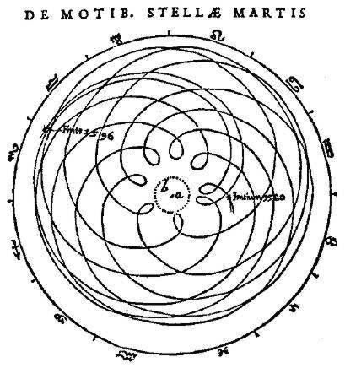
Johannes Kepler
Death of Tycho de Brahe
Kepler becomes Imperial Mathematicus (1601)
Access to all of Tycho’s data
Solves problem of the orbit of Mars (8 years)
Mars orbits sun in elliptical path
All planets move in elliptical paths: no epicycles
First accurate heliocentric model of universe
"Astronomia Nova " (1609)
Simple, elegant model
Natural laws: precise, verifiable statements based on data
Material bodies acted upon by forces
Accurate predictions
Ignored by Germans and Italians (incl. Galileo?)
Accepted by British (Thomas Harriot, Jeremiah Horrocks)
1571-1630

Slide 28

Kepler’s universe
Kepler’s planetary laws
1. Planets move in elliptical orbits (not circles)
2. Planets continuously vary their speed (not uniform)
3. Sun is at focus of ellipse (not center of circle)
Kepler’s other work: founded instrumental optics
Optics (1604)
Study of refraction by lenses
Light intensity α 1/r²
Principle of sight, spectacles
Camera obscura
Johannes Kepler
1571-1630

Slide 29
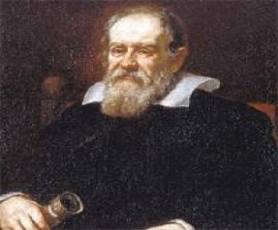
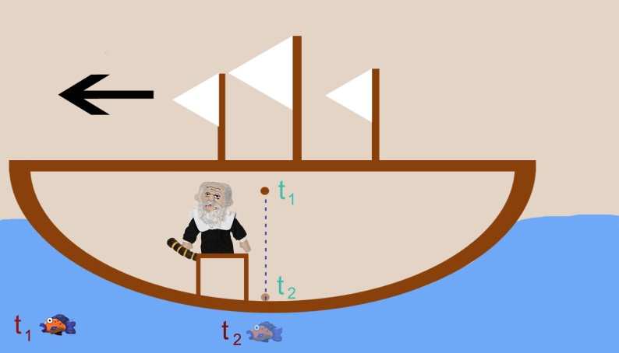
Galileo Galilei
Studied pendulum as student
(period depends only on length)
Invented pendulum timing device
Appointed lecturer in mathematics at the University of Pisa (1589)
Chair of Mathematics at the University of Padua (1592)
Studied mechanics in detail
Laid foundations of dynamics
Laws of motion of falling bodies
Optics: lenses, mirrors and camera obscura
Relativity of motion
Ball drops independent of ship’s motion
Could earth be moving?
Galileo Galilei
1564-1642
Relativity of motion

Slide 30
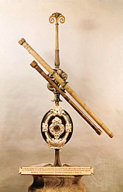
Galileo’s astronomy
Improved Dutch model of telescope (mag x 30)
Discovered Lunar surface not smooth (contradicts Ptolemy)
Discovered moons of Jupiter : earth not center of all things
Discovered phases of Venus (as predicted by Copernicus)
Discovered innumerable stars in Milky Way
Discovered sunspots: sun subject to decay etc
Correspondence with Kepler; belief in Copernican system
Measurements confirmed by Jesuits
Galileo Galilei
1564-1642

Slide 31
The Galileo Affair (I)
University Aristotelians opposed Galileo
Letter to Grand Duchess Christina
Defended Copernican system, suggested scriptures not literal
Church Charges brought against Galileo in 1615, dropped
Church demanded proof of Copernican system
Galileo refused (couldn't prove): ignored Kepler's findings
Galileo censured by decree (1616): Copernican model outlawed
Galileo Galilei
1564-1642

Slide 32
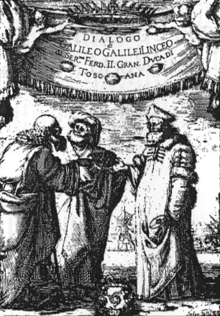
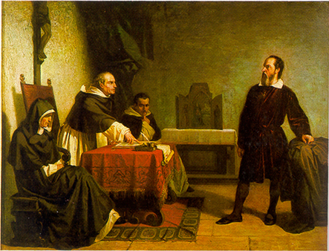
The Galileo Affair (II)
1623: New pope friendly towards Galileo
1632: "Dialogue on the Great World Systems”
Propounds Copernican system: pope cast as Simplicio
Pope displeased, felt deceived
1633: Galileo interrogated by Inquisition
Found guilty of defying 1616 decree
Sentence: House arrest for life: Dialogue prohibited
After trial
Magnum Opus – dynamics
Dialogue Concerning Two New Sciences (1636)
Dialogue of the two
world systems

Slide 33
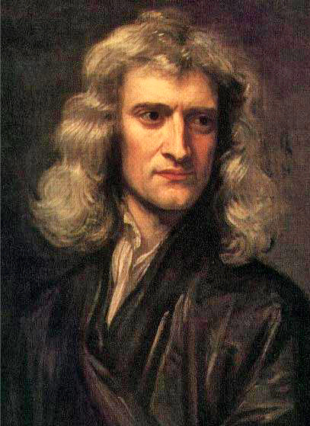
Isaac Newton
Born in Lincolnshire 1642
Promising student
Studied mathematics at Cambridge (TC)
Studies interrupted by Great Plague of 1666
Significant work at home in calculus, optics, gravitation
Gravitation theory synthesized what went before
1. Kepler's laws (planetary motion)
2. Galileo's laws (motion of bodies on earth)
What is nature of the force that drives the planets?
What will a body do if left alone?
Isaac Newton
1642 – 1727
Key step: Identified Keplerian orbit of moon
with Galilean orbit of projectile

Slide 34
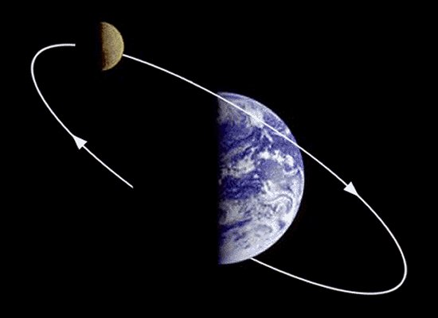
Isaac Newton
Universal law of gravity (1666)
Force of attraction proportional to the masses,
Inversely proportional to square of separation
Dropped for 20 years
Developed mechanics and calculus
Goaded back to problem by Halley
Computes force of earth's attraction for the moon (1686)
Explains observed motion: repeated for sun
Showed orbit produced by law was Kepler ellipse
Kepler's laws arise as consequence
Isaac Newton
1642 – 1727
Moon = falling body

Slide 35
Isaac Newton (1642 – 1727)
Newton’s Principia (1687):
Law 1 Every body continues in its state of rest, or uniform motion in a straight line, unless compelleed to change by forces acting on it
Law 2: The change in motion is proportional to the force impressed, and in the direction of the force
Law 3: To every action there is always an equal and opposite reaction: the mutual actions of two bodies upon each other are akways equal, and directed to contrary parts
Laws 6 and 7: Universal Law of Gravitation F_{G} = Gm₁m₂/r²

Slide 36
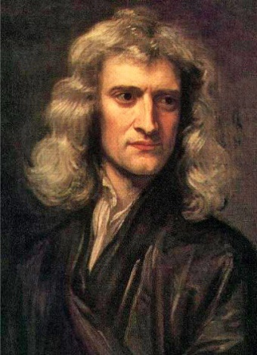
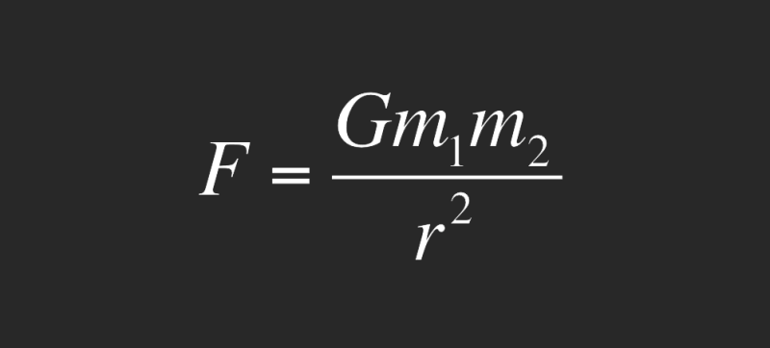
Newton’s law of gravity
F_{G} = GMm/r² G = constant (6.6x 10⁻¹¹)
Unites terrestrial and celestial gravity
Force on apple = force on planets
F_{G} v. weak force (G extremely small)
F_{G} only seen when one mass is a planet
F_{G} always attractive
M,m = inertial mass (see N2)
How does F_{G} act instantaneously across huge distances?

Slide 37
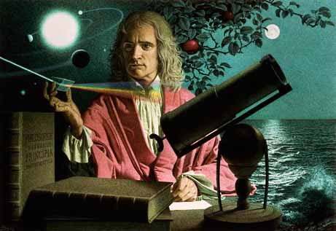
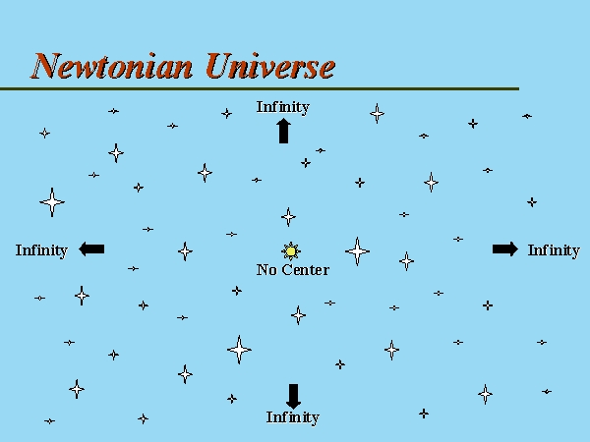
The Newtonian universe
1. Force of gravity –
Attractive, weak, infinite range
2. Eternal universe (infinite in time)
No beginning, no end
3. Bentley’s paradox
Why doesn’t gravity crush universe?
Finite mass in infinite space (Newton)
4. Olbers’ paradox
Why is the sky dark at night?
Clockwork universe: space and time a fixed stage

Slide 38
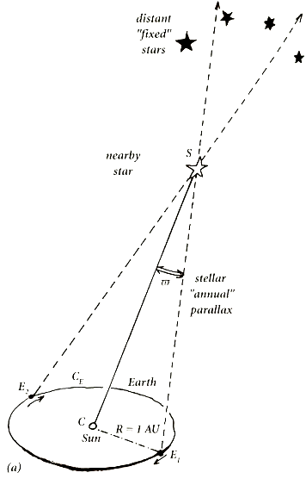
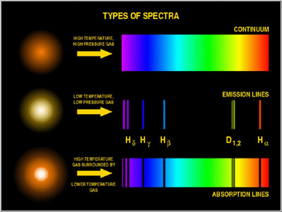
Astronomy in the 19th century
1. Improved telescopes
Distances to stars
2. Stellar parallax
Bessel 1838
3. Photography
Improved images
4. Spectroscopy
Analysis of starlight
Spectral lines of known elements
Stars made of familiar elements

Slide 39
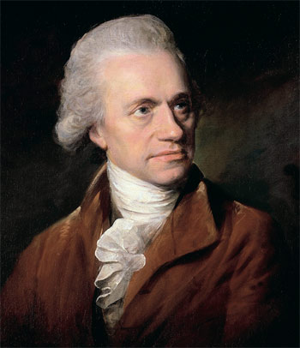
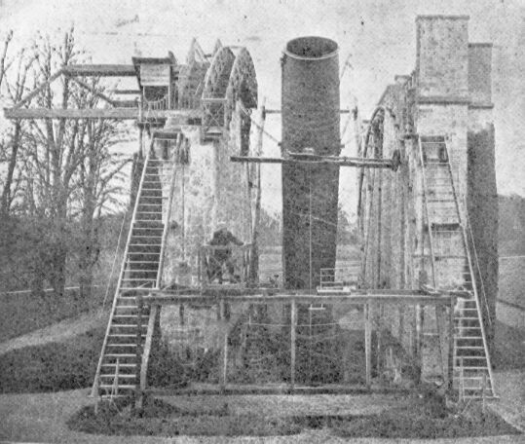
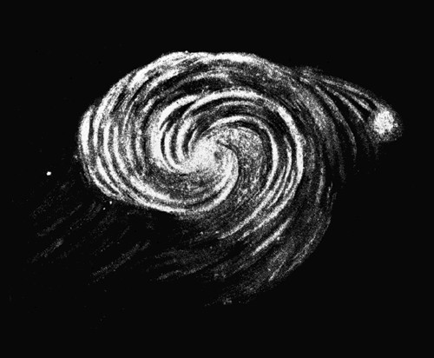
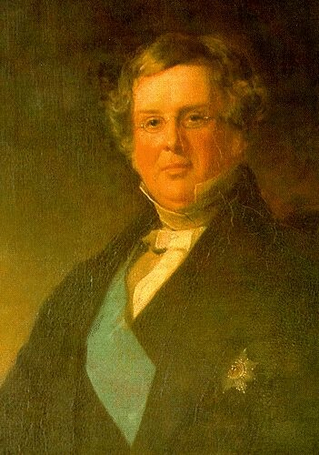
The starry nebulae
Extremely distant, cloud-like formations
Island universes? Kant, Laplace
Study of the nebulae using large telescopes
Herschel: 36-inch reflecting telescope
Some nebulae have spiral structure
Earl of Rosse (1845):72-inch telescope, Birr castle
Stars within spirals
Earl of Rosse: Birr castle
Distance to the nebulae?
Too distant for parallax method
William Herschel 1738-1822
William Parsons 1738-1822

Slide 40

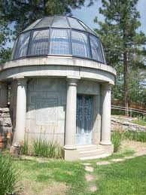
The motion of the nebulae
Vesto Slipher
Use of spectrograph to study nebulae
Lens speed of camera: Exposure time
First study of the nebulae (Lowell Observatory)
Light significantly blue-shifted (1912)
Dopper shift due to radial motion?
Approaching at 300 km/s
Redshift of the spiral nebulae
45 Doppler shifts (1917): all red-shifted except 4
Radial velocity outward? Large velocities: 300 to 1100 km/s
Conclusion
Distant nebulae moving away: most distant moving fastest
V.M. Slipher
1875-1969

Slide 41
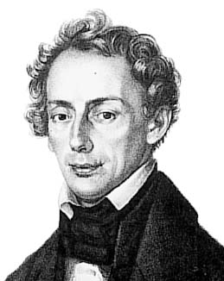
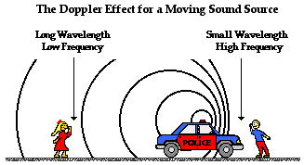

The Doppler effect
Perceived frequency of light and sound
depends on relative motion of observers
Measure motion of object by measuring
shift in frequency of light emitted
Christian Doppler
1803-1853

Slide 42
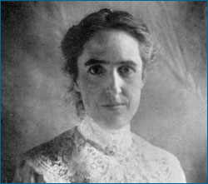


The great debate
A new measurement of distance (Leavitt)
Pulsating stars: Cepheid variables (1912)
Intrinsic luminosity related to period of pulsation
Measure distance by measuring period of luminosity
Size of Milky Way (Shapley)
Use Leavitt’s law to measure Milky Way (0.5 M LY)
V bright nova in Andromeda: within Milky Way?
Nebulae outside Milky Way? (Curtis )
Emission lines Doppler-shifted : Vesto Slipher
Motion too great to be confined to Milky Way
Measurement of distance to nebulae (Hubble)
Well outside Milky Way
Henrietta Leavitt
1868-1921
Harlow Shapley
1885-1972
Heber Curtis
1872-1942

Slide 43


Hubble’s answer (1925)
Edwin Hubble (1921)
Ambitious astronomer
Hooker telescope (Mt Wilson, 1917)
100-inch reflector
Resolved Cepheid stars in nebulae
Known luminosity and distance
Far beyond Milky Way! (1925)
Edwin Hubble (1889-1953)
Nebulae are distinct galaxies

Slide 44

Hubble’s Law (1929)
What do the velocities of the galaxies mean?
Is there a relation between distance and velocity ?
Combine 24 distances with Slipher redshifts
Approx linear relation: Hubble’s law
Furthest galaxies receding fastest
Slipher not acknowledged
H = 585 km/s/Mpc

Slide 45

Justification (1931)
Distances for 40 galaxies
Redshifts for 40 galaxies
Reduced scatter – linear relation
Justification
Explanation?

Slide 46


The expanding universe
What do the redshifts represent?
Recession velocities for distant galaxies?
If so, why?
Newtonian gravity pulls in F = GMm/r²
What is pushing out?
Isaac Newton
Space, time fixed

Slide 47




The special theory of relativity (1905)
Two principles
Laws of all physics identical for observers in relative uniform motion
Speed of light in vacuum identical for observers in relative uniform motion
Implications
Intervals in distance and time not universal
Experienced differently by bodies in relative uniform motion
Predictions (high-speed bodies)
Length contraction: time dilation
Mass increase: mass-energy equivalence
Minkowski space-time (1908)
Space-time invariant for observers in relative uniform motion

Slide 48


The general theory of relativity (1916)
Extending the special theory (1907-)
Relativity and accelerated motion?
Relativity and gravity?
The principle of equivalence
Equivalence of gravity and acceleration
Mach’s principle
Inertial mass defined relative to matter
Space and time defined by matter
A long road (1907-1915)
Curvilinear geometry, tensor algebra
Gravity = curvature of space-time

Slide 49







The field equations of GR (1915)
G_{μν} = - ĸ T_{μν}
10 non-linear differential equations that relate the geometry
of spacetime to the density and flow of energy and momentum
SR
GR
$${ds}^{2}=\sum_{μ,ν=1}^{4}{n_{μν}{dx}^{μ}{dx}^{ν}}$$
$${ds}^{2}=\sum_{μ,ν=1}^{4}{g_{μν}{dx}^{μ}{dx}^{ν}}$$
g_{μν} : variables

Slide 50


Three astronomical tests (Einstein, 1916)
Different in principle from Newton’s gravity
Small deviations in practice (weak scale)
The perihelion of Mercury
Well-known anomaly in Mercury’s orbit (43" per century)
Postdicted by GR (1916)
The bending of starlight by the sun (1.7")
Eclipse expeditions of Eddington and Dyson (1919)
Successful measurement (large error margin)
Gravitational redshift
Time dilation in strong gravitational field
Light from a massive star redshifted?

Slide 51


Eclipse Results (1919)
Sobral: 1.98" +/- 0.16
Principe: 1.7" +/- 0.4
Einstein famous (1919)
Asymmetric controversy (Collins and Pinch 1970s)
Claim of bias; rebutted by astronomers (RAS)

Slide 52



Einstein’s universe
Einstein: apply GR to the Universe (1917)
Ultimate test for new theory of gravitation
Assumptions
Static universe (small velocities of the stars)
Mach’s principle (metric tensor to vanish at infinity)
Isotropy and homogeneity (simplicity)
Boundary problem
Assume cosmos of closed curvature
But…no consistent solution
New term in field equations!
Cosmic constant - anti-gravity term
Radius and density defined by λ
G_{μν} = - ĸ T_{μν}
G_{μν} + λg_{μν} = - ĸ T_{μν}

Slide 53



Friedman’s universe
Allow time-varying solutions (1922)
Assume homogeneity, isotropy, positive curvature
Two independent differential equations from GFE
Evolving universes
Density of matter varies over time
Negative spatial curvature (1924)
Cosmic evolution, geometry depends on matter
Overlooked by community
Considered ‘suspicious’ by Einstein
Mathematical correction, later retracted
“To this a physical reality can hardly be ascribed”
G_{μν} + λg_{μν} = - ĸ T_{μν}
Alexander Friedman
(1888 -1925)

Slide 54



Lemaître’s universe (1927)
Expanding model of the cosmos from GR Similar but not identical to Friedman 1922
Redshifts of galaxies = expansion of space? Redshifts from Slipher, distances from Hubble
Ignored by community
Belgian journal (in French)
Rejected by Einstein:“Vôtre physique est abominable”
Lemaître’s recollection (1958)
“Einstein not up-to-date with astronomy”
Fr Georges Lemaître

Slide 55
The watershed: Hubble’s law (1929)
The redshifts of the spiral nebulae
Doppler shifts? (Slipher 1915, 1917)
The distances to the nebulae
Far beyond Milky Way (Hubble 1925)
A redshift/distance relation
Linear relation (Hubble, 1929)
H = 500 kms⁻¹ Mpc⁻¹
Landmark result in astronomy
Furthest galaxies receding the fastest
Link to relativity

Slide 56


The expanding universe (1930)
RAS meeting (May 1930)
If redshifts are velocities, and if effect is non-local
Hubble’s law = expansion of space? (Edd., de Sitter)
Dynamic model required
Static model unstable
Lemaître model adopted
1927 expanding model republished in English (1931)
Observational section omitted (rightly)
Lemaître-Friedman cosmology accepted
Time-varying radius, decreasing density of matter

Slide 57
Who discovered the expanding universe?
Einstein Basic framework for theory
Friedman Expanding universe (theoretical)
Hubble, Slipher Recession of the galaxies (obs)
Lemaitre Observation + theory
‘Hubble graph’ should be Hubble-Slipher graph
‘Hubble expansion should be Hubble-Lemaitre expansion
Astronomers sceptical (Hubble)

Slide 58




Models of the expanding universe (1930 -)
Tolman (1930, 31)
Expansion caused by annihilation of matter ?
Eddington (1930, 31)
On the instability of the Einstein universe
Expansion caused by condensation?
de Sitter (1930, 31)
Variety of expanding models
Heckmann (1931,32)
Spatial curvature (not translated)
Einstein (1931, 32)
Friedman-Einstein model λ = 0, k = 1
Einstein-de Sitter model λ = 0, k = 0
If redshifts represent expansion…
If effect is global…

Slide 59

A strange prediction: the big bang
Lemaître 1931: expanding U smaller in the past
Extrapolate to very early epochs
Extremely dense, extremely hot
Expanding and cooling ever since
‘Fireworks beginning’ at R = 0?
Fr Georges Lemaître
Rejected by community (1930-60)
Simplified models
Timescale problem
Later called ‘The big bang’

Slide 60


A second line of evidence
Gamow and nuclear physics (1940s)
Student of Friedman
How were the chemical elements formed?
Problems with stellar nucleosynthesis
Elements formed in the infant hot universe?
Theory predicts U = 75% Hydrogen, 25% Helium
Agreement with observation
Victory for big bang model
Georges Gamow
Heavier atoms formed in stars

Slide 61


Bonus: cosmic background radiation
Infant universe very hot
Dominated by radiation
Radiation still observable today?
Low temp, microwave frequency
A fossil from the early universe!
Released when atoms formed (300,000 yr)
Alpher, Gamow and Herman
No-one looked

Slide 62


The steady-state universe (1948)
Expanding but unchanging universe
Hoyle, Bondi and Gold (1948)
Disliked extrapolation to early epochs
Perfect cosmological principle?
Requires continuous creation of matter
Very little matter required
No beginning, no age paradox
Replace λ with creation term (Hoyle)
Improved version (1962)
Bondi, Gold and Hoyle
G_{μν} + C_{μν} = - k T_{μν}
G_{μν} + λg_{μν} = k T (C_{μ}+ C_{ν)}
Hoyle and Narlikar (1962)

Slide 63


Steady-state vs big bang (1950-70)
Optical astronomy (1950s)
Revised distances to the nebulae (Baade, Sandage)
New timescale of expansion
Radio-astronomy (1960s)
Galaxy distributions at different epochs
Cambridge 3C Survey (Ryle)
Nucleosynthesis of light elements
Gamow et al. 1948
Cosmic microwave background (1965)
Low temperature, low frequency
Remnant of young, hot universe
Allen Sandage
Martin Ryle

Slide 64

Cosmic background radiation (exp)
CMB discovered accidentally
Universal signal (1965)
Low frequency (microwave)
Low temperature (3K)
Penzias and Wilson (1965)
Echo of Big Bang!

Slide 65

Modern measurements of the CMB
Details of background radiation
Full spectrum
Comparison with theory
Perturbations?
Ground telescopes
Balloon experiments
Satellite experiments
COBE satellite (1992)

Slide 66


Today’s cosmological puzzles
Characteristics of background radiation
Isotropy, homogeneity, flatness (1970-80)
The theory of inflation (1981)
Exponential expansion within first second?
Explanation for homogeneity, flatness, galaxy formation
Which model of inflation? Bubble inflation?
Dark energy (1998)
Observation of accelerated expansion
The return of the cosmological constant
U mainly composed of dark energy
G_{μν} + λg_{μν} = - ĸ T_{μν}
Nature of DE unknown

Slide 67

Problems
Background radiation raised new questions
Horizon problem why so uniform?
Galaxy problem how did galaxies form?
Flatness problem fine balance?
Robert Dicke
Conflict between theory and experiment
Astrophysics: Ω = 0.3

Slide 68

Dark Matter
First suggested in 1930s
Stellar motion
normal gravitational effect but
cannot be seen directly
Explains motion of stars
Explains motion of galaxies
Explains gravitational lensing
Matter = OM (20%) + DM (80%)
Ω = 0.3 ?

Slide 69

The Theory of Inflation
Initial exponential expansion
Driven by phase transition
Repulsive force
Expansion of 10³⁵ in 10⁻³² s
Smooths out inhomogeneities
Smooths out curvature
‘No hair’ universe

Slide 70


The inflationary universe (1981)
Solves horizon problem
Early U incredibly small
Solves flatness problem
Geometry driven towards flatness
Mechanism for galaxy formation
Quantum fluctuations inflated
Ω = 1 ?
Conflict between theorists and experimentalists

Slide 71

Dark energy (1998)
Supernovae as standard candles (1998)
Furthest galaxies too far away
Expansion speeding up
Geometry of U flat (Ω = 1)
Support for inflation
Dark Energy

Slide 72


WMAP Satellite (2002)
Details of CMB spectrum
Details of galaxy formation
Details of flatness of U
Dark energy?
Cosmic microwave background

Slide 73

WMAP measurements of CMB (2005)
Spectrum of T variations
Geometry is flat (to 1%)
Dark energy 74%
Strong support for inflation
Strong support for dark energy
Fit to theory

Slide 74

Modern big bang model: Λ-CDM
A flat, accelerating universe containing matter, dark matter and dark energy
Ordinary matter: 4% (astrophysics)
Dark matter: 22% (astrophysics)
Dark energy : 74% (supernova, CMB)
ΛCDM
Ω = 1

Slide 75

Cause of acceleration: dark energy
Predicted by relativity
Cosmological constant
Natural tendency of space to expand
Energy of vacuum?
Why so small?
Why of similar density to matter?
Not well understood
Fate of universe?

Slide 76




New results: Planck Satellite (ESA, 2013)
1. Improved sensitivity
2. Full spectrum of T anisotropy
New acoustic peaks :scale invariance?
Accurate values for Ω_{Λ} , Ω_{M}
3. Gravitational lensing
Remove degeneracies
4. Polarization measurements
E-modes: fluctuations
B-modes: gravity waves?

Slide 77


Planck Satellite (ESA): Results

Slide 78


Planck results (2013)
1. New Hubble constant
67.3 +- 1.2 km/s/MPC
Age = 13.8 billion yr
2. Curvature ; flat
Ω_{k} = -0.0005 +- .07
3. New mass/energy parameters
Ω_{Λ} = 68, Ω_{DM} = 27, Ω_{OM} = 4.9 %

Slide 79


The big bang - problems
Nature of dark energy?
Role in BB?
Which model of inflation?
The multiverse?
The singularity problem
What banged?
What does time zero mean?
No-boundary universe

Slide 80

The singularity: a cyclic universe?
Breakdown at time zero
No model of bang itself
Multiple bangs?
Colliding branes
Prediction of string theory
Cyclic universe
Eternal universe
Cyclic universe
Tests? Non-Gaussianities in CMB

Slide 81

The big bang – evidence
  1. The expansion of the U
  2. The abundance of H and He
  3. The distribution of the galaxies
  4. The cosmic microwave background
How did it start?

Slide 82

The big bang model

